Slide 1
Today:
solutions for homework problems 9 – 12
tutorial on groundwater modelling

Slide 2
Solutions of Homework Problems 9 – 12

Slide 3
Homework Problem 9
The same series of batch experiments as in tutorial problem 16 are considered. However, experimental findings are now to be evaluated by assuming a Freundlich isotherm.
Plot mass ratio C_{a} vs. equilibrium concentration C_{eq} in a double-logarithmic diagram.
Determine the Freundlich coefficient K_{Fr} and the Freundlich exponent n_{Fr}.
a) first step: determine decadic logarithms of C_{eq} and C_{a}:
C₀ (mg/L) | C_{eq} (mg/L) | C_{a} (mg/g) | logC_{eq} | logC_{a}
50 | 15 | 0.09 | 1.18 | -1.06
75 | 28 | 0.12 | 1.45 | -0.93
100 | 40 | 0.15 | 1.60 | -0.82
150 | 61 | 0.22 | 1.79 | -0.65
200 | 82 | 0.30 | 1.91 | -0.53
250 | 104 | 0.37 | 2.02 | -0.44

Slide 4
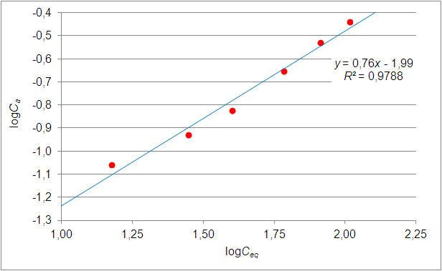


Homework Problem 9 – Solutions
a) cont.:
b) slope of regression line = 0.76 = n_{Fr} (with n_{Fr} = Freundlich exponent)
vertical intercept of regression line = –1.99 = logK_{Fr} (with K_{Fr} = Freundlich coefficient)

Slide 5
Homework Problem 10
y
A reactive tracer experiment was performed under following conditions:
steady uniform flow in an aquifer with thickness m = 10 m and effective porosity n_{e} = 0.2
linear velocity: v_{x} = 2·10⁻⁵ m/s, v_{y} = 0
dispersivities α_{L} = 0.5 m, α_{T} = 0.2 m
At t = 0, a tracer mass of M = 985 kg was injected at (x₀, y₀) = (0, 250 m) .
The tracer is subject to sorption and degradation with R = 4.75 and λ = 1 a⁻¹.
t = 5 a
C* = 4.43 mg/l
b
a
x
Where is the centre of the tracer mass after a period of t = 5 a?
Where is the concentration isoline C* = 4.43 mg/L at that time?

Slide 6
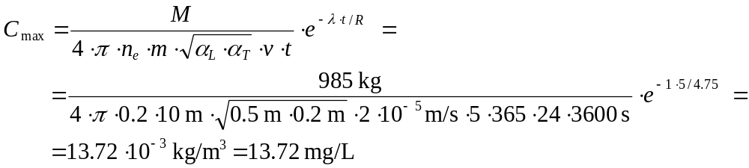
Homework Problem 10 – Solution
Step 1: x_{max} = x₀ + v_{x}·t/R = 0 m + 2·10⁻⁵ m/s · 5·365·24·3600 s / 4.75 = 663.92 m y_{max} = y₀ = 250 m
Step 2:
Step 3: f = C*/C_{max} = 4.43 / 13.72 = 0.3230
Step 4:

Slide 7

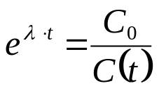
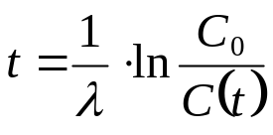
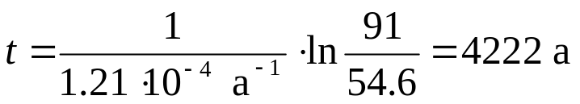
Homework Problem 11:
Groundwater age can be determined by applying the ¹⁴C method to organic carbon contained in the water. ¹⁴C is an unstable (= radioactive) carbon isotope with a half-life of 5730 a.
Determine the degradation rate constant.
Estimate the age of the groundwater in the sample for C₀ = 91 %mod. and C_{today} = 54.6 %mod.
Hint: 100 %mod. (“modern“) correspond to an activity of 0.226 Bq per gram of carbon (1 Bq = 1 Becquerel)
according to lecture material on first-order degradation: λ = ln2 / T_{1/2} = ln2 / (5730 a) = 1.21∙10⁻⁴ a⁻¹
exponential decrease of concentration:
Units are not im-portant in a ratio as long as the same unit is used for numerator and denominator!
multiply by e^{λ∙t} and divide by C(t):
take logarithm and divide by λ:
calculate groundwater age:

Slide 8
Homework Problem 12:
Sketch concentration profiles and breakthrough curves for a continuous solute injection by subsequently considering the following processes:
advection
advection + degradation (first-order, in water phase only)
advection + degradation + sorption (linear isotherm)
advection + degradation + sorption + dispersion
t=t
1
obs. pt.
C
max
C
max
C[mg/l]
C[mg/l]
injection point
obs. pt.
distance
t
time t
1

Slide 9
Tutorial on
Groundwater Modelling

Slide 10
2D Scenario
head =
254 m a.s.l.
impermeable
y = 2500 m
K = 0.002 m/s
linear
interpolation
N = 150 mm/a
W1
head =
260 m a.s.l.
W2
K = 0.005 m/s
river reach
N = 200 mm/a
head =
256 m a.s.l.
x = y = 0
impermeable
x = 4000 m
Model Muse

