Slide 1



Cutomer Churn Analysis
Team - Upgrad Shark

Slide 2
Problem Understanding
Customer Churn Problem
Many customers are leaving telecom services.
This causes loss for the company.
We need to understand why customers leave.
Goal of This Project
Find out why customers are leaving.
Analyze customer data.
Identify important factors affecting churn.
Questions to Answer
Which customers leave the most?
Does service quality affect churn?
Do price and plans affect customers?
Does contract type matter?
Importance
Helps reduce customer loss.
Improves customer satisfaction.
Helps company grow and earn more profit.

Slide 3
Dataset Overview & Approach
Dataset Overview
Approach
The dataset contains information about telecom customers and their subscription details. It is used to analyze customer behavior and identify churn patterns.
Key Details:
Total Records: ~7,000+ customers
Total Features: 20+ columns
Target Variable: Churn (Yes/No – whether a customer left the service)
Types of Features:
Customer Demographics :
Gender, Senior Citizen, Partner, Dependents
Account Information :
Tenure, Contract Type, Payment Method, Monthly Charges, Total Charges
Services Used :
Phone Service, Internet Service, Online Security, Streaming, etc.
Target Column :
Churn (indicates customer retention or loss)
Data preprocessing steps:
Handling missing values : Customers with blank total charges have 0
tenure, indicating new customers, so missing values were replaced with 0.
Checking duplicates : We have no any Duplicates.
Data type conversion : We have replaced the whitespaces
with 0 let's change the datatype to float.
Data Collection
Data Cleaning
Exploratory Data Analysis (EDA)
Feature Analysis
Churn Analysis
Insights Generation
Recommendations
_________________________________________________________

Slide 4
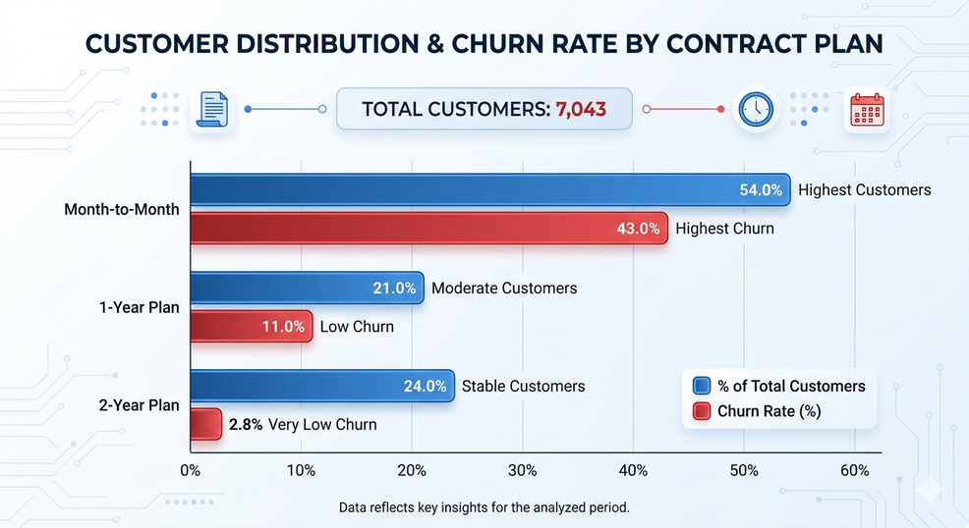
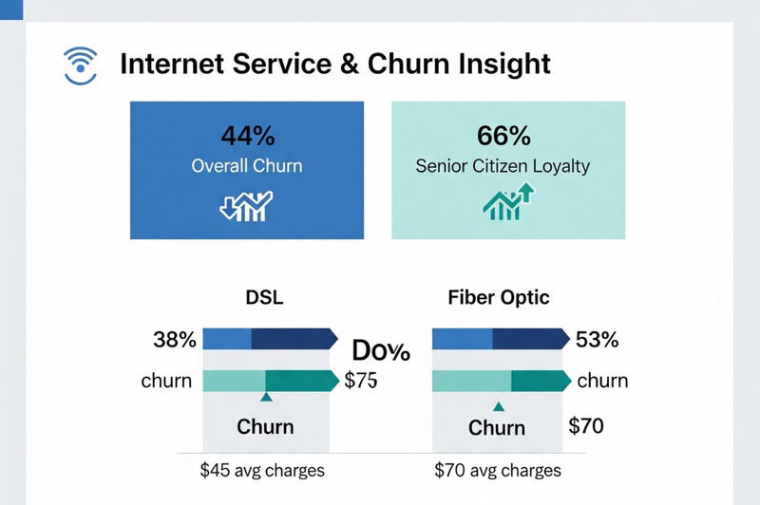
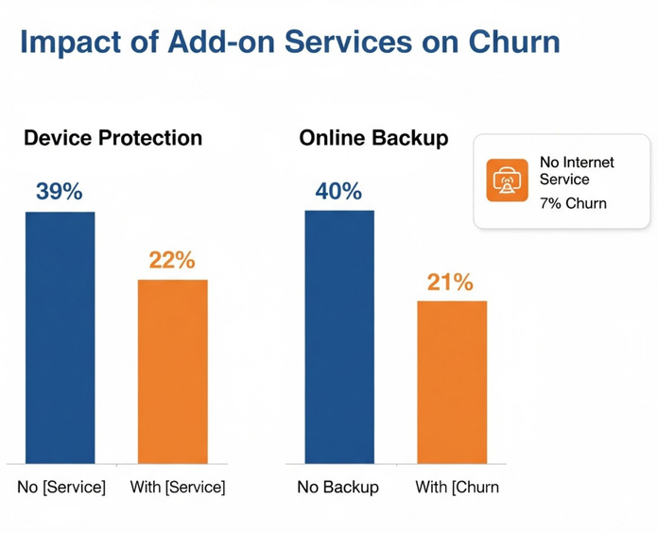
Key Insights
Short-term plans (Month-to-Month) have significantly higher churn,
while long-term contracts (especially 2-year) retain customers much better.
Total Customers: 7,043
Month-to-Month Plan has the highest customers (54%) and highest churn (43%)
1-Year Plan has moderate customers (21%) and low churn (11%)
2-Year Plan has stable customers (24%) and very low churn (2.8%)
Internet Service & Churn Insight
Overall internet users show ~44% churn
DSL users: Avg charges = 45, with 62% staying and 38% churn
Fiber Optic users: Avg charges = 70, with only 47% staying and 53% churn (highest)
66% of staying customers are Senior Citizens → more loyal segment
Fiber Optic users are leaving more despite higher charges, mainly due to speed and maintenance issues
Additional services
Device Protection & Online Backup – Churn Summary
Customers without Device Protection have high churn (~39%)
Customers with Device Protection have lower churn (~22%)
Customers without Online Backup also show high churn (~40%)
Customers with Online Backup have lower churn (~21%)
Customers with no internet service have very low churn (~7%)

Slide 5
Recommendations
Internet Service & Churn Insight
Make Long Plans Attractive (Encourage customers to choose long-term plans)
Catch Customers Before They Leave (Identify and retain high-risk users early)
Improve Service Experience (Better quality = happier, loyal customers)
Internet services
Improve internet speed and stabilityFix
frequent downtime and service issues
Promote Device Protection & Online Backup as bundles
Offer discounts or free trials for these services
Educate customers about data safety & device security benefits
Additional services

Slide 6
Assumptions & Limitations
📌 Assumptions
Data used is accurate and represents real customer behavior
Churn is mainly influenced by service quality, pricing, and contract type
Customers using internet services (Fiber/DSL) rely on consistent performance
Add-on services (Backup, Protection) increase customer retention
Senior citizens show more stable and loyal behavior
⚠️ Limitations
Dataset does not include customer satisfaction or feedback details (only inferred reasons)
External factors like competitor offers, location, or network coverage are not considered
Correlation observed (e.g., Fiber → high churn) does not guarantee causation
Some segments (like “No internet users”) may skew churn comparison

