Slide 1
VISUAL
AUTOMATION
Browser automation that reads image-codes with local OCR
Ashiwni Singh
Authorized testing only
Visual Automation · Overview Ashiwni Singh

Slide 2
OVERVIEW
What it is
— A single Python process that automates a visual verification step
— Launches Chromium — headful for manual login, or fully headless
— Detects the image-code on the page and reads it with PP-OCR on CPU
— No cloud, no API keys, no VLM — everything runs locally
— Validates the text before typing, submits, and verifies the result
— On failure: exit code 1 plus page screenshot + metadata artifacts
Visual Automation · Overview Ashiwni Singh

Slide 3
PIPELINE
How it works
— OPEN_BROWSER → AUTHENTICATE → CAPTURE → OCR → VALIDATE → FILL → SUBMIT → VERIFY
— Explicit state machine — the orchestrator is the single owner of state
— Bounded retries on every step — never a busy loop
— Element screenshots, not whole-page screenshots, for cleaner OCR
— Long-lived OCR model loaded once; reused for every attempt
— Exit code 0 = success, 1 = failure with diagnostics
Visual Automation · Overview Ashiwni Singh

Slide 4
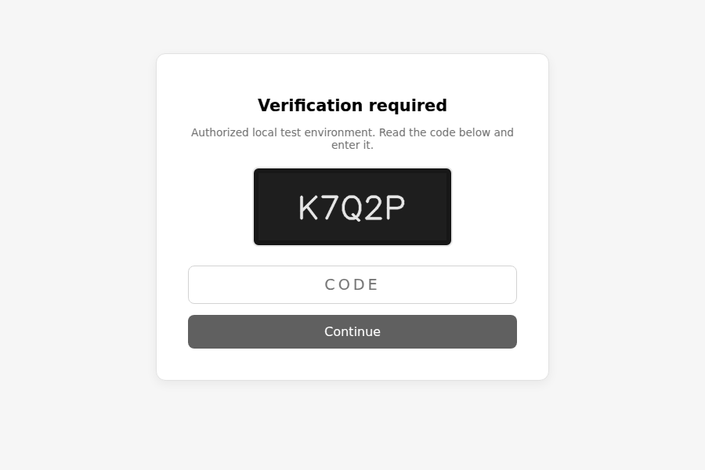
DEMO
See it run
Bundled authorized local test page — reads the code, fills it, verifies:
challenge → OCR reads → fills input → Continue → Verified (animated in slideshow)
Visual Automation · Overview Ashiwni Singh

Slide 5
GETTING STARTED
Run it in 5 minutes
— git clone https://github.com/prabhat-vishwakarma/visual-automation
— python3 -m venv .venv
— .venv/bin/pip install -r requirements.txt
— .venv/bin/python -m playwright install chromium
— Terminal 1: .venv/bin/python -m tools.serve_test_site
— Terminal 2: ./run.sh --config config/local-test.yaml → reads K7Q2P, exit 0
Visual Automation · Overview Ashiwni Singh

Slide 6
YOUR SITE
Use it on your own site
— Interactive wizard captures the page's selectors for you:
— .venv/bin/python -m tools.site_setup --url https://your-site.com
— Log in manually in the visible browser, go to the code step
— Pick the code image (OCR confirms it can read it), the input, and the button
— Config is written to config/site.yaml automatically
— Then run: ./run.sh --config config/site.yaml
Visual Automation · Overview Ashiwni Singh

Slide 7
BOUNDARIES
What it does not do
— No reCAPTCHA / hCaptcha / Turnstile / Cloudflare bypass
— No fingerprint evasion, proxy rotation, or access-control evasion
— No desktop-app automation — browsers only
— No secrets or credentials are ever logged
— Authorized test environments, internal apps, QA, and sites you own — only
Visual Automation · Overview Ashiwni Singh

Slide 8
REFERENCES
Links & files
GitHub (public) https://github.com/prabhat-vishwakarma/visual-automation
Download & install guide DOWNLOAD.md
Run configs config/local-test.yaml · config/site.yaml · config/portfolio.yaml
Selectors wizard tools/site_setup.py
Local test harness tools/serve_test_site.py
Author Ashiwni Singh
Visual Automation · Overview Ashiwni Singh

