Slide 1
HQL
Hibernate provides four different ways to retrieve data from database. HCQ, HQL and native SQL queries.
Using Identifier(Primary Key)
HQL
HQL queries are translated by Hibernate into conventional SQL queries . Hibernate also provides an API that allows you to directly issue SQL queries as well.
Using Native SQL
Although you should probably use HQL whenever possible, Hibernate does provide a way to use native SQL statements directly through Hibernate. One reason to use native SQL is that your database supports some special features through its dialect of SQL that are not supported in HQL. Another reason is that you may want to call stored procedures from your Hibernate application.
HCQ- Specially for fetching data.

Slide 2
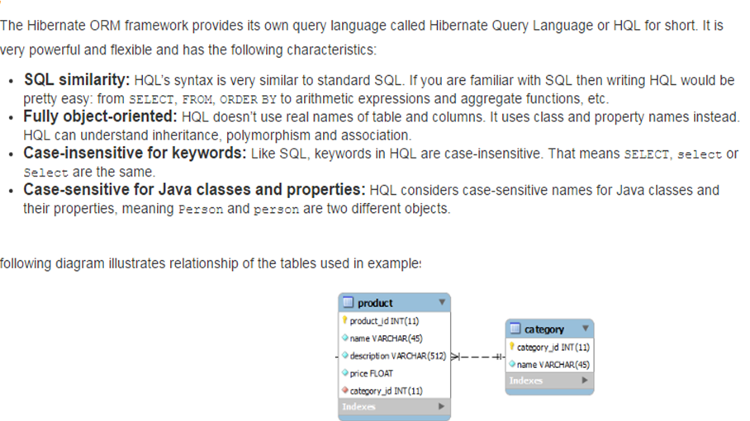

Slide 3
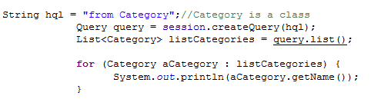
List all

Slide 4
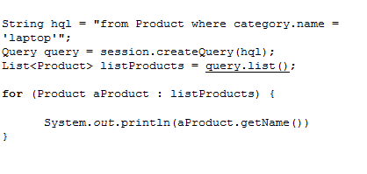
search

Slide 5
Named parameters
String hql = "from Product where description =:des";
Query query = session.createQuery(hql);
query.setString("des", "red");//better than query.setParameter
List<Product> listProducts = query.list();
for (Product aProduct : listProducts) {
System.out.println(aProduct.getName());

Slide 6
update
String hql = "update Product set price = :price where id = :id";
Query query = session.createQuery(hql);
query.setParameter("price", 488.9f);
query.setParameter("id", 3l);
int rowsAffected = query.executeUpdate();
if (rowsAffected > 0) {
System.out.println("Updated " + rowsAffected + " rows.");
}

Slide 7
delete
String hql = "delete from Product where id = :name“;
Query query = session.createQuery(hql);
query.setParameter("name", 4);
int rowsAffected = query.executeUpdate();
if (rowsAffected > 0) {
System.out.println("Deleted " + rowsAffected + " rows.");
}

Slide 8
Order by
String hql = "from Product order by price ASC";
Query query = session.createQuery(hql);
List<Product> listProducts = query.list();
for (Product aProduct : listProducts) {
System.out.println(aProduct.getName() + "\t - "
+ aProduct.getPrice());
}

Slide 9
pagignation
String hql = "from Product";
Query query = session.createQuery(hql);
query.setFirstResult(2);
query.setMaxResults(3);
List<Product> listProducts = query.list();
for (Product aProduct : listProducts) {
System.out.println(aProduct.getName() + "\t - "
+ aProduct.getPrice());
}

Slide 10
Aggregate fun
//HQL Aggregate function examples
// avg() , count(), max(), min() , sum()
Query query = session.createQuery("select sum(price) from Product");
float sumPrice = (Float) query.uniqueResult();
System.out.println("Sum of all Prices= "+sumPrice);

Slide 11
String hql = "SELECT SUM(E.salary), E.firtName
FROM Employee E " + "GROUP BY E.firstName“;
Query query = session.createQuery(hql);
List results = query.list();

Slide 12
The Criteria Query API providing a compile-time syntax checking that is not possible with a query language like HQL or SQL.

