Slide 1

API Testing

Slide 2
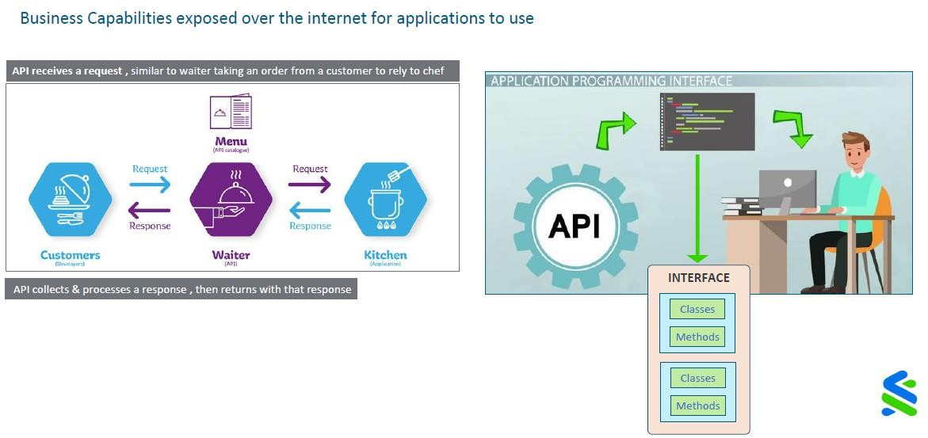
Application Programming Interface

Slide 3
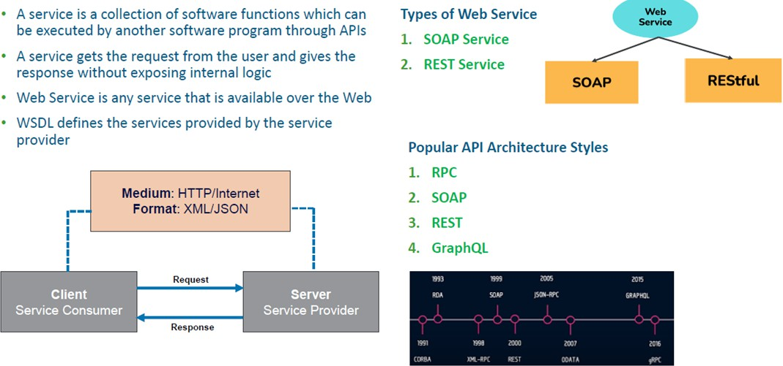
Web Services
INTERNAL

Slide 4
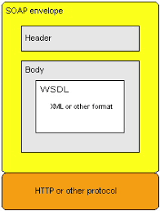
SOAP Web Service - Simple Object Access Protocol
INTERNAL
WSDL defines the services provided by the Web Service
The service is discoverable via UDDI (Universal Description, Discovery & Integration)
Clients uses stubs/proxies, use Stub to creates a SOAP request
SOAP request is sent to Web Service Skeleton, invokes the Web Service. Web Service uses skeleton to prepare the SOAP
response
SOAP response is interpreted by Stub

Slide 5
SOAP Web Service Sample App
http://www.dneonline.com/calculator.asmx?wsdl

Slide 6
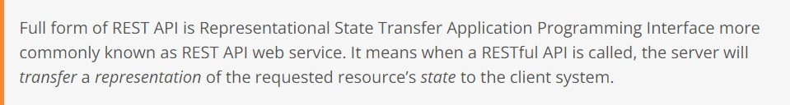
What is Rest API
INTERNAL

Slide 7
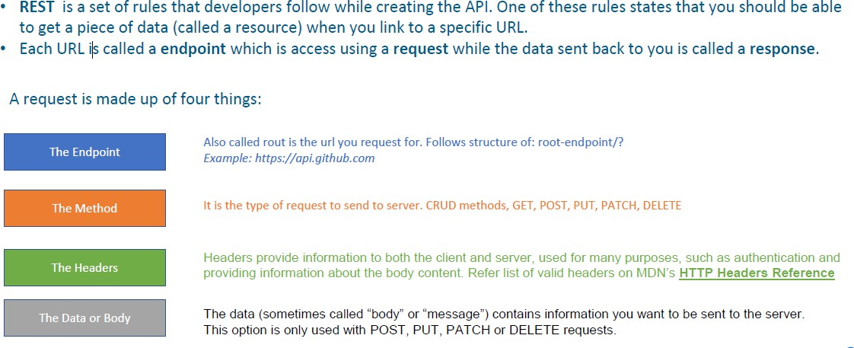
Anatomy of a REST API
INTERNAL

Slide 8
REST Web Service Resource
INTERNAL
Resource - It is the key abstraction of information in REST. REST Architecture treats every content as a resource, and it can be:
HTML Pages
Images
Videos
Dynamic Business Data
Every resource is uniquely identified by a URI
Example: https://jsonplaceholder.typicode.com/users/1

Slide 9
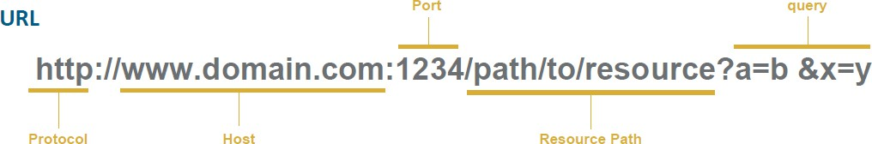
Resource Naming
INTERNAL
REST users URI to identify resources
As you traverse the path from more generic to more specific, you are navigating the data
Action | URI (Domain: https://reqres.in/)
List Users | https://reqres.in/api/users?page=2
Single User | https://reqres.in/api/users/2
Create Users | https://reqres.in/api/users
Update User | https://reqres.in/api/users/2

Slide 10
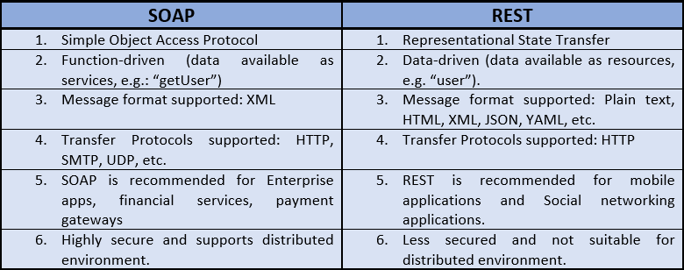
SOAP vs REST
INTERNAL

Slide 11
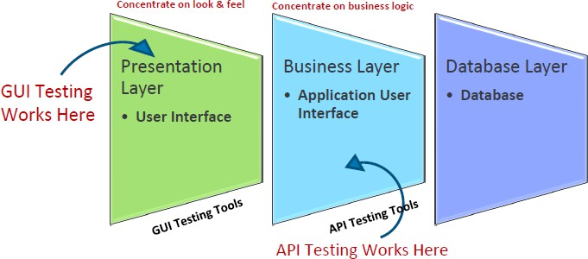
What is API Testing?
INTERNAL
It is a type of software testing where APIs are tested to determine if they meet expectations for functionality, reliability, performance, and security.
It is performed at the most critical layer of software architecture, the Business Layer. In the business layer, business logic processing
is carried out and all transactions between UI and database happen
API tests are different from GUI Tests and won't concentrate on the look and feel of an application. It mainly concentrates on the business logic layer of the software architecture.

Slide 12
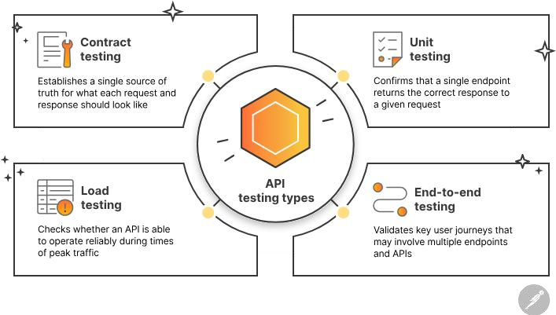
Why API Testing?
INTERNAL
Make sure API does what its supposed to do
Make sure API can handle the assigned load
Make sure API works across devices, browsers & systems
Reduce business development & test costs
Discover all possible ways user can mess up things

Slide 13
API as a Contract - First, check the Specification
INTERNAL
An API is essentially a contract between the client and the server Hence, before any implementation test can begin, make sure that the contract is correct
That can be done first by inspecting the spec (or the service contract itself, for example a Swagger interface or OpenAPI
reference)
Make sure that endpoints are correctly named, that resources and their types correctly reflect the object model
Check that there is no missing functionality or duplicate functionality
Check that relationships between resources are reflected in the API correctly

Slide 14
API Testing What to Test?
INTERNAL
HTTP Status code
Accuracy of data
Schema validation (response structure validation)
Response data validation (Data Accuracy, data types, data order etc)
Authorization checks
Implementation of response timeout
Error codes / Warning codes validation
Other Non-functional testing such as performance testing, Security testing etc

Slide 15
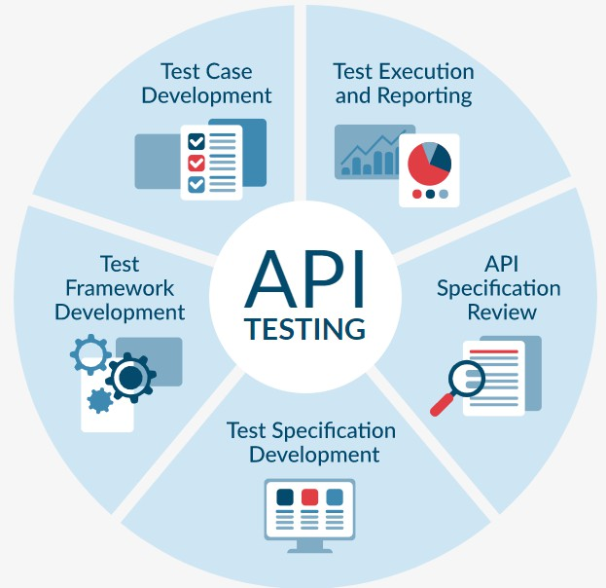
Stages Perform API Testing
INTERNAL
API Specification Review: Review the API Specification and use case documentation from test perspective
Test Specification Development: This document details the test conditions and expected results for each test case
Test Framework Development: Use standard Open-Source tools like SoapUI, JMeter or develop a set of static resources
Test Case Development: Coding of test scenarios, creating sanity check test suites, surveillance test suites
Test Execution and Reporting: Execution of the developed test suites & reporting

Slide 16
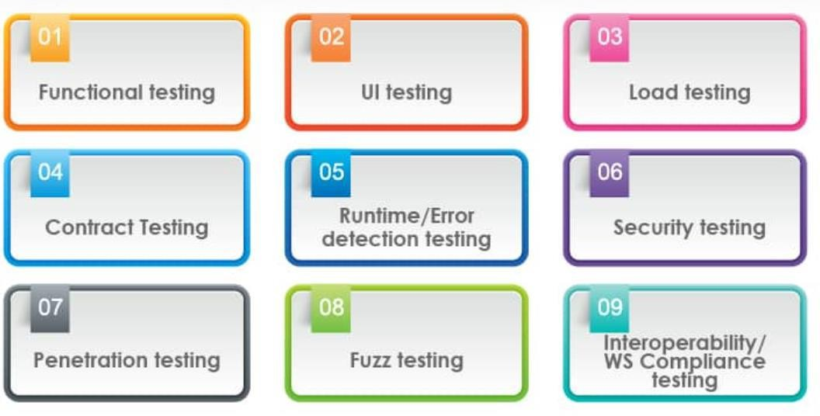
Types of API Testing
INTERNAL

Slide 17
API Functional Test Conditions
INTERNAL
Status Code Validation for Valid Requests: Verify that the API consistently returns the expected response status code, such as "200 OK," for valid and properly formatted requests.
Authentication Handling with Invalid Credentials: Test the API's response when provided with invalid authentication credentials, ensuring it consistently returns a "401 Unauthorized" status code as expected.
Graceful Handling of Missing or Invalid Parameters: Verify that the API handles missing or invalid request parameters gracefully and returns clear and user-friendly error messages that aid in troubleshooting.
Input Data Validation with Malformed Data: Test the API's input validation by submitting various forms of malformed data, such
as invalid email formats, and confirm that it properly rejects and responds to these inputs.
Timeout Handling under Load: Confirm that the API correctly handles timeouts by simulating requests that take longer to process, ensuring that it remains responsive and does not hang.

Slide 18
API Functional Test Conditions
INTERNAL
Pagination Functionality Verification: Test the API's pagination functionality by requesting specific pages of results and verifying that the responses contain the expected data and pagination information.
Concurrency Testing without Data Corruption: Verify that the API handles concurrent requests from multiple users without data corruption or conflicts, ensuring data integrity.
Response Format Adherence (JSON/XML): Ensure that the API consistently returns responses in the specified format (e.g., JSON or XML) and adheres to the defined schema for data structure.
Rate Limiting Assessment: Test the API's rate limiting by sending requests at a rate that exceeds the defined limits and checking
for the expected rate-limiting responses, ensuring that limits are enforced.
HTTP Method Support for CRUD Operations: Verify that the API supports a variety of HTTP methods (GET, POST, PUT, DELETE) for Create, Read, Update, and Delete operations, and that it returns appropriate responses for each.

Slide 19
API Functional Test Conditions
INTERNAL
Error Handling Capabilities for Meaningful Messages: Evaluate the API's error-handling capabilities by intentionally causing errors, such as invalid inputs or unexpected situations, and confirm that it consistently returns meaningful error messages for troubleshooting.
Sorting and Filtering Validation for Resource Listings: Verify that the API correctly sorts and filters resource listings based on specified
parameters, maintaining data accuracy.
Handling Long or Complex Data without Data Corruption: Ensure that the API properly handles long or complex strings, such as URLs or text fields, without truncating or corrupting the data.
Content Negotiation Support for Multiple Formats: Test the API's support for content negotiation by specifying different Accept headers (e.g., JSON, XML) and verifying that the response format matches the requested format.
Resource Not Found Handling (404 Not Found): Confirm that the API consistently returns the appropriate "404 Not Found" response when attempting to access a non-existent resource.
Response Time Measurement for Various Requests: Measure the API's response time for different types of requests to assess its performance and responsiveness.
Handling Large Payloads (File Uploads): Verify that the API can handle large payloads, such as file uploads, without encountering errors or significant performance degradation.

Slide 20

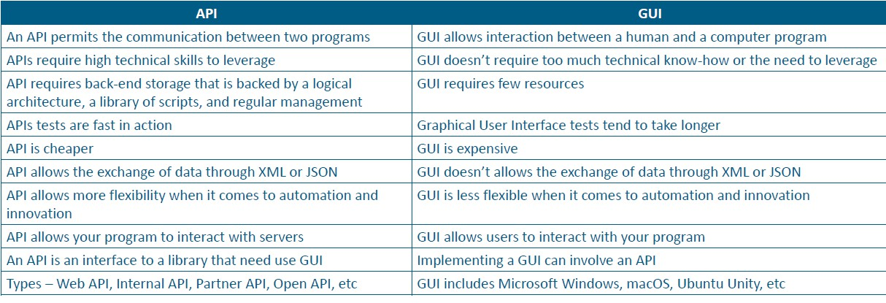
Compare UI Testing & API Testing
INTERNAL

Slide 21
Challenges of API Testing
INTERNAL
There is no GUI, which will make it difficult for testers to give input values
Test case management is difficult since a tester might have to deal with millions of test cases
The tester must possess expertise in the programming language(s) that are targeted by the API
Time-consuming, requires a lot of time and resources to develop tools and design tests
Improper documentation will make it difficult for a test designer to understand the purpose of API calls
Proper call sequencing is required as this may lead to inadequate coverage in testing
Exception handling functions need to be tested thoroughly

Slide 22
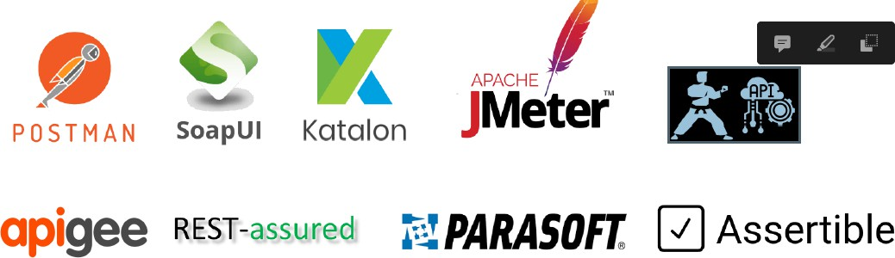
API Testing Tools Overview
INTERNAL
Considerations of Technology framework in picking a suitable Test Tool?
There are no perfect tools Each group has different requirements Virtually all API test tools work well and are great options, depending on your team's needs
Some of the factors like Budget, Resources with knowledge also plays a vital role in selecting a tool

