Slide 1
Python

Slide 2
What is Python ?
Python is a high level, interpreted language which has easy syntax and dynamic semantics.
Python is much easier than other programming languages and helps you create beautiful applications with less effort and much more ease.

Slide 3
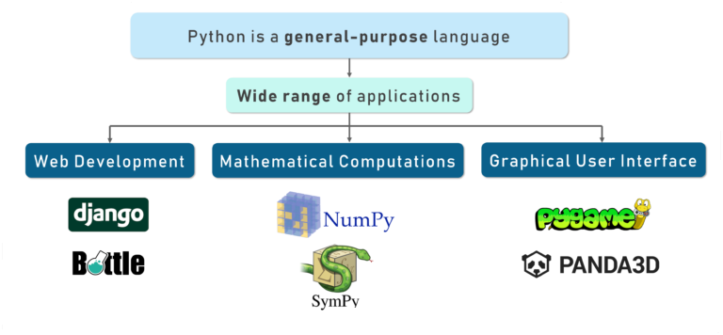
Python
Notes:
Python is a very versatile language. It has thousands of libraries and modules to work with.
Most of its libraries are open source it has gained a lot of traction among startups and the industry as well. And this definitely leads to millions of happy learners across the globe.
it has such a wide range of application, I couldn’t fit it all in one image!
Everything from web development using Django and bottle. Mathematical computations using Numpy, designing your own GUI using Tkinter and making your own games using Pygame and so on.

Slide 4
Why Python ?
You would wonder why use Python anyways?
Let me help you understand using the keywords in the formal definition of Python.
High Level
Python derives components from the natural language that we humans use to communicate with each other. This makes it easier for anyone to try and relate what exactly could be happening without the burden of going through tons of machine code.
Interpreted
Python codes are compiled line-by-line which makes debugging errors much easier and efficient. But this comes at a cost as it is much slower than other programming languages.
Easy Syntax
Python makes use of indentations instead of braces to distinguish what blocks of code come under which class or function. This makes the code look well distributed and makes it easy for anyone to read it.
Dynamic Semantics
If you are an old school coder, you would know that before using anything, you would need to initialize it. It does all of this dynamically.

Slide 5
Everything in Python is an Object
greetings
Hello
A=10
B=25
Add=A+B
print(Add)
10
A
25
def myFunction():
print(“Good Morning”)
B
Memory/Ram
Python
Other Programs Space in Memory
In built modules or library
User defined modules/classes/objects
myFunction

Slide 6
How is Python Used ?
Creating web applications with Python Frameworks such as Django and Flask
You can create workflows for the software that you are working on
Use Python to modify files and data stored in Databases
Scientific, Analytic and complex calculations can be taken care of easily
You can create software much quicker with Python, which is ready for deployment

Slide 7
Python Features
Simplicity: Think less of the syntax of the language and more of the code.
Open Source: A powerful language and it is free for everyone to use and alter as needed.
Portability: Python code can be shared and it would work the same way it was intended to. Seamless and hassle-free.
Being Embeddable & Extensible: Python can have snippets of other languages inside it to perform certain functions.
Being Interpreted: The worries of large memory tasks and other heavy CPU tasks are taken care of by Python itself leaving you to worry only about coding.
Huge amount of libraries: Data Science? Python has you covered. Web Development? Python still has you covered. Always.
Object Orientation: Objects help breaking-down complex real-life problems into such that they can be coded and solved to obtain solutions.

Slide 8
Python Features - Summary
To sum it up, Python has a simple syntax, is readable, and has great community support.
What can you do if you know Python? Well, you have a number of options to choose from.
Data Scientist
Machine Learning and Artificial Intelligence
Internet of Things
Web Development
Data Visualization
Automation

Slide 9
Career in Python
Data Scientist
A Data Scientist is someone who cracks complex problems which relate to the field of math, statistics and brings around a solution to these problems in a logical manner.
Software Engineer
Software engineers design, develop, test and maintain software applications that they create for their clients according to the requirements.
Web Developer
Web developers create web applications to serve their users using the client-server model. There are applications such as information sharing, social network platforms, entertainment which are just a few to name.

Slide 10
Python Interpreter
An interpreter is a computer program that directly executes, i.e. performs, instructions written in a programming or scripting language, without requiring them previously to have been compiled into a machine language program.
So unlike Java, Python uses an interpreter.

Slide 11
Installing Python Interpreter
Download python from python.org
You will get .exe file
Install python and include in your Path variables

Slide 12
Installing Python- Using Anaconda
Go to https://www.anaconda.com/distribution/
Download ancacoda IDE (Integrated Development Environment
Download Python 3.7 version for windows
Launch Jupyter Notebook

Slide 13
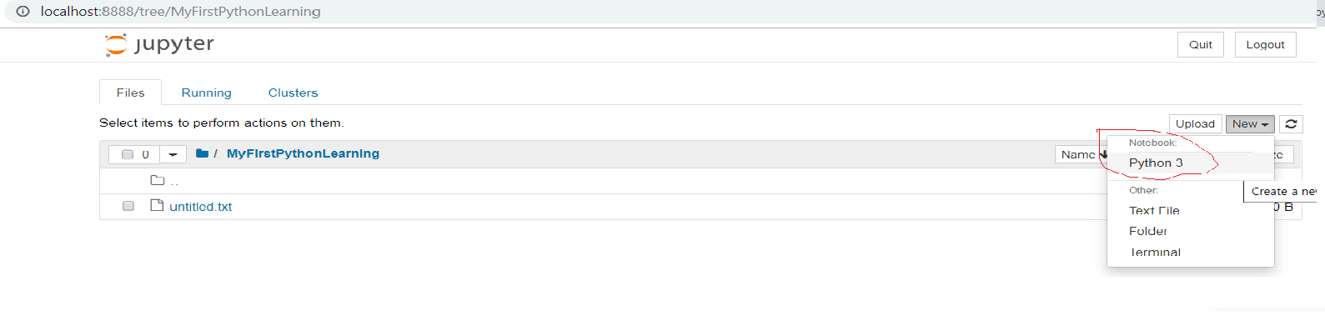
Lets Get Started with Hello World
Launch Jupyter Notebook
Click on New
Click on Python 3

Slide 14
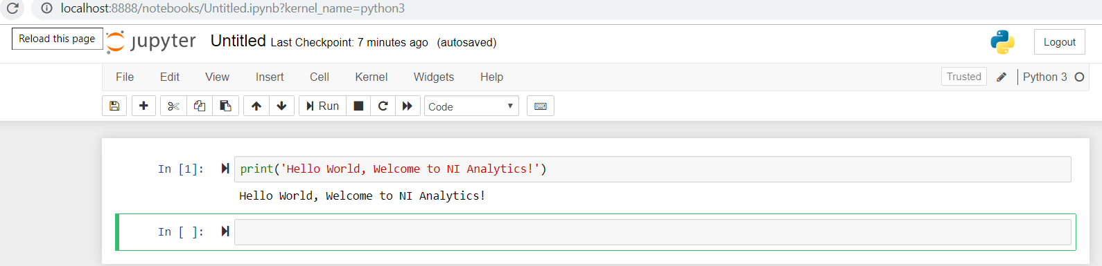
First Python Script - Welcome to NI Analytics

Slide 15
Comments in Python
Single line comment in Python is done using the # symbol.
#print('Hello World, Welcome to Analytics!’)
#print(1+2)
Multiple line comment
"""
Author: My Analytics
Description: Writes the words Hello World on the screen
"""
Or
'''
Author: My Analytics
Description: Writes the words Hello World on the screen
'''

Slide 16
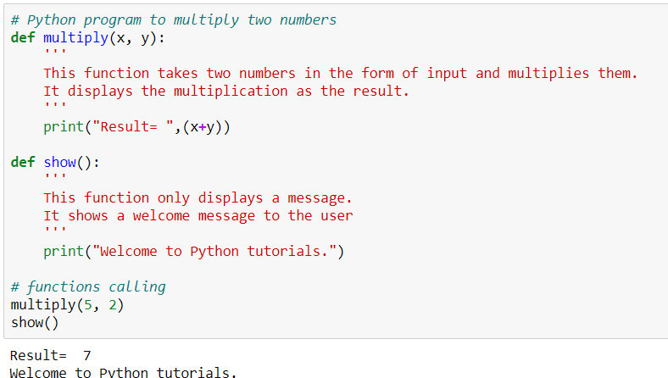
Comments and DocString

Slide 17
Variables in Python
Variables are nothing but reserved memory locations to store values.
This means that when you create a variable you reserve some space in memory.
A = 16
B= 20
C= 'Python'
A = 16
B= 20
C = 'Python'
Memory

Slide 18
Variables in Python
In Python you don’t need to declare variables before using it, unlike other languages like Java, C etc.
Assigning values to a variable:
Python variables do not need explicit declaration to reserve memory space. The declaration happens automatically when you assign a value to a variable. The equal sign (=) is used to assign values to variables.
Consider the below example:
S = 10
print(S)
This will assign value ‘10’ to the variable ‘S’ and will print it

Slide 19
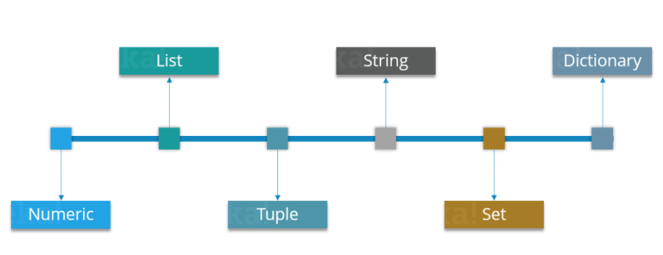
Python- Data Types
Notes:
Python supports various data types, these data types defines the operations possible on the variables and the storage method.
Let’s discuss each of these in detail.

Slide 20
Numeric - Integer
Just as expected Numeric data types store numeric values. They are immutable data types, this means that you cannot change it’s value.
Python supports three different Numeric data types:
Integer type: It holds all the integer values i.e. all the positive and negative whole numbers, example – 10.

Slide 21
Numeric - Float
Float type:
It holds the real numbers and are represented by decimal and sometimes even scientific notations with E or e indicating the power of 10 (2.5e2 = 2.5 x 102 = 250), example – 10.24.

Slide 22
Numeric- Complex Type
These are of the form a + bj, where a and b are floats and J represents the square root of -1 (which is an imaginary number),
example – 10+6j.
Now you can even perform type conversion.
For example, you can convert the integer value to a float value and vice-versa.

Slide 23
Numeric- Type Conversion
Consider the example below:
A = 10
# Convert it into float type
B = float(A)
print(B)
The code above will convert an integer value to a float type.
Similarly you can convert a float value to integer type:
A = 10.76
# Convert it into float type
B = int(A)
print(B)

Slide 24
List
You can consider the Lists as Arrays in C, but in List you can store elements of different types, but in Array all the elements should of the same type.
List is the most versatile datatype available in Python which can be written as a list of comma-separated values (items) between square brackets.
Consider the example below:
Subjects = ['Physics', 'Chemistry', 'Maths', 2]
print(Subjects)
Notice that the Subjects List contains both words as well as numbers. Now, let’s perform some operations on our Subjects List.
Notes:
Notice that the Subjects List contains both words as well as numbers. Now, let’s perform some operations on our Subjects List.

Slide 25
Operations performed on Lists
Syntax | Result | Description
Subjects [0] | Physics | This will give the index 0 value from the Subjects List.
Subjects [0:2] | Physics, Chemistry | This will give the index values from 0 till 2, but it won’t include 2 the Subjects List.
Subjects [3] = ‘Biology’ | [‘Physics’, ‘Chemistry’, ‘Maths’, ‘Biology’] | It will update the List and add ‘Biology’ at index 3 and remove 2.
del Subjects [2] | [‘Physics’, ‘Chemistry’, 2] | This will delete the index value 2 from Subjects List.
len (Subjects) | Length or number of elements in Subjects | This will return the length of the list
Subjects * 2 | [‘Physics’, ‘Chemistry’, ‘Maths’, 2] [‘Physics’, ‘Chemistry’, ‘Maths’, 2] | This will repeat the Subjects List twice.
Subjects [::-1] | [2, ‘Maths’, ‘Chemistry’, ‘Physics’] | This will reverse the Subjects List

Slide 26
Strings
Strings are amongst the most popular data types in Python.
We can create them simply by enclosing characters in quotes.
Python treats single and double quotes in exactly the same fashion.
Consider the example below:
S = "Welcome To My Python!"
D = 'Biology'

Slide 27
Operation performed on String
Syntax | Operation
print (len(String_Name)) | String legnth
print (String_Name.index(“Char”)) | Locate a character in String
print (String_Name.count(“Char”)) | Count the number of times a character is repeated in a String
print (String_Name[Start:Stop]) | Slicing
print (String_Name[::-1]) | Reverse a String
print (String_Name.upper()) | Convert the letters in a String to upper-case
print (String_Name.lower()) | Convert the letters in a String to lower-case

Slide 28
Tuples
A Tuple is a sequence of immutable Python objects. Tuples are sequences, just like Lists. The differences between tuples and lists are:
Tuples cannot be changed unlike lists
Tuples use parentheses, whereas lists use square brackets.
Consider the example below:
Chelsea = ('Hazard', 'Lampard', 'Terry')
Now you must be thinking why Tuples when we have Lists?
So the simple answer would be, Tuples are faster than Lists. If you’re defining a constant set of values which you just want to iterate, then use Tuple instead of a List.
Guys, all Tuple operations are similar to Lists, but you cannot update, delete or add an element to a Tuple.
Now, stop being lazy and don’t expect me to show all those operations, try it yourself.

Slide 29
Set
A Set is an unordered collection of items. Every element is unique.
A Set is created by placing all the items (elements) inside curly braces {}, separated by comma.
Consider the example below:
Set_1 = {1, 2, 3}
In Sets, every element has to be unique.
Try printing the below code:
Set_2 = {1, 2, 3, 3}
Here 3 is repeated twice, but it will print it only once.

Slide 30
Set- Operations
Union:
Union of A and B is a set of all the elements from both sets. Union is performed using | operator. Consider the below example:
A = {1, 2, 3, 4}
B = {3, 4, 5, 6}
print ( A | B)
Output = {1, 2, 3, 4, 5, 6}

Slide 31
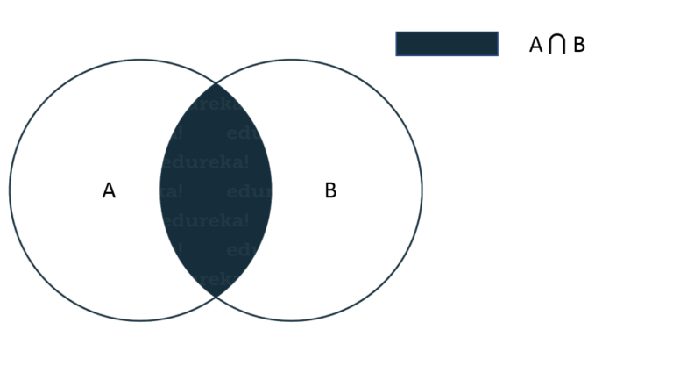
Set-Operations
Intersection
Intersection of A and B is a set of elements that are common in both sets. Intersection is performed using & operator. Consider the example below:
A = {1, 2, 3, 4}
B = {3, 4, 5, 6}
print ( A & B )
Output = {3, 4}

Slide 32
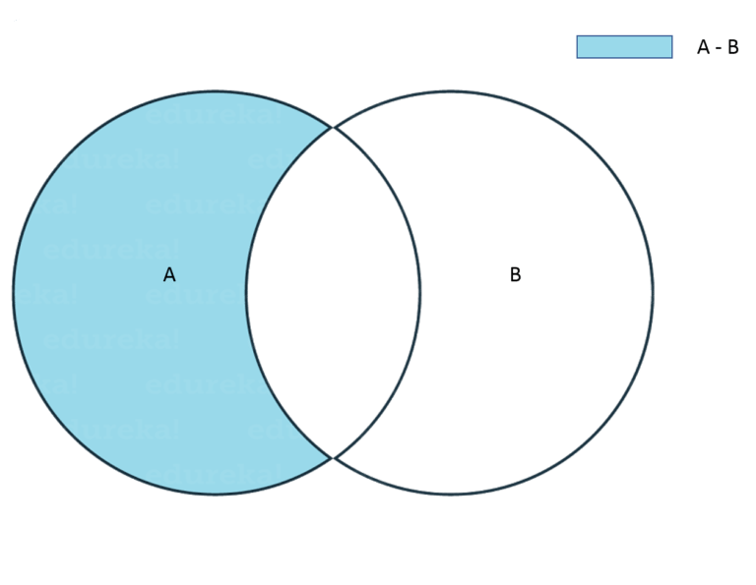
Set-Operations
Difference
Difference of A and B (A – B) is a set of elements that are only in A but not in B. Similarly, B – A is a set of element in B but not in A.
Consider the example below:
A = {1, 2, 3, 4, 5}
B = {4, 5, 6, 7, 8}
print(A - B)
Output = {1, 2, 3}

Slide 33
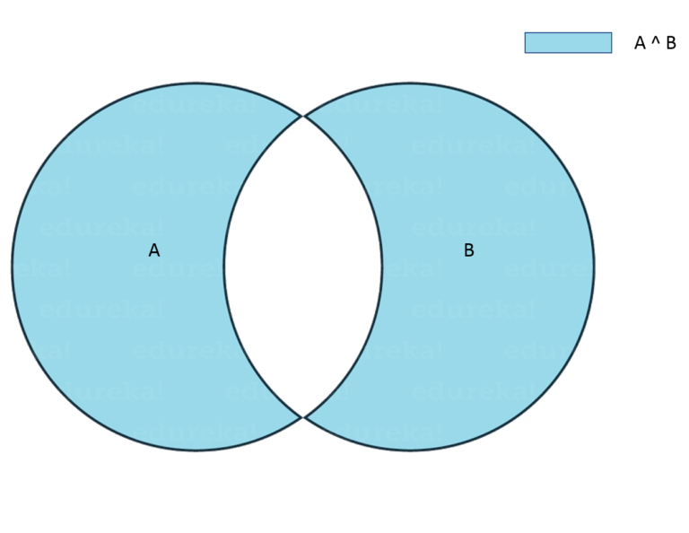
Set-Operations
Symmetric Difference
Symmetric Difference of A and B is a set of elements in both A and B except those that are common in both. Symmetric difference is performed using ^ operator. Consider the example below:
A = {1, 2, 3, 4, 5}
B = {4, 5, 6, 7, 8}
print(A ^ B)
Output = {1, 2, 3, 6, 7, 8}

Slide 34
Dictionary
Dictionaries contains these ‘Key Value’ pairs enclosed within curly braces and Keys and values are separated with ‘:’.
Consider the below example:
Dict = {'Name' : 'Saurabh', 'Age' : 23}
You know the drill, now comes various Dictionary operations.
Access elements from a dictionary:
Dict = {'Name' : 'Saurabh', 'Age' : 23}
print(Dict['Name'])
Output = Saurabh
Changing elements in a Dictionary:
Dict = {'Name' : 'Saurabh', 'Age' : 23}
Dict['Age'] = 32
Dict['Address'] = 'Starc Tower’
print(Dict)
Output = {'Name' = 'Saurabh', 'Age' = 32, 'Address' = 'Starc Tower'}

Slide 35
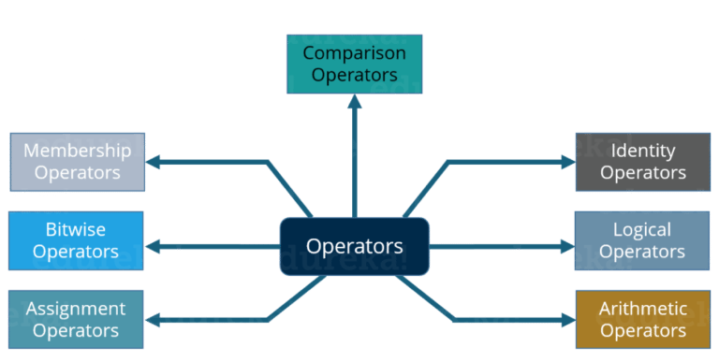
Operators
Operators are the constructs which can manipulate the values of the operands. Consider the expression
2 + 3 = 5, here 2 and 3 are operands and + is called operator.
Python supports the following types of Operators:

Slide 36
Airthmetic-Operator
These Operators are used to perform mathematical operations like addition, subtraction etc.
Assume that A = 10 and B = 20 for the below table.
Operator | Description | Example
+ Addition | Adds values on either side of the operator | A + B = 30
– Subtraction | Subtracts the right hand operator with left hand operator | A – B = -10
* Multiplication | Multiplies values on either side of the operator | A * B = 200
/ Division | Divides left hand operand with right hand operator | A / B = 0.5
% Modulus | Divides left hand operand by right hand operand and returns remainder | B % A = 0
** Exponent | Performs exponential (power) calculation on operators | A ** B = 10 to the power 20

Slide 37
Example
Consider the example below:
a = 21
b = 10
c = 0
c = a + b
print ( c )
c = a - b
print ( c )

Slide 38
Example
c = a * b
print ( c )
c = a / b
print ( c )
c = a % b
print ( c )
a = 2
b = 3
c = a**b
print ( c )
Output = 31, 11, 210, 2.1, 1, 8

Slide 39
Comparison- Operator
These Operators compare the values on either sides of them and decide the relation among them.
Assume A = 10 and B = 20.
Operator | Description | Example
== | If the values of two operands are equal, then the condition becomes true. | (A == B) is true
!= | If values of two operands are not equal, then condition becomes true. | (A != B) is true
> | If the value of left operand is greater than the value of right operand, then condition becomes true. | (a > b) is true
< | If the value of left operand is less than the value of right operand, then condition becomes true. | (a < b) is true
>= | If the value of left operand is greater than or equal to the value of right operand, then condition becomes true. | (a >= b) is true
<= | If the value of left operand is less than or equal to the value of right operand, then condition becomes true. | (a <= b) is true

Slide 40
Example
Consider the example below:
a = 21
b = 10
c = 0
if ( a == b ):
print ("a is equal to b")
else:
print ("a is not equal to b")
if ( a != b ):
print ("a is not equal to b")
else:
print ("a is equal to b")
if ( a < b ): print ("a is less than b")
else: print ("a is not less than b")
if ( a > b ):
print ("a is greater than b")
else:
print ("a is not greater than b")

Slide 41
Example
a = 5
b = 20
if ( a <= b ): print ("a is either less than or equal to b")
else: print ("a is neither less than nor equal to b")
if ( a => b ):
print ("a is either greater than or equal to b")
else:
print ("a is neither greater than nor equal to b")
Output = a is not equal to b
a is not equal to b
a is not less than b
a is greater than b
a is either less than or equal to b
b is either greater than or equal to b
Notes:
Now in the above example, I have used conditional statements (if, else). It basically means if the condition is true then execute the print statement, if not then execute the print statement inside else.

Slide 42
Assignment Operators
An Assignment Operator is the operator used to assign a new value to a variable. Assume A = 10 and B = 20 for the below table.
Operator | Description | Example
= | Assigns values from right side operands to left side operand | c = a + b assigns value of a + b into c
+= Add AND | It adds right operand to the left operand and assign the result to left operand | c += a is equivalent to c = c + a
-= Subtract AND | It subtracts right operand from the left operand and assign the result to left operand | c -= a is equivalent to c = c – a
*= Multiply AND | It multiplies right operand with the left operand and assign the result to left operand | c *= a is equivalent to c = c * a
/= Divide AND | It divides left operand with the right operand and assign the result to left operand | c /= a is equivalent to c = c / a
%= Modulus AND | It takes modulus using two operands and assign the result to left operand | c %= a is equivalent to c = c % a
**= Exponent AND | Performs exponential (power) calculation on operators and assign value to the left operand | c **= a is equivalent to c = c ** a

Slide 43
Example
a = 21
b = 10
c = 0
c = a + b
print ( c )
c += a
print ( c )
c *= a
print ( c )
c /= a
print ( c )
c = 2
c %= a
print ( c )
c **= a
print ( c )
Output = 31, 52, 1092, 52.0, 2, 2097152, 99864

