Slide 1
Python- Operators

Slide 2
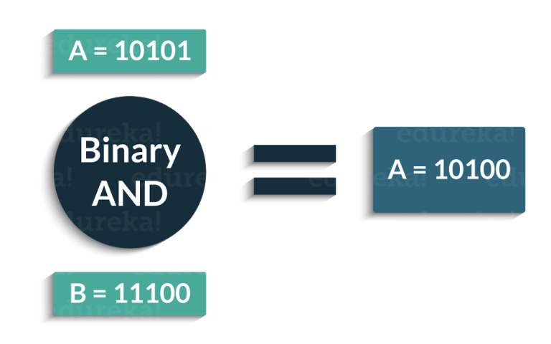
Bitwise Operators
These operations directly manipulate bits. In all computers, numbers are represented with bits, a series of zeros and ones. In fact, pretty much everything in a computer is represented by bits.
Example:

Slide 3
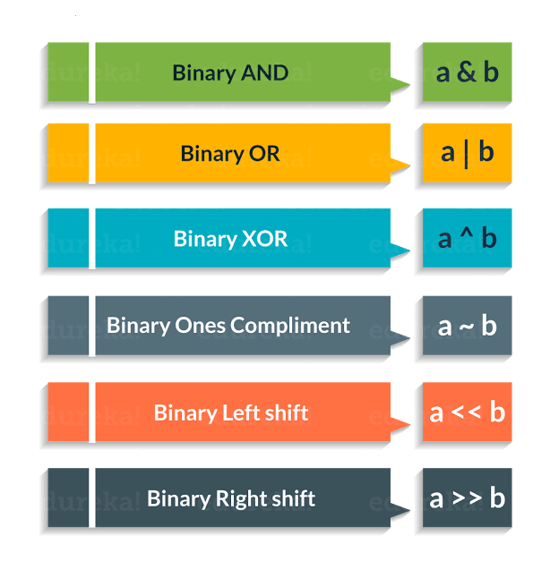
Bitwise Operators supported by Python

Slide 4
Binary AND
Python bitwise and operator returns 1 if both the bits are 1, otherwise 0.
Example:
A=10 => 2 1010 (Binary)
B=7 => 2 111(Binary)
1010
&
0111
A & B= 0010
2 Decimal

Slide 5
Binary OR
Python bitwise or operator returns 1 if any of the bits is 1. If both the bits are 0, then it returns 0. Example:
A=10 => 2 1010 (Binary)
B=7 => 2 111(Binary)
1010
|
0111
A | B= 1111
15 Decimal

Slide 6
Binary XOR
Python bitwise XOR operator returns 1 if one of the bits is 0 and the other bit is 1. If both the bits are 0 or 1, then it returns 0.
Example:
A=10 => 2 1010 (Binary)
B=7 => 2 111(Binary)
1010
^
0111
A ^ B= 1101
13 Decimal

Slide 7
Binary Ones ’ Complement Operator
Python Ones’ complement of a number ‘A’ is equal to -(A+1).
Example:
A = 60 # 60 = 0011 1100 (Binary)
~ A = -61 # -61 = -(0011 1101)

Slide 8
Binary Left Shift Operator
Python bitwise left shift operator shifts the left operand bits towards the left side for the given number of times in the right operand. In simple terms, the binary number is appended with 0s at the end.
Example:
A=10 => 2 1010 (Binary)
A << 2 = 1010 << 2
= 101000
= 40 (Decimal)

Slide 9
Binary Right Shift Operator
Python right shift operator is exactly the opposite of the left shift operator. Then left side operand bits are moved towards the right side for the given number of times. In simple terms, the right side bits are removed.
Example:
A=10 => 2 1010 (Binary)
A >> 2 = 1010 >> 2
= 10
= 2 (Decimal)

Slide 10
Consider the example below:
a = 58 # 111010
b = 13 # 1101
c = 0
c = a & b
print ( c ) # 8 = 1000
c = a | b
print ( c ) # 63 = 111111
c = a ^ b
print ( c ) # 55 = 110111
c = a >> 2
print ( c ) # 232 = 11101000
c = a << 2
print ( c ) # 14 = 1110
Output = 8,63,55,232,14

Slide 11
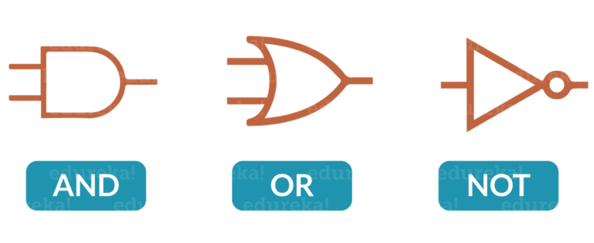
Logical Operators
Logical operators in Python are used for conditional statements are true or false. Logical operators in Python are AND, OR and NOT.
For logical operators following condition are applied.
Operator | Description | Example
and | True if both the operands are true | X and Y
or | True if either of the operands are true | X or Y
not | True if operand is false (complements the operand) | not X
Notes:
For AND operator – It returns TRUE if both the operands (right side and left side) are true
For OR operator- It returns TRUE if either of the operand (right side or left side) is true
For NOT operator- returns TRUE if operand is false

Slide 12
Logical Operators- Example
x = True
y = False
print('x and y is',x and y)
print('x or y is',x or y)
print('not x is',not x)
Output = x and y is False
x or y is True
not x is False

Slide 13
Membership Operators
These Operators are used to test whether a value or a variable is found in a sequence (Lists, Tuples, Sets, Strings, Dictionaries) or not.
Example:
X = [1, 2, 3, 4]
A = 3
print(A in X)
print(A not in X)
Output = True
False
Operator | Description | Example
in | True if value/variable is found in the sequence | 5 in x
not in | True if value/variable is not found in the sequence | 5 not in x
Notes:
These operators test for membership in a sequence such as lists, strings or tuples. There are two membership operators that are used in Python. (in, not in). It gives the result based on the variable present in specified sequence or string.

Slide 14
Identity Operators
These Operators are used to check if two values (or variables) are located on the same part of the memory. Two variables that are equal does not imply that they are identical.
Operator | Description | Example
is | True if the operands are identical | x is True
is not | True if the operands are not identical | x is not True

Slide 15
Identity Operators- Example
X1 = 'Welcome To Python!'
X2 = 1234
Y1 = 'Welcome To Python!'
Y2 = 1234
print(X1 is Y1)
print(X1 is not Y1)
print(X1 is not Y2)
print(X1 is X2)
Output = True
False
True
False

Slide 16
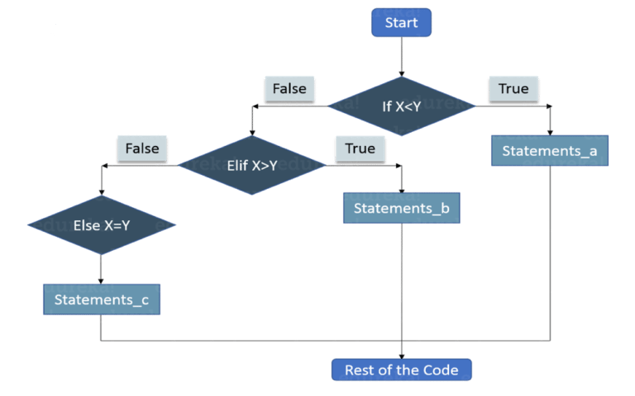
Conditional Statements
Conditional statements are used to execute a statement or a group of statements when some condition is true. There are namely three conditional statements – If, Elif, Else.
Consider the flow chart:
Notes:
Let me tell you how it actually works.
First the control will check the ‘If’ condition. If its true, then the control will execute the statements after If condition.
When ‘If’ condition is false, then the control will check the ‘Elif’ condition. If Elif condition is true then the control will execute the statements after Elif condition.
If ‘Elif’ Condition is also false then the control will execute the Else statements.

Slide 17
Conditional Statements
Below is the syntax:
if condition1:
statements
elif condition2:
statements
else:
statements
Consider the example below:
X = 10
Y = 12
if X < Y: print('X is less than Y’)
elif X > Y:
print('X is greater than Y')
else:
print('X and Y are equal')
Output = X is less than Y
Notes:
Consider the example below:
X = 10
Y = 12
if X < Y: print('X is less than Y')
elif X > Y:
print('X is greater than Y')
else:
print('X and Y are equal')
Output = X is less than Y

Slide 18
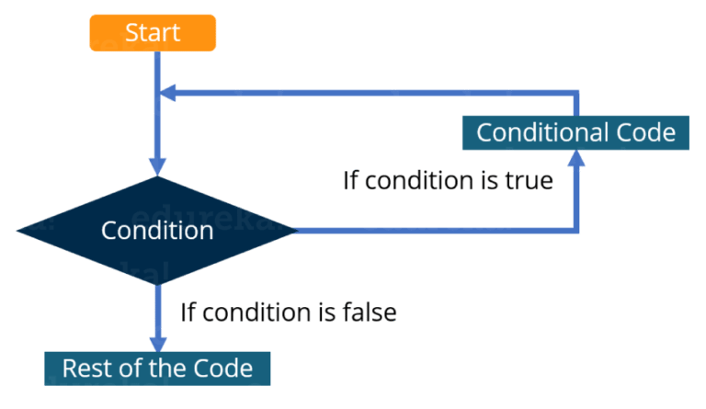
Loops
In general, statements are executed sequentially. The first statement in a function is executed first, followed by the second, and so on
There may be a situation when you need to execute a block of code several number of times
A loop statement allows us to execute a statement or group of statements multiple times.
The following diagram illustrates a loop statement:
Notes:
Let me explain you the above diagram:
First the control will check the condition. If it is true then the control will move inside the loop and execute the statements inside the loop.
Now, the control will again check the condition, if it is still true then again it will execute the statements inside the loop.
This process will keep on repeating until the condition becomes false. Once the condition becomes false the control will move out of loop.

Slide 19
Loops
There are two types of loops:
Infinite: When condition will never become false
Finite: At one point, the condition will become false and the control will move out of the loop
There is one more way to categorize loops:
Pre-test: In this type of loops the condition is first checked and then only the control moves inside the loop
Post-test: Here first the statements inside the loops are executed, and then the condition is checked
Python does not support Post-test loops.

Slide 20
Loops in Python
In Python, there are three loops:
While
For
Nested
While Loop: Here, first the condition is checked and if it’s true, control will move inside the loop and execute the statements inside the loop until the condition becomes false. We use this loop when we are not sure how many times we need to execute a group of statements or you can say that when we are unsure about the number of iterations.
Example:
count = 0
while (count < 10):
print ( count )
count = count + 1
print ("Good bye!")

Slide 21
Loops in Python
For Loop: Like the While loop, the For loop also allows a code block to be repeated certain number of times. The difference is, in For loop we know the amount of iterations required unlike While loop, where iterations depends on the condition. You will get a better idea about the difference between the two by looking at the syntax:
for variable in Sequence:
statements
Notice here, we have specified the range, that means we know the number of times the code block will be executed.
Consider the example:
fruits = ['Banana', 'Apple', 'Grapes']
for index in range(len(fruits)): #index is a variable for the index of fruits
print (fruits[index])
Output = Banana
Apple
Grapes

Slide 22
Loops in Python
Nested Loops: It basically means a loop inside a loop. It can be a For loop inside a While loop and vice-versa. Even a For loop can be inside a For loop or a While loop inside a While loop.
Consider the example:
count = 1
for i in range(10):
print (str(i) * i)
for j in range(0, i):
count = count +1
Notes:
Output =
1
22
333
4444
55555
666666
7777777
88888888
999999999

Slide 23
Functions
Functions are a convenient way to divide your code into useful blocks, allowing us to order our code, make it more readable, reuse it and save some time.
Simple rules to define a function in Python.
Function blocks begin with the keyword def followed by the function name and parentheses ( ( ) ).
Any input parameters or arguments should be placed within these parentheses. You can also define parameters inside these parentheses.
The first statement of a function can be an optional statement - the documentation string of the function or docstring.
The code block within every function starts with a colon (:) and is indented.
The statement return [expression] exits a function, optionally passing back an expression to the caller. A return statement with no arguments is the same as return None.

Slide 24
Functions
Syntax:
def functionname( parameters ):
"function_docstring"
function_suite or expression
return [expression]
Notes:
def add (a, b):
return a + b
c = add(10,20)
print(c)
Output = 30

Slide 25
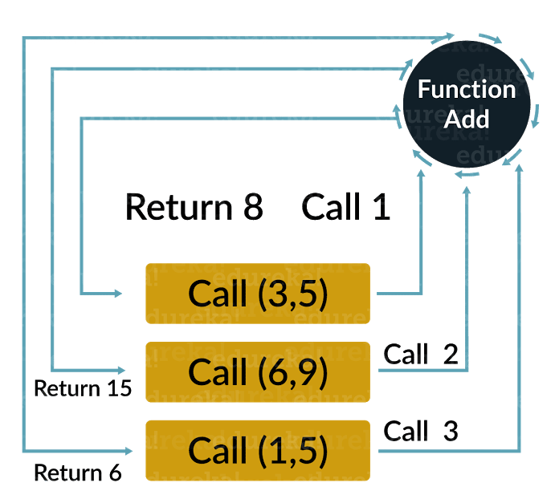
Calling a Function
Defining a function only gives it a name, specifies the parameters that are to be included in the function and structures the blocks of code.
Once the basic structure of a function is finalized, you can execute it by calling it from another function or directly from the Python prompt.
Example
Notes:
Example:
def add (a, b):
return a + b
c = add(10,20)
print(c)
Output = 30
Example:
def printme( str ):
"This prints a passed string into this function"
print str
return

Slide 26
Example
# Function definition is here
def printme( str ):
"This prints a passed string into this function"
print str
return;
# Now you can call printme function
printme("I'm first call to user defined function!")
printme("Again second call to the same function")
Notes:
Output:
I'm first call to user defined function! Again second call to the same function

Slide 27
Pass by Reference vs Value
All parameters (arguments) in the Python language are passed by reference. It means if you change what a parameter refers to within a function, the change also reflects back in the calling function.
For example
# Function definition is here
def changeme( mylist ):
"This changes a passed list into this function"
mylist.append([1,2,3,4]);
print "Values inside the function: ", mylist
return
# Now you can call changeme function
mylist = [10,20,30];
changeme( mylist );
print "Values outside the function: ", mylist

Slide 28
Pass by Reference vs Value- Example
In the above example, we are maintaining reference of the passed object and appending values in the same object.
So, this would produce the following result −
Values inside the function: [10, 20, 30, [1, 2, 3, 4]]
Values outside the function: [10, 20, 30, [1, 2, 3, 4]]

Slide 29
Pass by Reference vs Value - Example
There is one more example where argument is being passed by reference and the reference is being overwritten inside the called function.
# Function definition is here
def changeme( mylist ):
"This changes a passed list into this function"
mylist = [1,2,3,4]; # This would assig new reference in mylist
print "Values inside the function: ", mylist
return
# Now you can call changeme function
mylist = [10,20,30];
changeme( mylist );
print "Values outside the function: ", mylist

Slide 30
Pass by Reference vs Value - Example
The parameter mylist is local to the function changeme. Changing mylist within the function does not affect mylist. The function accomplishes nothing and finally this would produce the following result −
Values inside the function: [1, 2, 3, 4]
Values outside the function: [10, 20, 30]

Slide 31
Function Arguments
You can call a function by using the following types of formal arguments −
Required arguments
Keyword arguments
Default arguments
Variable-length arguments

Slide 32
Function Arguments
Required arguments
Required arguments are the arguments passed to a function in correct positional order. Here, the number of arguments in the function call should match exactly with the function definition.
To call the function printme(), you definitely need to pass one argument, otherwise it gives a syntax error as follows −
# Function definition is here
def printme( str ):
"This prints a passed string into this function"
print str
return;
# Now you can call printme function
printme()
Notes:
When the above code is executed, it produces the following result −
Traceback (most recent call last):
File "test.py", line 11, in <module>
printme();
TypeError: printme() takes exactly 1 argument (0 given)

Slide 33
Keyword arguments
Keyword arguments are related to the function calls. When you use keyword arguments in a function call, the caller identifies the arguments by the parameter name.
This allows you to skip arguments or place them out of order because the Python interpreter is able to use the keywords provided to match the values with parameters. You can also make keyword calls to the printme() function in the following ways −
# Function definition is here
def printme( str ):
"This prints a passed string into this function"
print str
return;
# Now you can call printme function
printme( str = "My string")
Notes:
When the above code is executed, it produces the following result −
My string
The following example gives more clear picture. Note that the order of parameters does not matter.
# Function definition is here
def printinfo( name, age ):
"This prints a passed info into this function"
print "Name: ", name
print "Age ", age
return;
# Now you can call printinfo function
printinfo( age=50, name="miki" )
When the above code is executed, it produces the following result −
Name: miki
Age 50

Slide 34
Default arguments
A default argument is an argument that assumes a default value if a value is not provided in the function call for that argument. The following example gives an idea on default arguments, it prints default age if it is not passed −
# Function definition is here
def printinfo( name, age = 35 ):
"This prints a passed info into this function"
print "Name: ", name
print "Age ", age
return;
# Now you can call printinfo function
printinfo( age=50, name="miki" )
printinfo( name="miki" )
Notes:
When the above code is executed, it produces the following result −
Name: miki
Age 50
Name: miki
Age 35

Slide 35
Variable-length arguments
You may need to process a function for more arguments than you specified while defining the function. These arguments are called variable-length arguments and are not named in the function definition, unlike required and default arguments.
Syntax for a function with non-keyword variable arguments is this −
def functionname([formal_args,] *var_args_tuple ):
"function_docstring"
function_suite
return [expression]
An asterisk (*) is placed before the variable name that holds the values of all nonkeyword variable arguments. This tuple remains empty if no additional arguments are specified during the function call.

Slide 36
Variable-length arguments
Following is a simple example −
# Function definition is here
def printinfo( arg1, *vartuple ):
"This prints a variable passed arguments"
print "Output is: "
print arg1
for var in vartuple:
print var
return;
# Now you can call printinfo function
printinfo( 10 )
printinfo( 70, 60, 50 )
Notes:
When the above code is executed, it produces the following result −
Output is:
10
Output is:
70
60
50

Slide 37
The Anonymous Functions
These functions are called anonymous because they are not declared in the standard manner by using the def keyword. You can use the lambda keyword to create small anonymous functions.
• Lambda forms can take any number of arguments but return just one value in the form of an expression. They cannot contain commands or multiple expressions.
• An anonymous function cannot be a direct call to print because lambda requires an expression
• Lambda functions have their own local namespace and cannot access variables other than those in their parameter list and those in the global namespace.
• Although it appears that lambda's are a one-line version of a function, they are not equivalent to inline statements in C or C++, whose purpose is by passing function stack allocation during invocation for performance reasons.

Slide 38
The Anonymous Functions
Syntax:
The syntax of lambda functions contains only a single statement, which is as follows −
lambda [arg1 [,arg2,.....argn]]:expression
Following is the example to show how lambda form of function works −
# Function definition is here
sum = lambda arg1, arg2: arg1 + arg2;
# Now you can call sum as a function
print "Value of total : ", sum( 10, 20 )
print "Value of total : ", sum( 20, 20 )
Notes:
When the above code is executed, it produces the following result −
Value of total : 30
Value of total : 40

Slide 39
The return Statement
The statement return [expression] exits a function, optionally passing back an expression to the caller. A return statement with no arguments is the same as return None.
All the above examples are not returning any value. You can return a value from a function as follows −
# Function definition is here
def sum( arg1, arg2 ):
# Add both the parameters and return them."
total = arg1 + arg2
print "Inside the function : ", total
return total;
# Now you can call sum function
total = sum( 10, 20 );
print "Outside the function : ", total
Notes:
When the above code is executed, it produces the following result −
Inside the function : 30
Outside the function : 30

Slide 40
Scope of Variables
All variables in a program may not be accessible at all locations in that program. This depends on where you have declared a variable.
The scope of a variable determines the portion of the program where you can access a particular identifier. There are two basic scopes of variables in Python −
• Global variables
• Local variables

Slide 41
Global vs. Local variables
Variables that are defined inside a function body have a local scope, and those defined outside have a global scope.
This means that local variables can be accessed only inside the function in which they are declared, whereas global variables can be accessed throughout the program body by all functions. When you call a function, the variables declared inside it are brought into scope. Following is a simple example −
total = 0; # This is global variable.
# Function definition is here
def sum( arg1, arg2 ):
# Add both the parameters and return them."
total = arg1 + arg2; # Here total is local variable.
print "Inside the function local total : ", total
return total;
# Now you can call sum function
sum( 10, 20 );
print "Outside the function global total : ", total
Notes:
When the above code is executed, it produces the following result −
Inside the function local total : 30
Outside the function global total : 0

Slide 42
Indentation
Refer : https://docs.python.org/2.0/ref/indentation.html

