Slide 1
Snowflake

Slide 2
What is Snowflake?
Definition
Snowflake is a cloud-native data warehouse platform built for:
  Data warehousing
  Data lakes
  Data engineering
  Data science
  Data sharing
  Real-time analytics
Unlike traditional databases, Snowflake is:
  Fully managed SaaS
  Multi-cloud (runs on Amazon Web Services, Microsoft Azure, Google Cloud Platform)
  Elastic & scalable
  Separates compute & storage

Slide 3
Why Snowflake is Popular?
✔ No infrastructure management
✔ Automatic scaling
✔ High concurrency
✔ Built-in security & governance
✔ Pay only for what you use

Slide 4
Snowflake vs Traditional Databases
Feature | Traditional DB | Snowflake
Deployment | On-premise | Cloud-native
Scaling | Vertical (add CPU/RAM) | Horizontal (scale warehouses independently)
Storage & Compute | Coupled | Fully separated
Maintenance | Manual tuning | Automatic
Data Sharing | Complex ETL | Secure data sharing
Pricing | Fixed infrastructure | Usage-based

Slide 5
Architecture Difference
Traditional DB (like Oracle Database or MySQL):
  Storage + Compute tightly coupled
  Scaling affects entire system
Snowflake:
  Storage → Independent
  Compute → Independent
  Cloud Services → Manages metadata
This separation is the game-changer.

Slide 6
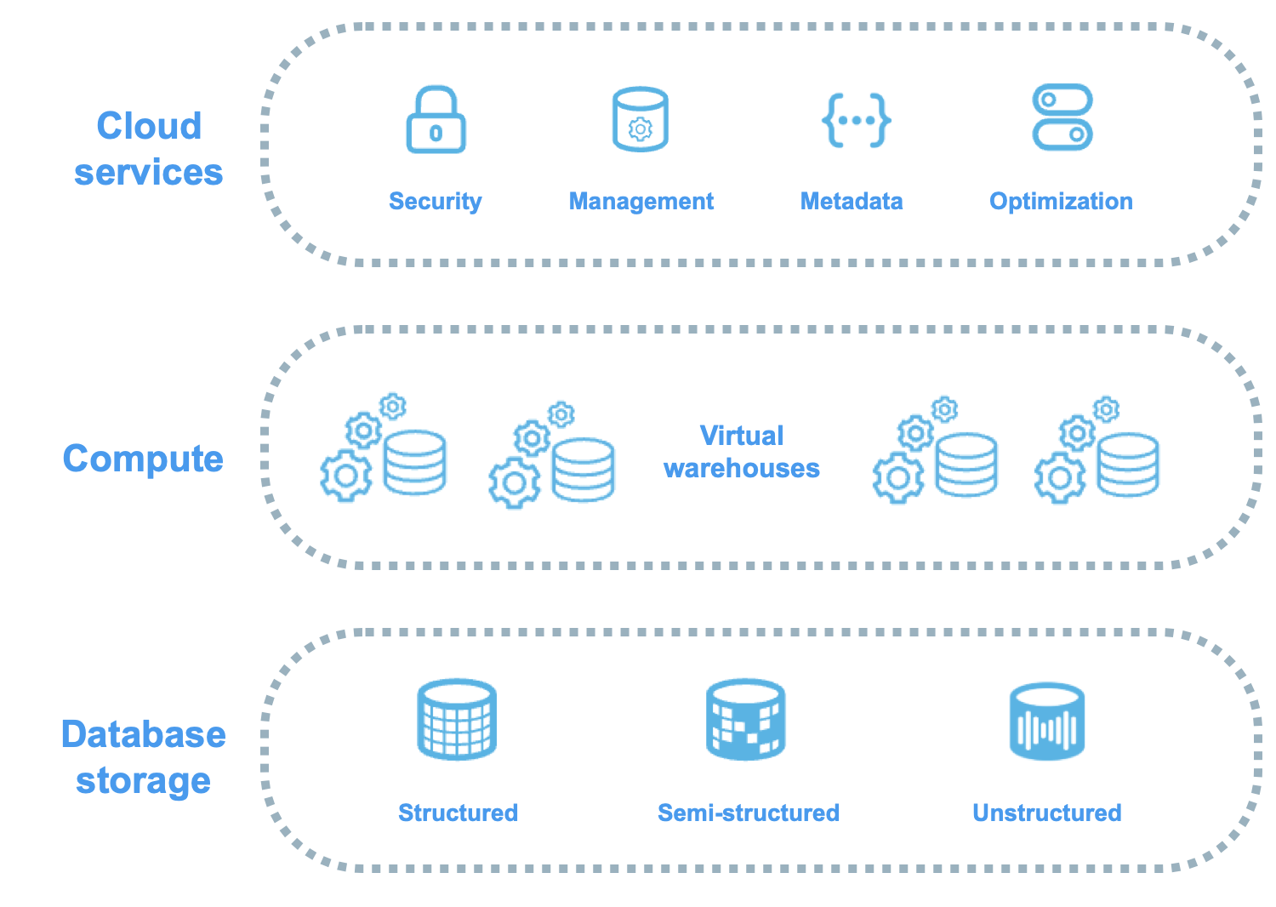
Snowflake Cloud Architecture
Snowflake has 3 main layers:
Storage Layer
Compute Layer (Virtual Warehouses)
Cloud Services Layer

Slide 7
Snowflake Cloud Architecture - Storage Layer
Stores data in cloud storage
Compressed & columnar format
Automatically partitioned into micro-partitions
Managed by Snowflake
User does NOT manage files.

Slide 8
Snowflake Cloud Architecture - Storage Layer
Snowflake supports the following kinds of data:
Structured data — such as rows and columns in a table — follows a strict tabular schema.
Semi-structured data — such as a JSON file or an XML file — has a flexible schema.
Unstructured data — such as a document, image, or audio file — has no inherent schema.
Snowflake supports several types of tables for data storage, including the following table types:
Snowflake tables
Apache Iceberg™ tables
Hybrid tables
Refer : https://docs.snowflake.com/en/user-guide/intro-key-concepts

Slide 9
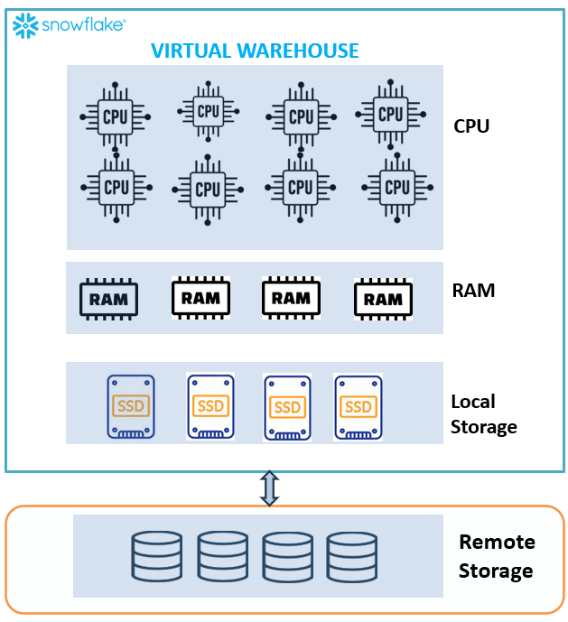
Snowflake Cloud Architecture - Compute Layer (Virtual Warehouses)
A virtual warehouse, often referred to simply as a “warehouse”, is a cluster of compute resources in Snowflake. A virtual warehouse is available in two types:
  Standard
  Snowpark-optimized
Executes queries
Can create multiple warehouses
Each warehouse is independent
Auto start / Auto suspend
Example:
BI team → Warehouse A
Data Engineering → Warehouse B
Data Science → Warehouse C
No resource contention!
Notes:
A warehouse provides the required resources, such as CPU, memory, and temporary storage, to perform the following operations in a Snowflake session:
Executing SQL SELECT statements that require compute resources (for example, retrieving rows from tables and views).
Performing DML operations, such as:
Updating rows in tables (DELETE , INSERT , UPDATE).
Loading data into tables (COPY INTO <table>).
Unloading data from tables (COPY INTO <location>).

Slide 10
Snowflake Cloud Architecture - Cloud Services Layer
The cloud services layer is a collection of services that coordinate activities across Snowflake. These services tie together all of the different components of Snowflake in order to process user requests, from sign-in to query dispatch. The cloud services layer also runs on compute instances that are provisioned by Snowflake from the cloud provider.
Services managed in this layer include the following:
  Security, authentication, and access control
  Snowflake Horizon Catalog
  Infrastructure management with cloud platforms
  Metadata management, including the SNOWFLAKE database and the Snowflake Information Schema
  Query parsing and optimization
  Regulatory compliance
Handles:
  Authentication
  Metadata
  Query optimization
  Transaction management
  Access control
Think of it as the “brain” of Snowflake.

Slide 11
Key Features- Virtual Warehouses
Independent compute clusters
Scale up (XS → 6XL)
Scale out (multi-cluster)
Auto suspend to save cost
Example:
  CREATE WAREHOUSE training_wh
  WAREHOUSE_SIZE = 'XSMALL'
  AUTO_SUSPEND = 60
  AUTO_RESUME = TRUE;

Slide 12
Key Features- Time Travel
Allows you to:
Query old data
Restore deleted tables
Recover from accidental DELETE
Example:
SELECT * FROM employees AT (TIMESTAMP => '2026-02-10 10:00:00’);
Retention:
Standard: 1 day
Enterprise: up to 90 days

Slide 13
Key Features- Zero-Copy Cloning
Instantly clone:
  Databases
  Schemas
  Tables
No physical copy
No extra storage cost (initially)
Example:
CREATE DATABASE test_db CLONE prod_db;
Used heavily in:
Testing
Dev environments
CI/CD pipelines

Slide 14
Key Features- Micro-partitions
Snowflake automatically:
  Divides data into 50–500 MB chunks
  Stores metadata about each partition
  Uses pruning for faster queries
Benefit:
  No manual indexing required
  Automatic optimization

Slide 15
Hands-On Labs (Practical Session)
LAB 1: Log in to Snowflake
Steps:
Go to Snowflake account URL
Enter:
  Account identifier
  Username
  Password
Select role (e.g., ACCOUNTADMIN)
Select warehouse

Slide 16
LAB 2: Explore Snowflake UI
In Snowsight explore:
Worksheets
Write SQL
Execute queries
View results
Databases
Logical container
Contains schemas
Schemas
Namespace inside database
Contains tables, views, stages
Warehouses
Compute engine
Start/Stop
Monitor usage

Slide 17
LAB 3: Create First Database and Schema
Step 1: Create Database
  CREATE DATABASE training_db;
  Verify:
    SHOW DATABASES;
Step 2: Use Database
    USE DATABASE training_db;
Step 3: Create Schema
  CREATE SCHEMA raw_layer;
  Verify:
    SHOW SCHEMAS;
Step 4: Create Warehouse
  CREATE WAREHOUSE training_wh
  WAREHOUSE_SIZE = 'XSMALL'
  AUTO_SUSPEND = 60
  AUTO_RESUME = TRUE;

Slide 18
LAB 3: Create First Database and Schema
Step 5: Use Warehouse
  USE WAREHOUSE training_wh;
Step 6: Create Sample Table
CREATE TABLE employees (
    emp_id INT,
    name STRING,
    department STRING,
    salary NUMBER
);
Step 7: Insert Data
  INSERT INTO employees VALUES
  (1, 'Rahul', 'IT', 50000),
  (2, 'Anita', 'HR', 40000);
Step 8: Query Data
  SELECT * FROM employees;

Slide 19
Practice Questions
Practice Exercise (Assignment for Learners)
Task 1
  Create:
  Database: company_db
  Schema: sales
  Warehouse: sales_wh
Task 2
  Create table:
  CREATE TABLE orders (
  order_id INT,
  customer_name STRING,
  amount NUMBER,
  order_date DATE
  );
Insert 5 records and query them.

Slide 20
Concept Reinforcement Questions
Why is separation of compute and storage important?
What problem does Virtual Warehouse solve?
What is Zero-Copy cloning and where is it useful?
How is Snowflake different from traditional RDBMS?
What are micro-partitions?

Slide 21
Why is separation of compute and storage important?
In traditional databases like Oracle Database or MySQL, storage and compute are tightly coupled.
In Snowflake, they are completely independent.
This architectural decision is one of the biggest reasons Snowflake is scalable and cloud-optimized.
Let’s break it down clearly.
Independent Scaling (Elasticity)
Better Performance & Concurrency
Cost Optimization (Pay for What You Use)
No Infrastructure Management
Workload Isolation
Faster Innovation & Dev/Test Environments

Slide 22
Independent Scaling (Elasticity)
Traditional System:
  If storage grows → you must upgrade the entire server (CPU + RAM + Disk).
Snowflake:
  Storage scales automatically in cloud object storage.
  Compute (Virtual Warehouse) scales separately.
Example:
  Your data grows from 1TB → 20TB
  You do NOT need to increase compute.
  Only storage cost increases.
Similarly:
  Heavy reporting load?
  Increase warehouse size temporarily.
✔ No over-provisioning
✔ True elasticity

Slide 23
Better Performance & Concurrency
In traditional databases:
  Multiple teams share the same CPU & memory.
  Heavy query slows everyone down.
In Snowflake:
  Each team can use a separate Virtual Warehouse.
  Warehouses do NOT compete for compute.
Example:
  BI Team → BI_WH
  Data Engineering → ETL_WH
  Data Science → DS_WH
  Each warehouse runs independently.
✔ No query blocking
✔ High concurrency
✔ Predictable performance

Slide 24
Cost Optimization (Pay for What You Use)
Snowflake pricing model:
  Storage → charged per TB
  Compute → charged per second while warehouse runs
Warehouses can:
  Auto-suspend
  Auto-resume
Example:
  If warehouse is idle for 5 minutes → it shuts down automatically.
  In traditional systems:
  Server runs 24/7 → cost is fixed.
✔ Lower operational cost
✔ Efficient resource usage

Slide 25
No Infrastructure Management
In legacy systems:
  Need capacity planning
  Need hardware upgrades
  Need disk management
In Snowflake:
  Storage is managed automatically in cloud.
  Compute clusters are abstracted.
✔ No DBA tuning required
✔ No index management
✔ No partition management

Slide 26
Workload Isolation
Different workloads behave differently:
Because compute is separate:
  You can assign different warehouse sizes.
  ✔ Proper workload isolation
  ✔ Optimized performance per team
Workload | Needs
ETL Jobs | Heavy compute
BI Reports | Medium compute
Data Science | Large memory
Ad-hoc Queries | Small compute

Slide 27
Faster Innovation & Dev/Test Environments
Since storage is shared but compute is independent:
  Developers can spin up small warehouses
  Testing can happen without impacting production
Combine this with:
  Time Travel
  Zero-Copy Cloning
You get extremely flexible environments.

Slide 28
Separation of compute and storage enables:
✔ Independent scaling
✔ High concurrency
✔ Cost efficiency
✔ Workload isolation
✔ Elastic cloud architecture
✔ No infrastructure headache

Slide 29
What problem does Virtual Warehouse solve?
In Snowflake, a Virtual Warehouse is the compute engine that runs SQL queries.
It solves one major problem that traditional databases like Oracle Database or MySQL struggle with:
⚠️ Resource contention and performance bottlenecks

Slide 30
Core Problem #1: Resource Contention
In Traditional Databases
  One server
  One CPU pool
  One memory pool
  Everyone shares resources
If:
  ETL job runs → CPU spikes
  BI team runs reports → slow
  Data scientist runs heavy query → everything blocks
All users compete for the same compute.

Slide 31
Virtual Warehouse Solution
Snowflake separates compute into independent clusters called Virtual Warehouses.
Each warehouse:
  Has its own CPU
  Has its own memory
  Runs independently
  Does not share compute with others
Example:
Now:
✔ ETL won’t slow BI
✔ BI won’t affect data science
✔ Complete workload isolation
Team | Warehouse
BI | BI_WH
ETL | ETL_WH
Data Science | DS_WH

Slide 32
Core Problem #2: Scaling Limitations
Traditional scaling:
  Increase entire server size
  Expensive
  Risky
  Requires downtime
With Virtual Warehouses:
Scale Up
Increase size:
XSMALL → SMALL → MEDIUM → LARGE
Scale Out
  Enable multi-cluster for concurrency
  No downtime required.

Slide 33
Core Problem #3: Cost Inefficiency
Traditional systems:
  Server runs 24/7
  Fixed cost
Virtual Warehouses:
  Auto suspend when idle
  Auto resume when query runs
  Charged per second
Example:
CREATE WAREHOUSE etl_wh
WAREHOUSE_SIZE = 'SMALL'
AUTO_SUSPEND = 60
AUTO_RESUME = TRUE;
Pay only when queries run

Slide 34
Core Problem #4: Unpredictable Performance
In shared systems:
  Query timing unpredictable
  Heavy jobs block smaller queries
Virtual Warehouse ensures:
  ✔ Dedicated compute
  ✔ Predictable performance
  ✔ High concurrency

Slide 35
Real-World Example
Imagine a company:
  9 AM: BI team runs dashboards
  10 AM: Data engineers run ETL
  11 AM: Data scientists train models
Without Virtual Warehouse:
System crashes or slows down.
With Virtual Warehouses:
Each team has separate compute clusters.
System remains stable.
Notes:
A Virtual Warehouse solves the problem of resource contention, scaling limitations, workload interference, and cost inefficiency by providing independent, elastic, and auto-managed compute clusters.

Slide 36
Summary
Virtual Warehouse provides:
  ✔ Workload isolation
  ✔ Independent scaling
  ✔ High concurrency
  ✔ Cost control
  ✔ Auto suspend/resume
  ✔ No performance interference

