Slide 1
Java Database Connectivity (JDBC)

Slide 2
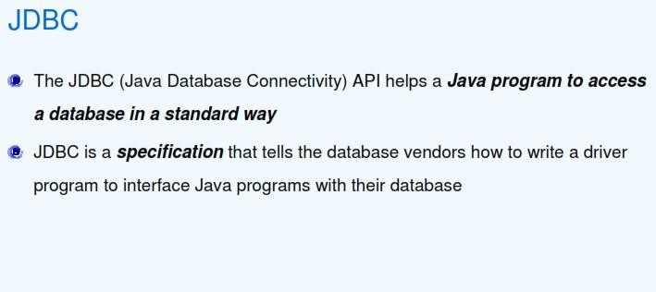
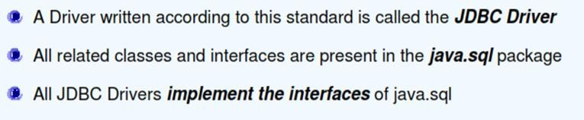
What is JDBC?

Slide 3
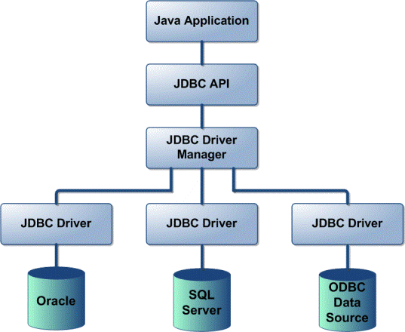
JDBC Architecture
JDBC Architecture consists of two layers:
JDBC API: This provides the application-to-JDBC Manager connection.
JDBC Driver API: This supports the JDBC Manager-to-Driver Connection.
The JDBC driver manager ensures that the correct driver is used to access each data source. The driver manager is capable of supporting multiple concurrent drivers connected to multiple heterogeneous databases.
The JDBC API uses a driver manager and database-specific drivers to provide transparent connectivity to heterogeneous databases.
Java Database Connectivity (JDBC) API library Versions:
The JDBC 1.0 API
The JDBC 1.2 API
The JDBC 2.0 API
The JDBC 3.0 API
Latest as on current date: The JDBC 4.0 API

Slide 4
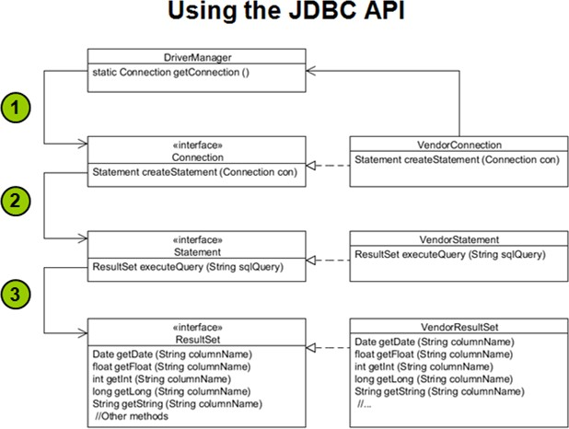
JDBC API

Slide 5
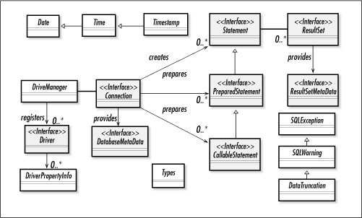
JDBC API

Slide 6
JDBC API
The JDBC API is made up of some concrete classes, such as Date, Time, and SQLException, and a set of interfaces that are implemented in a driver class that is provided by the database vendor.
Because the implementation is a valid instance of the interface method signature, once the database vendor’s Driver classes are loaded, you can access them by following below sequence:
Use the class DriverManager to obtain a reference to a Connection object using the getConnection method . The typical signature of this method is getConnection (url, name, password), where url is the JDBC URL, and name and password are strings that the database will accept for a connection.
Use the Connection object (implemented by some class that the vendor provided) to obtain a reference to a Statement object through the createStatement method. The typical signature for this method is createStatement () with no arguments.
Use the Statement object to obtain an instance of a ResultSet through an executeQuery (query) method. This method typically accepts a string (query) where query is a static string SQL.

Slide 7
JDBC Driver Types
JDBC Drivers Types:
JDBC driver implementations vary because of the wide variety of operating systems and hardware platforms in which Java operates.
Sun has divided the implementation types into four categories:
Type 1 - JDBC-ODBC Bridge Driver
Type 2 - JDBC-Native API Driver
Type 3 - Network Protocol Driver
Type 4 - Native Protocol Driver

Slide 8
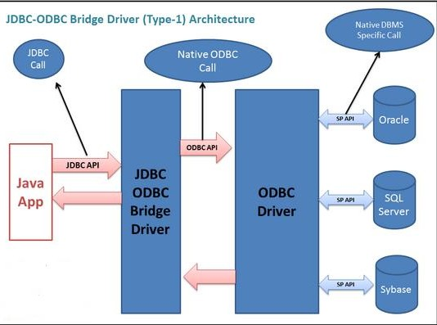
Type 1: JDBC-ODBC Bridge Driver
In a Type 1 driver, a JDBC bridge is used to access ODBC(Open database Connectivity) drivers installed on each client machine. Using ODBC requires configuring on your system a Data Source Name (DSN) that represents the target database.
The JDBC type 1 driver, also known as a JDBC-ODBC Bridge converts JDBC methods into ODBC function calls. Sun has provided JDBC-ODBC Bridge driver, sun.jdbc.odbc.JdbcOdbcDriver
When Java first came out, this was a useful driver because most databases only supported ODBC access but now this type of driver is recommended only for experimental use or when no other alternative is available.
Advantage:
Can Connect to almost any database on any
system, for which ODBC driver is installed.
Easier installation
Disadvantage:
The ODBC Driver needs to be installed on the client machine.
This driver is platform dependent as it uses ODBC and ODBC depends on native libraries of the operating system
Not suitable for applets because the ODBC driver is required on all client machines.

Slide 9
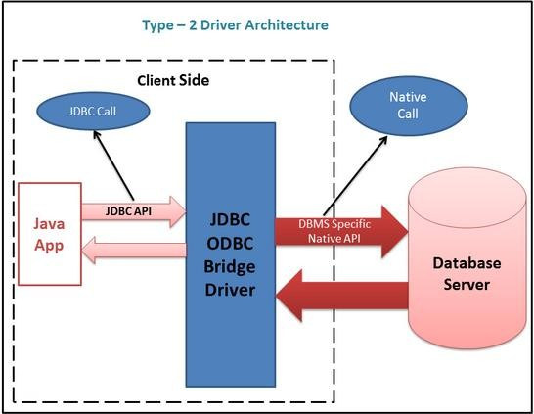
Type 2: JDBC-Native API
In Type 2 driver, JDBC API calls are converted into native C/C++ API calls which are unique to the database. These drivers are typically provided by the database vendors .
The JDBC type 2 driver uses the libraries of the database which are available at client side and this driver converts the JDBC method calls into native calls of the database. Due to this reason this driver is also known as a Native-API driver.
This type of driver is now obsolete

Slide 10
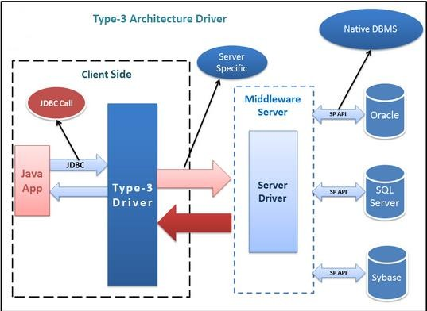
JDBCType 3 driver: Network-protocol Driver
The JDBC type 3 driver is installed in the middle tier(application server) .
This middle tier converts JDBC method calls into the vendor specific database protocols .
Type 3 driver can be used for multiple databases. Due to this reason these drivers
are also known as a Network-Protocol drivers.
Advantage:
There is no need for the vendor database library on the client machine because middleware is database independent and it communicates with client.
Type 3 driver can be used in any web application as well as on internet also because there is no software required at client side.
A single driver can handle any
database
The middleware server can also provide the typical services such as connections, auditing, load balancing, logging etc.
Disadvantage:
(1) An Extra layer is needed.

Slide 11
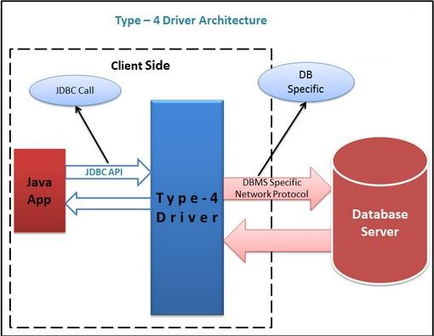
JDBCType 4 driver: Native protocol Driver
Type 4 driver is a pure Java-based driver that communicates directly with vendor's database through socket connection.
This is the highest performance driver available for the database and is usually
provided by the vendor itself.
This kind of driver is extremely flexible, you don't need to install special software on the client or server. Further, these drivers can be downloaded.
MySQL's Connector/J driver is a Type 4 driver.
Because of the proprietary nature of their network protocols, database vendors usually supply type 4 drivers.

Slide 12
Which Driver ?
If you are accessing only one type of database, such as Oracle, Sybase, or IBM, the preferred driver is Type 4.
If your Java application is accessing multiple types of databases at the same time, Type 3 is the preferred driver.
Type 2 drivers are useful in situations where a type 3 or type 4 drivers are not yet available for your database.
The Type 1 driver is not considered as a deployment-level driver and is
typically used for development and testing purposes only.

Slide 13
JDBC Type 4 Drivers of well-known Databases
Oracle : is an object-relational database management system produced and marketed by Oracle Corporation. Latest Version is: Oracle 11g
Oracle JDBC Type 4 driver: ojdbc6.jar : contains classes for use in JDK 1.6
http://www.oracle.com/technetwork/database/features/jdbc/index-091264.html
MySQL : is open source SQL database management system, is developed, distributed, and supported by Oracle Corporation. Latest Version is: MySQL5.6.12
MySQL JDBC Type 4 driver: mysql-connector-java-5.1.25
http://dev.mysql.com/downloads/mysql/
JavaDB ( Apache Derby) : is an open source RDBMS implemented entirely in Java . Latest Version is: db-derby-10.9.1.0
JavaDB JDBC Type 4 driver: derby.jar
Download the database from http://db.apache.org/derby/releases/release-10.9.1.0.cgi
derby.jar is the JDBC Type 4 driver provided in <installation_path\ db-derby-10.9.1.0-bin\lib
4. SQL * Server : Relational database management system developed by Microsoft. Latest Version: SQL Server 2012
SQL*Server JDBC Type 4 driver: Microsoft JDBC Driver 4.0 is the Official
Microsoft JDBC driver for SQL Server (sqljdbc_4.0.2206.100_enu.exe )
http://www.microsoft.com/en-us/sqlserver/default.aspx

Slide 14
Type-4 Driver Classes, Port Numbers and URI of well-known databases
Type-4 driver classes of well-known databases
SQL Server : Oracle : MySQL :
com.microsoft.jdbc.sqlserver.SQLServerDriver oracle.jdbc.OracleDriver com.mysql.jdbc.Driver
Database | Default Port Number | URI ( Using Type-4 Drivers )
MySQL | 3306 | jdbc:mysql://localhost:3306
JavaDB (Derby) | 1527 | jdbc:derby://localhost:1527
Oracle | 1521 | jdbc:oracle:thin:@//server:1521/SERVICE_NAME
SQL * Server | 1443 | jdbc:sqlserver://localhost:1433
The purpose of ports is to uniquely identify different applications or processes running on a single computer and thereby enable them to share a single physical connection to a packet-switched network like the Internet.

Slide 15
Building a JDBC application
Following are the six steps involved in building a JDBC application:
Import the packages : Include the packages containing the JDBC classes needed
for database programming. Most often, import java.sql.*
Register/Loading the JDBC driver : Initialize a driver so that we can open a communications channel with the database.
Open a connection : Requires using the DriverManager.getConnection() method to create a Connection object, which represents a physical connection with the database.
Execute a query : Requires using an object of type Statement for building and submitting an SQL statement to the database.
Extract data from result set : Use appropriate ResultSet.getXXX() method to retrieve the data from the result set.
Clean up the environment . Requires explicitly closing all database resources
versus relying on the JVM's garbage collection.
Loading the type 4 driver:
Class.forname(“Driver_classname");
Ex.
Class.forName ("oracle.jdbc.OracleDriver");
The class Loader of JVM loads the specified Driver class into the memory at run-time.

Slide 16
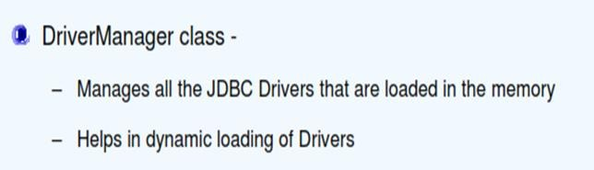
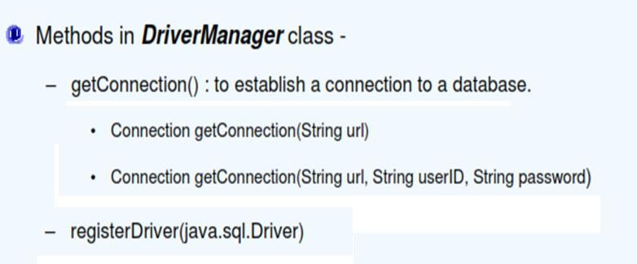
DriverManager class
Class.forName("com.mysql.jdbc.Driver");
Connection connection= DriverManager.getConnection("jdbc:mysql://localhost:3306/electronics","root",“root");

Slide 17
DriverManager class: Connecting through Type 4 drivers
Connecting to MySQL database
Class Loader of JVM loads the specified
Class.forName("com.mysql.jdbc.Driver");
Driver class into the memory at run-time
password
Connection connection=
DriverManager.getConnection("jdbc:mysql://localhost:3306/tutorial,"root",“root");
URI
User-id
Establishes connection to the specified database and returns Connection object
Port
number
Connecting to Oracle database
Class.forName ("oracle.jdbc.OracleDriver"); // Load the Driver class Connection connnection = DriverManager.getConnection("jdbc:oracle:thin:@localhost:1521:orcl","scott","tiger");
SID
(system identifier)

Slide 18
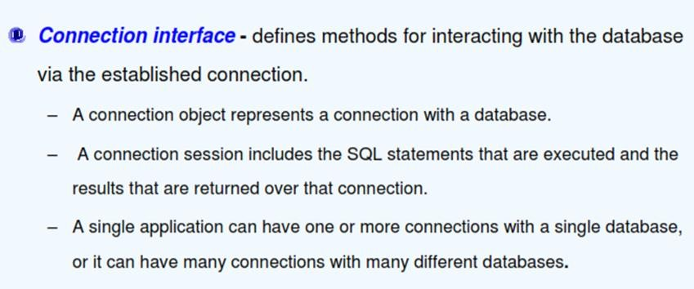
Connection Interface
We obtain the connection object by the following statement:
Connection connnection = DriverManager.getConnection("jdbc:oracle:thin:@localhost:1521:orcl","scott","tiger");

Slide 19
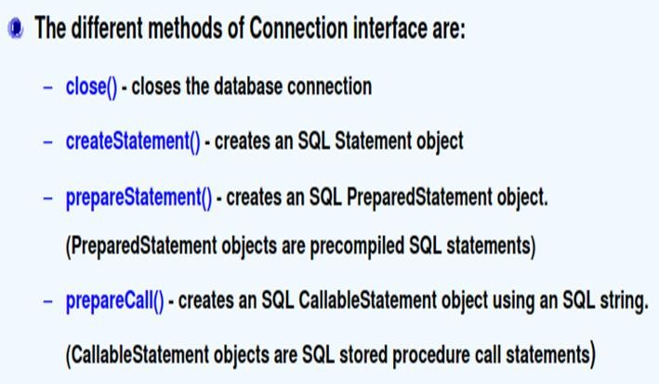
Connection Interface methods
Statement statement = connection.createStatement(); //Creates a SQL statement

Slide 20
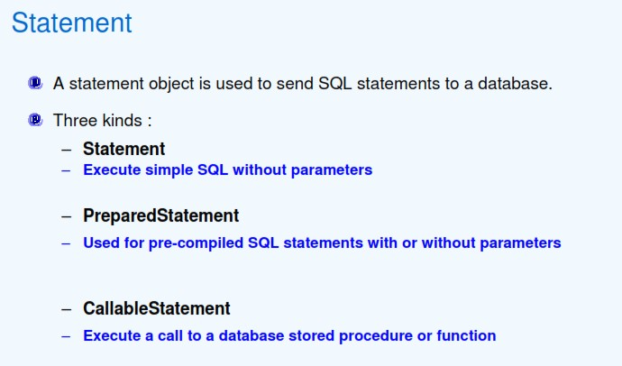
Statement Interface
PreparedStatement and CallableStatement are the interfaces that extend Statement interface

Slide 21
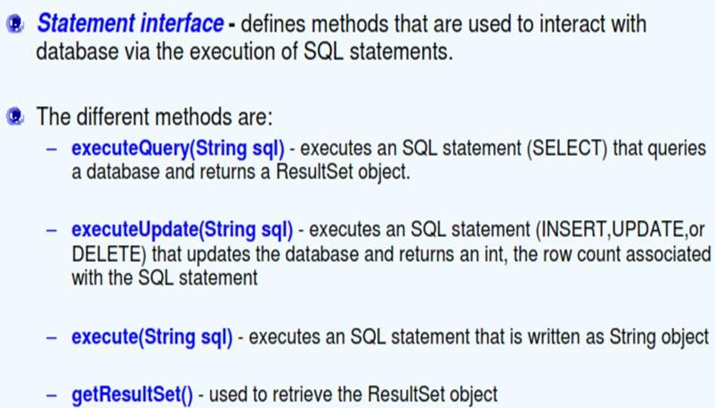
Statement Interface methods

Slide 22
OracleConnection Utility class
Java Project : JDBCProject
public class OracleConnection { static{
try {
Class.forName("oracle.jdbc.OracleDriver");
} catch (ClassNotFoundException e) {
// TODO Auto-generated catch block
e.printStackTrace();
After creating the java project,
load the JDBC Type 4 jar file into project’s class path.
}
}
public static Connection getConnection(){ try {
Connection connection =
DriverManager.getConnection("jdbc:oracle:thin:@//localhost:1521/orcl","scott","tiger"); return connection;
} catch (SQLException e) {
// TODO Auto-generated catch block e.printStackTrace();
return null;
}
}
}

Slide 23
Checking the connectivity to oracle database
public class OracleConnectionTester {
public static void main(String[] args) {
Connection connection=null; try{
connection = OracleConnection.getConnection(); if(connection!=null){ System.out.println("Connection is successful");
}else{
System.out.println("Unable to connect");
}
}
catch(Exception exception){
exception.printStackTrace();
}
Java Project : JDBCProject
finally{ try {
if(connection!=null){
connection.close();
}
} catch (SQLException e) {
e.printStackTrace();
}
}
}
}

Slide 24
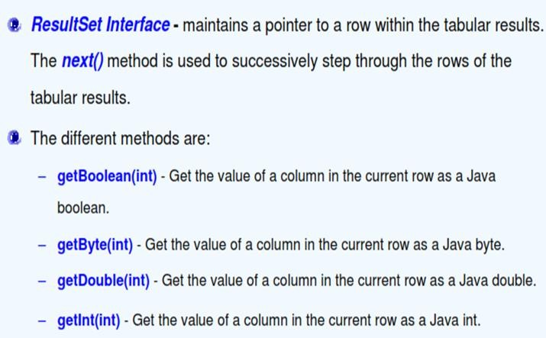
ResultSet Interface

Slide 25
ResultSet Interface
Result set(Memory)
Table ( Hard Drive)
program
1 Smith New York
Clark
Ravi Kumar
. . .
. . .
Sydney
Mumbai
ResultSet resultSet= statement.executeQuery("select * from tutorial.city");
System.out.println("Sno Name City");
while(resultSet.next()){
System.out.print(resultSet .getInt(1)+ " "); // resultSet.getInt(“Sno”); System.out.print(resultSet .getString(2)+ " "); System.out.print(resultSet .getString(3));
System.out.println(" ");
}
A ResultSet object maintains a cursor pointing to its current row of data.
Initially the cursor is positioned before the first row.
The next() method moves the cursor to the next row, and because it returns false when there are no more rows in the ResultSet object, it can be used in a while loop to iterate through the result set.
The ResultSet interface provides getter methods (getBoolean, getLong, and so
on) for retrieving column values from the current row. Values can be retrieved
using either the index number of the column or the name of the column.

Slide 26
Adding JDBC Type-4 driver to your project in Eclipse IDE
Right-Click on the project name
Click on Properties
In the Properties for Project Name window, Select Java Build Path
Click on Libraries Tab
Click on Add External JARs… button
Opens File dialog box, open the folder that contains JDBC driver jar file,
select the file and click on Open button
You will observe JDBC driver jar file placed in the Libraries tab, click on OK button
In the Package Explorer, Under your Project Name, you will find JDBC jar file
in Referenced Libraries

Slide 27
Type-4 driver Example : Querying table
Demo Activity
Java Project: JDBCProject
public class EmployeeDetails {
public static void main(String [] args) throws Exception{ Connection connection=null; ResultSet resultSet=null; try{
connection = MyOracleConnection.getConnection();
Statement statement = connection.createStatement(); //Create a SQL statement resultSet = statement.executeQuery("select * from employee"); // Execute the query System.out.println("Empno Ename Job Hiredate Salary Commission Deptno"); while(resultSet .next()){
System.out.print(resultSet .getInt(1)+ " "); System.out.print(resultSet .getString(2)+ " "); System.out.print(resultSet .getString(3)+" "); System.out.print(resultSet .getDate(4)+" "); System.out.print(resultSet .getDouble(5)+" "); System.out.print(resultSet .getDouble(6)+" "); System.out.println(resultSet .getInt(7)+" "); System.out.println(" ");
}
}
catch(SQLException exception){ exeption.printStackTrace();} finally{
if(connection != null){
connection.close(); resultSet.close();}}}}

Slide 28
statement.executeUpdate method
Demo Activity
Java Project: JDBCProject
Class name : UpdateEmployee
………..
int count= statement.executeUpdate("delete from employee where empno=1014");
System.out.println(“No. of rows deleted: “+ count);
int count= statement.executeUpdate("insert into employee
values(1015,‘James',‘PROGRAMMER’,’05-SEP-2010’,4500.0,null,10)");
System.out.println(“No. of rows inserted: “+ count);
int count= statement.executeUpdate(“update employee set comm=100.00 where comm is null”);
System.out.println(“No. of rows updated: “+ count);
………..
//in the catch block,
Note: Oracle date format is : DD-MON-YYYY

Slide 29
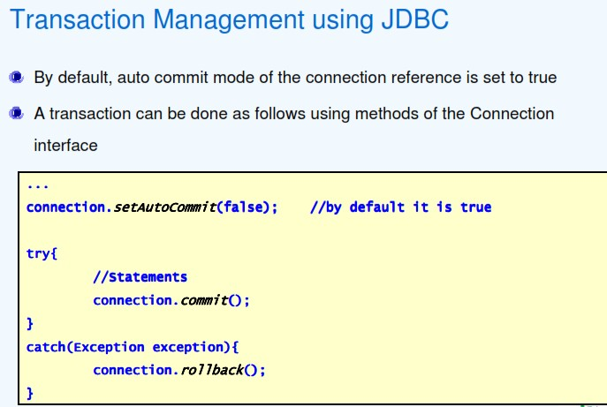
Commit and Rollback

Slide 30
statement.executeUpdate method
Demo Activity
Java Project: JDBCProject
Class name : UpdateEmployee
try{
………..
connection.setAutoCommit(false);
int count= statement.executeUpdate(“update employee set salary =salary+0.10*salary”);
System.out.println(“No. of rows updated: “+ count);
int count= statement.executeUpdate("delete from employee where empno=1014"); System.out.println(“No. of rows deleted: “+ count);
int count= statement.executeUpdate("insert into employee values(1020,‘Jim',‘CLERK’,’15-SEP-
2012’,1500.0,null,10)");
System.out.println(“No. of rows inserted: “+ count);
connection.commit();
}
…..
// In the catch block, connection.rollback();
………..

Slide 31
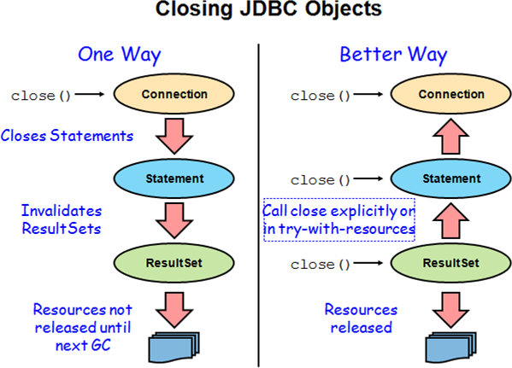
Closing JDBC objects

Slide 32
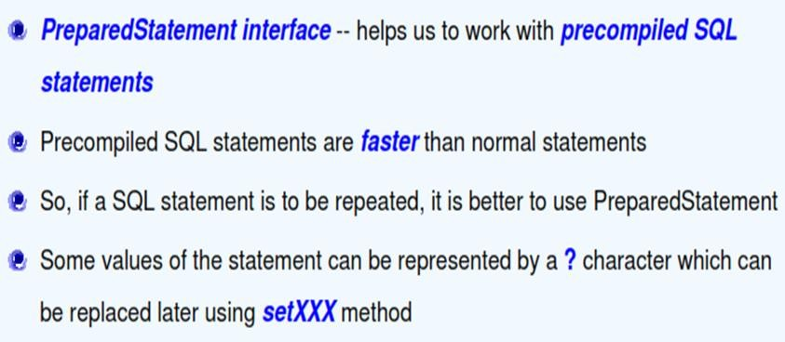
PreparedStatement Interface
Example:
String sql = "SELECT * FROM tutorial.employee WHERE empno = ?" ; PreparedStatement preparedStatement = connection.prepareStatement(sql); preparedStatement.setInt(1,4); // here 1 indicates 1st placeholder and 4 indicates empno resultSet = preparedStatement.executeQuery();

Slide 33
PreparedStatement example
Demo Activity
Java Project: JavaJDBCProject
…….
String str= "SELECT * FROM EMPLOYEE where salary > ? and job =?";
Connection connection=null; PreparedStatement preparedStatement = null; ResultSet resultSet =null;
try{
connection = MyOracleConnection.getConnection();
preparedStatement = connection.prepareStatement(str); preparedStatement.setDouble(1,2000.50); preparedStatement.setString(2, "DEVELOPER"); resultSet = preparedStatement.executeQuery();
if(resultSet != null{
// display employee details
}
}
……………….

Slide 34
Scrollable and Updatable ResultSet
A default ResultSet object is not updatable and has a cursor that moves forward only. Thus, we can iterate through it only once and only from the first row to the last row.
It is possible to produce ResultSet objects that are scrollable and/or updatable.
The following code fragment illustrates how to make a result set that is scrollable and insensitive to updates by others, and that is updatable.
// ResultSet object will be scrollable, will not show changes made by others and will be
updatable
Statement stmt = connection.createStatement( ResultSet.TYPE_SCROLL_INSENSITIVE, ResultSet.CONCUR_UPDATABLE);

Slide 35
Scrollable and Updatable ResultSet
A set of updater methods were added to this interface in the JDBC 2.0 API
The updater methods may be used in two ways:
to update a column value in the current row. In a scrollable ResultSet object, the cursor can be moved backwards and forwards, to an absolute position, or to a position relative to the current row.
The following code fragment updates the NAME column in the fifth row
of the ResultSet object rs and then uses the method updateRow() to
update the data source table from which rs was derived.
Do not use *
resultSet=statement.executeQuery("select empno,ename,job,salary,deptno from
employee");
resultSet.absolute(5); // moves the cursor to the fifth row of rs
// updates the NAME column of row 5 to be Ravi Kumar
resultSet.updateString(“ENAME", "Ravi Kumar"); resultSet.updateRow(); // updates the row in the data source

Slide 36
Scrollable and Updatable ResultSet
2. To insert column values into the insert row. An updatable ResultSet object has a special row associated with it that serves as a staging area for building a row to be inserted.
The following code fragment moves the cursor to the insert row, builds a three-column row, and inserts it into rs and into the data source table using the method insertRow().
rs.moveToInsertRow(); // moves cursor to the insert row
// updates the first column of the insert row to be David Smith
rs.updateString(1, "David Smith");
rs.updateInt(2,35); // updates the second column to be 35 rs.updateBoolean(3, true); // updates the third column to true rs.insertRow();
rs.moveToCurrentRow();

Slide 37
ResultSetMetaData
Demo Activity
To access the meta data information of database objects, use ResultSetMetaData interface.
Create instance of ResultSetMetaData as shown below :
ResultSetMetaData resultSetMetaData=resultSet.getMetaData();
By invoking the instance methods , we can access information such as column names, number of columns etc.
………
ResultSetMetaData resultSetMetaData = resultSet.getMetaData();
int count=resultSetMetaData.getColumnCount();
System.out.println("No. of columns in employee table: "+ count);
System.out.println("Column Names...");
for(int i=1;i<=count;i++){
System.out.println(resultSetMetaData.getColumnName(i));
}

Slide 38
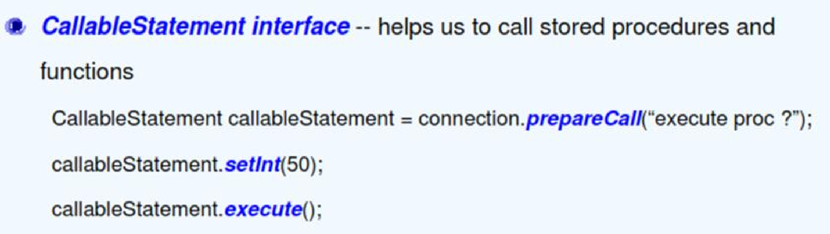
CallableStatement Interface
In Oracle

Slide 39
Creating stored procedure in Oracle
create or replace procedure PR_empName(emp_id IN NUMBER,emp_name OUT VARCHAR2)
AS
BEGIN
select ename into emp_name from employee where empno=emp_id; END; /
Formal parameter types are unconstrained in oracle
Parameter Modes:
IN ( is the default mode ) : IN indicates that a parameter can be passed into stored procedures but any modification inside stored procedure does not change parameter
OUT : indicates that stored procedure can change this parameter and pass back to the calling program.
IN OUT : We can pass parameter into stored procedure and get it back with the new value from calling program
The syntax of defining a parameter in stored procedure is as follows:
MODE parameter_name parameter_mode parameter_type

Slide 40
Another Example : stored procedure in Oracle
create or replace procedure get_emp_details(p_empno IN number, p_name OUT varchar2,
p_desig OUT varchar2,p_sal OUT number )
AS
begin
select ename,job,sal into p_name,p_desig,p_sal
from emp where empno = p_empno;
end//

Slide 41
Calling Oracle procedure from a java program
String call = "{ call PR_empName(?,?)}"; CallableStatement cstmt = connection.prepareCall(call); cstmt.setInt(1, id);
cstmt.registerOutParameter(2, oracle.jdbc.OracleTypes.VARCHAR); cstmt.executeQuery();
name = cstmt.getString(2);

Slide 42
Stored function in Oracle
create or replace function getEmployeeTotalPay(p_empno IN number) return number
as
v_total number:=0; begin
select sal+nvl(comm,0) into v_total from emp where empno=p_empno; return v_total;
exception
when others then return 0;
end;
/

Slide 43
Creating stored function in Oracle
create or replace function get_empName(emp_id IN NUMBER) RETURN VARCHAR2
AS
emp_name employee.ename%type; BEGIN
select ename into emp_name from employee where empno=emp_id;
return emp_name;
end;/
Calling Oracle function from a java program
String call = "{ ? := call get_empName(?)}"; CallableStatement cstmt = connection.prepareCall(call);
cstmt.registerOutParameter(1, oracle.jdbc.OracleTypes.VARCHAR);
cstmt.setInt(2, 1010);
cstmt.executeQuery(); name = cstmt.getString(1);
empno

Slide 44
Calling stored function in Oracle
private static double getEmployeeTotalPay(int empid) {
String sql="{call ? :=getEmployeeTotalPay(?)}"; try(Connection connection=MyOracleConnection.getConnection();
CallableStatement callableStatement=connection.prepareCall(sql)
){
callableStatement.registerOutParameter(1, oracle.jdbc.OracleTypes.NUMBER); callableStatement.setInt(2, empid); callableStatement.executeQuery();
System.out.println("Total Pay= "+callableStatement.getDouble(1));
}
catch(SQLException e){
e.printStackTrace();
}
catch(Exception e){
e.printStackTrace();
}
return 0;
}

Slide 45
Converting java.util.Calendar to java.sql.Date object
Converting java.util.GregorianCalendar object to java.sql.Date object:
Ex. java.util.Calendar hdate = new java.util.GregorianCalendar(2014,2,15);
Convert java.util.Calendar to java.util.Date
java.util.Date mdate = hdate.getTime();
Convert java.util.Date to java.sql.Date
java.sql.Date ndate = new java.sql.Date(mdate.getTime());
Converting java.sql.Date to java.util.Calendar object
// convert java.sql.Date to java.util.Date
java.sql.Date sdate = resultSet.getDate("birthdate"); java.util.Date udate = new java.util.Date(sdate.getTime()); OR
java.util.Date date = java.sql.Date.valueOf(localDate);
// convert java.util.Date to java.util.Calendar java.util.Calendar cdate = Calendar.getInstance(); cdate.setTime(udate);

Slide 46
java.time.LocalDate to java.sql.Date and vice-versa
java.time.LocalDate of JDK 8
To convert from LocalDate to java.sql.Date :
LocalDate localDate= Local.of(2001,10,16);
java.sql.Date.valueOf( localDate );
To convert from java.sql.Date to LocalDate:
sqlDate.toLocalDate();

Slide 47

Thank You!

