Slide 1
Mastering the Spring Framework
Chapter 3:
Introduction to SpringBoot

Slide 2
Chapter Objectives
In this chapter, we will discuss:
Understanding what a Spring Boot & its features

Slide 3
What is SpringBoot?
It is a Spring module which provides RAD (Rapid Application Development) feature to Spring framework.
no requirement for XML configuration.
uses convention over configuration software design paradigm
It provides opinionated 'starter' POMs to simplify your Maven configuration.
It automatically configure Spring whenever possible.
It provides production-ready features such as metrics, health checks and externalized configuration.

Slide 4
Springboot features
Web Development
SpringApplication
Application events and listeners
Admin features
Externalized Configuration
Properties Files
YAML Support
Type-safe Configuration
Logging
Security

Slide 5
Starter Template
Spring Boot starters are templates that contain a collection of all the relevant transitive dependencies that are needed to start a particular functionality.
For example, If you want to create a Spring WebMVC application then in a traditional setup, you would have included all required dependencies yourself. It leaves the chances of version conflict which ultimately result in more runtime exceptions.
With String boot, to create MVC application all you need to import is spring-boot-starter-web dependency.

Slide 6
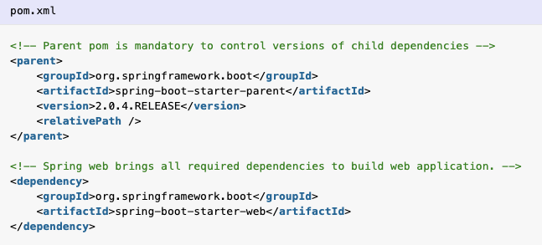
Starter Template

Slide 7
Spring boot autoconfiguration
Autoconfiguration is enabled with @EnableAutoConfiguration annotation.
Spring boot auto configuration scans the classpath, finds the libraries in the classpath and then attempt to guess the best configuration for them, and finally configure all such beans.
Auto-configuration tries to be as intelligent as possible and will back-away as you define more of your own configuration.
Auto-configuration is always applied after user-defined beans have been registered.
Spring boot auto-configuration logic is implemented in spring-boot-autoconfigure.jar.

Slide 8
Embedded Server
Spring boot applications always include tomcat as embedded server dependency.
It means you can run the Spring boot applications from the command prompt without needling complex server infrastructure.
You can exclude tomcat and include any other embedded server if you want. Or you can make exclude server environment altogether. It’s all configuration based.

Slide 9
Bootstrap the application
To run the application, we need to use @SpringBootApplication annotation.
Behind the scenes, that’s equivalent to @Configuration, @EnableAutoConfiguration, and @ComponentScan together.
It enables the scanning of config classes, files and load them into spring context.
execution start with main() method. It start loading all the config files, configure them and bootstarp the application based on application properties in application.properties file in /resources folder.

Slide 10
Advantages of Springboot
Spring boot helps in resolving dependency conflict. It identifies required dependencies and import them for you.
It has information of compitable version for all dependencies. It minimizes the runtime classloader issues.
It’s “opinionated defaults configuration” approach helps you in configuring most important pieces behind the scene. Override them only when you need. Otherwise everything just works, perfectly. It helps in avoiding boilerplate code, annotations and XML configurations.
It provides embedded HTTP server Tomcat so that you can develop and test quickly.

