Slide 1
Mastering the Spring Framework
CHAPTER 4:
REST WEB SERVICES WITH SPRING BOOT

Slide 2
Chapter Objectives
In this chapter, we will:
Introduce REST Web Services Introduce Spring Boot
Learn how to write REST Web services using Spring Boot

Slide 3
Chapter Concepts
Web Services
HTTP and JSON
RESTful Services
Spring Boot
Summary

Slide 4
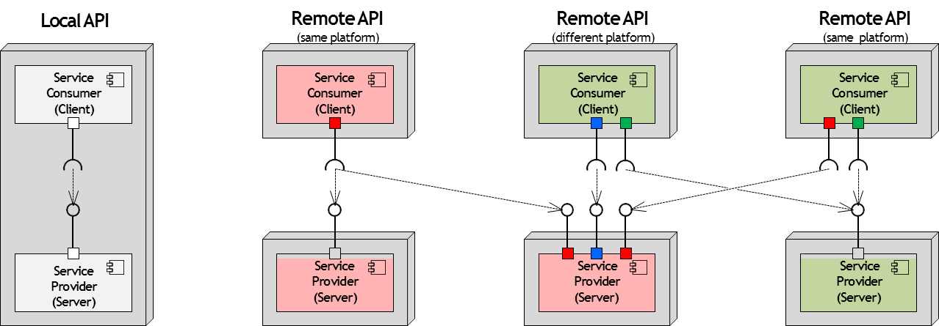
Application Programming Interface (API
API is a set of clearly defined methods of communication between various software components

Slide 5
Web Services
Web Service
Cross-platform way to integrate applications
Application functionality exposed over network, typically over WWW
Communication protocols: usually HTTP, but can use other protocols such as ESMTP, message queues, etc.
They provide great interoperability and extensibility They are loosely coupled
Can be combined to build complex applications
Components can be developed in different languages on different architectures

Slide 6
Types of Web Services
Simple Object Access Protocol (SOAP) Web Services
Interfaces defined using Web Services Description Language (WSDL)
Messages are exchanged in XML
Representational State Transfer (RESTful) Web Services
Lightweight infrastructure which is completely stateless
Implementations require minimal tooling

Slide 7
SOAP vs. REST: Typical Use Cases
Simple Object Access Protocol (SOAP) Web Services
RPC style of integration (verb-first)
System to System integration within a single enterprise or across enterprises
Presence or need for enterprise-wide integration standards (primarily WS-Security)
Strong formal service contracts and formal governance (in most cases)
Service consumers are known and very often formal agreements
Representational State Transfer (RESTful) Web Services
‘Document’ CRUD style of integration (noun-first)
Client (Browser) to System as well as System to System integration
Many ‘unknown’ consumers (client apps for Yahoo, Google, etc.—any Internet service)
Need for high adaptability and flexibility

Slide 8
REST – High-Level Overview
Representative State Transfer—REST or ReST
A software architecture style
Guidelines and best practices for creating scalable web services
Described in Roy Fielding's doctoral thesis
Typically communicates over HTTP Common data exchange format – JSON
REST was developed by W3C in parallel with HTTP 1.1
The World Wide Web is an implementation of REST
There is no official standard for REST APIs
REST is an architectural style
SOAP is a protocol which has standards
REST usually uses standards such as HTTP, URI, JSON, XML

Slide 9
Chapter Concepts
Web Services
HTTP and JSON
RESTful Services
Spring Boot
Summary

Slide 10
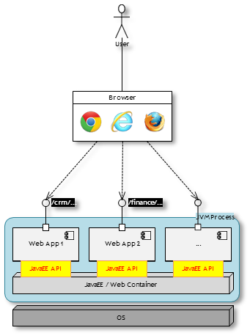
Web Applications and Web Containers
Web Application is a client–server computer program where:
The client (including the user interface and client-side logic) runs in a web browser
The server produces dynamic content (such as HTML pages) based on user actions
Java Web Applications are managed and executed by special middleware called ‘JavaEE container’ or ‘Web / Servlet Container’
Web Container is a runtime environment for web application which handles:
Network connectivity
Lifecycle management
Application security
Concurrency
Transactions
Etc.

Slide 11
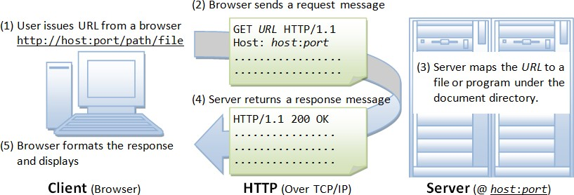
HTTP – HyperText Transfer Protocol

Slide 12
RESTful Service Implementation
Java RESTful services are deployed within JavaEE or Web Container
Same as Web Applications
Major differences between Web Application and RESTful Service implementations:
Data exchange format HTML vs. JSON/XML/…
Frameworks used
SpringMVC/Struts2 vs. DropWizard/Restlet
Some frameworks, such as PlayFramework or Spring Boot, can be used for both
Specifications adhered to ServletAPI vs. JAX-RS
Some implementations are ‘specification agnostic’, but follow common ‘request dispatch’ pattern
Client implementation
Browser vs. RESTful client (i.e., another application)

Slide 13
JSON
JavaScript Object Notation (JSON)
A lightweight data-interchange format derived from the ECMAScript (JavaScript)
Syntax defined in ECMA-404 – The JSON Data Interchange Standard
Easy for humans to read and write, easy for machines to parse and generate
JSON is built on two structures
Object (map): a collection of name:value pairs separated by comma
{"key1":"value1", "key2":"value2"}
Array (list): a collection of ordered values separated by comma
["value1", "value2", "value3"}]
JSON values can be:
Strings ("string1")
– Numbers (10, 3.141, 2.5E6)
Boolean (true or false)
null
Another Object or Array (map of lists, list of maps, map of maps, list of lists)

Slide 14
JSON – Combining Objects and Arrays
Objects and Arrays can be combined:
Family members aggregated by last name
{"Smiths": ["John", "Jane"],
"Jones" : ["Ann", "Dave", "Rob"]}
List of individuals (with ‘firstName’ – optional)
[
{"lastName": "Doe“
{"lastName": "Smith", "firstName": "John"},
{"lastName": "Smith", "firstName": "Jane"}
]
List of individuals (with ‘firstName’ – optional)
{"building1": {"1A": {"Smiths": ["John", "Jane" ]},
{"Jones" : ["Ann", "Dave", "Rob"]}},
{"2A": {"Kramer": ["Cosmo" ]}}
}

Slide 15
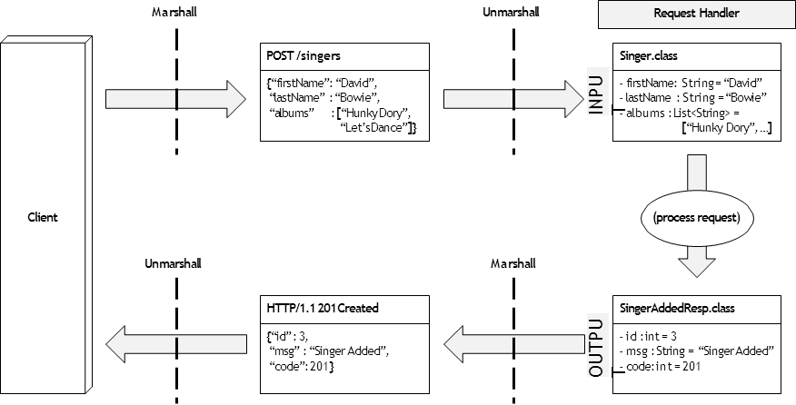
Request/Response (De-)Serialization (from)to JSON
Web Application is using JSP, JSF, or other templating engines to generate HTML response
Spring Boot framework is using special libraries to automatically convert Java objects (POJOs – Plain Old Java Objects) into JSON/XML and vice versa

Slide 16
Chapter Concepts
Web Services
HTTP and JSON
RESTful Services
Spring Boot
Summary

Slide 17
REST Principles
Application domain model (resources) are manipulated using standard set of actions
Resources are identified by Uniform Resource Identifiers (URIs) and organized into collections in a tree-like structure
E.g.: http://mydealership.com/locations/{locId}/cars/{carId}
Actions are normally represented via HTTP operations applied to any part of URI
GET, POST, DELETE, PUT, PATCH, etc.
Data can be exchanged in various formats, though most common ones are JSON and XML Interactions are stateless
Actions are used to change the state of the resource one at a time
Each call is normally independent from each other
Errors are handled via HTTP status codes
200: OK; 404: Resource Not Found; 400: Bad Request; 201: New Resource Created

Slide 18
REST Operations – GET
GET operation is a safe method and has no side effects (‘R’ in the CRUD)
Server-side content is unchanged
Request |  |  | Response
GET /inventory/cars/1 | HTTP/1.1 |  | HTTP/1.1 200 | OK
Host: mydealership.com |  |  | {"model" : | "honda",
 |  |  | "licPlate": | "BDK032",
 |  |  | "invId" : | 1}
GET /inventory/cars Host: mydealership.com | HTTP/1.1 |  | HTTP/1.1 200 [{"model" : | OK "honda",
 |  |  | "licPlate": | "BDK032",
 |  |  | "invId" : | 1},
 |  |  | {"model" : | "toyota",
 |  |  | "licPlate": "invId" : | "GAV101" 2}]

Slide 19
REST Operations – POST
POST operation is used to create resources (‘C’ in the CRUD)
Normal practice is to return a handler (id) to the created resource
Request Response
POST /inventory/cars HTTP/1.1 HTTP/1.1 201 Created
Host: mydealership.com {"model" : "ford",
{"model" : "ford", "licPlate": "KYE903",
"licPlate": "KYE903"} "invId" : 3}
{"invId" : 3}
OR, simply,
GET /inventory/cars/3 Host: mydealership.com
HTTP/1.1
HTTP/1.1 200 OK
{"model" : "ford", "licPlate": "KYE903",
"invId"
: 3}

Slide 20
REST Operations – PUT
PUT is an idempotent operation used to replace existing resource or create one if it doesn’t exist (‘C’ and ‘U’ in the CRUD)
Resource is replaced as a ‘whole’
Request |  |  | Response
GET /inventory/cars/1 Host: mydealership.com | HTTP/1.1 |  | HTTP/1.1 200 {"model" : "licPlate": | OK "honda", "BDK032", … }
PUT /inventory/cars/1 | HTTP/1.1 |  | HTTP/1.1 200 | OK
Host: mydealership.com {"model" : "tesla", "licPlate": "AAA001"} GET /inventory/cars/1 HTTP/1.1 Host: mydealership.com |  |  | (with optional mirroring back of updated resource) HTTP/1.1 200 OK {"model" : "tesla", "licPlate": "AAA001", … }

Slide 21
REST Operations – PATCH
PATCH is an operation used to update existing resource (‘U’ in the CRUD)
Only some attributes of the resource are updated
Not used too often due to ambiguity of operation to be used (default is ‘update’)
Request |  |  | Response
GET /inventory/cars/1 Host: mydealership.com | HTTP/1.1 |  | HTTP/1.1 200 {"model" : "licPlate": | OK "honda", "BDK032", … }
PATCH /inventory/cars/1 | HTTP/1.1 |  | HTTP/1.1 200 | OK
Host: mydealership.com {"model": "tesla"} GET /inventory/cars/1 HTTP/1.1 Host: mydealership.com |  |  | (with optional mirroring back of updated resource) HTTP/1.1 200 OK {"model" : "tesla", "licPlate": "BDK032", … }

Slide 22
REST Operations – DELETE
DELETE is an idempotent operation used to delete existing resource (‘D’ in the CRUD)
Request |  |  | Response
GET /inventory/cars/1 Host: mydealership.com | HTTP/1.1 |  | HTTP/1.1 200 {"model" : "licPlate": | OK "honda", "BDK032", … }
DELETE /inventory/cars/1 | HTTP/1.1 |  | HTTP/1.1 200 | OK
Host: mydealership.com GET /inventory/cars/1 HTTP/1.1 Host: mydealership.com |  |  | (with optional mirroring back of deleted resource) HTTP/1.1 404 Not Found

Slide 23
HTTP Status Codes
The HTTP protocol defines meaningful status codes
Which can be returned from a RESTful service
Using status codes can help service consumers
Determine how to understand the service response
Especially when errors occur
What is status code 418?
https://en.wikipedia.org/wiki/List_of_HTTP_status_codes

Slide 24
HTTP Status Codes (continued)
OK
Created
204 No Content
Bad Request
Unauthorized
403 Forbidden
404 Not Found
405 Method Not Allowed
410 Gone 418 ?
Response to a successful request
Response to POST that results in a resource creation Response to a successful request that does not return a body The request was malformed
Either invalid or missing authentication details in request User does not have access to the requested resource We’ve all been here before
The HTTP method is not allowed for this user The resource is no longer available

Slide 25
Why Should I Use a Status Code?
They communicate to the RESTful client
When an exceptional event occurs
When some special behavior is required
Many status codes represent situations that are worth handling with a special response Many widely used APIs are using them
A convention is being created
Following that convention makes it easier for users of your RESTful service
https://gist.github.com/vkostyukov/32c84c0c01789425c29a

Slide 26
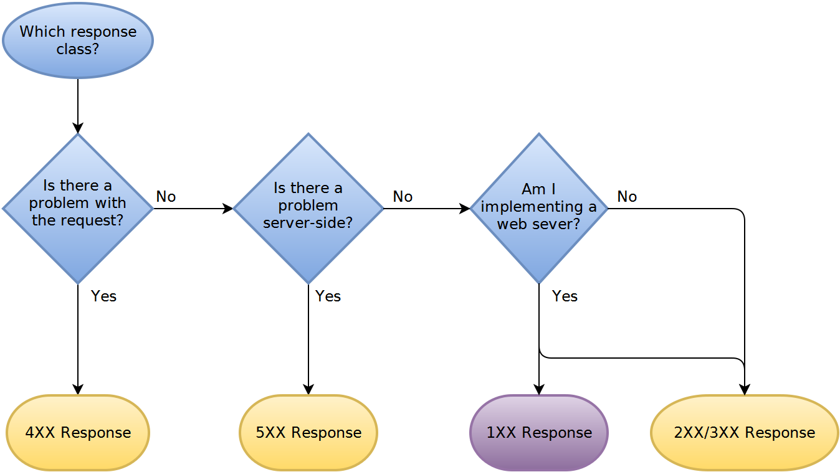
What Status Should I Return?
The following flowcharts answer this question
From http://racksburg.com/choosing-an-http-status-code/
The flowcharts for each category of response are too big to fit on these slides
Visit the above URL to see them

Slide 27
How to Return a Status Code
Two main methods for returning an HTTP status code response
Return a Response object
That wraps your Java return object
And adds the status code
Throw a WebApplicationException
Will turn this into a Response object
And send it back to the client with the status code

Slide 28
RESTful API: Best Practices
Use correct HTTP method names
Use nouns, not verbs, in the URI
That is, do NOT use /addCar, /deleteCar, /updateCar
Whenever ‘special’ actions are to be communicated, append ‘verb’ to the resource name:
POST /accounts:transferMoney
{“fromAccount”: “0123”, “toAccount”: “4567”, “amount”: 100}
In most cases, special verbs can be avoided, though might require thinking out-of-box
POST /transfers
{“fromAccount”: “0123”, “toAccount”: “4567”, “amount”: 100}
Resource | GET read | POST create | PUT update | DELETE delete
/cars | Returns a list of cars | Create a new car | Bulk update of cars | Delete all cars
/cars/711 | Returns a specific car | Method not allowed (405) | Updates a specific car | Deletes a specific car

Slide 29
RESTful API: Best Practices (continued)
To implement concurrency and pagination use ‘ETag’ together with ‘If-Match’ Server sets ETag HTTP response header based on the content on the response
Client mirrors back ETag value in the If-Match HTTP request header together with
request
Server processes the request only if recalculated value of ETag for the resource matches the value of If-Match request header
Protects against concurrent modification of resource (or collection during iteration)
Facilitates ‘Read-Modify-Write’ pattern
Facilitates ‘continuation’ reads
Use URI query parameters for filtering, sorting, field selection, pagination
– GET /cars?color=red&seats=2
&sort=manufacturer,model
&fields=manufacturer,model,id,color &offset=10&limit=5

Slide 30
RESTful API: Best Practices (continued)
Version your API to avoid breaking existing clients when API changes
http://mydealership.com/api/v1/inventory/cars/1 Use a simple ordinal number
Avoid dot notation such as 2.5
Use correct HTTP status codes to communicate both success and failures
See https://tools.ietf.org/html/rfc7231 for details; keep in mind that industry practice might deviate occasionally
Duplicate HTTP status code in the body of the Response message:
HTTP/1.1 404 Not Found
{"Message": "Not Found", "Code" : 404}
HTTP/1.1 201 Created
{"Message": "Created", "Code" : 201}
HTTP/1.1 200 OK
{"Response" : {"model" : "honda",
"licPlate": "BDK032", "invId" : 1},
"Message" : "Ok", "Code" : 200}

Slide 31
RESTful API: Best Practices (continued)
Build the API with consumers in mind
Make sure hierarchy is easy to navigate for your target clients/application domain
Add filtering, sorting, pagination capabilities
Create two endpoints per resource
The resource collection (e.g., /cars)
Individual resource within the collection (e.g., /cars/{carId})
Alternate resource names with IDs as URL nodes where needed
/LEVEL 1 | /LEVEL | 2 | /LEVEL 3 / …
/locations/{locId} | /cars |  | /{carId}
 | /staff |  | /{empId}
 | /sales |  | /{yyyymmdd}
/employees/{empId} /accounts /{accountId}/transactions/{txnId}

Slide 32
Richardson Maturity Model
Dr. Leonard Richardson developed a model that breaks down the principal elements of a REST approach into three steps
http://martinfowler.com/articles/richardsonMaturityModel.html
Model defines four maturity levels of RESTful API
Level 0:
RPC-style API, usually with a single endpoint
Level 1 – Resources:
Resources are introduced; multiple endpoints based on the structured URI
Level 2 – HTTP Verbs:
Same as Level 1 + HTTP verbs to distinguish between operations
Level 3 – Hypermedia Controls:
HATEOS (Hypertext As The Engine Of Application State) – ‘Discoverable’ API
Response message contains WHAT we can do next and HOW to do it
Think hyperlinks on HTML pages

Slide 33
Exercise: Create URI Resource Hierarchy
Pick a subject domain
Can be anything: HR system, car dealership, inventory system, etc.
Create a hierarchy of resources following best practices
CHALLENGE!
Is there any other way to navigate your subject domain?

Slide 34
Chapter Concepts
Web Services
HTTP and JSON
RESTful Services
Spring Boot
Summary

Slide 35
Spring Boot
Makes it easy to create standalone applications
Very little configuration required
Spring and third-party libraries included
Some of the key features include:
Applications begin with main method
Embed Tomcat, Jetty, or Undertow directly in application
Starter POMs provided simplify Maven configuration
Automatically configures Spring whenever possible
Provides production-ready metrics, health checks, and externalized configuration
An ‘accelerator’ to build applications fast
Spring MVC, Spring Security, and other Spring libraries can be used WITHOUT Spring Boot

Slide 36
Traditional JavaEE Frameworks vs. Spring Boot
Traditional frameworks
Pick favorite MVC framework Download additional libraries
Make sure to use the right version
Add Spring framework if needed
Compile and create WAR file
Install and configure application server Deploy WAR file to application server
Spring Boot
Put Spring Boot library in project dependencies
Implement web application to conventions of Spring Boot
Compile & run!

Slide 37



Traditional vs. Spring Boot Deployment
Traditional Deployment Spring Boot Deployment
User
User
Browser
Browser
/crm/...
/finance/...
JVM Process 1
JVM Process 2
/crm/...
SpringBoot App 1
/finance/...
SpringBoot App 2
Web App 1
Web App 2
...
...
Web App 1
Web App 2
...
Tomcat / WAS / ...
Tomcat / WAS / ...
Tomcat / Jetty
Tomcat/ Jetty
Tomcat / Jetty
OS
OS
deploy
configure
monitor
- install
- configure
configure
run
monitor
maintain
Administrator
Administrator

Slide 38
Hello World with Spring Boot
Spring Boot provides a parent POM and also starter projects
Have dependencies required for application type
For example, starter Web has dependencies for Spring MVC and REST applications
<parent>
<groupId>org.springframework.boot</groupId>
<artifactId>spring-boot-starter-parent</artifactId>
<version>1.5.4.RELEASE</version>
</parent>
<dependencies>
<dependency>
<groupId>org.springframework.boot</groupId>
<artifactId>spring-boot-starter-web</artifactId>
</dependency>

Slide 39
A Simple Service
The service will return the string “Hello World!” when requested
@SpringBootApplication
public class HelloApplication {
public static void main(String[] args) throws Exception { SpringApplication.run(HelloApplication.class, args);
}
}
Entry point of application
@RestController
public class HelloService {
@RequestMapping("/hello")
String home() {
return "Hello World!";
}
/hello routed to this method
}

Slide 40
A Simple Service Explained
@RestController indicates class represents one or more endpoints
@RequestMapping defines routing information for the services
@SpringBootApplication tells Spring to detect dependencies
Configure application based on these dependencies
Equivalent to using @Configuration, @EnableAutoConfiguration, and
@ComponentScan with their default attributes
The main method
Delegates work to SpringApplication
Bootstraps application starting Tomcat
Gotcha: make sure @SpringBootApplication bean is located in the package at the ‘top’/‘above’ other annotated beans

Slide 41
Running a Spring Boot Application
The application can be started using a Maven run goal
Provided by the starter parent POM
Can choose port number Tomcat starts on
Default port is 8080
mvn -Dserver.port=9090 spring-boot:run

Slide 42
A Currency Service
Following examples show a service returning currency data
Data will be serialized into JSON:
["USD", "CAD", "GBP"]
@RestController
public class CurrencyService {
private final Logger log = LoggerFactory.getLogger(this.getClass());
@RequestMapping(value="/currencies", method = RequestMethod.GET)
public List<Currency> getCurrencies(){ return Arrays.asList(Currency.values());
}
}
Accessed by /currencies
and HTTP GET only

Slide 43
Receiving Client Data
JSON data sent from client will be marshalled to Java Objects
@RequestBody indicates data posted from client
Unmarshalling happens automatically
{
"currency": "EUR",
public class MarketOrder { private Currency currency;
"amount" "side"
}
: 11,
: "BUY"
private int private Side
amount; side;
}
@RestController
public class OrderService {
private final Logger log = LoggerFactory.getLogger(this.getClass());
@RequestMapping(value="/order", method = RequestMethod.POST)
public void addOrder(@RequestBody MarketOrder order){
// process order
log.info("Order received "+ order);
POJO with properties matching
}
JSON property names
}

Slide 44
Processing Request Parameters and Path Variables
@RequestParam("<param name>")
@PathVariable <named uri segment>
Example:
/cars/711?fields=model
...
@RequestMapping(value="/cars/{carId}", method = RequestMethod.GET) public Car getCarDetails(@PathVariable("carId") int carId,
@RequestParam("fields") String fieldsToReturn){
// return car model
log.info("Car details ("+ fieldsToReturn +") returned"); return carRepository.findCar(carId);
}

Slide 45
RequestMapping Annotation Shortcuts
‘Verb-specific’ specializations of RequestMapping annotation (SpringBoot v1.4+)
@GetMapping
@PostMapping
@PutMapping
@DeleteMapping
@PatchMapping
Most attributes can be applied both at class (@RestController) and method levels
GET /inventory/cars/711
@RestController @RequestMapping("/inventory") public class CarInventoryService {
@GetMapping("/cars/{carId}")
public Car getCarDetails(@PathVariable int carId){...}

Slide 46
Content Negotiation
The REST controllers can accept and respond with data in different formats
Controller inspects ‘Content-Type’ and ‘Accept’ headers set by the client and decides whether it can process the request in ‘Content-Type’ format and respond in the format indicated by ‘Accept’ header:
Controller (consumes = application/json,
produces = application/xml)
Request (Content-Type = application/json,
HTTP/1.1 201 Created
Content-Type: application/xml
<invId>3</invId>
Accept
= application/xml, application/json)
POST /cars HTTP/1.1 Host : mydealership.com Content-Type: application/json Accept : application/xml,
application/json
{"model" : "ford", "licPlate": "KYE903"}
Controller (consumes = application/json,
produces = application/json)
HTTP/1.1 201 Created
Content-Type: application/json
{"invId": 3}

Slide 47
Content Negotiation (continued)
Controller capabilities are defined via ‘produces’ and ‘consumes’ attributes of
@RequestMapping annotation
To serialize data into XML, add the following dependency to pom:
@RequestMapping(value="/cars", method = RequestMethod.POST, produces={MediaType.APPLICATION_JSON_VALUE, MediaType.TEXT_XML_VALUE}, consumes=MediaType.APPLICATION_JSON_VALUE)
public Car createCarRecord(){ return new Car(…);
}
Produces JSON (default) or XML
Consumes JSON
<dependency>
<groupId>com.fasterxml.jackson.dataformat</groupId>
<artifactId>jackson-dataformat-xml</artifactId>
</dependency>

Slide 48
Exception Handling
Any unhandled exception causes the server to return an HTTP 500 response
There are two ways to customize exception handling
Per exception
By annotating custom exceptions with @ResponseStatus annotation
Globally
By creating classes annotated with @ControllerAdvice annotation
{ "timestamp": 1516773431477,
"status" : 500,
"error" : "Internal Server Error",
"exception": "com.artilekt.bank.business.AccountNotFoundException", "message" : "Account [eebb2ced] not found",
"path" : "/accounts/eebb2ced" }

Slide 49
Exception Handling Customization – Per Exception
Annotate custom exceptions with @ResponseStatus and define HTTP error code
@ResponseStatus(HttpStatus.NOT_FOUND)
public class AccountNotFoundException extends RuntimeException {
...
}
Exceptions thrown from within your code …
public Account findAccountByNumber(String accountNumber) { Account acc = dao.getAccount(accountNumber);
if (acc == null)
throw new AccountNotFoundException("Account ["+accountNumber+"] not found"); return acc;
}
… would be automatically converted to JSON
{ "timestamp": 1516940765026, "status": 404, "error": "Not Found", "exception": "com.artilekt.bank.business.AccountNotFoundException", "message" : "Account [eebb2ced] not found", "path": "/accounts/eebb2ced" }

Slide 50
Exception Handling Customization – Global
To fully customize error response, define @ControllerAdvice class(es)
@ControllerAdvice
public class ClientExceptionHandler extends ResponseEntityExceptionHandler {
@ExceptionHandler({ ClientDuplicateException.class })
protected ResponseEntity<GenericErrorResponse> handleConflict(RuntimeException ex,
WebRequest request) { GenericErrorResponse response = new GenericErrorResponse(); response.setErrorCode("Client Duplicate"); response.setErrorMessage(ex.getMessage());
return new ResponseEntity<>(response, HttpStatus.CONFLICT);
}
}
public class GenericErrorResponse { private String errorCode; private String errorMessage;
}
{
"errorCode" : "Client Duplicate", "errorMessage": "Client [Client [id = a001]]
already exists" }

Slide 51
Spring Boot Actuator
Includes a number of features that let you monitor and manage your application
Endpoints are made available over HTTP; for example:
/actuator/beans – lists all Spring beans in the application
/actuator/configprops – list of all @ConfigurationProperties
/actuator/metrics – list of metrics for the application
/actuator/health – application health information
Many more
Enabled by including the following dependency:
<dependency>
<groupId>org.springframework.boot</groupId>
<artifactId>spring-boot-starter-actuator</artifactId>
</dependency>

Slide 52
Spring Boot DevTools
Spring Boot DevTools improves the development-time experience when working on Spring Boot applications
Automatic Restart of application whenever files on the classpath change
Live Reload triggers a browser refresh when a resource is changed Requires browser plugin
Global Settings properties defined in ~/.spring-boot-devtools.properties file which will apply to all Spring Boot applications on your machine that use devtools
Remote Applications enable ‘live’ deployment of updates to remote server as well as remote debugging
H2 Web Console to view content of in-memory H2 database, available at /h2-console
http://www.h2database.com/html/quickstart.html#h2_console

Slide 53
Spring Boot DevTools (continued)
To include devtools support, simply add the module dependency to your build
<dependencies>
<dependency>
<groupId>org.springframework.boot</groupId>
<artifactId>spring-boot-devtools</artifactId>
<optional>true</optional>
</dependency>
</dependencies>

Slide 54
Testing Services with Postman
Postman is a tool that can be used to test REST services
Enables messages to be configured
Service responses to be viewed
Allows to create ‘collections’ of requests, similar to ‘SOAP UI’ test suites Use this to ‘replay’ messages during service development
Your instructor will now demonstrate Postman RestAssured is a library for writing tests for REST services
Provides DSL that supports given-when-then structure
Details found at rest-assured.io

Slide 55
Spring Boot Details
Full details of Spring Boot can be found at:
http://docs.spring.io/spring-boot/docs/current/reference/
Skeleton Spring Boot project generator:
http://start.spring.io/

Slide 56
Chapter Concepts
Web Services
HTTP and JSON
RESTful Services
Spring Boot
Summary

Slide 57
Chapter Summary
In this chapter, we have:
Introduced REST Web Services Introduced Spring Boot
Learned how to write REST Web services using Spring Boot

