Slide 1
Microservices Architecture & System Design

Slide 2
Course Objectives
Understand Microservices Architecture
Learn System Design Principles
Implement Design Patterns
Deploy using Docker & Kubernetes
Build Enterprise Systems

Slide 3
Monolith Architecture
Single codebase application
All modules tightly coupled
Difficult to scale
Slow deployments
Single point of failure

Slide 4
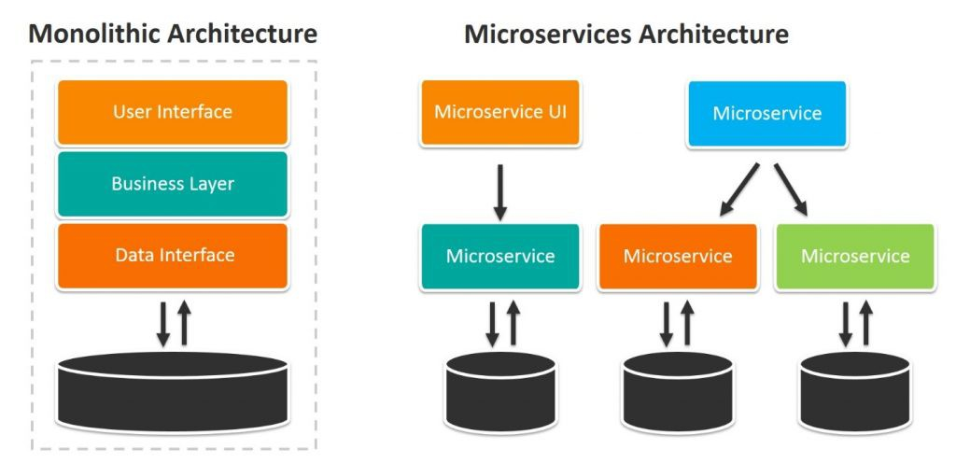
What is a Monolith?
Let us start with a simple question.
Imagine a Banking Application.
It has features like:
Login
Customer management
Account management
Transactions
Notifications
In traditional architecture, all of this is built into one single application.
This is called a Monolithic Architecture.
Notes:
Everything is inside one codebase:
One project
One deployment
One database

Slide 5
Problems with Monolith
Monolith works well initially.
But as application grows, problems start.
Problem 1 – Hard to Scale
    If only transaction module needs scaling, you must scale entire application.
    Example:
    Transaction load increases → deploy 10 copies of full application
    This wastes resources.
Problem 2 – Hard to Maintain
Code becomes huge.
Example:
    1 million lines of code
    Hundreds of developers
    Understanding and modifying code becomes difficult.

Slide 6
Problems with Monolith
Problem 3 – Single Point of Failure
If one module crashes, entire application crashes.
Example:
    Transaction bug → whole banking app down
Problem 4 – Slow Deployment
Even a small change requires full deployment.
Example:
    Fix typo in notification → redeploy full system
    This is inefficient.

Slide 7
Question
What problems have you faced working on large applications?

Slide 8
Introduction to Microservices
Microservices solve these problems.
Instead of one big application, we break it into small services.
Each service handles one business function.
Example:
Banking application split into:
    Auth Service
    Customer Service
    Account Service
    Transaction Service
Each service is independent.
Notes:
Each service:
Has its own code
Has its own database
Deploys independently

Slide 9
Microservices Architecture
Application split into small services
Each service independently deployable
Independent database per service
Improved scalability
Fault isolation

Slide 10
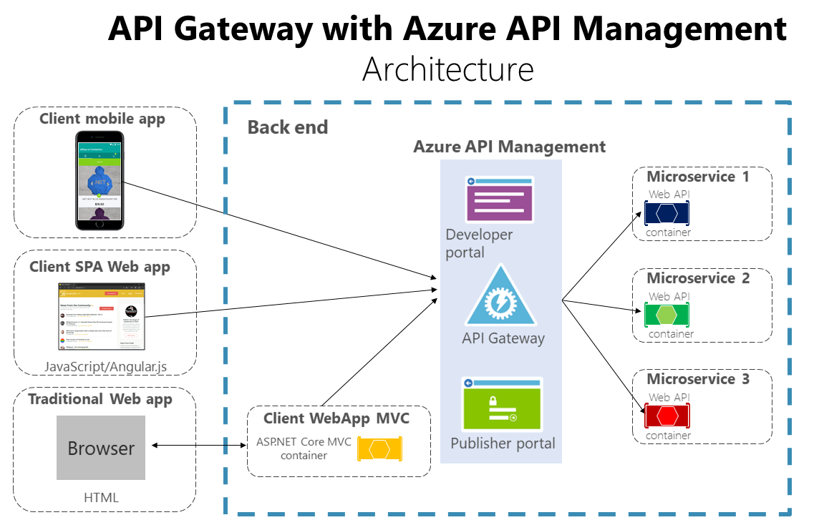
Microservices Architecture

Slide 11
Advantages of Microservices
Independent Deployment
    We can deploy Customer Service without touching Transaction Service.
Independent Scaling
    If transaction load increases, scale only Transaction Service.
Fault Isolation
    If Notification Service crashes, Banking still works.
Technology Flexibility
    One service can use:
      Java
      Another can use Python
      Another can use NodeJS

Slide 12
Microservices Principles
Single Responsibility Principle
    Each service does one job.
      Example:
      Customer Service → manages customers only.
Loose coupling
    Services should not depend tightly on each other.
High cohesion
    All related functionality stays inside same service.
Independent deployment
    Each service deploys independently.
Domain driven design

Slide 13
Example Monolithic Vs Microservices
We will now analyze a Monolithic Banking Application.
Modules:
    Auth
    Customer
    Account
    Transaction
Which module can become microservice?

Slide 14
Example Monolithic Vs Microservices
We will now analyze a Monolithic Banking Application.
Modules:
    Auth
    Customer
    Account
    Transaction
Which module can become microservice?

Slide 15
Answer
Auth Service
Customer Service
Account Service
Transaction Service

Slide 16
Microservices Architecture Patterns
Microservices require specific patterns to work efficiently.
Pattern 1 – Database per Service
Each service has its own database.
    Why?
      To avoid coupling.
Pattern 2 – API Gateway
Single entry point.
    Client → API Gateway → Microservice

Slide 17
Microservices Architecture Patterns
Pattern 3 – Service Discovery
    Services find each other dynamically.
Pattern 4 – Circuit Breaker
    Prevents cascading failures.
Pattern 5 – Saga Pattern
    Manages distributed transactions.
Pattern 6 – Event Driven Architecture
    Services communicate using events.
Pattern 7 – CQRS Pattern
    Separate read and write operations.
Pattern 8 – Strangler Pattern
    Gradually migrate monolith → microservices.

Slide 18
Exercise
Open draw.io.
Create architecture with:
    API Gateway
    Customer Service
    Account Service
    Database per service

Slide 19
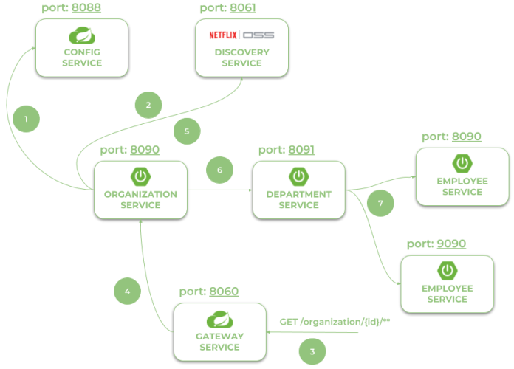
Spring Boot Microservice Creation
We will now build our first microservice.
Spring Boot is industry standard for microservices.
Layers:
    Controller → handles HTTP requests
    Service → business logic
    Repository → database access
    Entity → database object
Notes:
Using Spring Boot 3 in cloud-native development
Provide service discovery for all microservices with Spring Cloud Netflix Eureka. Anticipating your questions – yes, Eureka is still there. It’s the last of Netflix microservices components still available in Spring Cloud
Spring Cloud OpenFeign in inter-service communication
Distributed configuration with Spring Cloud Config
API Gateway pattern with Spring Cloud Gateway including a global OpenAPI documentation with the Springdoc project
Collecting traces with Micrometer OpenTelemetry and Zipkin
http://localhost:8060/employee/
http://localhost:8060/department/organization/1
http://localhost:8060/department/organization/1/with-employees
http://localhost:8060/organization/
http://localhost:8060/organization/1/with-departments
http://localhost:8060/swagger-ui.html

Slide 20
MicroServices with Spring Cloud Example
Architecture of microservices-based system consists of the following modules:
gateway-service - a module that Spring Cloud Netflix Zuul for running Spring Boot application that acts as a proxy/gateway in our architecture.
config-service - a module that uses Spring Cloud Config Server for running configuration server in the native mode. The configuration files are placed on the classpath.
discovery-service - a module that depending on the example it uses Spring Cloud Netflix Eureka or Spring Cloud Netflix Alibaba Nacos as an embedded discovery server.
employee-service - a module containing the first of our sample microservices that allows to perform CRUD operation on in-memory repository of employees
department-service - a module containing the second of our sample microservices that allows to perform CRUD operation on in-memory repository of departments. It communicates with employee-service.
organization-service - a module containing the third of our sample microservices that allows to perform CRUD operation on in-memory repository of organizations. It communicates with both employee-service and organization-service.
Notes:
http://localhost:8060/employee/
http://localhost:8060/department/organization/1
http://localhost:8060/department/organization/1/with-employees
http://localhost:8060/organization/
http://localhost:8060/organization/1/with-departments
http://localhost:8060/swagger-ui.html

Slide 21
Hands On
Step 1 – Create Project
Go to Spring Initializr
Dependencies:
Spring Web
Spring Data JPA
PostgreSQL
Lombok
Step 2 – Create Entity
  @Entity
  public class Customer {
  @Id
  private Long id;
  private String name;
  private String email;
  }
Explain:
@Entity → maps to database table

Slide 22
Hands On
Step 3 – Repository
  public interface CustomerRepository extends JpaRepository<Customer, Long> {
  }
Step 4 – Service
  @Service
  public class CustomerService {
  @Autowired
  CustomerRepository repository;
  public List<Customer> getAllCustomers() {
  return repository.findAll();
  }
  }

Slide 23
Hands On
Step 5 – Controller
@RestController
@RequestMapping("/customers")
public class CustomerController {
@Autowired
CustomerService service;
@GetMapping
public List<Customer> getAll() {
return service.getAllCustomers();
}
}
Run application.
Test in browser:
http://localhost:8081/customers

Slide 24
Hands On
Database per Service Pattern
Each microservice must have its own database.
Bad Practice:
    Multiple services using same database.
Good Practice:
    Separate databases.
Create database:
    For example customer_db

Slide 25
Hands On
Interservice Communication REST
Microservices must communicate.
Two types:
    Sync → REST
    Async → Kafka
Today we use REST.

Slide 26
Hands On
Account Service calling Customer Service:
RestTemplate restTemplate = new RestTemplate();
Customer customer =
restTemplate.getForObject(
"http://localhost:8081/customers/1",
Customer.class
);
Notes:
Explain flow step-by-step.

Slide 27
Hands On
OpenFeign Client
RestTemplate requires lots of code.
Feign simplifies it.
  @FeignClient(name="customer-service")
  public interface CustomerClient {
  @GetMapping("/customers/{id}")
  Customer getCustomer(@PathVariable Long id);
  }
  Feign automatically calls service.

Slide 28
Hands On
DTO Pattern
Never expose entity directly.
Use DTO.
Why?
    Security
    Flexibility
    public class CustomerDTO {
    private Long id;
    private String name;
    }

Slide 29
Interservice Communication (REST)
What is Interservice Communication?
Interservice communication is the process by which microservices communicate with each other to fulfill a business request.
Example: Banking System
When transferring money:
    Transaction Service communicates with Account Service
    Account Service communicates with Notification Service
    Because each service is independent, communication is required.

Slide 30
Types of Interservice Communication
There are two types:
Synchronous Communication (REST)
Asynchronous Communication (Kafka / Message Broker)

Slide 31
Type 1: Synchronous Communication (REST)
Definition
  In synchronous communication, one service calls another service using HTTP and waits for response.
Example:
  Transaction Service → calls → Account Service → waits for response
Architecture:
Transaction Service → Account Service → Response → Transaction Service

Slide 32
Real Banking Example
Transfer Money Flow:
  Transaction Service
  ↓
  Account Service (debit)
  ↓
  Response
  ↓
  Transaction Service continues

Slide 33
Advantages and Disadvantages
Advantages
  Simple
  Easy to implement
  Immediate response
  Easy debugging
Disadvantages
  Tight coupling
  High latency
  Service dependency
  Cascade failure risk

Slide 34
Type 2: Asynchronous Communication (Kafka)
Definition
    In asynchronous communication, services communicate using events.
    The sender does not wait for response.
Architecture:
Transaction Service → Kafka → Notification Service
Transaction Service publishes event.
Notification Service consumes event.

Slide 35
Real Banking Example
Money transfer completed:
Transaction Service publishes event:
    Transaction Completed
Notification Service consumes event:
    Send Email / SMS

Slide 36
Advantages and DisAdvantages
Advantages
  Loose coupling
  Highly scalable
  Fault tolerant
  Fast response
Disadvantages
  Complex implementation
  Eventual consistency
  Debugging harder

Slide 37
Problems in Interservice Communication
Problem 1: Tight Coupling
Definition:
    Service depends heavily on another service.
Example:
    Transaction Service directly calls Account Service.
    If Account Service is down → Transaction Service fails.

Slide 38
Problems in Interservice Communication
Problem 2: Latency
Definition:
    Delay caused due to network communication.
Example:
    Transaction Service → Account Service → Customer Service → Response
    Multiple network calls increase delay.

Slide 39
Problems in Interservice Communication
Problem 3: Cascade Failure
Example:
    Service A → calls Service B → calls Service C
    If C fails → B fails → A fails
Entire system fails.

Slide 40
Problems in Interservice Communication
Solution
Use:
  REST → for immediate response
  Kafka → for async operations
  Circuit breaker → for fault tolerance

Slide 41
DEMO- Java & SpringBoot
In Java Based Microservices Environment, HTTP communication between different services is typically facilitated using the RestTemplate or WebClient libraries. In Spring Cloud Environment, this can be achieved using Open Feign.
RestTemplate: RestTemplate is a synchronous, blocking HTTP client provided by the Spring framework. It offers a straightforward API for making HTTP requests and handling responses.

Slide 42
DEMO- Java & SpringBoot
As of Spring 5, RestTemplate has been deprecated in favor of WebClient, which is part of the Spring WebFlux module and provides a non-blocking, reactive approach to HTTP communication.
WebClient (Preferred for Reactive Programming): WebClient is a non-blocking, reactive HTTP client introduced in Spring WebFlux. It is part of the Spring 5 and Spring Boot 2.x release. It is the preferred choice for making HTTP requests in reactive applications and supports both synchronous and asynchronous programming models.

Slide 43
DEMO- Java & SpringBoot
Open Feign: Feign is Web service Client developed by Netflix and integrated into Spring Cloud Ecosystem. Feign may be a preferred option when working with Spring-Cloud based Environments, Feign integrates Seamlessly with other Spring Cloud components like Service Registry (Eureka or Consul) and load balancing (Ribbon)

Slide 44
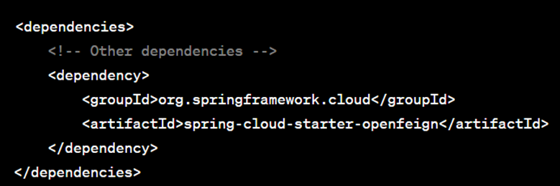
DEMO- Java & SpringBoot
Open Feign:
Step 1- Add dependency

Slide 45
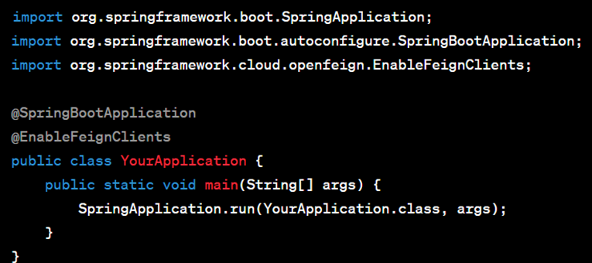
DEMO- Java & SpringBoot
Open Feign:
Step 2: Enable Feign Client In your Spring Boot application’s main class, annotate it with @EnableFeignClients to enable Feign client functionality. This annotation scans for interfaces annotated with @FeignClient and creates the client implementations automatically.

Slide 46
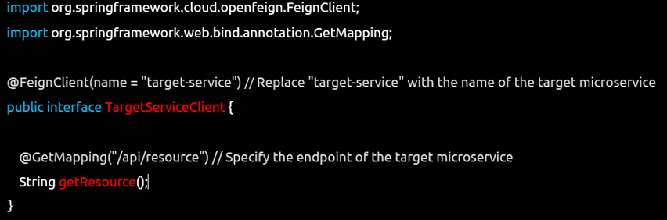
DEMO- Java & SpringBoot
Open Feign:
Step 3: Create a Feign client interface specifying the API contract

Slide 47
DEMO- Java & SpringBoot
Open Feign:
Step 3: Create a Feign client interface specifying the API contract

Slide 48
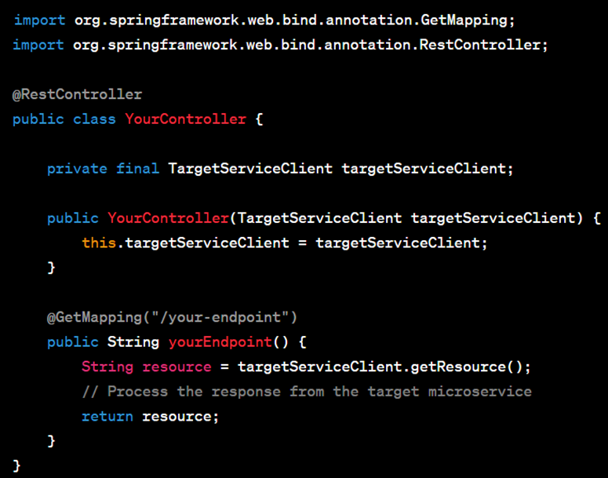
DEMO- Java & SpringBoot
Open Feign:
Step 4: Use the Feign Client
In the service or controller, inject the Feign client interface and use it to make requests to the target microservice.
Press enter or click to view image in full size
Notes:
Apart from these options, Apache HttpClient, OkHttp, Retrofit are different other frameworks that can be integrated with Java Microservices Environment to send requests and receive responses between Services.
Depending on your project specific requirements, such as performance, ease of use, integration with existing frameworks, and support for desired protocols, authentication mechanisms, one can choose the best that fits the needs.

Slide 49
API Gateway Pattern
Single entry point
Routes requests to services
Handles authentication
Handles rate limiting
Improves security

Slide 50
Service Discovery Pattern
Automatically detects services
Removes hardcoded URLs
Uses service registry like Eureka
Improves scalability
Improves flexibility

Slide 51
Database per Service Pattern
Each service owns its database
Avoid shared database
Loose coupling
Independent scaling
Better fault isolation

Slide 52
Communication Types
Synchronous Communication
  REST APIs
Asynchronous Communication
  Kafka Events
Improves scalability
Improves decoupling

Slide 53
Resilience Patterns & Fault Tolerance
• Understand distributed system failures
• Implement Circuit Breaker
• Implement Retry pattern
• Implement Timeout pattern
• Implement Bulkhead pattern
• Implement Fallback pattern
• Simulate failures and observe resilience
• Build production-ready fault tolerant microservices

Slide 54
What is Fault Tolerance?
Fault tolerance = ability of system to continue working even when failures occur.

Slide 55
Why failures happen in Microservices?
Because services communicate over network.
Failures are inevitable.

Slide 56
Types of Failures
1. Service Failure
Service crashes or stops.
Example:
Customer Service down.
Order Service calling:
    GET http://localhost:8081/customers/1
Result:
    Connection refused
Real example:
    Swiggy order placed → restaurant service down → order fails

Slide 57
Types of Failures
2. Network Failure
Network slow or timeout.
Example:
Service responds after 20 seconds.
    User waits → bad experience
3. Cascading Failure (Most dangerous)
One failure spreads across system.
Example:
Service A calls B
Service B calls C
Service C fails
→ B fails
→ A fails
→ Entire system down

Slide 58
Without Fault Tolerance
User → Order Service → Customer Service (DOWN)
Result → System crash

Slide 59
With Fault Tolerance
User → Order Service → Customer Service (DOWN)
Result → fallback response
System continues working

Slide 60
Circuit Breaker Pattern
Prevents cascading failures
Stops calls when service fails
Improves fault tolerance
Implemented using Resilience4j
Provides fallback mechanism

Slide 61
Circuit Breaker Pattern
Problem Without Circuit Breaker
Every request tries failed service.
Result:
System slow
Thread exhaustion
Crash

Slide 62
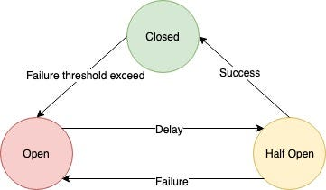
Circuit Breaker Pattern
Circuit Breaker Solution
Stops calling failed service temporarily.
Closed State (Normal)
Requests allowed
Working normally

Slide 63
Circuit Breaker Pattern
Open State (Failure detected)
Requests blocked
Immediately return fallback
Half Open State (Testing)
Allows few requests
If success → closed
If failure → open

Slide 64
Demo
Step 1: Enable in Controller
@RestController
@RequestMapping("/orders")
public class OrderController {
@Autowired
CustomerServiceClient customerServiceClient;
@GetMapping("/{id}")
@CircuitBreaker(
name = "customerService",
fallbackMethod = "fallbackCustomer"
)
public String getOrder(@PathVariable int id) {
return customerServiceClient.getCustomer(id);
}
public String fallbackCustomer(int id, Exception ex) {
return "Fallback: Customer service unavailable";
}
}

Slide 65
Demo
Step 2: application.yml
resilience4j:
circuitbreaker:
instances:
customerService:
registerHealthIndicator: true
slidingWindowSize: 5
minimumNumberOfCalls: 3
failureRateThreshold: 50
waitDurationInOpenState: 10s
Call multiple times:
http://localhost:8080/orders/1
Observe:
Fallback: Customer service unavailable
Circuit breaker opens.

Slide 66
Retry Pattern
Problem
Temporary failures happen.
Example:
Network glitch.
Retry can fix.
Retry Pattern
Automatically retries failed request.
Example:
Try 1 → fail
Try 2 → fail
Try 3 → success

Slide 67
Hands-on Retry
@GetMapping("/{id}")
@Retry(name="customerService", fallbackMethod="fallbackCustomer")
public String getOrder(@PathVariable int id) {
return customerServiceClient.getCustomer(id);
}

Slide 68
Hands-on Retry
Config:
resilience4j:
retry:
instances:
customerService:
maxAttempts: 3
waitDuration: 2s
Observe logs.
Service called multiple times.

Slide 69
Timeout Pattern
Problem
Service responds slowly.
User waits forever.
Timeout Solution
Cancel request after timeout.

Slide 70
Hands-on Timeout
Customer Service delay:
    Thread.sleep(10000);
Order Service:
    @TimeLimiter(name="customerService")
Config:
resilience4j:
timelimiter:
instances:
customerService:
timeoutDuration: 2s
Result:
Timeout occurs after 2 seconds.

Slide 71
Bulkhead Pattern
Problem
    One slow service consumes all threads.
    Entire system blocks.
Bulkhead Solution
    Separate thread pools.
    Like ship compartments.
    If one fails, others safe.

Slide 72
Hands-on Bulkhead
@Bulkhead(name="customerService")
Config:
resilience4j:
bulkhead:
instances:
customerService:
maxConcurrentCalls: 2
Only 2 concurrent calls allowed.

Slide 73
Fallback Pattern
Purpose
  Provide backup response.
Example:
Customer Service down
Return:
Guest Customer

Slide 74
Hands-on
@CircuitBreaker(name="customerService",
fallbackMethod="fallbackCustomer")
public String getOrder(int id) {
return customerServiceClient.getCustomer(id);
}
public String fallbackCustomer(int id, Exception ex) {
return "Fallback Customer";
}

Slide 75
Saga Pattern
1. Problem: Distributed Transaction Problem in Microservices
In monolithic applications, we use:
@Transactional
This ensures:
• All DB operations succeed → COMMIT
• If any fails → ROLLBACK
But in microservices:
Payment Service → Account Service → Notification Service
Each service has its own database.
There is NO global transaction manager.

Slide 76
Saga Pattern
Example: Money Transfer
Transfer ₹500 from Account A → Account B
Steps:
    1. Debit Account A
    2. Credit Account B
    3. Send notification
Problem scenario:
    Step 1 → SUCCESS
    Step 2 → FAIL
Result:
    Account A debited
    Account B not credited
    DATA INCONSISTENT
We need distributed rollback.

Slide 77
Saga Pattern
Solution: Saga Pattern
Saga = sequence of local transactions
Each step has:
    • Forward action
    • Compensation action (rollback)
Example Saga
Consistency restored.
Step | Action | Compensation
Debit A | debit() | credit()
Credit B | credit() | debit()
Notify | sendNotification() | none
If step 2 fails:
Saga triggers compensation of step 1
credit(A)
Consistency restored.

Slide 78
Saga Pattern
Two Types of Saga Pattern
1. Orchestration
2. Choreography

Slide 79
Saga Orchestration
Concept
    There is a central controller:
Saga Orchestrator
Flow:
Orchestrator → Debit Service
Orchestrator → Credit Service
Orchestrator → Notification Service
Orchestrator
|
|---> Account Service (Debit)
|
|---> Account Service (Credit)
|
|---> Notification Service

Slide 80
Advantages & Disadvantages
Advantages
  • Central control
  • Easy monitoring
  • Easy error handling
Disadvantages
  • Single point of failure
  • Tight coupling

Slide 81
Saga Choreography
No central controller.
Services communicate via events.
Flow:
    TransferService → publishes TransferInitiated
    AccountService listens → debits → publishes Debited
    AccountService listens → credits → publishes Credited
    NotificationService listens → sends notification
TransferService → Event → AccountService → Event → NotificationService

Slide 82
Advantages & DisAdvantages
Advantages
• Fully event driven
• Loose coupling
• Scalable
Disadvantages
• Hard to track flow
• Debugging complex

Slide 83
Architecture for Hands-on
We implement:
    transfer-service
    account-service
    notification-service
    Kafka
    MySQL
Flow:
    Transfer Initiated Event
    ↓
    Account Service Debit
    ↓
    Debit Success Event
    ↓
    Account Service Credit
    ↓
    Credit Success Event
    ↓
    Notification Service

Slide 84
Hands On - Database Design
CREATE TABLE accounts (
id BIGINT PRIMARY KEY,
name VARCHAR(50),
balance DOUBLE
);
Sample data:
INSERT INTO accounts VALUES (1,'Prabhat',10000);
INSERT INTO accounts VALUES (2,'Rahul',5000);

Slide 85
Hands On - Kafka Topics
transfer-initiated
account-debited
account-credited
transfer-failed

Slide 86
Transfer Service Implementation
TransferController
@RestController
@RequestMapping("/transfer")
@RequiredArgsConstructor
public class TransferController {
private final KafkaTemplate<String, Object> kafkaTemplate;
@PostMapping
public String transfer(@RequestBody TransferRequest request) {
kafkaTemplate.send("transfer-initiated", request);
return "Transfer Initiated";
}
}
TransferRequest DTO:
@Data
@AllArgsConstructor
@NoArgsConstructor
public class TransferRequest {
private Long fromAccount;
private Long toAccount;
private Double amount;
}

Slide 87
Hands On -Account Service Implementation
Account Entity
@Entity
@Data
public class Account {
@Id
private Long id;
private String name;
private Double balance;
}
Repository
public interface AccountRepository extends JpaRepository<Account, Long> {
}

Slide 88
Hands On – Kafka Consumer
@Component
@RequiredArgsConstructor
public class TransferConsumer {
private final AccountRepository repo;
private final KafkaTemplate<String, Object> kafkaTemplate;
@KafkaListener(topics = "transfer-initiated")
public void debit(TransferRequest request) {
Account from = repo.findById(request.getFromAccount()).get();
if(from.getBalance() < request.getAmount()) {
kafkaTemplate.send("transfer-failed", request);
return;
}
from.setBalance(from.getBalance() - request.getAmount());
repo.save(from);
kafkaTemplate.send("account-debited", request);
}
}
Credit Consumer
@Component
@RequiredArgsConstructor
public class CreditConsumer {
private final AccountRepository repo;
private final KafkaTemplate<String, Object> kafkaTemplate;
@KafkaListener(topics = "account-debited")
public void credit(TransferRequest request) {
Account to = repo.findById(request.getToAccount()).get();
to.setBalance(to.getBalance() + request.getAmount());
repo.save(to);
kafkaTemplate.send("account-credited", request);
}
}

Slide 89
Hands On – Kafka Consumer
Compensation Consumer
@Component
@RequiredArgsConstructor
public class CompensationConsumer {
private final AccountRepository repo;
@KafkaListener(topics = "transfer-failed")
public void rollback(TransferRequest request) {
Account from = repo.findById(request.getFromAccount()).get();
from.setBalance(from.getBalance() + request.getAmount());
repo.save(from);
System.out.println("Rollback completed");
}
}

Slide 90
Hands On – Notification Service
@Component
public class NotificationConsumer {
@KafkaListener(topics = "account-credited")
public void notify(TransferRequest request) {
System.out.println("Transfer successful: " + request);
}
}
application.yml (Kafka Config)
spring:
kafka:
bootstrap-servers: localhost:9092
consumer:
group-id: saga-group
auto-offset-reset: earliest
producer:
key-serializer: org.apache.kafka.common.serialization.StringSerializer
value-serializer: org.springframework.kafka.support.serializer.JsonSerializer
consumer:
value-deserializer: org.springframework.kafka.support.serializer.JsonDeserializer

Slide 91
Hands On – Running the System
Start services:
Zookeeper
Kafka
Account Service
Transfer Service
Notification Service
Call API:
POST http://localhost:8081/transfer
{
"fromAccount": 1,
"toAccount": 2,
"amount": 500
}

Slide 92
Hands On – Expected Flow
Transfer Service → transfer-initiated event
Account Service → debit
Account Service → account-debited event
Account Service → credit
Account Service → account-credited event
Notification Service → notification sent
Failure Scenario:
If insufficient balance:
transfer-initiated
↓
transfer-failed
↓
compensation triggered
↓
balance restored

Slide 93
Hands On – Full Event Flow Diagram
Transfer Service
| transfer-initiated
↓
Account Service (Debit)
| account-debited
↓
Account Service (Credit)
| account-credited
↓
Notification Service
Failure:
transfer-initiated
↓
Debit fails
↓
transfer-failed
↓
Rollback executed

Slide 94
Questions
Q: Why Saga Pattern used?
Answer: Manage distributed transactions
Q: Types?
Answer: Orchestration and Choreography
Q: Difference?
  Orchestration → central controller
  Choreography → event driven

Slide 95
Event Driven Architecture
Services communicate via events
Uses Kafka or message brokers
Improves scalability
Loose coupling
Better performance

Slide 96
Event Driven Architecture
Traditional Communication vs Event Driven
    Traditional (Synchronous REST)
    Transaction Service → REST Call → Notification Service
Problem:
    • Tight coupling
    • If notification service is down → transaction fails
    • Slow response
Event Driven Architecture
Transaction Service → Publish Event → Kafka → Notification Service
Transaction Service does NOT know Notification Service exists.

Slide 97
Event Driven Architecture
What is an Event?
Event = Something that happened in system.
Examples:
  • OrderCreated
  • PaymentCompleted
  • TransactionCompleted
  • UserRegistered
Example Event JSON:
{
"transactionId": "TXN123",
"amount": 5000,
"status": "SUCCESS"
}

Slide 98
Event Driven Architecture
Transaction Service ------> Kafka ------> Notification Service
(Producer) Event (Consumer)
Benefits of Event Driven Architecture
Benefit 1: Loose Coupling
Producer does not know consumer.
Before:
Transaction → Notification REST
After:
Transaction → Kafka ← Notification
Independent services.
Benefit 2: Scalability
Kafka handles millions of events per second.
Example:
1 Producer → Kafka → 100 Consumers
Benefit 3: Fault Tolerance
If consumer is down:
Kafka stores events.
Consumer processes later.

Slide 99
Event Driven Architecture
Real Banking Example
User transfers money.
Steps:
    Transaction Service processes payment
    Publishes event
    Notification Service sends email
Benefit 4: Asynchronous Communication
User gets fast response.
Notification happens later.

Slide 100
Kafka Introduction
What is Kafka?
Kafka is a distributed event streaming platform.
Used by:
    • Netflix
    • Uber
    • LinkedIn
    • Amazon

Slide 101
Core Kafka Concepts
Concept 1: Producer
Producer sends event to Kafka.
Example:
    Transaction Service → Kafka
Code example:
kafkaTemplate.send("transaction-topic", event);
Concept 2: Consumer
Consumer reads event from Kafka.
Example:
    Notification Service
  @KafkaListener(topics = "transaction-topic")
  public void consume(String message)

Slide 102
Core Kafka Concepts
Concept 3: Topic
Topic = Event channel.
Example:
    transaction-topic
Like table name in database.
Concept 4: Broker
Kafka server.
localhost:9092
Concept 5: Offset
Event position.
    Event1 offset 0
    Event2 offset 1
Kafka Flow:
Producer → Topic → Consumer

Slide 103
Kafka Setup Hands-on using Docker
Step 1 Install Docker
Verify:
    docker --version
Step 2 Create docker-compose.yml
Create file:
    docker-compose.yml
  version: '3'
  services:
  zookeeper:
  image: bitnami/zookeeper:latest
  environment:
  ALLOW_ANONYMOUS_LOGIN: yes
  ports:
  - "2181:2181"
  kafka:
  image: bitnami/kafka:latest
  ports:
  - "9092:9092"
  environment:
  KAFKA_CFG_ZOOKEEPER_CONNECT: zookeeper:2181
  ALLOW_PLAINTEXT_LISTENER: yes
  KAFKA_CFG_LISTENERS: PLAINTEXT://:9092
  KAFKA_CFG_ADVERTISED_LISTENERS: PLAINTEXT://localhost:9092
  depends_on:
  - zookeeper

Slide 104
Kafka Setup Hands-on using Docker
Step 3 Start Kafka
Run
docker-compose up -d
Verify:
docker ps
You should see:
kafka
zookeeper
Step 4 Create Topic
Run:
    docker exec -it kafka_container_name bash
Then:
  kafka-topics.sh --create \
  --topic transaction-topic \
  --bootstrap-server localhost:9092 \
  --partitions 1 \
  --replication-factor 1
Verify:
    kafka-topics.sh --list --bootstrap-server localhost:9092

Slide 105
Kafka Producer Implementation
Architecture
    Transaction Service → Kafka → Notification Service
Step 1 Create Spring Boot Project
    Go to:
    https://start.spring.io
    Dependencies:
      • Spring Web
      • Spring for Apache Kafka
      • Lombok
Step 2 application.yml
server:
port: 8081
spring:
kafka:
bootstrap-servers: localhost:9092

Slide 106
Kafka Producer Implementation
Step 3 Create Event Model
package com.example.transaction.event;
import lombok.*;
@Data
@AllArgsConstructor
@NoArgsConstructor
public class TransactionEvent {
private String transactionId;
private double amount;
private String status;
}

Slide 107
Kafka Producer Implementation
Step 4 Create Kafka Producer Config
package com.example.transaction.config;
import org.springframework.context.annotation.Configuration;
@Configuration
public class KafkaProducerConfig {
}
(Spring Boot auto config is enough)

Slide 108
Kafka Producer Implementation
Step 5 Create Producer Service
package com.example.transaction.service;
import com.example.transaction.event.TransactionEvent;
import org.springframework.kafka.core.KafkaTemplate;
import org.springframework.stereotype.Service;
@Service
public class TransactionProducer {
private final KafkaTemplate<String, Object> kafkaTemplate;
public TransactionProducer(KafkaTemplate<String, Object> kafkaTemplate) {
this.kafkaTemplate = kafkaTemplate;
}
public void publishEvent(TransactionEvent event) {
kafkaTemplate.send("transaction-topic", event);
System.out.println("Event published: " + event);
}
}

Slide 109
Kafka Producer Implementation
Step 6 Create Controller
package com.example.transaction.controller;
import com.example.transaction.event.TransactionEvent;
import com.example.transaction.service.TransactionProducer;
import org.springframework.web.bind.annotation.*;
@RestController
@RequestMapping("/transactions")
public class TransactionController {
private final TransactionProducer producer;
public TransactionController(TransactionProducer producer) {
this.producer = producer;
}
@PostMapping
public String createTransaction() {
TransactionEvent event =
new TransactionEvent(
"TXN123",
5000,
"SUCCESS"
);
producer.publishEvent(event);
return "Transaction completed";
}
}
Run Transaction Service
mvn spring-boot:run
Test:
POST http://localhost:8081/transactions
Output
Event published: TransactionEvent(transactionId=TXN123, amount=5000, status=SUCCESS)

Slide 110
Kafka Consumer Implementation
Create Notification Service
New Spring Boot Project
Dependencies:
  • Spring Web
  • Spring Kafka
  • Lombok
application.yml
server:
port: 8082
spring:
kafka:
bootstrap-servers: localhost:9092
consumer:
group-id: notification-group
auto-offset-reset: earliest

Slide 111
Kafka Consumer Implementation
Create Consumer
package com.example.notification.consumer;
import com.example.notification.event.TransactionEvent;
import org.springframework.kafka.annotation.KafkaListener;
import org.springframework.stereotype.Service;
@Service
public class NotificationConsumer {
@KafkaListener(
topics = "transaction-topic",
groupId = "notification-group"
)
public void consume(TransactionEvent event) {
System.out.println("Received event: " + event);
sendNotification(event);
}
private void sendNotification(TransactionEvent event) {
System.out.println(
"Sending notification for transaction: "
+ event.getTransactionId()
);
}
}

Slide 112
Kafka Consumer Implementation
Event Model (same as producer)
package com.example.notification.event;
import lombok.*;
@Data
@AllArgsConstructor
@NoArgsConstructor
public class TransactionEvent {
private String transactionId;
private double amount;
private String status;
}
Run Notification Service
mvn spring-boot:run
Test Flow
Call Transaction API:
    POST http://localhost:8081/transactions
Output Transaction Service
Event published: TXN123
Output Notification Service
Received event: TXN123
Sending notification for transaction: TXN123

Slide 113
Complete Flow Diagram
Client
|
v
Transaction Service
|
v
Kafka Topic
|
v
Notification Service

Slide 114
Production Folder Structure
Transaction Service
transaction-service
├ controller
├ service
├ event
├ config
Notification Service
notification-service
├ consumer
├ event
├ service

Slide 115
Questions
Q1: What is Kafka?
    Event streaming platform.
Q2: What is Topic?
    Event channel.
Q3: Producer role?
    Publishes event.
Q4: Consumer role?
    Consumes event.
Q5: Benefit of Kafka?
    Loose coupling.

Slide 116
Docker Overview
Containerization platform
Ensures consistent environments
Easy deployment
Supports microservices
Improves portability

Slide 117
Kubernetes Overview
Container orchestration platform
Automatic scaling
Self healing
Load balancing
Production deployment

Slide 118
Monitoring with Prometheus & Grafana
Monitor system performance
Track CPU and memory usage
Track API performance
Detect failures
Improve reliability

Slide 119
System Design Concepts
Scalability
Availability
Reliability
Fault tolerance
CAP theorem

Slide 120
CAP Theorem
Consistency
Availability
Partition tolerance
Only two can be achieved simultaneously
Important for distributed systems

Slide 121
Deployment Architecture
Client → API Gateway
Gateway → Microservices
Microservices → Databases
Kafka for messaging
Monitoring using Prometheus

Slide 122
Best Practices
Use API Gateway
Use Service Discovery
Use Database per service
Implement monitoring
Use containerization

Slide 123
Final Project
Build Banking Microservices System
API Gateway
Multiple microservices
Kafka messaging
Docker and Kubernetes deployment

