Slide 1
Logistic Regression

Slide 2
What is Logistic Regression?
Logistic Regression is a supervised machine learning algorithm used for classification problems, especially binary classification.
Instead of predicting a continuous value (like Linear Regression), it predicts a probability between 0 and 1.
Example Use Cases:
Spam vs Not Spam
Fraud vs Legit Transaction
Disease vs No Disease

Slide 3
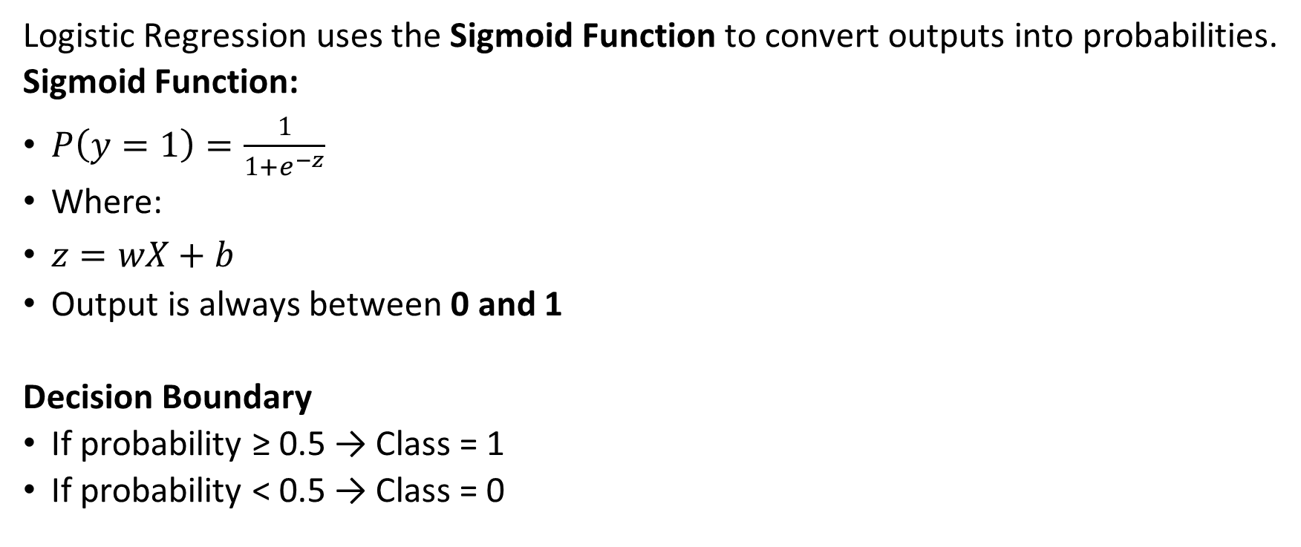
How It Works?
Logistic Regression uses the Sigmoid Function to convert outputs into probabilities.
Sigmoid Function:
$P\left(y=1\right)=\frac{1}{1+e^{−z}}$
Where:
$z=wX+b$
Output is always between 0 and 1
Decision Boundary
If probability ≥ 0.5 → Class = 1
If probability < 0.5 → Class = 0

Slide 4
Why Not Linear Regression?
Linear regression:
Can give outputs < 0 or > 1
Not suitable for classification
Logistic regression:
Outputs probabilities
Works well for classification

Slide 5
Example: Predict if a student will pass or fail
from sklearn.linear_model import LogisticRegression
from sklearn.model_selection import train_test_split
from sklearn.metrics import accuracy_score
import numpy as np
# Feature: Hours studied
X = np.array([[1], [2], [3], [4], [5], [6]])
# Target: 0 = Fail, 1 = Pass
y = np.array([0, 0, 0, 1, 1, 1])
# Split data
X_train, X_test, y_train, y_test = train_test_split(X, y, test_size=0.2)
# Create model
model = LogisticRegression()
# Train model
model.fit(X_train, y_train)
# Predict
y_pred = model.predict(X_test)
# Accuracy
print("Accuracy:", accuracy_score(y_test, y_pred))
# Predict probability
print("Probability of passing:", model.predict_proba([[3.5]]))
Notes:
Output Explanation
predict() → gives class (0 or 1)
predict_proba() → gives probability
Example:
[[0.3, 0.7]]
70% chance of passing

Slide 6
Visual Understanding
Logistic regression creates an S-shaped curve
It separates classes using a decision boundary

Slide 7
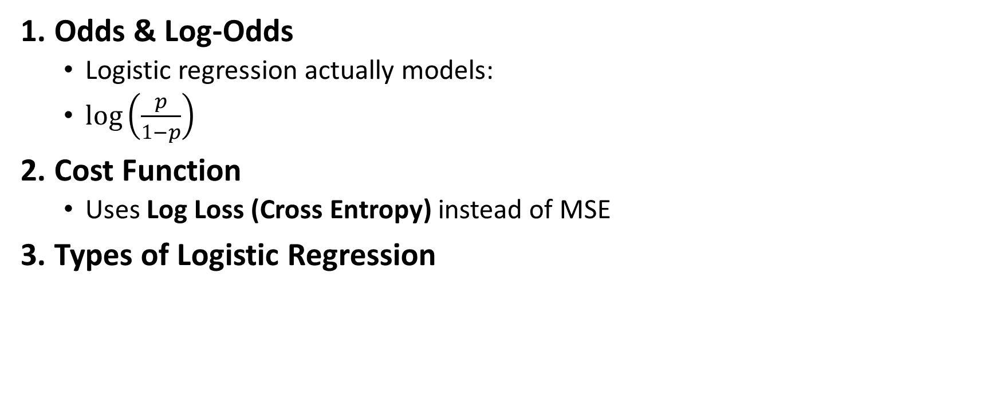
Key Concepts
1. Odds & Log-Odds
  Logistic regression actually models:
  $\log\left(\frac{p}{1−p}\right)$
2. Cost Function
  Uses Log Loss (Cross Entropy) instead of MSE
3. Types of Logistic Regression
Type | Description
Binary | 2 classes
Multinomial | Multiple classes
Ordinal | Ordered classes

Slide 8
Predict Customer Churn - Example
import pandas as pd
from sklearn.linear_model import LogisticRegression
# Sample dataset
df = pd.DataFrame({
'age': [22, 25, 47, 52],
'salary': [20000, 25000, 50000, 60000],
'churn': [0, 0, 1, 1]
})
X = df[['age', 'salary']]
y = df['churn']
model = LogisticRegression()
model.fit(X, y)
print(model.predict([[30, 30000]]))

Slide 9
Advantages & Limitations
Advantages
  Simple & fast
  Interpretable
  Works well for linear boundaries
Limitations
  Struggles with complex relationships
  Assumes linear relationship
  Sensitive to outliers

Slide 10
When to Use Logistic Regression
Use it when:
  Problem is classification
  Need probability output
  Dataset is not extremely complex

Slide 11
What is a Decision Tree?
A Decision Tree is a supervised machine learning algorithm used for:
Classification (Yes/No, Spam/Not Spam)
Regression (predict numbers)
It works like a flowchart of decisions:
Is Age > 30?
Yes → Buy = Yes
No → Buy = No
Each node = a question
Each branch = an answer
Each leaf = final prediction

Slide 12
Why Use Decision Trees?
Easy to understand (human-like reasoning)
No need for feature scaling
Handles both numerical & categorical data

Slide 13
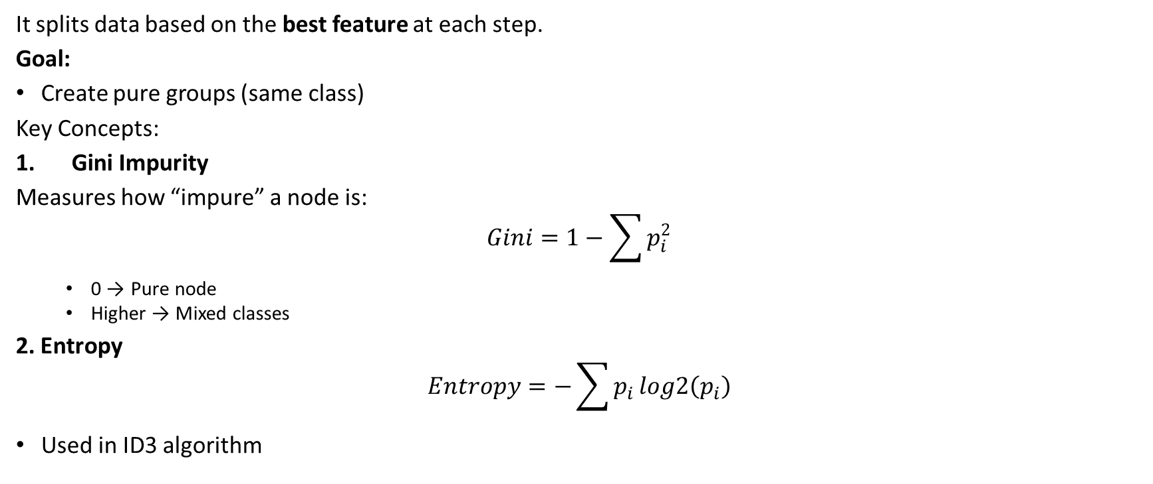
How Decision Tree Works?
It splits data based on the best feature at each step.
Goal:
Create pure groups (same class)
Key Concepts:
Gini Impurity
Measures how “impure” a node is:
$$Gini=1−\sum{p_{i}^{2}}$$
  0 → Pure node
  Higher → Mixed classes
2. Entropy
$$Entropy=−\sum{p_{i}}log2\left(p_{i}\right)$$
Used in ID3 algorithm

Slide 14
Key Concepts
3. Information Gain
  Reduction in impurity after split
  Choose split with highest gain

Slide 15
How Tree Builds
Pick best feature (max information gain)
Split dataset
Repeat for each branch
Stop when:
  Pure node OR
  Max depth reached

Slide 16
Example (Simple Classification)
Predict if a person buys a product
from sklearn.tree import DecisionTreeClassifier
from sklearn.model_selection import train_test_split
from sklearn.metrics import accuracy_score
# Features: Age
X = [[22], [25], [47], [52], [46], [56]]
# Target: 0 = No, 1 = Yes
y = [0, 0, 1, 1, 1, 1]
# Split data
X_train, X_test, y_train, y_test = train_test_split(X, y, test_size=0.2)
# Create model
model = DecisionTreeClassifier()
# Train
model.fit(X_train, y_train)
# Predict
y_pred = model.predict(X_test)
# Evaluate
print("Accuracy:", accuracy_score(y_test, y_pred))
# Predict new data
print(model.predict([[30]]))

Slide 17
Visualizing the Tree
from sklearn import tree
import matplotlib.pyplot as plt
tree.plot_tree(model, filled=True)
plt.show()
This shows:
  Decision rules
  Splits
  Predictions

Slide 18
Decision Tree (Real Dataset Example)
from sklearn.datasets import load_iris
from sklearn.tree import DecisionTreeClassifier
# Load dataset
data = load_iris()
X = data.data
y = data.target
# Train model
model = DecisionTreeClassifier(max_depth=3)
model.fit(X, y)
# Predict
print(model.predict([X[0]]))

Slide 19
Advantages & Disadvantages
Advantages
Easy to interpret
Works with non-linear data
No scaling required
Disadvantages
Overfitting (very common)
Sensitive to small data changes
Can become complex

Slide 20
Avoid Overfitting (Important)
Use parameters:
DecisionTreeClassifier(
max_depth=3,
min_samples_split=5,
min_samples_leaf=2
)

Slide 21
Intuition Summary
Decision Tree is:
“A sequence of questions that splits data into smaller and purer groups until a final decision is made.”

Slide 22
Real-World Use Cases
Fraud detection
Customer segmentation
Medical diagnosis
Recommendation systems

Slide 23
What is Random Forest?
Random Forest is an ensemble learning algorithm that combines multiple Decision Trees to improve accuracy and reduce overfitting.
Instead of relying on one tree, it builds a “forest” of trees and takes a majority vote (classification) or average (regression).

Slide 24
Why Random Forest?
A single Decision Tree:
  High variance (overfits easily)
Random Forest:
  Reduces overfitting
  More accurate
  More stable
Core Idea (Simple Intuition)
“Train many decision trees on different subsets of data and combine their predictions.”

Slide 25
How Random Forest Works (Step-by-Step)
1. Bootstrapping (Bagging)
  Randomly sample data with replacement
  Each tree gets different data
2. Feature Randomness
  Each split considers only a random subset of features
3. Train Multiple Trees
  Build many decision trees independently
4. Aggregation
  Classification → Majority voting
  Regression → Average prediction

Slide 26
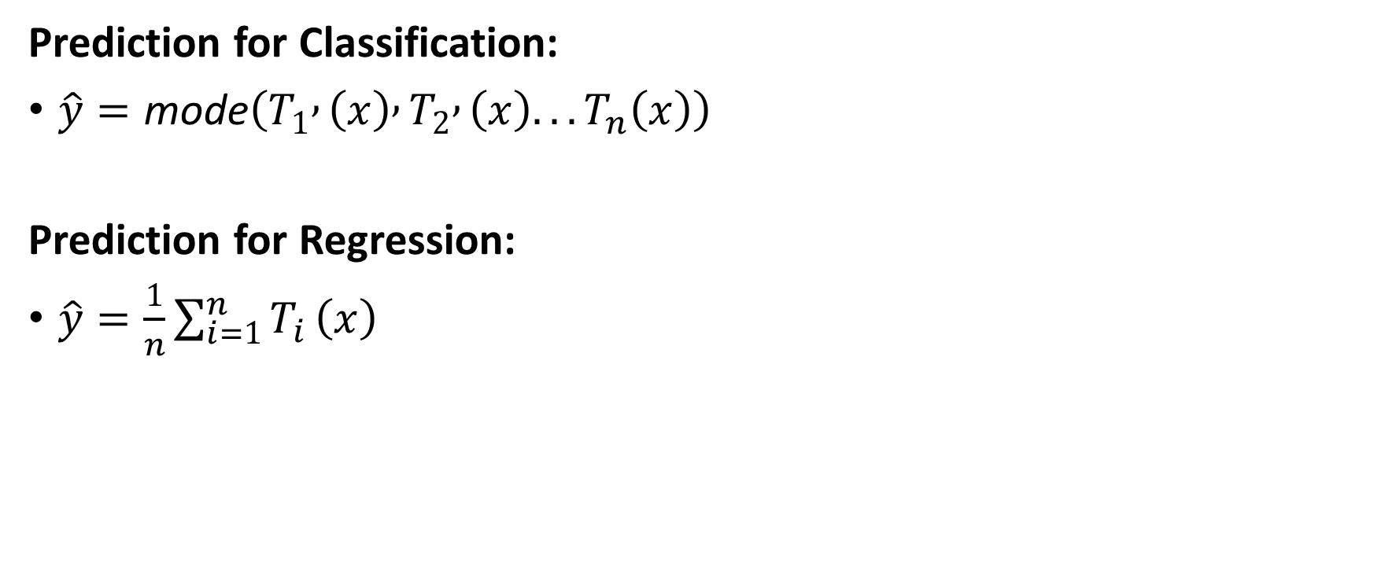
Mathematical Intuition
Prediction for Classification:
$\hat{y}=\text{mode}\left(T_{1} , \left(x\right) , T_{2} , \left(x\right)...T_{n}\left(x\right)\right)$
Prediction for Regression:
$\hat{y}=\frac{1}{n}\sum_{i=1}^{n}{T_{i}}\left(x\right)$

Slide 27
Example (Classification)
from sklearn.ensemble import RandomForestClassifier
from sklearn.model_selection import train_test_split
from sklearn.metrics import accuracy_score
# Sample data
X = [[22], [25], [47], [52], [46], [56]]
y = [0, 0, 1, 1, 1, 1]
# Split
X_train, X_test, y_train, y_test = train_test_split(X, y, test_size=0.2)
# Model
model = RandomForestClassifier(n_estimators=100)
# Train
model.fit(X_train, y_train)
# Predict
y_pred = model.predict(X_test)
print("Accuracy:", accuracy_score(y_test, y_pred))
print("Prediction:", model.predict([[30]]))

Slide 28
Real Dataset Example
from sklearn.datasets import load_iris
from sklearn.ensemble import RandomForestClassifier
data = load_iris()
X = data.data
y = data.target
model = RandomForestClassifier(n_estimators=100, max_depth=3)
model.fit(X, y)
print(model.predict([X[0]]))

Slide 29
Important Parameters
RandomForestClassifier(
n_estimators=100, # number of trees
max_depth=5, # depth of each tree
min_samples_split=2,
min_samples_leaf=1,
max_features='sqrt' # features considered per split
)
Feature Importance (Very Powerful)
import pandas as pd
model.fit(X, y)
importance = model.feature_importances_
print(importance)
Which features matter most?

Slide 30
Advantages & Disadvantages
Advantages
  High accuracy
  Handles non-linear data
  Reduces overfitting
  Works well on large datasets
Disadvantages
  Slower than single tree
  Less interpretable
  Large memory usage

Slide 31
Decision Tree vs Random Forest
Feature | Decision Tree | Random Forest
Accuracy | Medium | High
Overfitting | High | Low
Speed | Fast | Slower
Interpretability | Easy | Hard
Intuition Summary:
Random Forest is:
A team of decision trees where each tree votes, making the final decision more reliable.

Slide 32
Real-World Use Cases
Fraud detection
Credit scoring
Recommendation systems
Medical diagnosis

Slide 33
What is K-Means Clustering?
K-Means Clustering is an unsupervised machine learning algorithm used to group similar data points into clusters.
Unsupervised means:
No labels (no correct answers given)
The algorithm finds patterns on its own

Slide 34
Goal of K-Means
Divide data into K groups (clusters) such that:
  Points in the same cluster are similar
  Points in different clusters are different

Slide 35
Real-Life Examples
Customer segmentation
Image compression
Grouping news/articles
Fraud detection patterns

Slide 36
How K-Means Works
Step 1: Choose number of clusters (K)
  Example: K = 2
Step 2: Initialize centroids
  Pick K random points as cluster centers
Step 3: Assign points to nearest centroid
  Use distance (usually Euclidean)
Step 4: Update centroids
  Compute mean of all points in each cluster
Step 5: Repeat until convergence
  No change in clusters OR
  Centroids stop moving

Slide 37
Distance Formula (Euclidean)
𝑑=∑(𝑥𝑖−𝑦𝑖)2
Used to measure similarity between points

Slide 38
Objective Function
K-Means tries to minimize:
∑(distance between points and their centroid)2
This is called Within-Cluster Sum of Squares (WCSS)

Slide 39
Example (Basic)
from sklearn.cluster import KMeans
import numpy as np
# Sample data
X = np.array([
[1,2], [2,3], [3,4],
[10,11], [11,12], [12,13]
])
# Create model
kmeans = KMeans(n_clusters=2)
# Train
kmeans.fit(X)
# Output
print("Cluster labels:", kmeans.labels_)
print("Centroids:", kmeans.cluster_centers_)

Slide 40
Visualization
import matplotlib.pyplot as plt
plt.scatter(X[:,0], X[:,1], c=kmeans.labels_)
plt.scatter(kmeans.cluster_centers_[:,0],
kmeans.cluster_centers_[:,1],
s=200, marker='X')
plt.show()

Slide 41
Choosing the Right K (Elbow Method)
Try different values of K and pick optimal one
wcss = []
for i in range(1, 10):
kmeans = KMeans(n_clusters=i)
kmeans.fit(X)
wcss.append(kmeans.inertia_)
plt.plot(range(1,10), wcss)
plt.show()
Look for “elbow point”

Slide 42
Advantages & Disadvantages
Advantages
Simple & fast
Works well for large datasets
Easy to implement
Disadvantages
Need to choose K manually
Sensitive to initial centroids
Struggles with non-spherical clusters

Slide 43
Intuition Summary
K-Means is:
  An algorithm that repeatedly groups data by minimizing distance to cluster centers.

Slide 44
DBSCAN — Density-Based Clustering

Slide 45
What is DBSCAN?
DBSCAN (Density-Based Spatial Clustering of Applications with Noise) is an unsupervised learning algorithm that groups data based on density (how closely points are packed).
Unlike K-Means:
No need to choose number of clusters (K)
Can detect arbitrary-shaped clusters
Can identify outliers (noise)
Core Idea
“Clusters are areas of high density separated by areas of low density.”

Slide 46
Key Concepts
1. Epsilon (ε)
Radius around a point
Defines neighborhood size
2. MinPts
Minimum number of points required to form a dense region
3. Types of Points
Core Point
  Has ≥ MinPts within ε radius
Border Point
  Inside ε of a core point
  But has fewer neighbors
Noise Point
  Not part of any cluster

Slide 47
How DBSCAN Works
Pick a point
Check neighbors within ε
If neighbors ≥ MinPts → create cluster
Expand cluster by adding nearby points
Repeat for all points
Distance Measure (Usually Euclidean)
𝑑=∑(𝑥𝑖−𝑦𝑖)2d=∑(xi​−yi​)2​

Slide 48
Example (Basic)
from sklearn.cluster import DBSCAN
import numpy as np
# Sample data
X = np.array([
[1,2], [2,3], [3,4],
[10,11], [11,12], [12,13],
[50,50] # noise
])
# Create model
dbscan = DBSCAN(eps=2, min_samples=2)
# Train
dbscan.fit(X)
# Output
print("Cluster labels:", dbscan.labels_)
Output Interpretation
[0, 0, 0, 1, 1, 1, -1]
0, 1 → clusters
-1 → noise (outlier)

Slide 49
Visualization
import matplotlib.pyplot as plt
labels = dbscan.labels_
plt.scatter(X[:,0], X[:,1], c=labels)
plt.show()

Slide 50
DBSCAN vs K-Means
Feature | K-Means | DBSCAN
Need K? | Yes | No
Shape | Circular clusters | Any shape
Outliers | Poor handling | Excellent
Speed | Fast | Slower

Slide 51
When to Use DBSCAN
Use DBSCAN when:
  Data has irregular shapes
  You need outlier detection
  Number of clusters is unknown
Challenges
  Choosing ε (epsilon) is tricky
  Sensitive to data scale
  Struggles with varying densities
Intuition Summary:
DBSCAN is:
“A clustering algorithm that finds dense regions and labels sparse points as noise.”

Slide 52
Real-World Use Cases
Fraud detection
GPS location clustering
Anomaly detection
Image segmentation

Slide 53
Important Point
Always scale your data before DBSCAN:
from sklearn.preprocessing import StandardScaler
X_scaled = StandardScaler().fit_transform(X)

