Slide 1
PySpark

Slide 2
PySpark Fundamentals
What is PySpark?
PySpark is the Python API for Apache Spark — a distributed data processing engine designed for big data at scale.
Distributed Processing Concepts
Core Idea:
Instead of processing data on one machine → split data across multiple machines (cluster)
Key Concepts:
Cluster → group of machines
Parallelism → tasks executed simultaneously
Partitioning → splitting data into chunks
Fault tolerance → recompute lost partitions
Example: If you process 1TB data:
Single machine → hours
Spark cluster → minutes

Slide 3
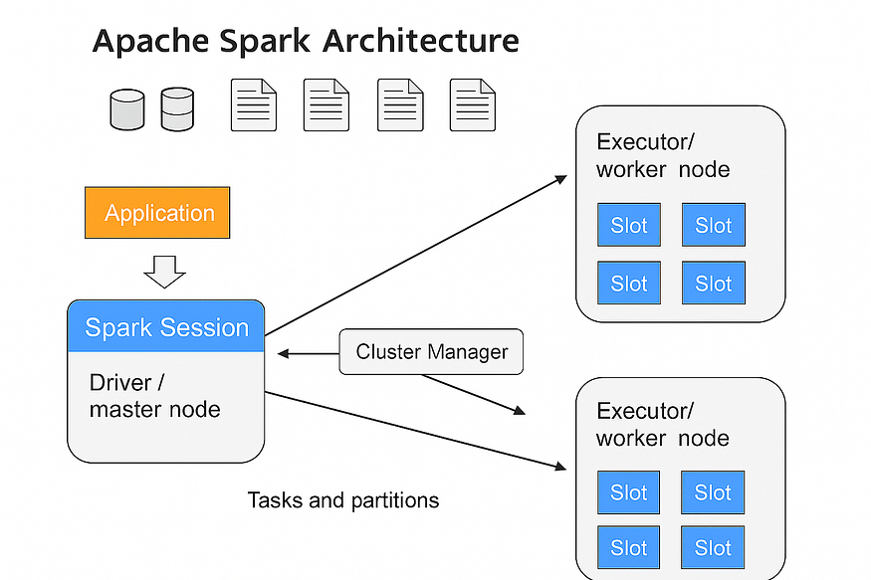
Spark Architecture
Components:
Driver
Main program (your PySpark script)
Creates SparkSession
Builds execution plan
Executors
Worker nodes
Execute tasks
Store data in memory
Cluster Manager
Allocates resources
Examples:
YARN
Kubernetes
Standalone
Flow :
Driver → creates DAG → sends tasks → Executors → return results
Notes:
https://blog.dataengineerthings.org/understanding-apache-spark-architecture-a-beginner-friendly-guide-for-data-engineers-28a14648ed2b

Slide 4
RDD vs DataFrame vs Dataset
In Apache Spark, RDDs, DataFrames, and Datasets are data abstractions used for distributed processing. While they share traits like fault tolerance and lazy evaluation, they differ in optimization, type safety, and language support.
RDD (Resilient Distributed Dataset)
The original Spark abstraction, RDDs are immutable collections of objects distributed across a cluster.
Best For: Low-level transformations, unstructured data (like media streams), or when you need total control over data lineage and partitioning.
Limitation: It lacks a schema, meaning Spark cannot optimize queries automatically. It also relies on expensive Java serialization.
Documentation: RDD Programming Guide (Apache Spark).

Slide 5
RDD vs DataFrame vs Dataset
2. DataFrame
Introduced in Spark 1.3, a DataFrame organizes data into named columns, similar to a table in a relational database.
Best For: Most data engineering tasks, ETL, and SQL-style analytics. It is the default choice for Python (PySpark) and R users.
Performance: Uses the Catalyst Optimizer and Project Tungsten for superior execution speed compared to RDDs.
Limitation: It is "untyped," meaning errors in column names or types are often only caught at runtime.

Slide 6
RDD vs DataFrame vs Dataset
3. Dataset
Introduced in Spark 1.6, Datasets combine the type safety of RDDs with the performance optimizations of DataFrames.
Best For: Production systems in Scala or Java where compile-time safety is critical for complex business logic.
Relationship: In Spark 2.0+, DataFrame is essentially an alias for Dataset[Row].
Optimization: Uses Encoders to map JVM objects to Spark's internal binary format, reducing garbage collection overhead.

Slide 7
RDD vs DataFrame vs Dataset
Feature | RDD | DataFrame | Dataset
Level | Low | High | High
Type Safety | No | No | Yes (Scala)
Performance | Slow | Fast | Fast
Optimization | Manual | Catalyst Optimizer | Catalyst
Choosing between RDDs, DataFrames, and Datasets depends on your specific use case:
Use RDDs for low-level transformations and flexibility.
Use DataFrames for structured data and SQL-like operations.
Use Datasets when type safety and performance are critical in Scala/Java.
Recommendation:
Use DataFrame (MOST IMPORTANT)
Notes:
Source: https://medium.com/@kiranvutukuri/rdds-vs-dataframes-vs-datasets-choosing-the-right-part-11-b12d6969885d

Slide 8
SparkSession
SparkSession
Entry point to PySpark:
from pyspark.sql import SparkSession
spark = SparkSession.builder \
.appName("ETL Example") \
.getOrCreate()
Lazy Evaluation & DAG
Lazy Evaluation:
Spark does NOT execute immediately.
df = spark.read.csv("data.csv")
df = df.filter("age > 25") # NOT executed yet
df.show() # Execution happens here
DAG (Directed Acyclic Graph):
Logical execution plan
Optimized before execution

Slide 9
Data Processing with PySpark
Reading Data
df_csv = spark.read.csv("data.csv", header=True, inferSchema=True)
df_json = spark.read.json("data.json")
df_parquet = spark.read.parquet("data.parquet")
Transformations
df_filtered = df_csv.filter(df_csv.age > 25)
Select Columns
df_selected = df_csv.select("name", "age")
Aggregations
from pyspark.sql.functions import avg
df_avg = df_csv.groupBy("department").agg(avg("salary"))
Joins
df_joined = df1.join(df2, on="id", how="inner")

Slide 10
Data Processing with PySpark
Writing Data
df.write.mode("overwrite").parquet("output/")
df.write.csv("output_csv/")
Handling Large Data Efficiently
Best Practices:
Use partitioning
Avoid collect()
Use broadcast joins
Cache data
df.cache()

Slide 11
End-to-End ETL Pipeline
Scenario:
Process sales data → clean → aggregate → store
Step 1: Setup
from pyspark.sql import SparkSession
from pyspark.sql.functions import col, sum
spark = SparkSession.builder.appName("ETL Pipeline").getOrCreate()
Step2: Extract
df = spark.read.csv("sales.csv", header=True, inferSchema=True)
Step 3: Transform
# Clean data
df_clean = df.filter(col("amount").isNotNull())
# Business logic
df_transformed = df_clean.groupBy("region").agg(sum("amount").alias("total_sales"))
Step 4: Load
df_transformed.write.mode("overwrite").parquet("output/sales_summary")

Slide 12
DEMO
from pyspark.sql import SparkSession
from pyspark.sql.functions import col, sum, avg, count, when, upper, to_date
# 1. Initialize Spark Session spark = SparkSession.builder \ .appName("SalesDataPipeline") \ .getOrCreate()
# 2. Extract: Load raw sales data (Sample data creation)
data = [ ("Store1", "2023-01-01", "Laptop", 1200.0, 2), ("Store2", "2023-01-02", "mouse", 50.0, None), # Missing quantity ("Store1", "2023-01-02", "LAPTOP", 1200.0, 1), # Mixed casing ("Store3", "2023-01-03", None, 0.0, 1), # Null product ("Store2", "2023-01-04", "Mouse", 55.0, 5) ]
columns = ["store_id", "sale_date", "product_name", "price", "quantity"]
df = spark.createDataFrame(data, columns)
# 3. Clean: Handle nulls, standardize text, and cast types
cleaned_df = df.filter(col("product_name").isNotNull()) \
.withColumn("product_name", upper(col("product_name"))) \
.withColumn("sale_date", to_date(col("sale_date"))) \
.na.fill({"quantity": 0}) # Fill missing quantity with 0
# 4. Aggregate: Group by store and product to find total revenue # Revenue = price * quantity
processed_df = cleaned_df.withColumn("revenue", col("price") * col("quantity")) \ .groupBy("store_id", "product_name") \ .agg( sum("revenue").alias("total_revenue"), avg("price").alias("avg_unit_price"), count("product_name").alias("transaction_count") )
processed_df.show()
# 5. Store: Save results to Parquet for efficient storage
output_path = "processed_sales_data"
processed_df.write.mode("overwrite").parquet(output_path)
Notes:
Core Processing Steps
Initialization: Use the SparkSession.builder to create an entry point.
Cleaning: Apply filter() to remove nulls and use na.fill() to handle missing values.
Transformation: Use withColumn() to create new features or cast data types, such as converting strings to dates with to_date().
Aggregation: Combine groupBy() and agg() to calculate metrics like sum, average, and count.
Storage: Use write.parquet() to save processed data in a columnar format that supports efficient compression and faster future reads.

Slide 13
References:
https://sparkbyexamples.com/pyspark-tutorial/
https://blog.dataengineerthings.org/understanding-apache-spark-architecture-a-beginner-friendly-guide-for-data-engineers-28a14648ed2b
https://medium.com/@kiranvutukuri/rdds-vs-dataframes-vs-datasets-choosing-the-right-part-11-b12d6969885d

