Slide 1

React
INTERNAL

Slide 2
Module 1: Components, Props, state, Hooks, useState
Module 2: List rendering, JSON, Bootstrap,
Intercomponent communication, Forms
Module 3: React Router, Axios and REST
S/W Requirements
IDE : Visual Studio
Browser: Google Chrome

Slide 3
Module 1
Components, Props, state, Hooks, useState
2

Slide 4
Module 1 Design
Target web page for showcasing components, props and state
Creating components
Props
State Handling
Use Case 1
A webpage with standalone components
Lifecycle Methods
Module 1
S/W Requirements
Interactive Components
IDE : Visual Studio Code
Browser: Google Chrome
Cheat Sheet for
React

Slide 5
Module 1: Overview
As part of this module, we will cover the most important and basic concepts of react. These concepts form the building block of any react application
The basic concepts that would be covered in this module are
Components
JSX syntax
Props and prop handling
Introduction to Hooks and useState Hook
State and updating state
Basic component hierarchy
Best practices for state updates
Interactive components (Event Handling)

Slide 6
Introducing Use Case 1
5

Slide 7
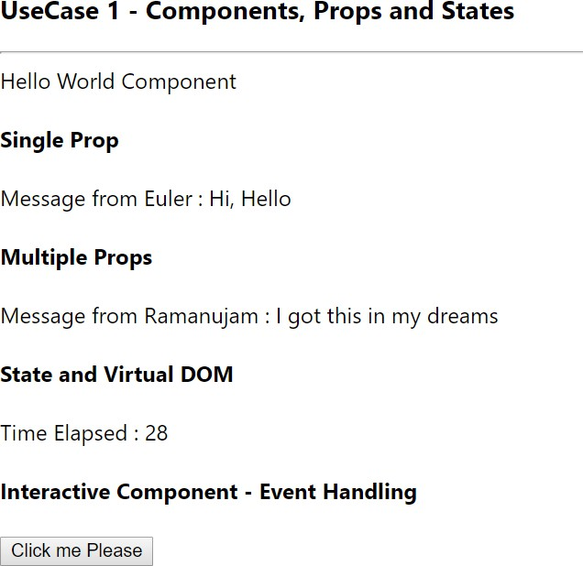
Presenting Use Case 1

Slide 8
Components in our use case
HelloWorld Component
HelloMessage (prop1)
HelloMessage (prop1, prop2)
Counter (State Changes)
Alert (event handling)
Sent props
Prop not sent – default value

Slide 9
Use case 1 - Explanation
As part of this use case, Create a simple react app with a single page which contains the below components
Give this page a title with h3 enabled text (UseCase 1 - Components, Props and States)
Also ensure that the entire page has a left and a right margin of 100px
Create all the below mentioned components under src/components/ subfolder
Create a component named HelloWorld displaying a simple text as “Hello World Component”
Create a component named HelloMessage which can receive 2 properties (name and message). If message prop is missing, use “Hi, Hello” as the default message.
Create a component named Counter which displays the time elapsed in seconds. Implement this by
using react state concept. Also, use the browser’s event setInterval for the implementation.
Create a component named Alert which shows up a button and when the button is clicked, should show an alert dialog with the message “React is a great UI library”
Display all these above components one by one in the order as shown in the use case 1

Slide 10
What is React?
9

Slide 11

What is React
React is a JavaScript library, created and open sourced by Facebook
React is a declarative, efficient, and flexible JavaScript library for building user interfaces
React lets you compose complex UIs from small and isolated
pieces of code called “components”
React can be used to make Rich internet applications, with more complex UI logic and user interactions. E.g. Facebook, Netflix
React can be used to built all modern applications right from
financial applications to consumer apps

Slide 12
Installation and Creating a React app
Install one of the latest Node.js version (LTS release) v8.0 would be optimal
Check if node.js is properly installed using the below command
node –v
Refer the below official getting started page
https://reactjs.org/docs/create-a-new-react-app.html
Install the create-react-app tool using the below npm command
npm install –g create-react-app
Create a new react app using the below command
create-react-app app-name
Change to the app folder and run the below command to start the react application
npm start
Once the app is run, it should open up the browser and show up the default react application

Slide 13
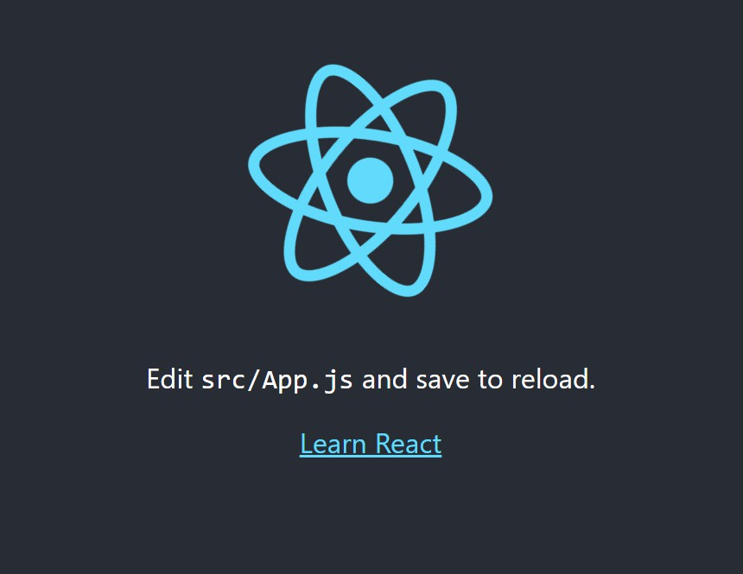
First app’s output
The first react application which you created using create-react-app should show the default output as shown in the below image. This output ensures that everything went well with your installation and build process in your local development machine.

Slide 14
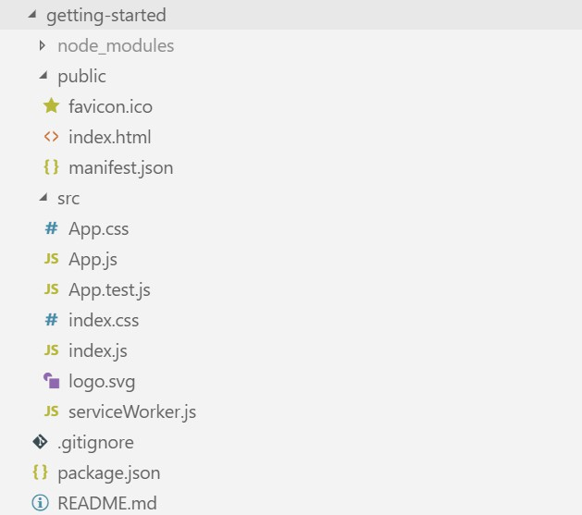
React app – Folder Structure
Folder Structure – The default app created by create-react-app contains the below folder structure and the set of files

Slide 15
About the app files
For the project to build, these files must exist with exact filenames
public/index.html - the page template
src/index.js - the JavaScript entry point
Regarding the other major files/folders
node_modules/ - the folder where all the required packages are installed
package.json - the package manager file, where all dependencies are mentioned
App.js - The root component of our app
App.css - css specific to the app component
All the new application code that the developer has to add for writing business logic/components are
typically put under the src/ folder
Only files under public can be used from public/index.html

Slide 16
Why create-react-app
create-react-app is an officially supported way to create single-page React applications. It offers a modern build setup with no configuration
React apps are mostly written with ES6. Babel is used for ES6 to ES5 conversion
create-react-app has the following advantages
Takes care of babel conversion from ES6 to ES5
Scaling to many files and components
Using third-party libraries from npm
Detecting common mistakes early
Live-editing CSS and JS in development
Optimizing the output for production

Slide 17
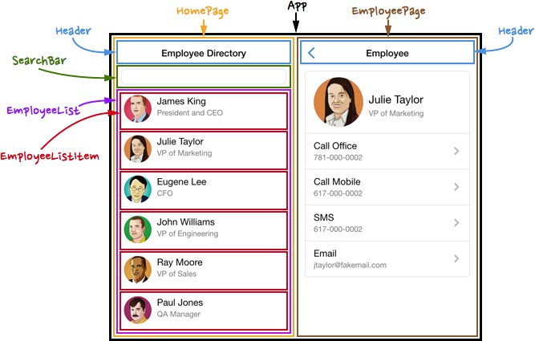
What are Components?

Slide 18
What are Components?
Components let you split the UI into independent, reusable pieces, and think about each piece in isolation
Conceptually, components are like JavaScript functions. They accept arbitrary inputs (called “props”) and return React elements describing what should appear on the screen
A component contains both the UI and the data logic associated with the UI
Components can be created using es6 functions.
React components are written using the JSX syntax (more specific to React only).

Slide 19
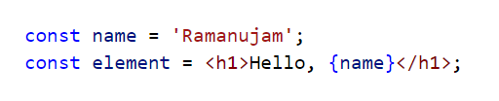
What is JSX and Why?
JSX is a syntax extension to JavaScript
JSX is a template language, but it comes with the full power of JavaScript
Example of a simple JSX code
Why JSX?
React embraces the fact that rendering logic is inherently coupled with other UI logic: how events are handled, how the state changes over time, and how the data is prepared for display
Embedding expressions in JSX
You can put any valid JavaScript expression inside the curly braces in JSX

Slide 20
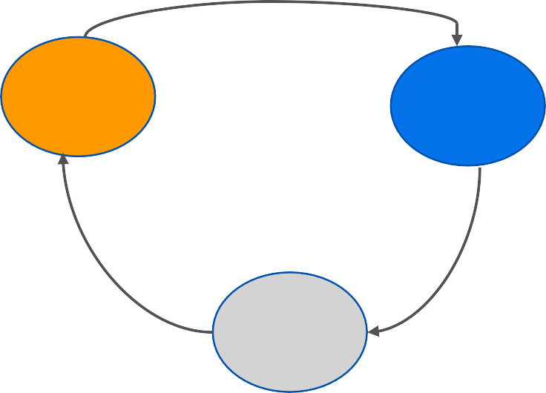
One way data binding
Data binding is a common terminology in UI development, which determines how data gets bound to the UI
React uses 1-way data binding, where the data flows in one direction (Unidirectional data flow)
How 1-way data binding works?
Whenever the state changes, the view is updated
View can trigger actions
Actions could update the state
Any state changes will update the view again
As depicted, the single source of truth is the state
Views
Actions
State

Slide 21

Creating Components
A component can be created using a simple JavaScript function also

Slide 22
Component Props
What are Props?
Props represents a single object containing all the attributes/properties sent to the component
Props can be compared to something like a collection of all parameters passed to a function
Why Props?
Props can be used for inter component message passing
Components can be logically organized into a parent child relationship
The parent component can pass props to the child component

Slide 23
Component Hierarchy Example
The below picture shows the simplest component hierarchy that can be a possible in a simple react app
App component is the root component and it has 5 children components
App – Root
HelloWorld
HelloMessage
HelloMessage
Counter
Alert

Slide 24
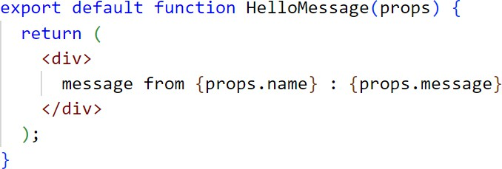
Using Props in a component
Props can be passed to a component just like any html attributes
Props could be strings, numbers, Boolean or objects (e.g employee, product etc)
A simple component HelloMessage which can receive two props (name and message)
The HelloMessage component is receiving two props(name and message)
If props are missing, no values displayed.

Slide 25
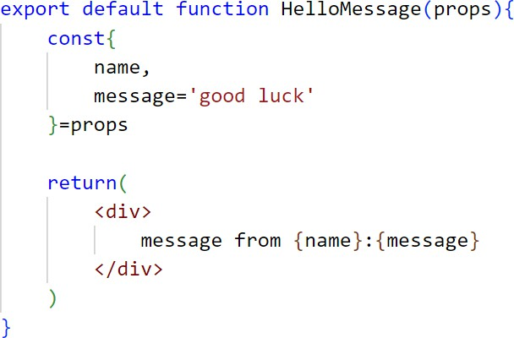
Default Props
Default values of props can be declared as de-structuring objects as shown in the below code

Slide 26
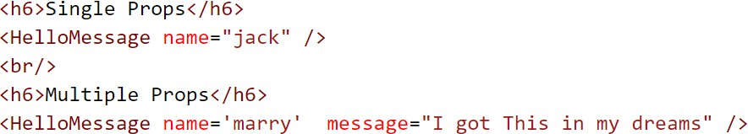


Passing props to a component
The HelloMessage component can be used and rendered in other components as shown below
We have used HelloMessage component in 2 different ways as shown in the above diagram
In the first usage, we are only sending the name prop. Hence the default message ‘good luck’ will be used and rendered.
Output
But in the 2nd usage, we are sending both the props, name and message
Output

Slide 27
Component State
What is a component state?
The heart of every React component is its “state”
State is an object that determines how that component renders & behaves
In other words, “state” is what allows you to create components that are dynamic and interactive
State is a JavaScript object that stores a component’s dynamic data and determines the component’s behavior
Unique features of state
State can be managed inside functional component
Unlike props, state is private to a component
In React, state is immutable
Immutability dictates that state should never be changed directly but changes should be made to a copy of the current state
State changes can be through a special react method called useState() in functional component.

Slide 28
State Usage and State Changes
We can refer to state all throughout the component code using useState(). We will be focusing on useState hook in our projects.
To modify the state, we have to use the useState assigned method in the declaration.
Whenever we want to change the UI, we update the state with corresponding data, then react
will automatically update the UI based on the state changes
This process is called re-rendering and react uses the concept of a virtual DOM to make state changes/transition fast and efficient
Hence the UI changes are pretty responsive and fast compared to the standard DOM manipulation

Slide 29
React virtual DOM
The virtual DOM (VDOM) is a programming concept where an ideal, or “virtual”, representation of a UI is kept in memory and synced with the “real” DOM by a library such as ReactDOM. This process is
called reconciliation
DOM manipulation is a very costly operation and React minimizes the DOM manipulation by using the virtual
DOM
Whenever state changes occur, React makes a diff between the actual DOM and the virtual DOM and updates only what is needed. Hence React based UIs are pretty-fast in the benchmarks
Virtual DOM
React runs the diffing algorithm and does reconciliation
Builds/rebuilds the
component tree
App
DOM
Events triggered

Slide 30
React Hooks
Hooks are a new addition in React 16.8.
Hooks are functions that help in using state and Lifecycle features without writing class.
If we want to add state for a functional component, we can use React hooks.
React provides a few inbuilt hooks like “useState”, “useEffect”, etc .
Custom hooks can also be created to reuse component logic.

Slide 31
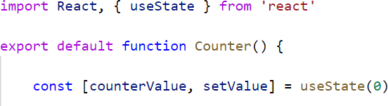
useState Hook
useState is a special function that declares a state variable.
It takes the initial state as input and returns a pair of values:
the current state
a function that updates it
We declare a state variable called counterValue and set it to 0.
React will remember its current value between re-renders and provide the most recent one to our function. If we want to update the current count, we need to use setValue() method.

Slide 32

useState() correct usage
There are a couple of things one should know about useState()
Syntax:
Array with two elements
Initial Value : Pass the initial value to the useState Hook. It can accept string, number, array, object
value :
React assigns the current value to the first element
function : React assigns the update function to the second element

Slide 33
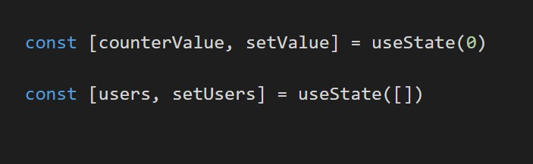
useState() usage
State updates may be asynchronous
Multiple state variables can be assigned inside a functional component
useState() only works in functional component

Slide 34
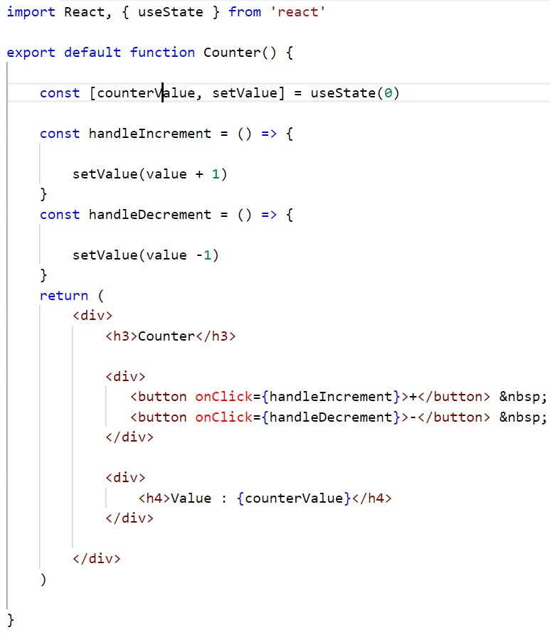
Functional Component using useState() - Counter
Setting Initial State
Changing State with state method
Using value with {} syntax

Slide 35
React component lifecycle methods
Every react component has a lifecycle associated with it. The component goes from a creation state to a destruction state and everything in between
To put it in other words, during the component lifecycle, react components gets mounted to the DOM,
then goes through an updating phase, and finally gets unmounted from the DOM
During this lifecycle, various events could happen and react provides certain methods/hooks to hook into the lifecycle event and add some custom behaviour. These are called lifecycle methods/hooks
After React 16.8 release, Hooks have eliminated lot of boilerplate code which was required in Class Components and made the lifecycle management less complicated for developers
Hooks are used in functional components

Slide 36
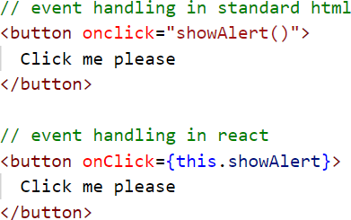
Interactive components – Event handling
To make components more interactive, with user input, we need to handle events in components
Handling events with React elements is very similar to handling events on DOM elements. But there are some syntactic differences
React events are named using camelCase, rather than lowercase.
With JSX you pass a function as the event handler, rather than a string. In functional component, this keyword is not required.
You are not calling the showAlert method, just passing the method name

Slide 37
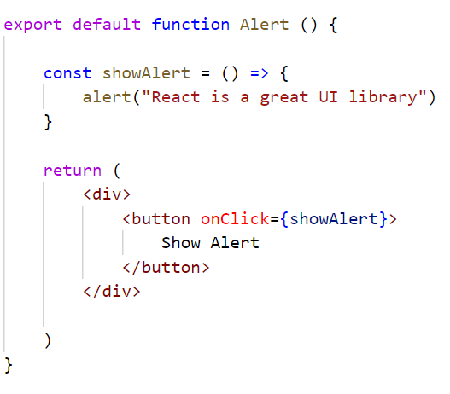
An interactive React component - Alert
Event Handler
Event handler, as a class function
React way of assigning event listeners, camelCase event name and pass the event handler function name

Slide 38
Module 2
List rendering, JSON, Bootstrap, Intercomponent communication, Forms
37

Slide 39
Module 2 – Design
Component Hierarchy & Intercomponent communication
Target web page for showing customers list, form and details components
List Rendering & JSON data handling
Styling UI with Boostrap
Use Case 2
React forms and form handling
Module 2
A webpage with multiple communicating components
Stateful vs Stateless components
S/W Requirements
IDE : Visual Studio Code
Browser: Google Chrome
Cheat Sheet for
React

Slide 40
Module 2 - Overview
As part of this module, we will cover some advanced concepts of react that will help in building real world components and
applications
The concepts that we are covering in this module are
List rendering
Using JSON data
Installing and adding 3rd party libraries
Using bootstrap UI library in our react apps
Handlings Forms
Advanced component hierarchy
React devtools
Forms and form handling in React
Parent to child communication through props
Child to parent communication through events
Conditional rendering of components
Forms Validation

Slide 41
Introducing Use Case – 2
40

Slide 42
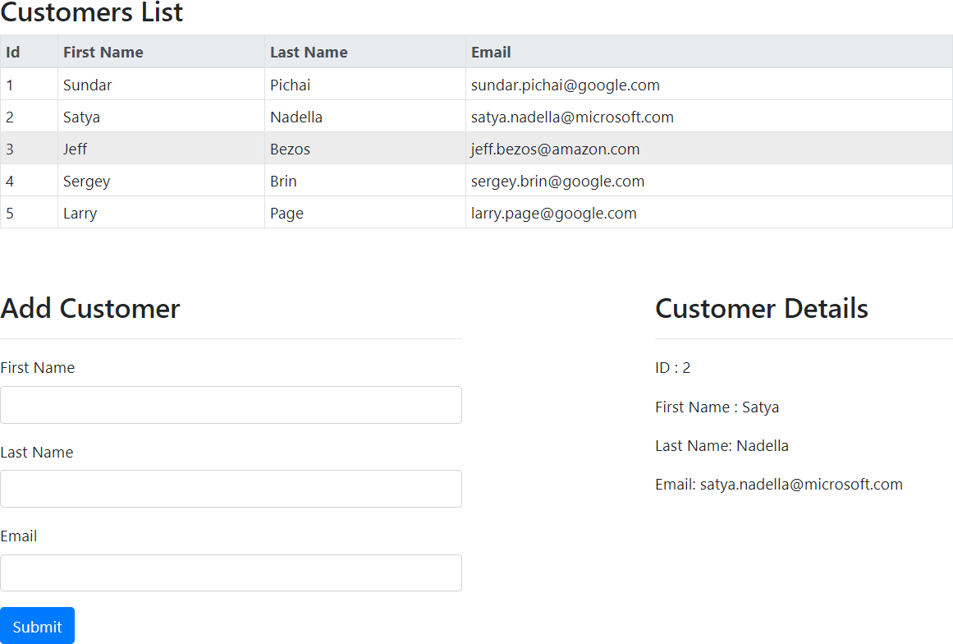
Presenting Use Case 2

Slide 43
Use case 2 - Explanation
As part of this use case, Create a react app with a single page which contains the below components and interactions between them
Ensure that the entire page has a left and a right margin of equal width
Create all the below mentioned components under src/components/customers subfolder
Create a CustomerList component, which can show a list of customers. For this use case, pick up the customers from a json file named customers.json
The customer data should have 4 fields (id, firstName, lastName, email)
Ensure that the CustomerList component is displayed in the top of the page, with the title
“Customer List” just above the table
Create a CustomerForm component which contains a form to enter the new customer details. The customer form should have 3 fields i.e First Name, Last Name, Email
Once the user enters the customer details and hit the submit button, a new customer has to be
added to the list in the CustomersList component
Create a CustomerDetails component, side-by-side to the CustomerForm component.
When the user clicks/selects a row in the CustomersList component, then the CustomerDetails
component should show up or update itself with the corresponding customer details

Slide 44
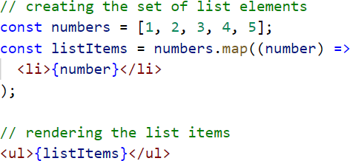
Rendering Lists
You can build collections of elements and include them in JSX using curly braces {}
Lets assume we want to display a list of items in an unordered list or want to display a list of items in a table, we need to render multiple elements inside a component
So, we loop through the items array using the JavaScript map() function and return a <li> or <tr>
element for each item. Finally we use/assign the array of react elements inside a component

Slide 45
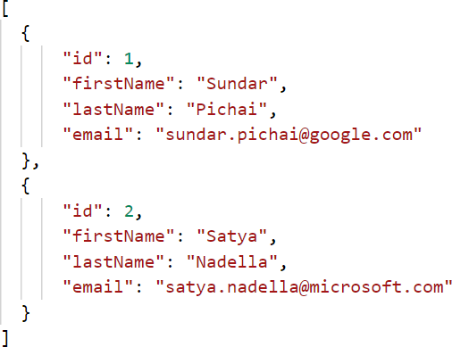
JSON sample data
In the previous slide, we handled an array of numbers which is hardcoded in the code
In many scenarios, we might have to use a JSON file
E.g.customers.json or listOfCustomers.json
A sample JSON file, customers.json is shown below

Slide 46

Loading JSON data in Components
To load json data, use the below syntax
JSON data is used commonly during development phase for storing mock data
JSON can be used for metadata, such as user settings or theme settings etc

Slide 47
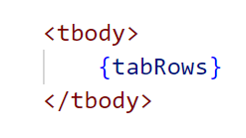
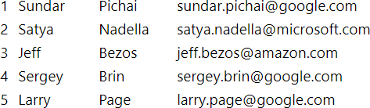
Rendering a set of row elements
Displaying an array of customers in a table row format could be achieved as
tabRows() should return the entire set of react elements needed to show the array of customers
tabRows() should return an array of <tr><tr/> elements, where in each <tr> element should represent one customer data
The implementation of the tabRows() method (presented in the next slide) should render output as shown below

Slide 48
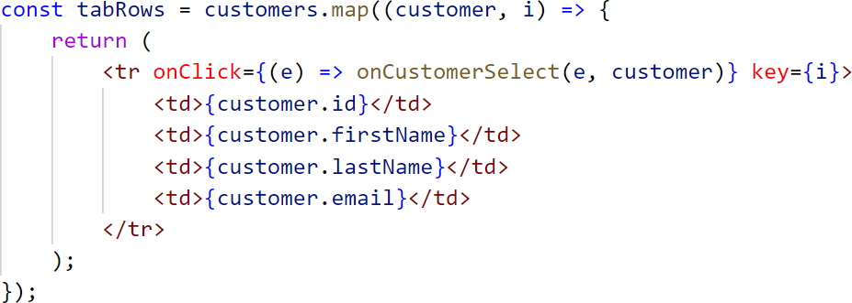
Rendering set of rows through map
tabRows() - loops through the customers array, then creates an array of react elements i.e an array of <tr> elements with customer data
* The above component is functional component example.
A “key” is a special string attribute you need to include when creating lists of elements. This is
internally used by react for optimizing how it handles the rendering logic an updates

Slide 49
Bootstrap
48

Slide 50
Adding Bootstrap to react
Lets add bootstrap to our react app to make our react components more beautiful, responsive and compatible with most popular browsers,
To add bootstrap to a react application, use the below command
npm install bootstrap
Enable the styling by adding css import in our index.js or app.js file
import 'bootstrap/dist/css/bootstrap.min.css’;

Slide 51
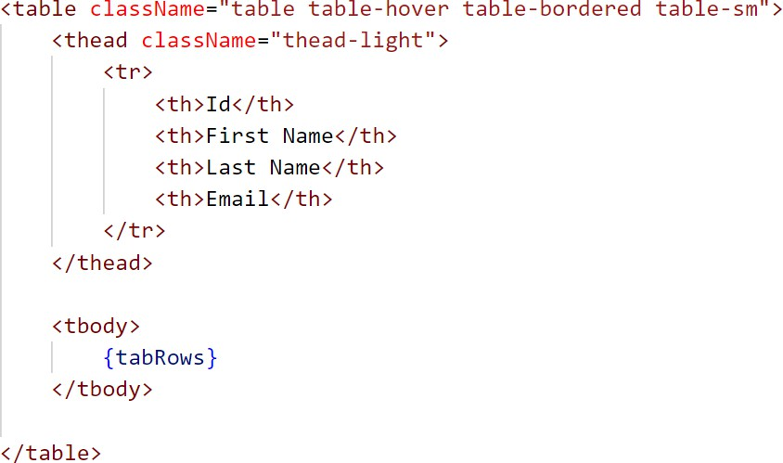
A table with bootstrap styles
Use the below bootstrap styles to make a bordered table and less padding between the columns
React uses the property name className to assign css classes, as compared to class keyword in standard
html

Slide 52
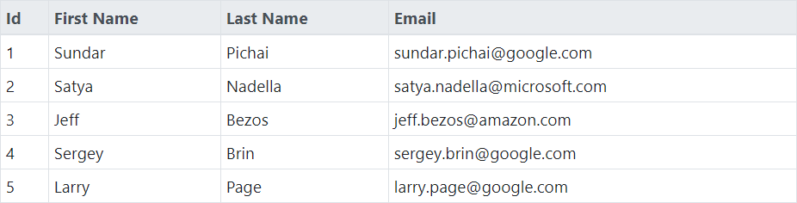
Table styles – Bootstrap enabled React tables
We added the most common table styles such as table, table-hover, table-bordered, table-sm
table – will add rows and column lines to make it look like a proper table
table-hover – when the user hovers the mouse over the table, the row would be selected
table-borderd – makes the outer borders for the table
table-sm – controls the spacing between columns (sm – small spacing)
We also added thead-light to the table header, which adds light color filling to the table header
After applying bootstrap classes, the customer list component should look below

Slide 53
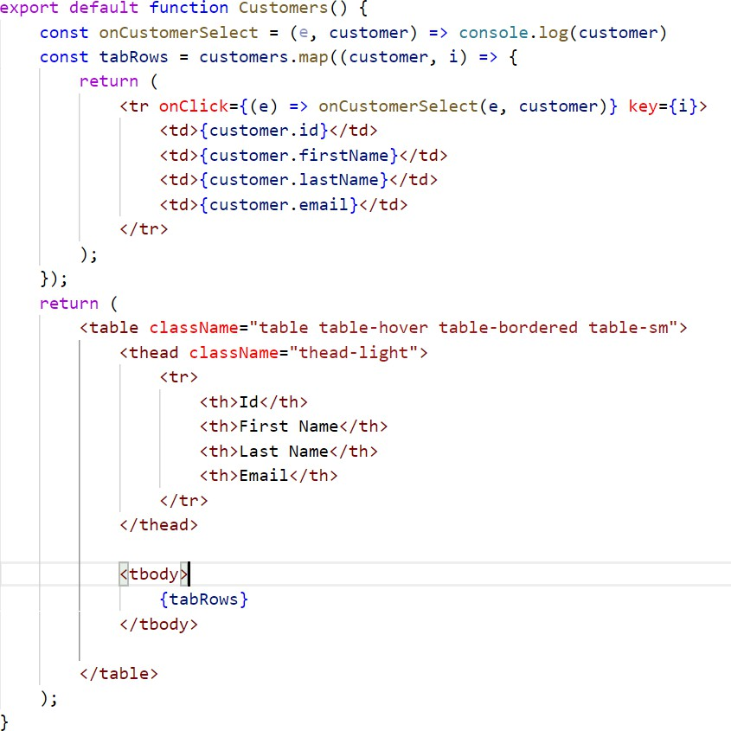
Code Snippet

Slide 54
Intercomponent communication
53

Slide 55
Intercomponent communication
In the first module, we saw how to develop standalone components. We looked at props, state and event handling
But in real world applications, we will have more complex component hierarchy, where in components
have to communicate to each other to exhibit their behavior
The ultimate goal of component oriented ui development approach is to define exactly what the component is internally made up of and what the component expects from the outside world

Slide 56

Two level component hierarchy
The below picture shows the 2 level component hierarchy
App is the root component, that contains the child component named CustomerList. The CustomerList
component in turn contains 2 children. i.e CustomerForm and CustomerDetails component
App Component
Uses customers.json Contains addCustomer() method implementation
Child Calls addCustomer() in parent thru event handling
Customers List
prop: addCustomer
prop: customer
Customer Form
Customer Details

Slide 57
More about component hierarchy
Real world application comprises of many components which interact with each other. When a component’s complexity increases, it is better to split it up into multiple components and have communication between them
Parent to child communication can happen by sending data through props object, in our example, the
CustomerList component sends customer as the prop to the CustomerDetails component
Child to parent communication can happen by calling a method in the parent. Child can know which method to call based on what the parent sends in the props object. E.g. addCustomer is the method name which is sent in the props, which in turn would be called by the child
The actual implementation of addCustomer method is present in the parent component(in our case, it is
CustomerList component)

Slide 58

Parent to child communication
React apps are made up of multi-level component hierarchies (a tree of components)
In a tree of components, there is a need to communicate data from the parent to the child or vice-versa
In react, any parent component can send data to the child component through the props object
Passing props to the child component
Customers List
prop: customer
Using props in the child component
Customer Details

Slide 59
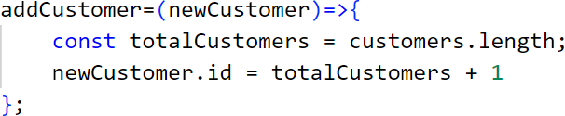
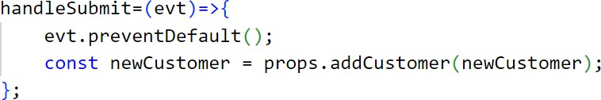
Child to parent communication
Child components can also communicate back to the parent
Child cannot pass data to the parent through props. Rather child component communicates with the parent by calling a method in the parent component
It can also pass data to the parent through the method arguments
Parent implements the addCustomer method
Customers List
prop: addCustomer
Child calls addCustomer()
Calls addCustomer()
Customer Form

Slide 60
Forms in React
59

Slide 61
Forms in React
The standard way to do forms in React is to use what are called as “controlled components”
In html, form elements such as <input>, <textarea> and <select> etc maintain their own state
and update it based on user input
In React, any mutable state is kept in the state property of functional components and only updated with useState() hook.
In the standard approach of dealing with forms, we can combine the above two by making the
React state be the “single source of truth”

Slide 62
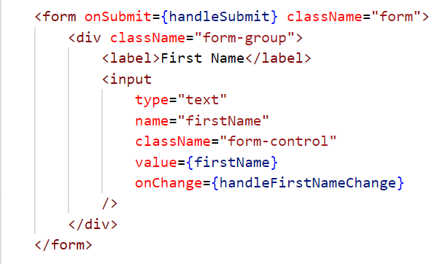

Form handling – listening to changes
Since the value attribute is set on our form element, the displayed value will always be firstName which is assigned to useState, making the React state the source of truth
Since handleFirstNameChange runs on every keystroke to update the React state, the displayed value will update as the user types

Slide 63
Forms Validation
62

Slide 64
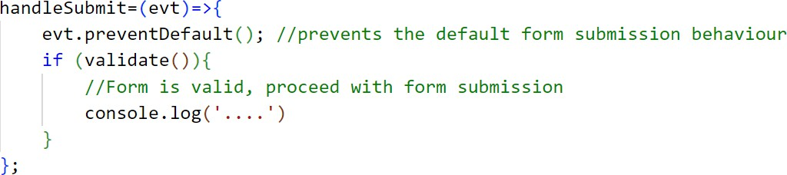
Form validations
In React forms, validations could be done using regular JavaScript techniques or code
In real world apps, 3rd party validation libraries could also be used, that would simplify the validation logic
Validation could happen during various user interactions
When the user submits the form
Or when the user is entering inputs in the form fields
So, forms could be made as interactive as possible using clientside validations
Just before the form is getting submitted, we can apply validation logic as shown below
If valid, the data is sent to the server, else errors should be shown in the form or webpage

Slide 65
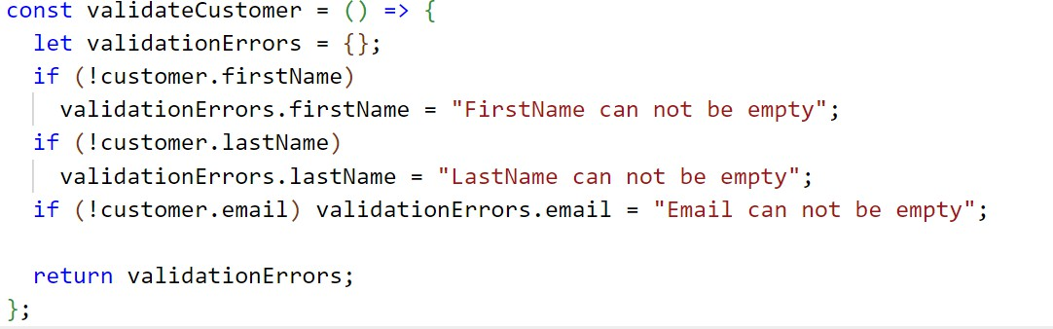
Form validations
A simple form validation method just before submitting customer form is shown below

Slide 66
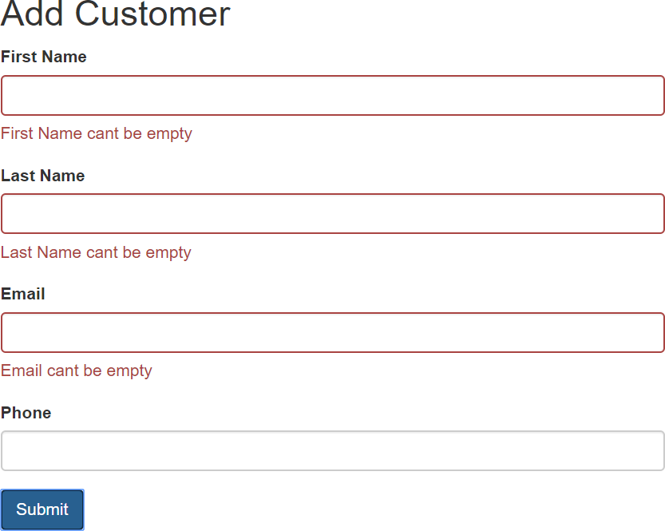
Displaying Form Errors
We have to apply dynamic styles to our forms so that on form submission, any error should be indicated as shown below

Slide 67
Displaying and styling error messages
While doing form validations, its important to differentiate valid and invalid fields
Also, error messages specific to individual columns could be displayed
There are some styles available in bootstrap library for handling success and error scenarios
has-error
has-success
We have to apply the error classes only if any errors are there. So, we have to apply bootstrap styles dynamically
There is a very useful 3rd party library named classnames, which can be used to apply css styles dynamically
Install the 3rd party library using the below command
npm install classnames

Slide 68
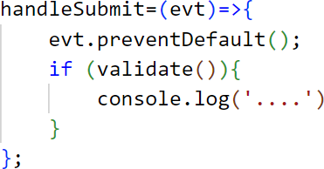
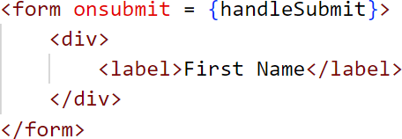
Handling events – e.preventDefault()
In a standard browser, whenever a user submits the form, the page refreshes after making a post request. Also, when the user clicks on a href link, the browser page gets redirects or refreshes
But when we develop single page apps with React, we don’t want the browser page to get refreshed. We want a
seamless behaviour without reloading the page
To achieve this, whenever form submission happens or the link is clicked, we have to capture the event and call
evt.preventDefault() to suppress the browser’s default behaviour
Here, event is a synthetic event. React defines these synthetic events according to the W3C spec, so you don’t need to worry about cross-browser compatibility

Slide 69
React Developer Tools

Slide 70
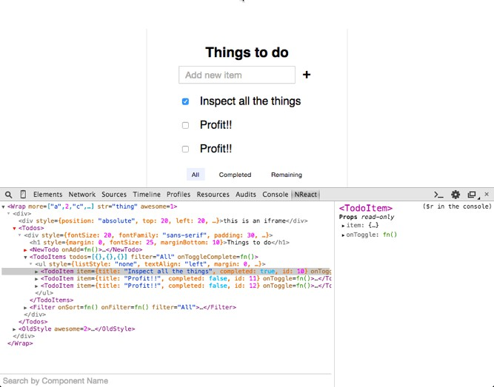
React Developer Tools
React Developer Tools lets you inspect the React component hierarchy, including component props and state

Slide 71
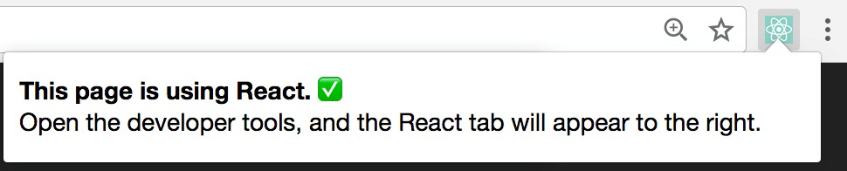
React Developer Tools - Usage
Its popularly know as React Devtools
It exists both as a browser extension (for Chrome and Firefox), and as a standalone app
The extension will light up on the websites using React

Slide 72
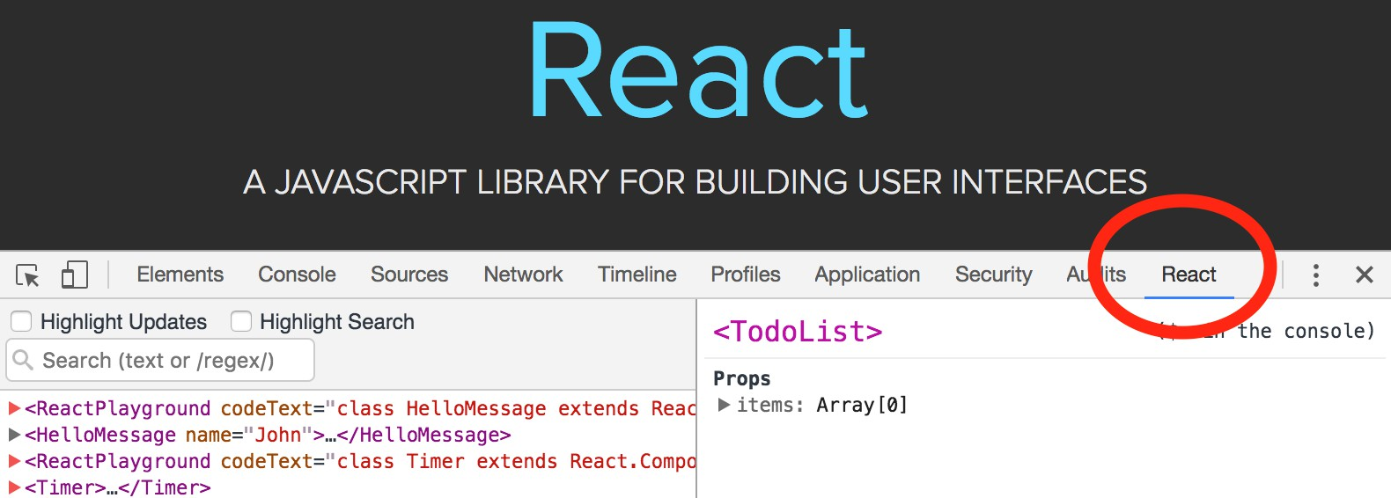
React Devtools tab
On the websites that use React, you will see a tab called React in Chrome Developer Tools
A quick way to bring up the DevTools is to right-click on the page and press Inspect

Slide 73
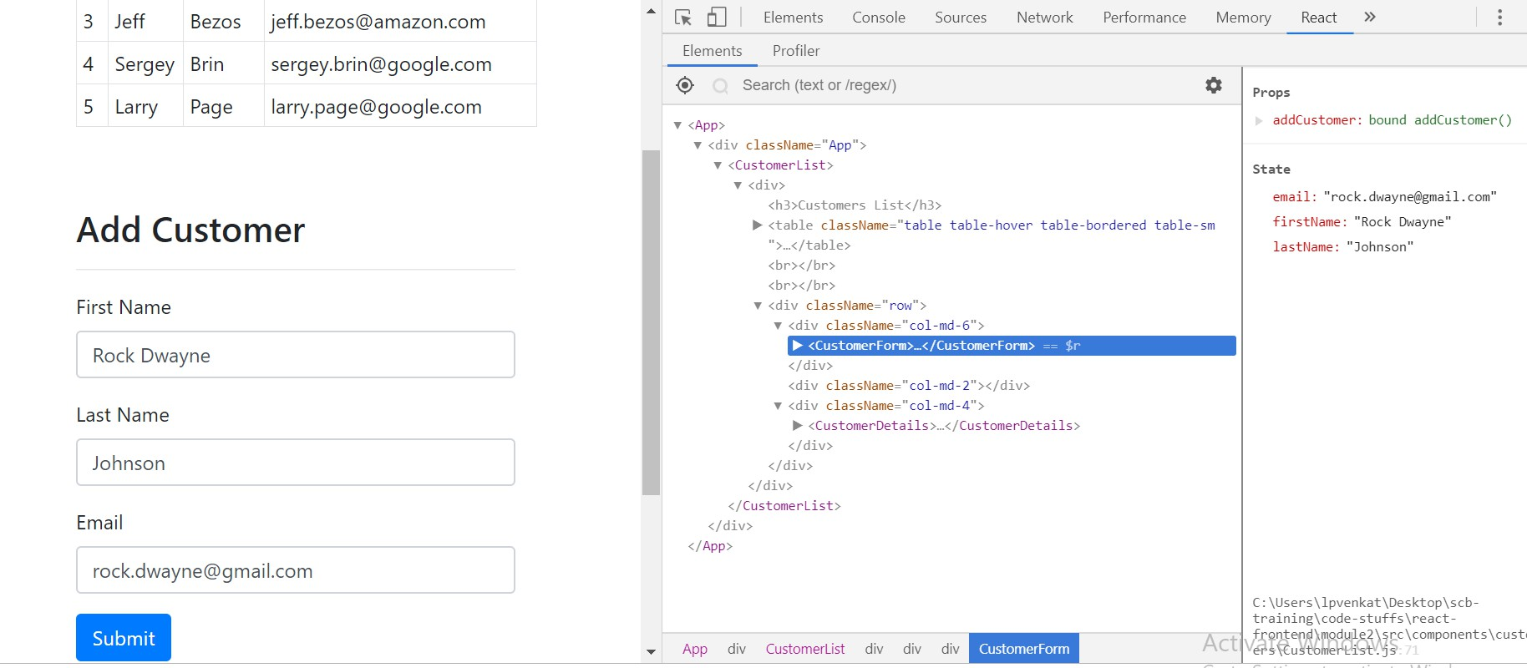
Inspecting use case 2 components with Devtools
Devtools showing the components hierarchy for use case 2 (also showing the current state/props
of CustomerForm)

Slide 74
Module 3
React Router, Axios and REST
73

Slide 75
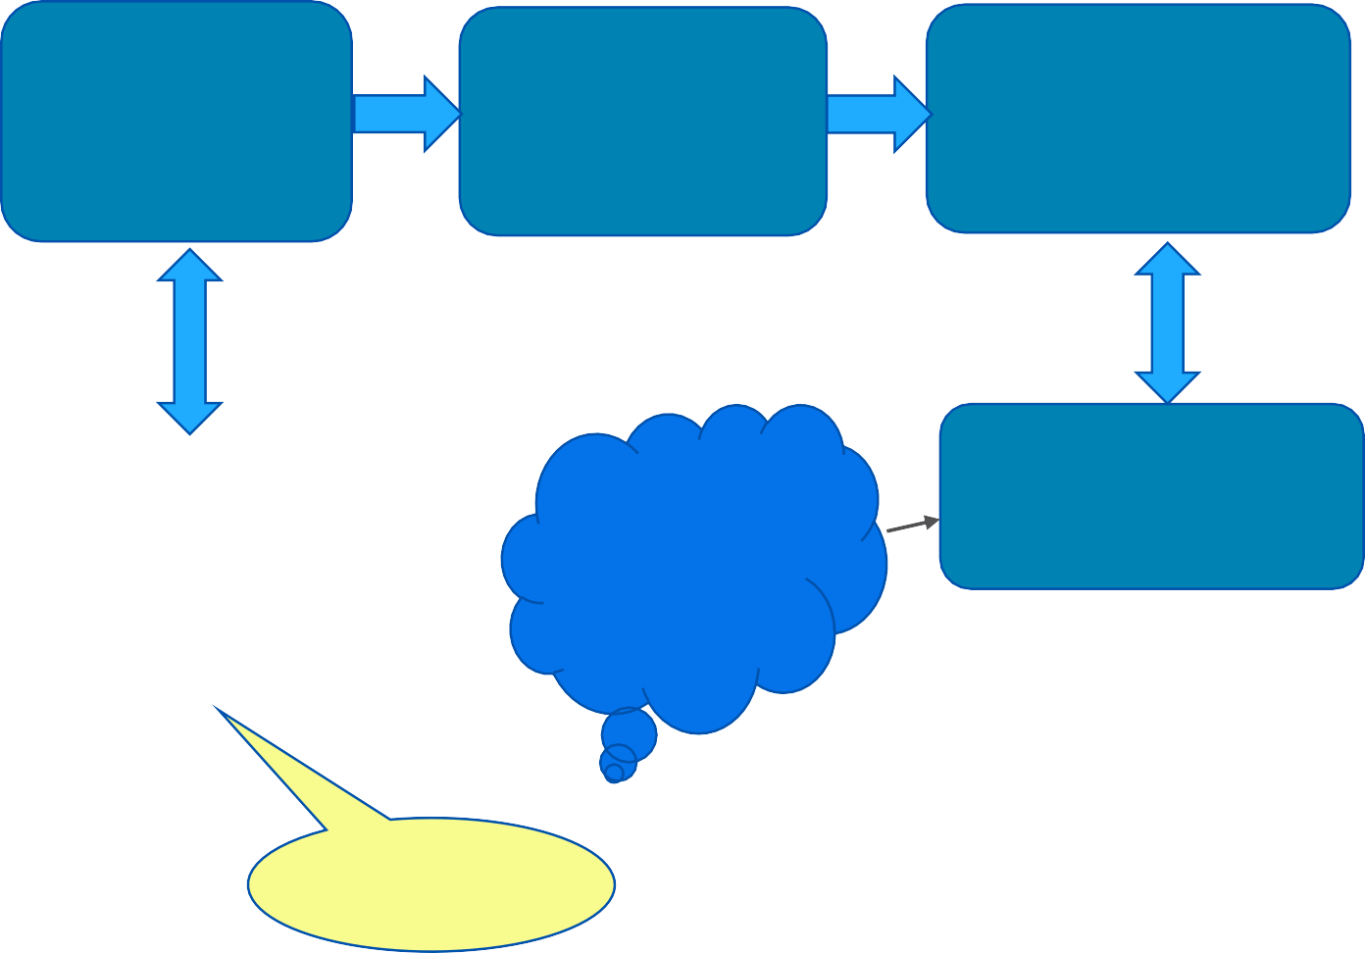
Module 3 – React advanced concepts
A webapp with multiple pages that can talk to the backend services
URL routing, Benefits, React Router
Routes mapping, Navigation, Route params
Consuming REST in React, General concepts, ideas
useEffect Hook to load API data before Component renders
Axios for REST api handling, Success and Error Handling
Module 3 React – Router, Axios, REST
Use Case 2
A full app to manage customers and view their account details
Cheat Sheet for React
S/W Requirements
IDE : Visual Studio Code
Browser: Google Chrome

Slide 76
Module 3 - Overview
As part of this module, we will cover topics such as Routing, Http services and Form validation
The concepts that we are covering in this module are
URL based routing
Installing and configuring React router
Using route parameters
URL Links, navigation and redirection
A full set of CRUD pages using react-router
Basics of consuming REST services in React
Installing and using axios
Full CRUD operations using axios
useEffect Hook and its usages
Handling success and Error scenarios
React build and deployment techniques

Slide 77
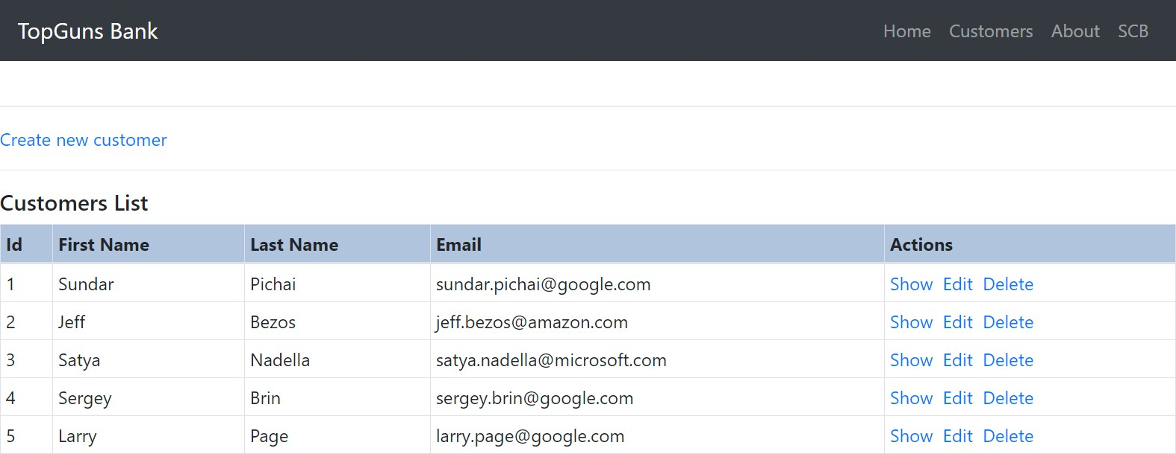
Use case 3 - Explanation
Create a react app to manage customers data and view their account details
The user/admin of this app should be able to manage the CRUD operations of customers
The admin should be able to view the account details of the selected customer

Slide 78
Use case 3 - Explanation
As shown in the previous slide, the app should have a navigation bar in the top, using which we navigate to the home page, about page, customers page etc
The customers page should display all the customer details in a table format, with options/links to do all CRUD operations on the customer data
When the user clicks on “Show” link, the app should be redirected to the customer details page
Create/Edit links should take the user to the customer form page, where in the create/edit action could be done
Delete link, when clicked, should ask for confirmation and delete the customer entry from the list
The home page and about page should have proper information about the bank, and the role of this
application in the bank respectively

Slide 79
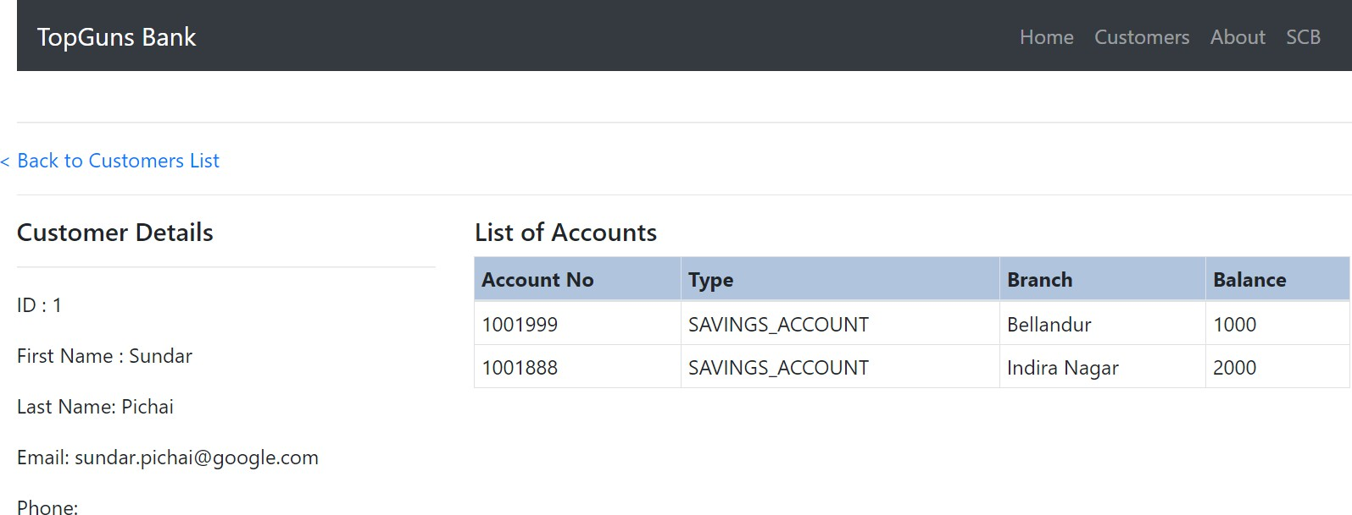
Use case 3 – Customer Details Page
The details page should show customer’s details, his/her accounts holding information. It should also have a navigation link back to the customer’s list page

Slide 80
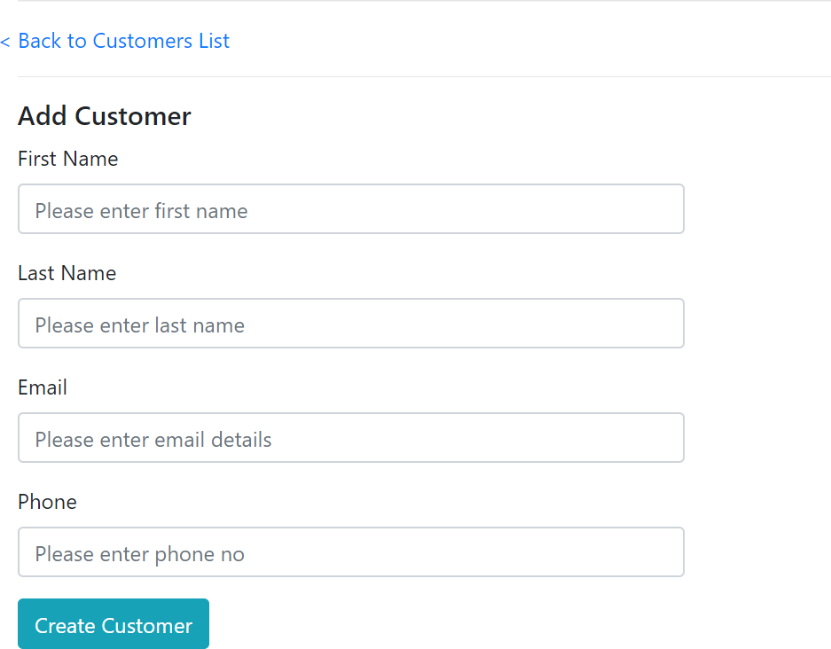
Use case 3 – Customer Form Page
The create/edit links or action should redirect the app to the customer form as shown
The form should validate if the fields are not empty and are in right format
Once the form is submitted, the control should get redirected to the list page, if customer creation/update was successful
If failure, the form should display error message and wait for the user action
The form should also have a navigation button back to the customers list page

Slide 81
Routing in React

Slide 82
Routing in React
Traditionally, Routing was used in the server side for mapping URLs to html pages
But in SPA frameworks such as React, the entire control is in client side
When the user visits a URL, different components could be rendered based on the URL mapping
This method of routing is also called a component routing
The following table shows a sample routing configuration
Route URL | Component
‘/about’ | About
‘/home’ | Home
‘/customers’ | CustomersList
‘/customers/new’ | CustomerForm
‘/customers/145’ | CustomerDetails

Slide 83
What is use of React Routing?
Single page apps became mainstream to enable desktop like user experience inside the browser
Then why is URL routing so important in single page apps that are created by React
The main uses of URL routing are
URLs can be bookmarked in browsers for reference later
URLs can be shared with others
Search engine friendliness
Routing is not mandatory in react apps, but for the above reasons it could be enabled by using 3rd party libraries

Slide 84
How to enable routing?
There are many libraries to enable routing in react apps
The most popular one is the React router
React router provides a declarative way to define routes
To install react router, use the below command
npm install react-router-dom
The library is called react-router-dom because it is targeted for web routing as compared to routing in react-native mobile apps

Slide 85
React router
React router provides three types of components for working with routing
Router components
Route matching components
Navigation components
React router provides a declarative way to do routing, hence react router components also look like typical react components

Slide 86
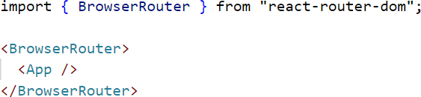
Router components
At the core of every react router application, there should be a router component
For web projects, react-router-dom provides <BrowserRouter />
<BrowserRouter/> can be used when we have a server that responds to requests
In a react router application, the entire app/root component should be encompassed inside a
BrowserRouter component

Slide 87
Route matching components
The route matching components can be used to control what components need to be rendered based on
location of the web page
There are 2 types of route matching components
<Route />
<Link />
You can include a <Route> anywhere that you want to render content based on the location
Route matching is done by comparing a <Route>'s path prop to the current location’s pathname
<Routes>
<Route path="/" element={<Home />}></Route>
<Route path="/customer" element={<Customer />}></Route>
</Routes>
In the above example, we have seen only static strings in the path
If we have match dynamic URLs such as ‘/customers/1’, ‘/customers/2’ etc. we have to use regex pattern matching as shown below

Slide 88
Route matching - Link
The <Link> component can be used to group <Route>s together
<div>
<Link to="/">Home</Link>|&nbsp;
<Link to="/customer">Customer</Link>
</div>
The exact attribute is used to indicate that the route path should be exactly matched and not just prefix matching
For e.g. the “/” path might match every possible component that starts with “/”, but if we use
exact, it will not match any other path matching the prefix

Slide 89
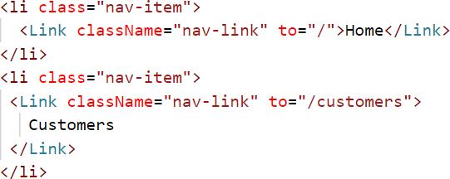
Navigation components
When we want to create links in our application, React Router provides a <Link> component
Whenever we render a <Link>, an anchor <a> will be rendered in your application’s html
The to attribute refers to the target link
The <Link> component has an attribute named to, which can be used to set the target navigation link

Slide 90
REST services

Slide 91
Consuming REST services
Most of the modern web apps communicate with a REST backend to get the actual data
Till now, we have only seen how to work with local JSON data
Because all browser based apps rely on HTTP protocol, REST is the most popular architecture to consume
data across the internet
REST services are called through HTTP and data format used is JSON
React apps can communicate with any internet services or our own backend server through HTTP and REST using JSON as the data format
HTTP_REQUEST
Spring Boot
Backend Server
HTTP_RESPONSE
React app
HTTP_REQUEST
Other Internet Services (Youtube, Github etc)
HTTP_RESPONSE

Slide 92
How to consume HTTP services in React
We can use the native browser methods such as fetch() in order to call http services from our react app
But in order to simplify and reduce a lot of boilerplate code, some popular 3rd party libraries are
used in order to consume http services
The most common in the React ecosystem is a library named axios
Please see https://github.com/axios/axios for complete details
The main features of axios library are
Make XMLHttpRequests from the browser
Supports the Promise API
Intercept request and response
Automatic transforms for JSON data

Slide 93
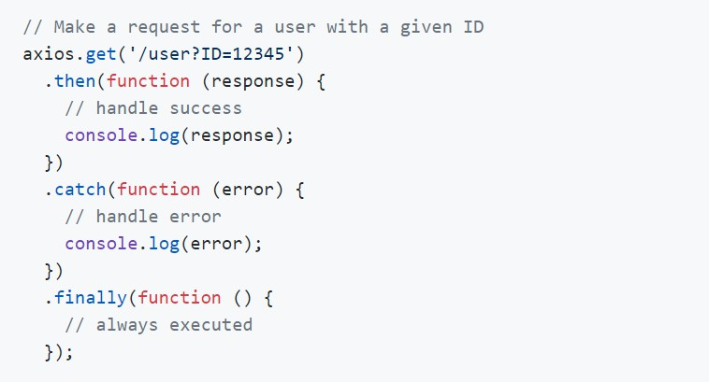
Axios Installation and Usage
Axios can be installed and added to our react app using the below command
npm install axios
Axios can be imported using the syntax
A sample axios usage is shown below

Slide 94
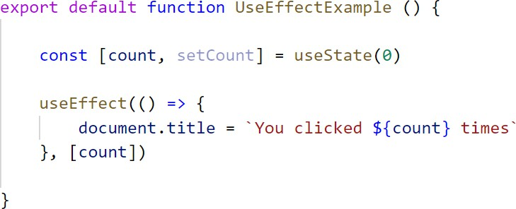
useEffect Hook
useEffect hook lets us perform side-effects in function component.
Data fetching, setting up a subscription, and manually changing the DOM in React components
are all examples of side effects.
useEffect (callback, dependencies) takes two arguments:
callback function - This function we pass is our effect. When React renders our component, it will remember the effect we used, and then run our effect after updating the DOM.
dependencies is an optional array of dependencies. useEffect() executes callback only if the
dependencies have changed between renderings.

Slide 95
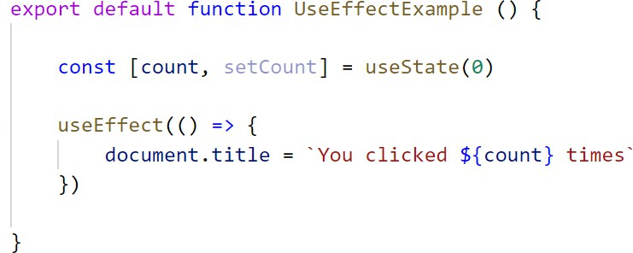
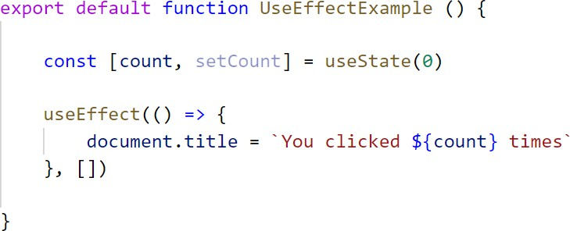
useEffect() Dependencies
dependencies argument of useEffect(callback, dependencies) lets you control when the side-
effect runs. When dependencies are:
Not provided: the side-effect runs after every rendering.
An empty array []: the side-effect runs once after the initial rendering.

Slide 96
useEffect() Dependencies continued
Has props or state values [prop1, prop2, ..., state1, state2]: the side-effect runs only when any dependency value changes.

Slide 97
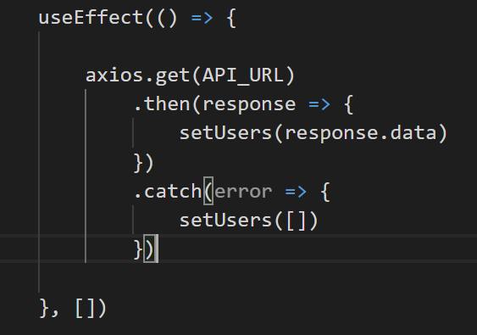
Axios – HTTP GET operation
The HTTP GET operation is done using axios.get() method. For eg, we can use this method to fetch a list of customers or a single customer details (for anything that is read only)
The CRUD operations could be triggered on various user events or interaction
When we are loading initial data for a functional component from the backend, its important to make the HTTP get calls in the useEffect Hook, so that the component is ready and mounted
The above axios.get() method is making a HTTP GET operation on the URL
http://localhost:8080/api/customers

Slide 98

Promises Usage
In the modern day JavaScript development, Promises are very common
Functional programming JavaScript are achieved through callbacks and promises provide an easy way to program with callbacks
A typical promise usage, as used in axios is shown below
Axios get method is returning a promise object and hence we are able to do a .then() and a .catch() call on it

Slide 99
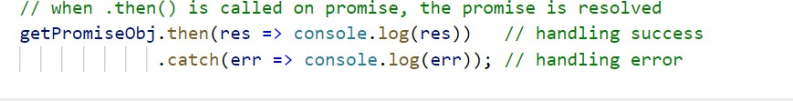
Promises Usage – More clarification
If we split the axios.get() call code into multiple statements, we can understand it much better
First receive the promise object
Now, define the actions for success using .then() and error scenario using .catch() methods

Slide 100
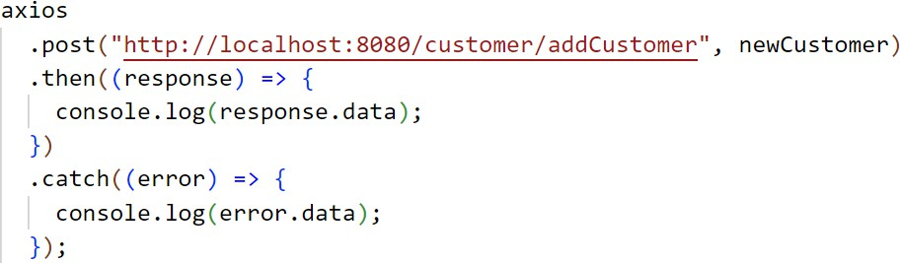
Axios – HTTP POST operation
POST is used for creating a new customer entity in the backend database
The HTTP POST operation is done using axios.post() method
POST operations are generated from html forms where user input various types of data
A sample axios.post() call is below
In a post call, the first parameter is the URL to which the POST is done and the 2nd parameter is the POST
data, in this case it’s the new customer data

Slide 101
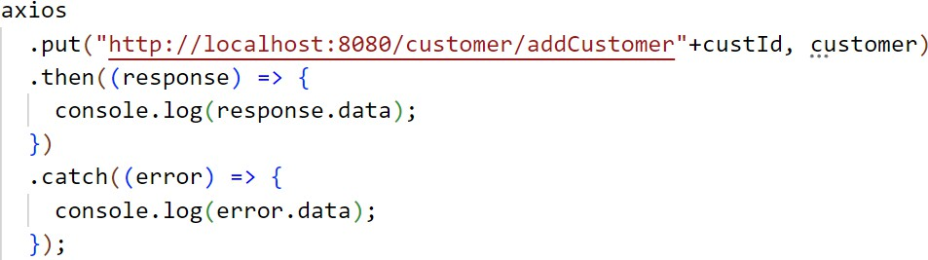
Axios – PUT operation
HTTP PUT operation is used for updating entities
When the user does edit/update operation on any entity(e.g.customer), PUT is used
A sample PUT call could be done using axios as below
PUT operation is similar to POST, where the 1st parameter is the URL and 2nd parameter is the data that is updated
PUT on http://localhost:8080/api/customers/123

Slide 102
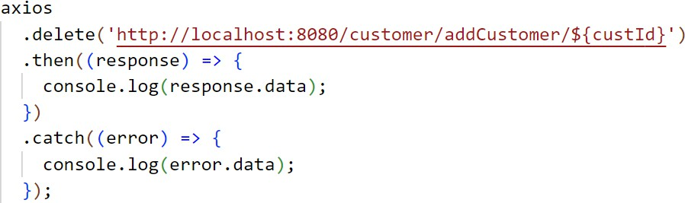
Axios – delete operation
HTTP DELETE method is used for delete operation
The HTTP POST operation is done using axios.delete() method.

Slide 103

Thank You
INTERNAL

