Slide 1
Ansible

Slide 2
Overview of Configuration Automation
Continuous configuration automation (CCA) is the methodology or process of automating the deployment and configuration of settings and software for both physical and virtual data center equipment.
CCA tools are used for what is called DevOps, and are often included as part of a DevOps toolchain. CCA grew out of a push to develop more reliable software faster.
CCA tools bring a newly found level of precision, efficiency and flexibility to the challenges of infrastructure and application configuration management.
CCA tools support administrators and developers to automate the configuration and Orchestration of physical and virtual infrastructure in a systematic way that give visibility to state of infrastructure within an enterprise.
Generally thought of as an extension of infrastructure as code (IaC) frameworks.
CCA tools include Ansible, Chef software, Otter, Puppet (software), Rudder (software) and SaltStack.
Each tool has a different method of interacting with the system some are agent-based, push or pull, through an interactive UI.

Slide 3
What is Ansible?
Ansible is an open source automation and orchestration tool for software provisioning, configuration management, and software deployment.
Ansible can easily run and configure Unix-like systems as well as Windows systems to provide infrastructure as code.
It contains its own declarative programming language for system configuration and management.

Slide 4
Why use Ansible?
Benefits of using Ansible
One of the most significant advantages of Ansible is that it is free to use by everyone.
It does not need any special system administrator skills to install and use Ansible, and the official documentation is very comprehensive.
Its modularity regarding plugins, modules, inventories, and playbooks make Ansible the perfect companion to orchestrate large environments.
Ansible is very lightweight and consistent, and no constraints regarding the operating system or underlying hardware are present.
It is also very secure due to its agentless capabilities and due to the use of OpenSSH security features.
Another advantage that encourages the adoption of Ansible is its smooth learning curve determined by the comprehensive documentation and easy to learn structure and configuration.

Slide 5
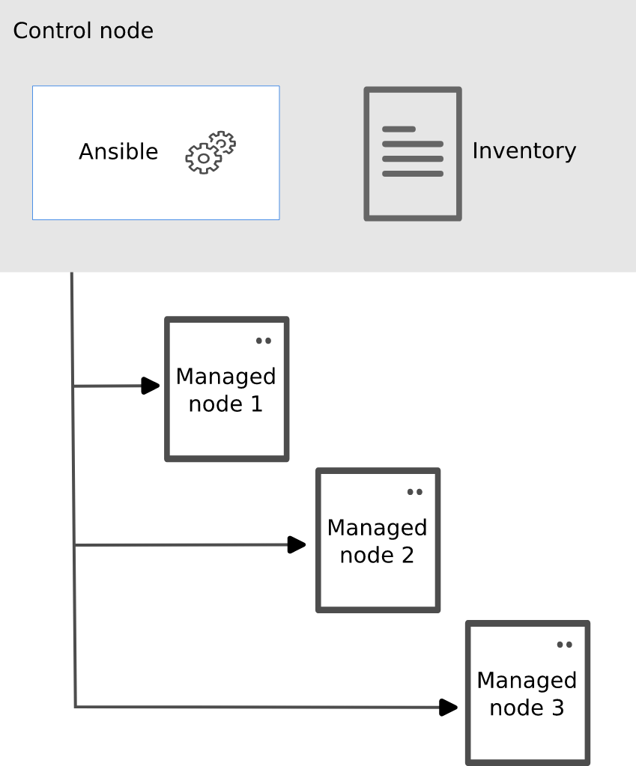
Ansible
Ansible automates the management of remote systems and controls their desired state.
A basic Ansible environment has three main components:
Control node
Managed node
Inventory

Slide 6
Important terms used in Ansible
Ansible server:
  The machine where Ansible is installed and from which all tasks and playbooks will be ran
Module:
  Basically, a module is a command or set of similar Ansible commands meant to be executed on the client-side
Task:
  A task is a section that consists of a single procedure to be completed
Role:
  A way of organizing tasks and related files to be later called in a playbook
Fact:
  Information fetched from the client system from the global variables with the gather-facts operation
Inventory:
  File containing data about the ansible client servers. Defined in later examples as hosts file
Play:
  Execution of a playbook
Handler:
  Task which is called only if a notifier is present
Notifier:
  Section attributed to a task which calls a handler if the output is changed
Tag:
  Name set to a task which can be used later on to issue just that specific task or group of tasks.

Slide 7
Installation
Demo

