Slide 1
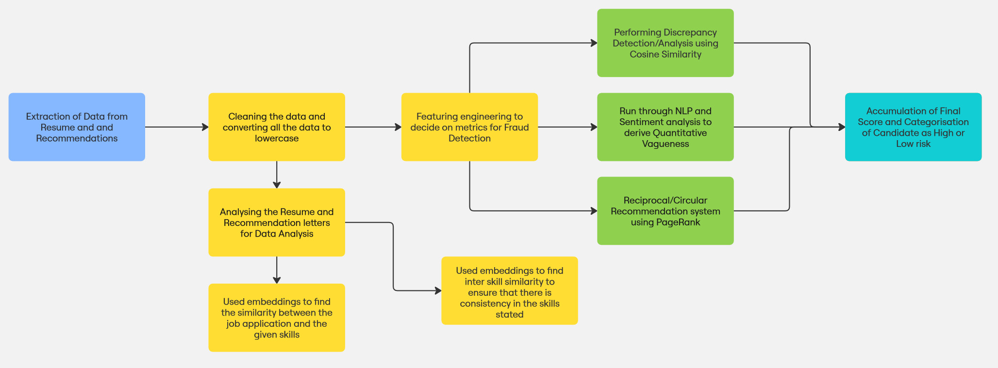
FLOWCHART OF OUR PROCESS

Slide 2

Three Step Approach to Fraud Detection
Scoring and Flagging for Risk
After applying the detection algorithms, assign a fraud risk score to each candidate. This score is based on the cumulative results of the metrics and algorithms.
We get two categories of candidates:-
High risk
Low risk
Determining Metrics
Our first order of business was to decide on the metrics to test each resume on. We formulated some potential metrics that if found in a resume would assign it a quantitative score that would translate it to being a Fraud resume. A resume will be tested on multiple of these metrics and a score is assigned for each metric, all of these scores at the end will be accounted and accumulated to tell if a resume is fraud or not.
3
2
Implementing Detection Algorithms
Once the metrics are defined, the next step is to implement algorithms that can automatically detect fraud based on these metrics.
Main two algorithms/technologies were used by us:-
1. Natural Language Processing
2. Pagerank
1

Slide 3
We used COSINE SIMILARITY to assess alignment between résumé and recommendation letter.
Age experience analysis to flag cases where a candidate’s claimed role doesn’t match their likely career stage.
Discrepancies
Exaggerated Job Titles
We checked for any generic phrases in recommendation letters that don’t indicate any specific achievements.
We looked for unusually short tenures in past jobs, which may suggest job-hopping or embellishing experience.
Vague or Inflated Language
Time Spent in Previous Roles
Red Flags
We used PAGERANK to detect circular endoresements, where two or more individuals repeatedly recommended each other.
We used COSINE SIMILARITY with TF-IDF to calculate the similarity between skills and experience and if it was low then more likely it is scam.
Reciprocal Recommendations
Skills-Experience Mismatch
This is a potential Red Flag that could be implemented. Cross-check educational claims via databases like National Student Clearinghouse or certification bodies.
We calculated duration of each job role and check for overlaps or unreasonable gaps
Inconsistent Employment Dates
Fabricated Education or Certifications
We could use background verification services to confirm employment, LinkedIn or previous employer records could be used to cross check employment claims
We could compare the claimed salary with industry standards for the candidate’s experience and location using platforms like Glassdoor or PayScale.
Shady Employment at a Company
Misrepresentation of Salary

Slide 4
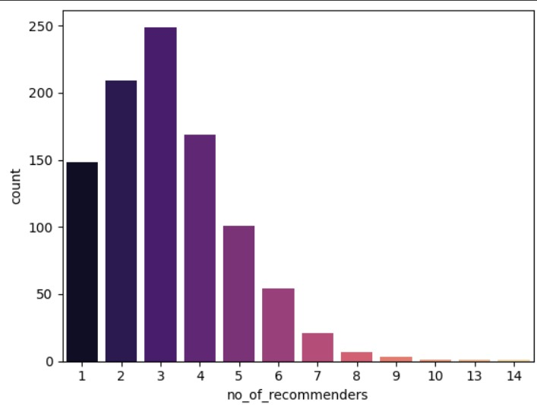
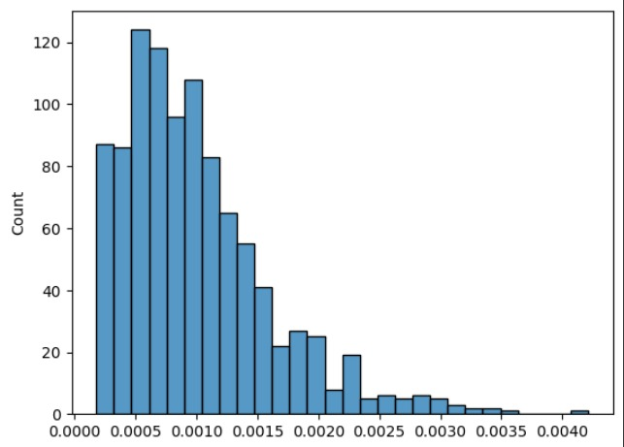
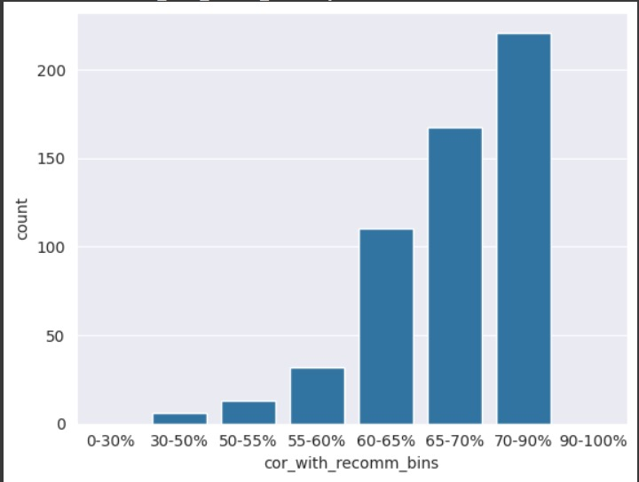
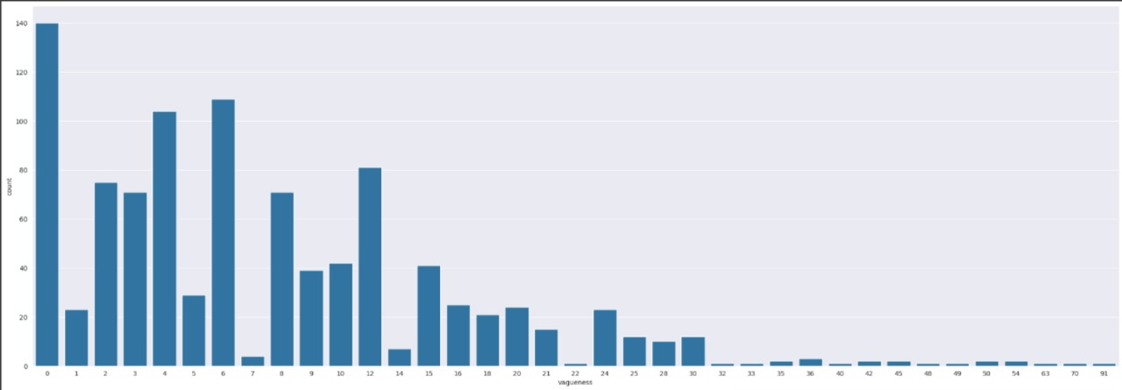
KEY FINDINGS
Count of Number of recommenders
Count of PageRank
Count of Number of Vague terms
Count of similarity recommendation with resume (using bins)

Slide 5
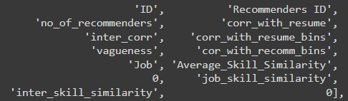
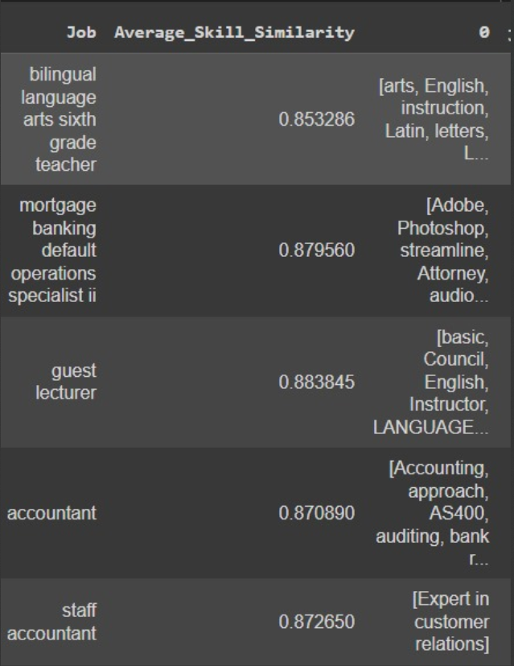
DATA ANALYSIS
TO FIND THE BEST CANDIDATE
For a deeper understanding of the resume dataset and recommendations, we created a keyword list which shows strength and quality of these connections. We went through each resume's recommendation letters, opened the file and read all the lines into a list, then we iterated through each sentence in the document to find those quality keywords or phrases and count occurrences.
We created a metric named “meaningful connection score” by dividing the quality keywords and phrases by total sentences. Resume with less meaningful connection score tends to be a fraud, which we cross checked with our fraud detection model and those with higher scores have good content in their recommendation letters.
We further extracted the Skills stated by candidates in their resumes, and added it as a list to the dataset. Using this we found inter skill similarity, as well as similarity between the job stated and the skills provided.

Slide 6
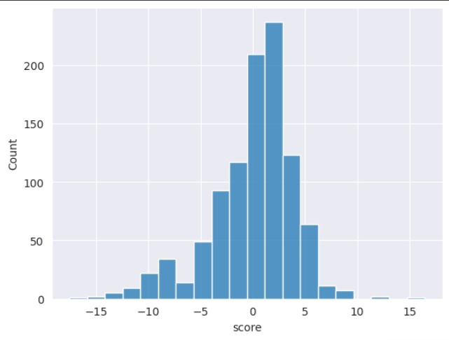
FINAL FINDINGS
We also found the inter skill similarity so as to ensure that the skills given are consistent with each other and there is no sharp difference in skills given.
Finally the numerical based columns were transformed such that a higher score means a better resume, while a lower score means a poorer resume and a higher chance of it being a fraud. Weights were assigned to the transformed columns and added to give a final score data frame. The scores in this ranged from -17.5 to 16.5.
After all the analysis, we finally assigned weights to all the columns and found a final score in which we observed that most of the resume’s falls in average category, that is most of them are neither frauds nor excellent.
A score less than -10 has a high chance of being a fraud while a majority of the resumes are near 0, which is they are neither very well made nor frauds, which is to be expected.

Slide 7
Challenges and Solutions
that we faced and devised throughout the process
Defining Metrics
At the outset, it was difficult to decide which metrics would best capture fraudulent behavior in résumés and recommendations. Fraud is subtle and can manifest in various ways.
1
We conducted brainstorming sessions and settled on three key metrics: discrepancy between résumé and recommendation, reciprocal endorsements, and vague or exaggerated language.
Challenge
Solution
Handling Ambiguity in Data
Résumés and recommendation letters often contain ambiguous or highly varied language, making it challenging to detect fraud consistently.
We employed Natural Language Processing (NLP) techniques to handle diverse language structures.
2
Large Dataset Processing
Processing large datasets of candidates and their professional connections was slow and computationally expensive, especially for graph-based analysis and NLP tasks.
3
We optimized our code by using parallelized graph algorithms and leveraging cloud computing resources to ensure that even large datasets could be processed within the time constraints of the hackathon.
Balancing Accuracy with Performance
Some algorithms, especially those related to graph analysis, had high computational complexity, which slowed down our overall system performance.
We fine-tuned our models by focusing on high-impact areas and applying performance optimizations, we balanced accuracy and speed effectively.
4

