Slide 1
Olist
E-Commerce
Sales Intelligence
A full-stack data intelligence project built with Claude AI
100,000 orders · 9 datasets · 4 analysis phases · Brazil 2016–2018
100k
R$15.4M
9
4
Orders
Revenue
Datasets
Phases
Built with Claude AI · Olist Dataset (Kaggle)

Slide 2
OLIST E-COMMERCE INTELLIGENCE
OVERVIEW
Project Overview
From 9 raw CSVs to a full data intelligence deck — in plain English using Claude AI
01
02
03
04
Data Exploration
Revenue Analysis
RFM Segmentation
Reviews & Churn
Merged 9 CSVs into 32-column master. Profiled 100k orders. Only 2 missing values in delivered orders.
Monthly trend, category breakdown, delivery performance, payment patterns. 22% YoY growth confirmed.
Scored 93,358 customers on R·F·M. 9 segments mapped. R$6.15M at-risk revenue identified.
Delivery delay vs satisfaction (r=−0.267, p<0.0001). 97% single-purchase rate. R$1.72M churn loss.
Data: Olist Brazilian E-Commerce Dataset (Kaggle) · Analysed with Claude AI · 2016–2018

Slide 3
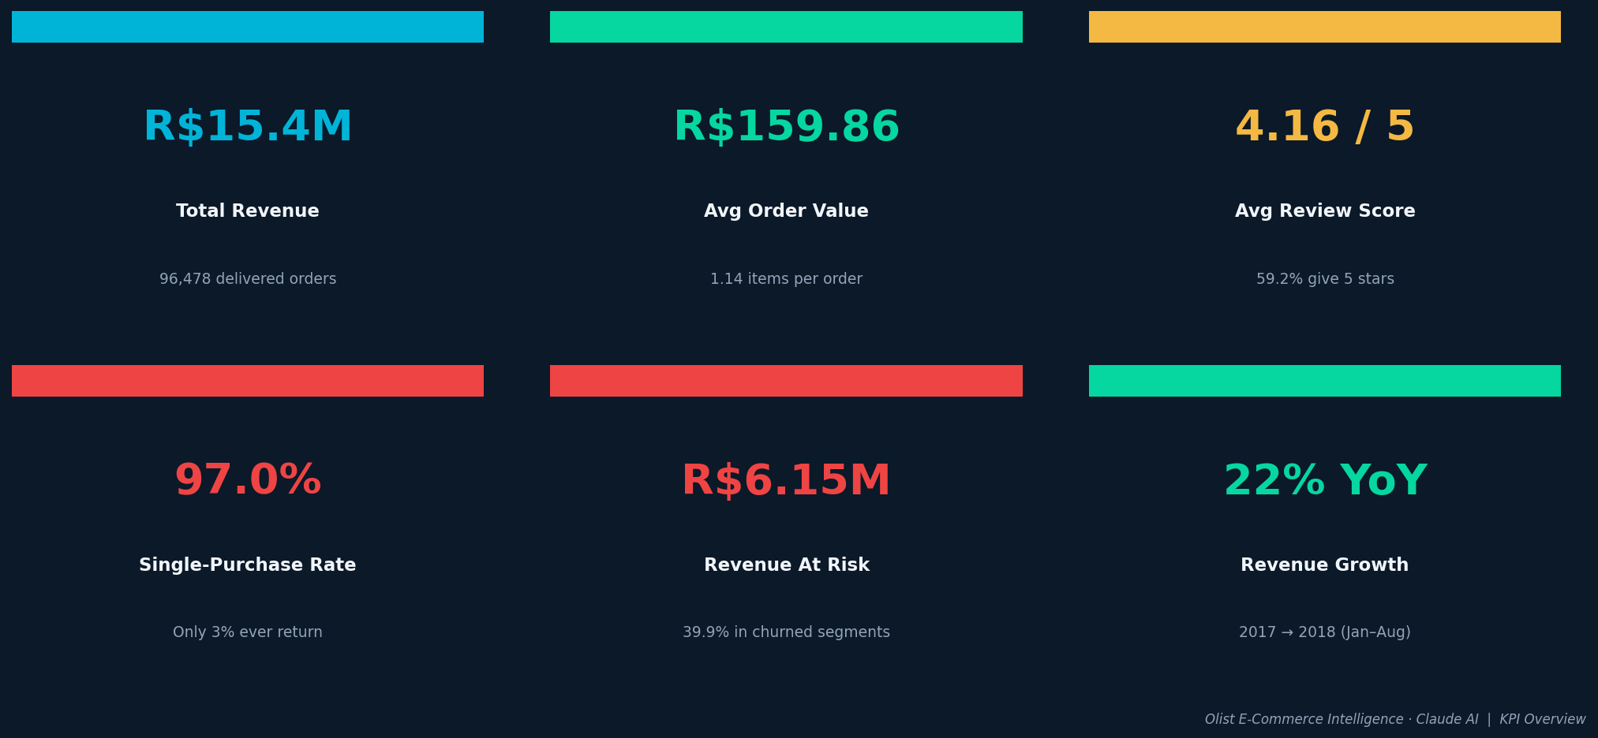
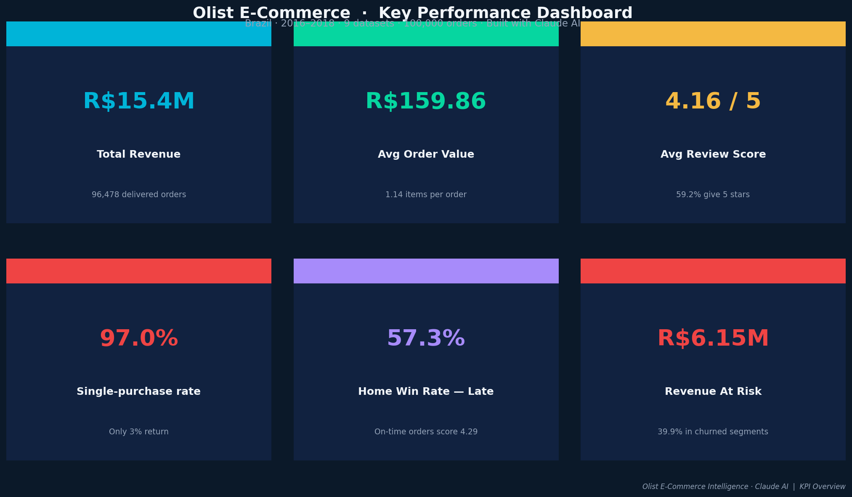
OLIST E-COMMERCE INTELLIGENCE
KEY METRICS
6 KPIs That Define the Business
Data: Olist Brazilian E-Commerce Dataset (Kaggle) · Analysed with Claude AI · 2016–2018

Slide 4
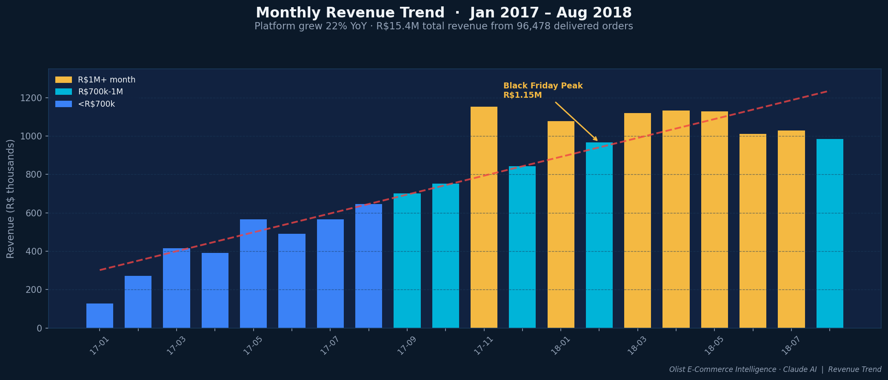
OLIST E-COMMERCE INTELLIGENCE
PHASE 2
Revenue Trend · Jan 2017 – Aug 2018
22%
YoY Growth
2017→2018 Jan-Aug
R$1.15M
Peak Month
Nov 2017 Black Friday
Monday
Best Sales Day
32% more vs Saturday
Data: Olist Brazilian E-Commerce Dataset (Kaggle) · Analysed with Claude AI · 2016–2018

Slide 5
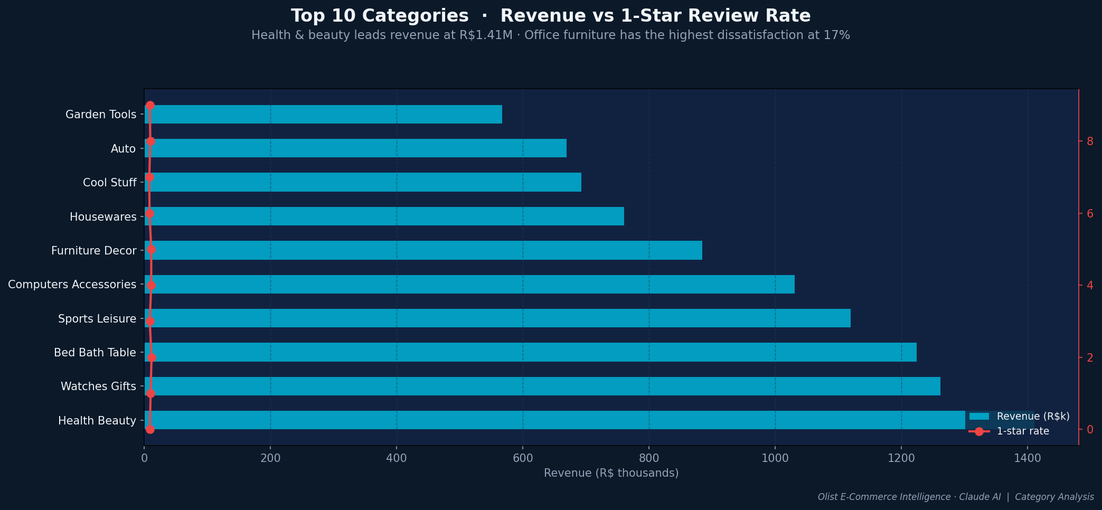
OLIST E-COMMERCE INTELLIGENCE
PHASE 2
Category Analysis · Revenue vs Customer Satisfaction
Health & beauty #1 at R$1.41M · Office furniture worst 1-star rate at 17% · Books highest rated at 4.54★
Data: Olist Brazilian E-Commerce Dataset (Kaggle) · Analysed with Claude AI · 2016–2018

Slide 6
RFM Customer
Segmentation
Phase 03 · 93,358 customers · 9 segments · R$6.15M at risk
R · Recency F · Frequency M · Monetary

Slide 7
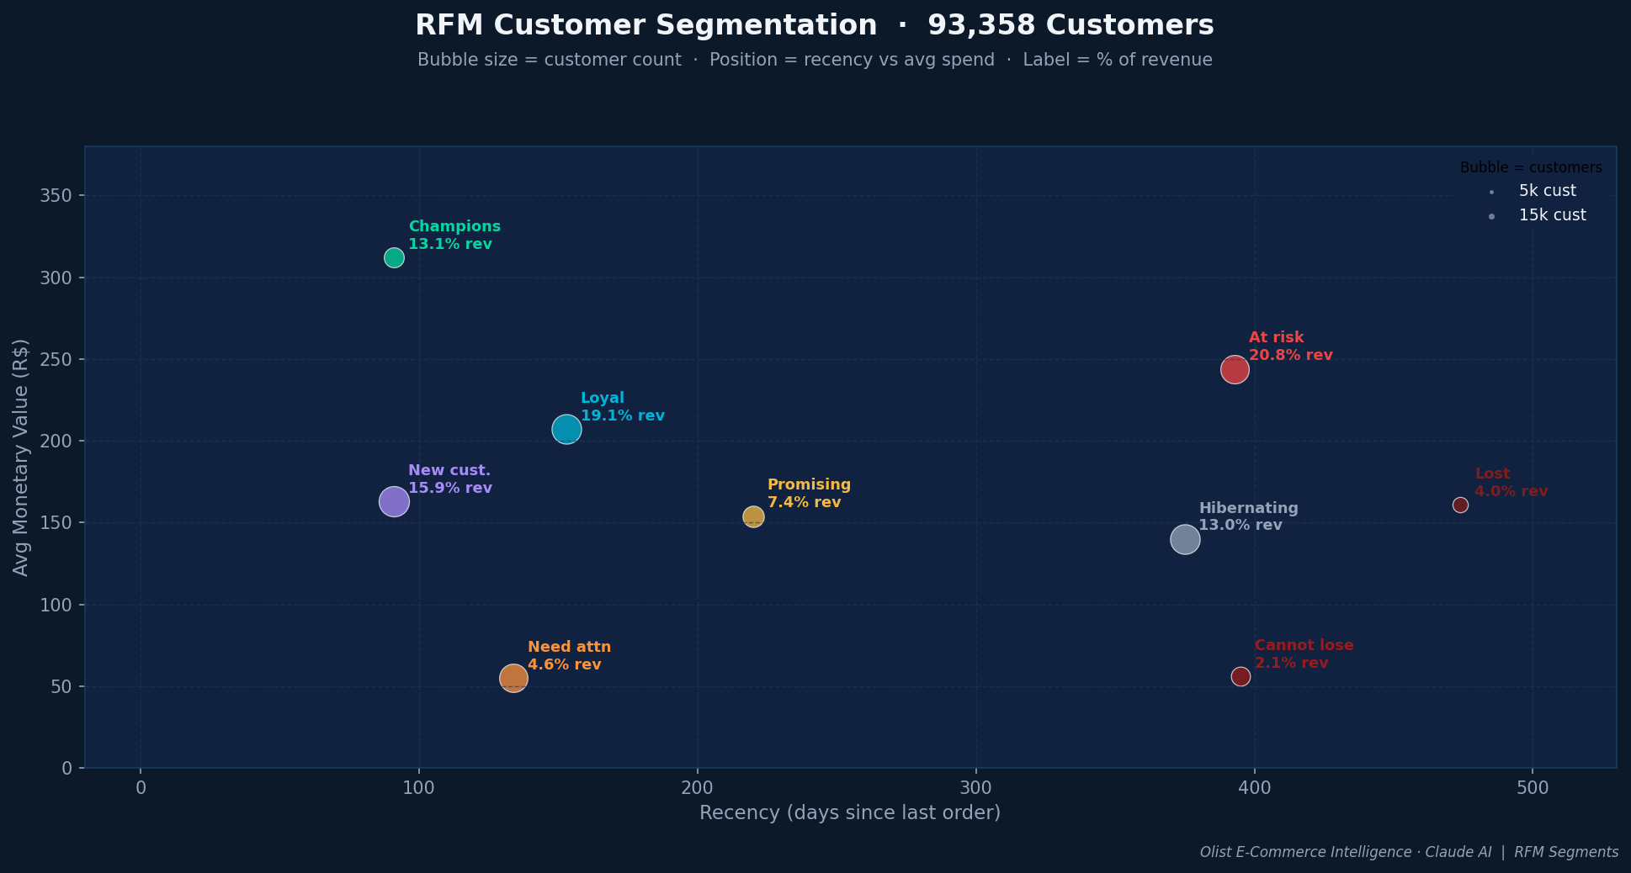
OLIST E-COMMERCE INTELLIGENCE
PHASE 3
Customer Segments · Recency vs Monetary Value
Bubble = customer count · Position = recency vs avg spend · Label % = share of platform revenue
Data: Olist Brazilian E-Commerce Dataset (Kaggle) · Analysed with Claude AI · 2016–2018

Slide 8
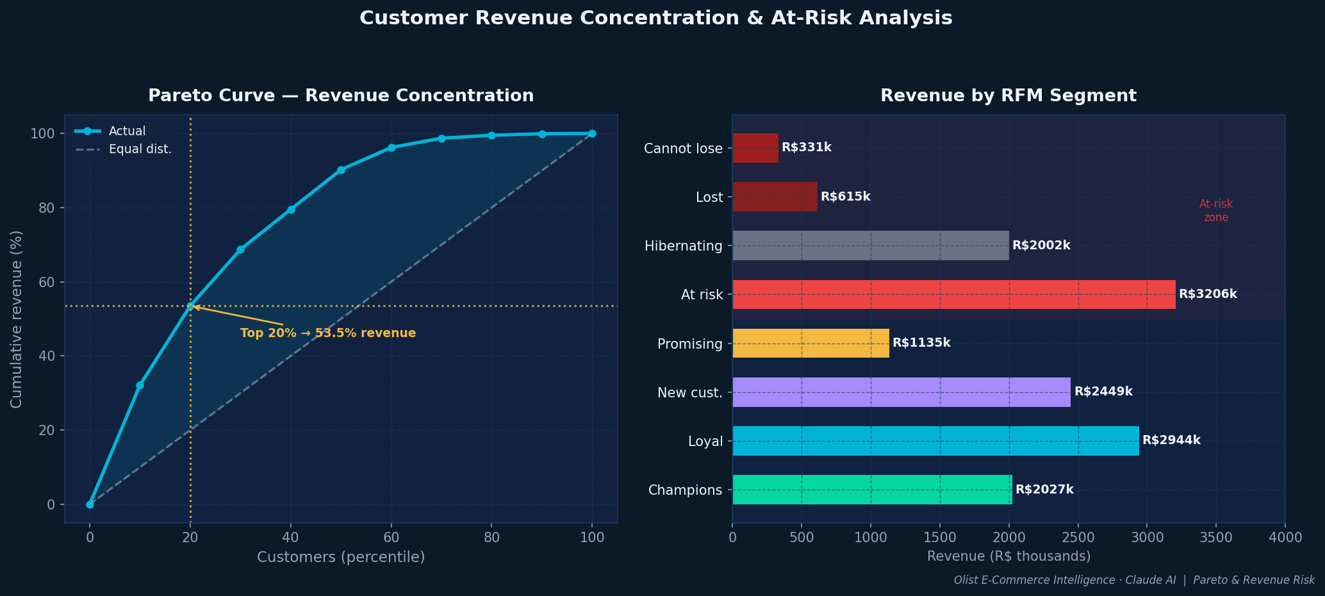
OLIST E-COMMERCE INTELLIGENCE
PHASE 3
Pareto Curve & Revenue At-Risk Analysis
Top 20% customers → 53.5% of revenue · R$6.15M in at-risk segments · 97% of customers buy once and never return
Data: Olist Brazilian E-Commerce Dataset (Kaggle) · Analysed with Claude AI · 2016–2018

Slide 9
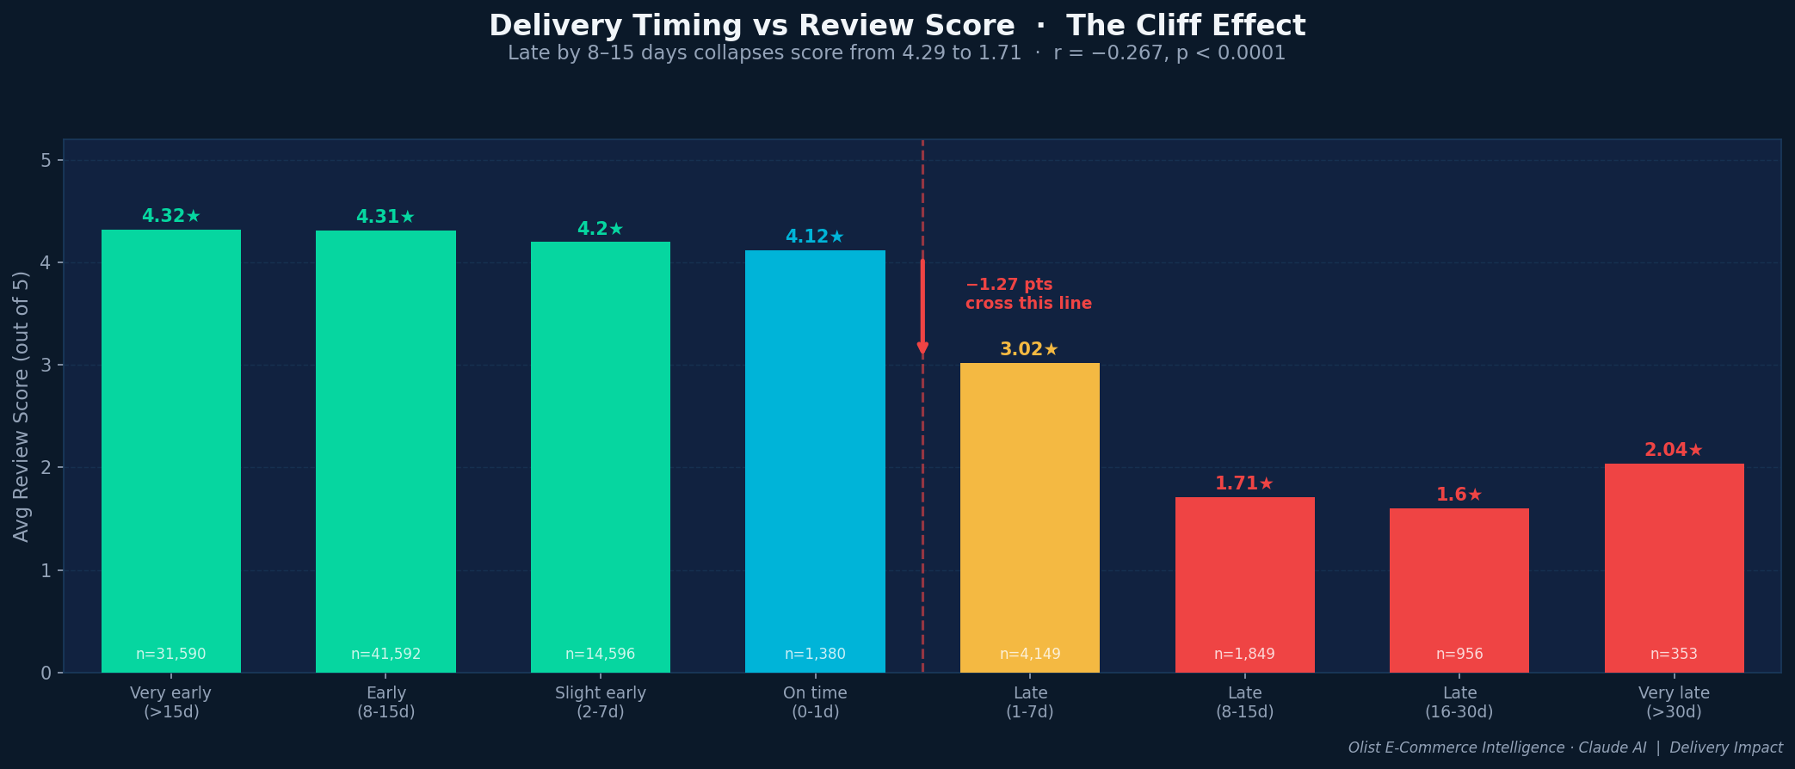
OLIST E-COMMERCE INTELLIGENCE
PHASE 4
The Delivery Cliff · How Lateness Destroys Satisfaction
r=−0.267
Pearson correlation
delay vs review score
p<0.0001
T-test: t=125.21
statistically definitive
−1.83pts
Score drop (late)
4.29 on-time → 2.46 late
Data: Olist Brazilian E-Commerce Dataset (Kaggle) · Analysed with Claude AI · 2016–2018

Slide 10
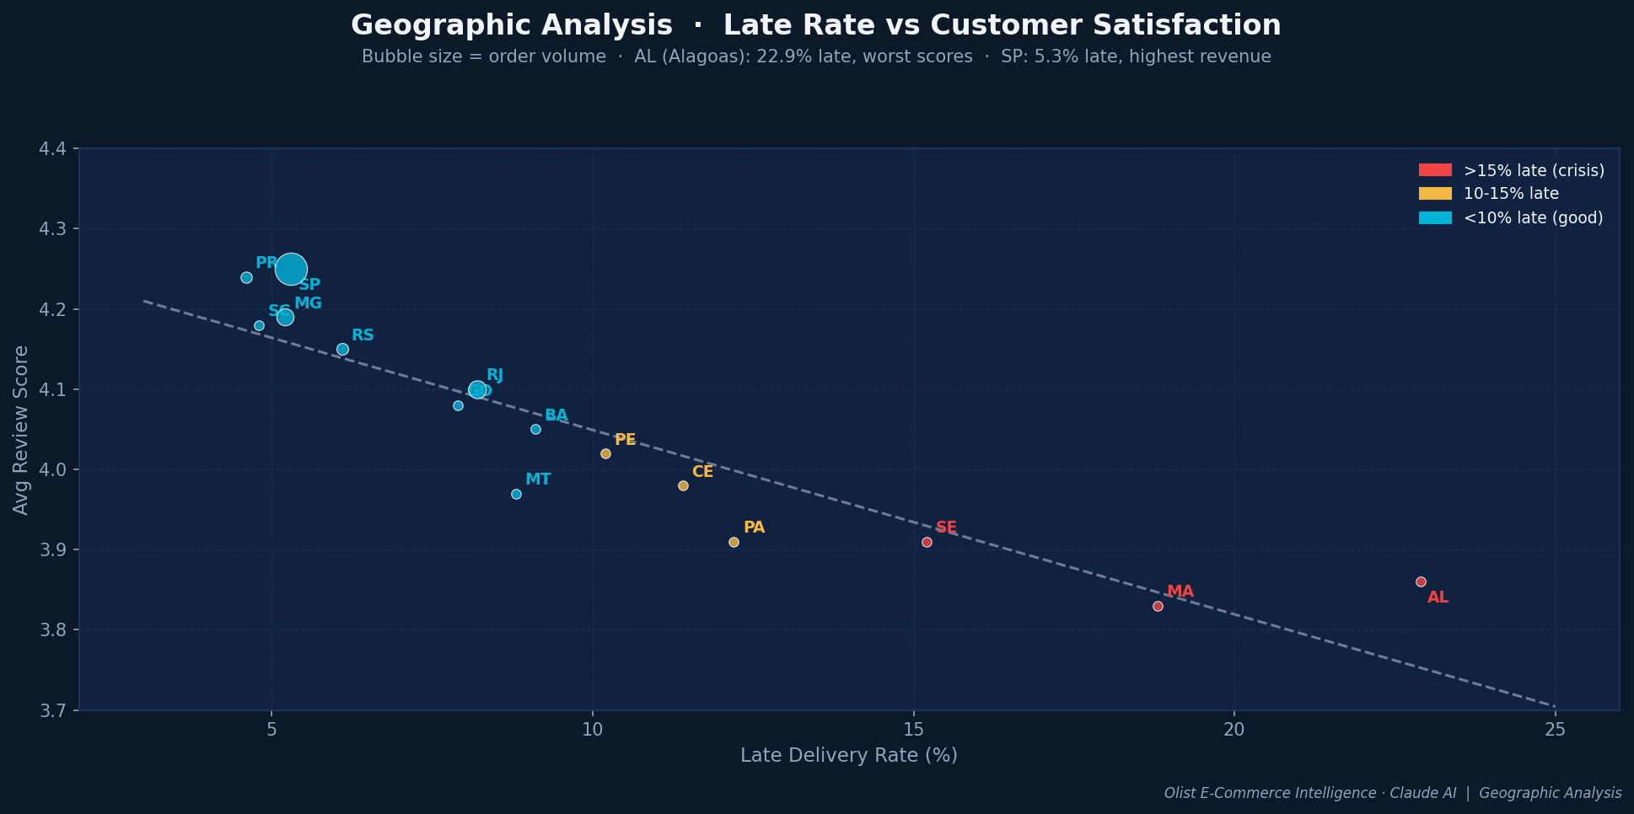
OLIST E-COMMERCE INTELLIGENCE
PHASE 4
Geographic Analysis · Logistics Drive Satisfaction
SP: 5.3% late · 8.3d delivery · 4.25★ vs AL: 22.9% late · 24d delivery · 3.86★ — Fix northeast logistics = fix platform NPS
Data: Olist Brazilian E-Commerce Dataset (Kaggle) · Analysed with Claude AI · 2016–2018

Slide 11
OLIST E-COMMERCE INTELLIGENCE
FINDINGS
5 Key Findings That Change How You See This Business
01
Platform growing — but concentrated
02
Health & beauty beats electronics
03
97% of customers never come back
22% YoY growth, R$1M+/month from 2018. But 37% of revenue is São Paulo alone. Geographic diversification is both the risk and the growth opportunity.
R$1.41M vs R$1.03M. High-AOV repeat-purchase beauty products outperform one-off electronics buys. Product mix strategy matters.
Repeat buyers spend 92% more (R$308 vs R$161). Moving 5% more customers to a 2nd purchase adds millions without acquisition spend.
04
Late delivery collapses NPS instantly
05
Geography = logistics = satisfaction
Being 1-7 days late drops score from 4.12 to 3.02. 8-15 days late: 1.71. Not a slope — a cliff. Office furniture is the crisis at 17% 1-star.
AL: 22.9% late, 24-day delivery, 3.86★. SP: 5.3% late, 8.3 days, 4.25★. Infrastructure in northeast is the clearest NPS lever.
Data: Olist Brazilian E-Commerce Dataset (Kaggle) · Analysed with Claude AI · 2016–2018

Slide 12
OLIST E-COMMERCE INTELLIGENCE
ACTION PLAN
Business Recommendations · Prioritised by Revenue Impact
P1
P2
P3
P4
P5
Win-back At Risk
2nd purchase activation
Fix furniture logistics
Northeast infrastructure
Champions programme
R$641k+
Low effort
R$M LTV
Low effort
NPS +2pt
Med effort
R$500k+
High effort
LTV +40%
Low effort
13,166 customers, R$244 avg, gone 393 days. 10-15% win-back discount at 20% conversion = R$641k recovered. Highest ROI action.
14,984 new customers in 90-day window. 'Complete your collection' email within 30 days. Moves repeat rate 3%→8-10%.
17% 1-star, 20d avg delivery. Dedicated fulfilment for bulky goods = immediate NPS improvement across platform.
AL/MA/PA: 15-23% late rates. Scores 0.4★ lower. Regional warehousing or carrier contracts unlocks underserved market.
6,493 customers, R$312 avg, 13.1% of revenue. Early access, referral incentives. Cheapest revenue to protect.
Data: Olist Brazilian E-Commerce Dataset (Kaggle) · Analysed with Claude AI · 2016–2018

Slide 13
The business has the data.
Now it has the answers.
22% revenue growth — but 97% of customers buy once and leave
R$6.15M in at-risk revenue across churned and dormant segments
Delivery lateness collapses satisfaction — it's a cliff, not a slope
São Paulo is the model. The northeast needs to catch up.
Champions (7% of customers) generate 13.1% of revenue — protect them
Built with Claude AI · Olist Dataset · Brazil 2016-2018

