Slide 1
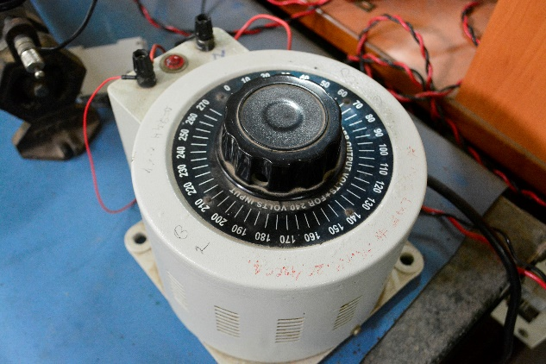
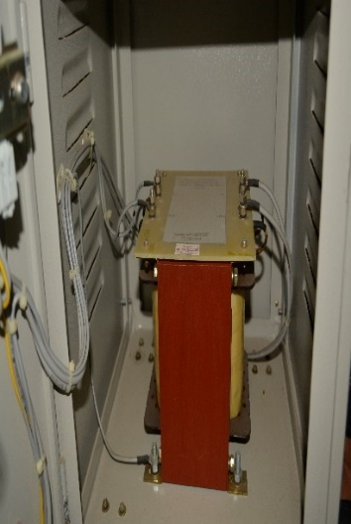
EN 319 Experiment no.2
Open and short circuit tests on single phase transformer

Slide 2
OUTLINE
Introduction
Principle of operation and construction
Equivalent circuit
Efficiency
Voltage regulation

Slide 3
INTRODUCTION
Used for:
Transforming the voltage / current levels
Galvanic isolation / protection
Measurement: Power transformers and high frequency transformers
Static device : No rotating parts-no mechanical losses
Principle of working: electromagnetic induction

Slide 4
Operating and Construction
Working principle
https://www.youtube.com/watch?v=vh_aCAHThTQ&list=PLuUdFsbOK_8qQ-KKUpZDX3k45vv2DxdB7&index=1
Types of winding
https://www.youtube.com/watch?v=_yRua9HjXI&list=PLuUdFsbOK_8qQ-KKUpZDX3k45vv2DxdB7&index=2
Types of core
https://www.youtube.com/watch?v=XrIXioEn3yQ&list=PLuUdFsbOK_8qQ-KKUpZDX3k45vv2DxdB7&index=3

Slide 5
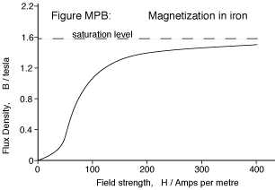
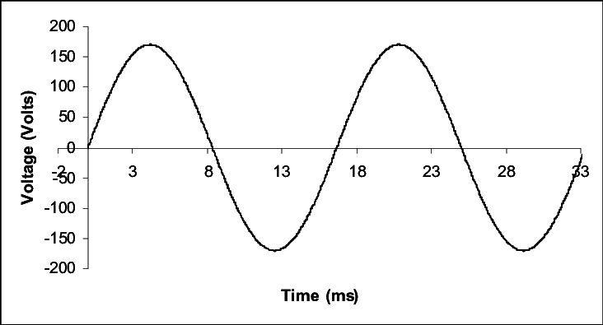



Magnetization curve
Results in sinusoid flux

Slide 6
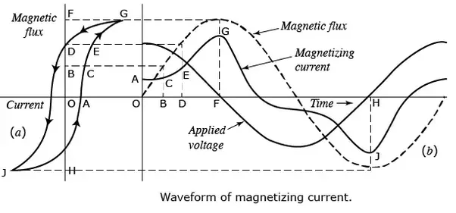
Waveform of magnetizing current

Slide 7

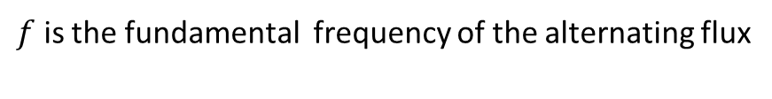
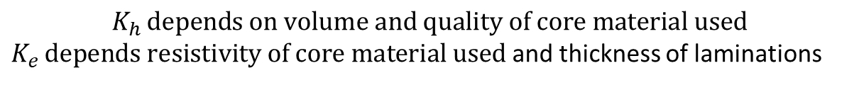
Core Losses
$$K_{h }depends on volume and quality of core material used$$
$K_{e }depends resistivity of core material used$ and thickness of laminations
$f$ is the fundamental frequency of the alternating flux
$B_{m}$ is the maximum flux density in the core
The other losses in a transformer(normally neglected) are stray load loss and dielectric loss

Slide 8
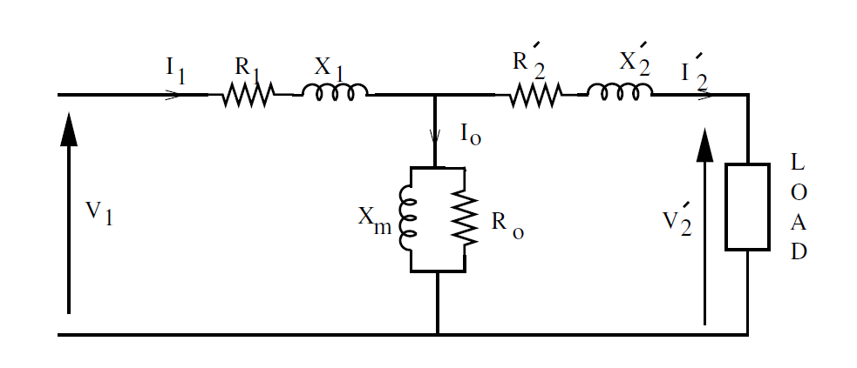
Equivalent circuit

Slide 9
Efficiency
Where x is loading factor (kVA), kVA is name plate rating, cos φ is power factor PCu is full load copper loss and Pi is the constant iron loss.
Condition for max efficiency:
Max efficiency:

Slide 10
Voltage regulation
UP REGULATION
DOWN REGULATION
DOWN Regulation in terms of circuit impedances
SIGN CONVENTION: +sign for lagging (inductive) pf and
– sign for leading (capacitive) pf
(Remember: Regulation is negative for leading pf !)

Slide 11
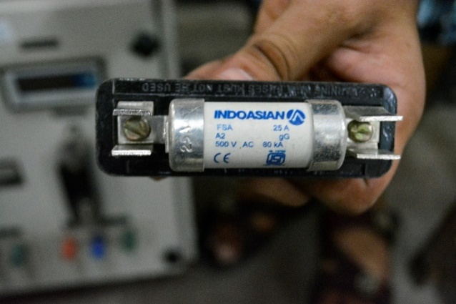
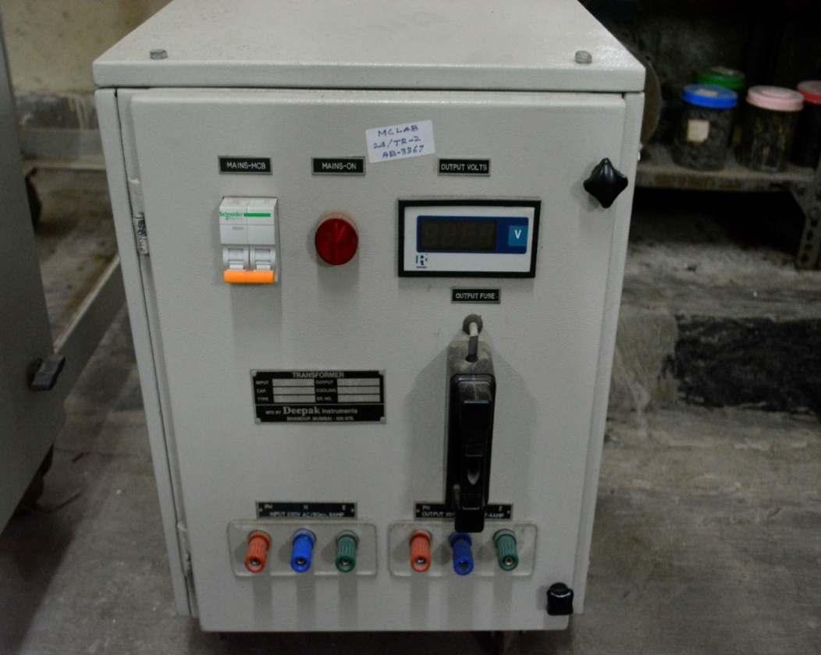
Experiment Details
Ac output fuse block
SINGLE PHASE TRANSFORMER
MFD BY: DEEPAK INSTRUMENTS
RATING : 2000VA
1 phase ac Input terminal
1 phase ac output terminal
*Note the NAME PLATE and fuse ratings
before the expt is conducted

Slide 12
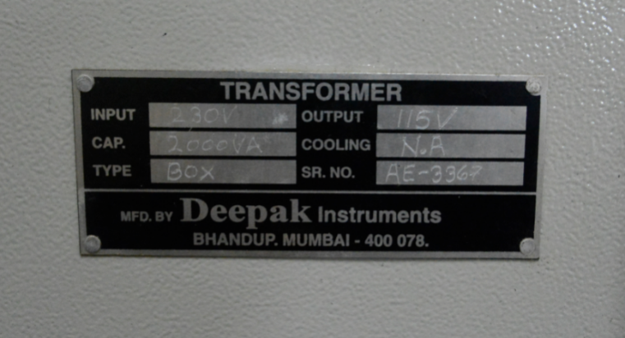
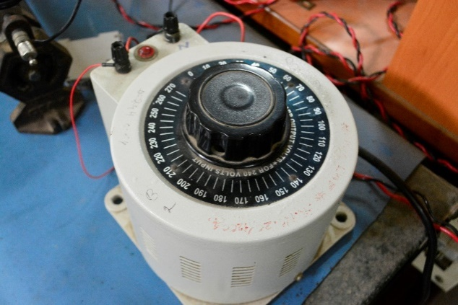
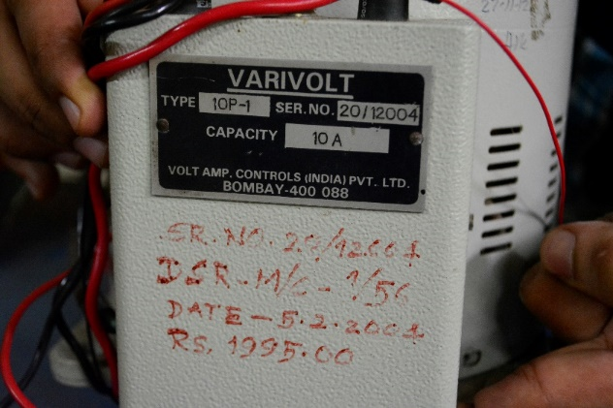
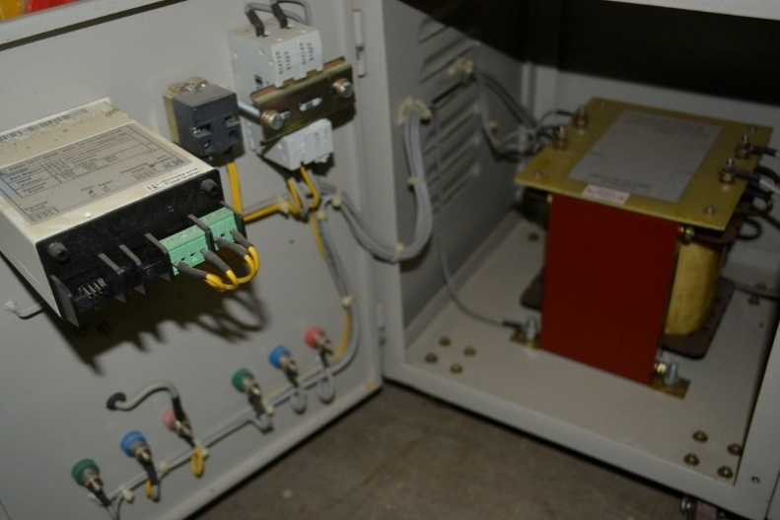
SINGLE PHASE
VARIAC
MFD BY:
VOLTAMP CONTROLS
Name plate details of 1ph transformer
Transformer (inside
the cabinet)
1ph input VARIAC and its
Name plate details

Slide 13
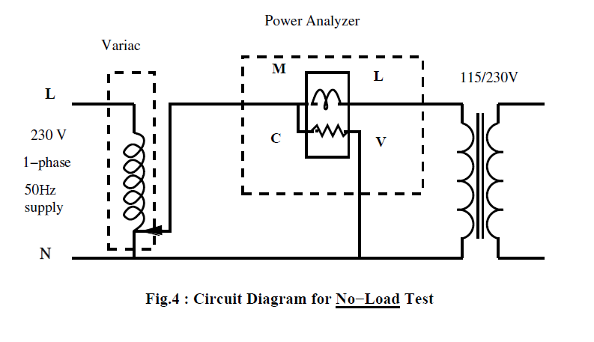
OC Test

Slide 14
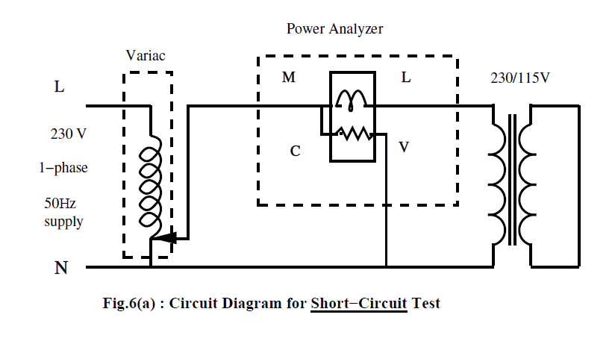
SC Test
NOTE: Slowly increase the applied voltage

Slide 15
Readings
OC Test
Primary |  | Wattmeter reading (W)
Voltage(V) | Current(A)
SC Test
Primary |  | Wattmeter reading(W)
Voltage(V) | Current(A)
Characteristics
Sr No. | Percentage loading (x) | Calculated Efficiency (%) |  |  | Calculated Voltage Regulation
 |  | pf= 1 | pf= 0.8 (lag) | pf= 0.6 (lead) | pf= 1 | pf= 0.6 (lag) | pf= 0.6 (lead)
1
2

Slide 16
Lab Reports (1 per batch)
Aim / Objective
Name plate details
Procedure: Mention the steps which you have followed while performing the experiments in your own words.
Properly labelled circuit diagrams in pencil
Readings in tabulated format with current waveforms drawn (pencil)
Sample calculations for equivalent circuit & efficiency and voltage regulation
Graphs of efficiency and regulation variation with loading (x)
Observations , Conclusions
Answers to the questions in the manual
Clearly mention the Date, Batch no., Roll no. and Expt. no. on front sheet.

