Slide 1
Environmental management systems such as ISO 14001 and their possible role in assuring Environmental sound management of recoverable materials/resources –
The Experience of
Philippine Recyclers, Inc.
Notes:
Environmental sound management (ESM)

Slide 2
What is PRI ?
Lead-acid battery recycler
Production capacity of 36,000 MT/year
Operations consist of –
  Raw materials preparation
    Battery breaking
    De-sulfurization
  Smelting
    Reverberatory Furnace
    Blast Furnace
  Refining and Alloying
  Plastic by-product processing
  Waste water treatment
  Waste materials segregation, recovery and disposal
Employs 143 regular workers and about 100 contractual or temporary workers
Maintains a network of about 300 scrap battery collection centers nation-wide
Notes:
Smelting is a form of extractive metallurgy; its main use is to produce a metal from its ore.
A homogeneous mixture or solid solution of two or more metals, the atoms of one replacing or occupying interstitial positions between the atoms of the other: Brass is an alloy of zinc and copper.
What is sulfation? During use, small sulfate crystals form, but these are normal and are not harmful. During prolonged charge deprivation, however, the amorphous lead sulfate converts to a stable crystalline that deposits on the negative plates. This leads to the development of large crystals, which reduce the battery’s active material that is responsible for high capacity and low resistance. Sulfation also lowers charge acceptance. Sulfation charging will take longer because of elevated internal resistance.

Slide 3
Why ISO 14001 ?
Environmental issues were traced to inadequate management system design and implementation.
Previous successes of sister companies in ISO 9000 implementation.
ISO 14001 presented a convenient model for an environmental mgmt. system.
Third party audits provided objective and credible evidence of compliance.

Slide 4
MINIMUM REQUIREMENTS FOR CERTIFICATION
The Company must have:
A sound understanding of it environmental aspects and impacts
An environmental policy stating the intention and principles of the organization in relation to its overall environmental performance
Objectives and targets which define broad environmental goals and more detailed performance requirements.
An environmental management program for the objectives and targets
Appropriate control procedures for the activities related to significant aspects.
Internal audits of the EMS
Long-terms goal for environmental performance/protection of the environmental (continual improvement)

Slide 5
MINIMUM REQUIREMENTS FOR CERTIFICATION
The EMS must be:
Fully designed and documented even where full implementation is incomplete
Implemented to the extent that:
- All staff are aware of the company’s significant environmental aspects, environmental programs and initiatives.
- All key relevant staff are trained on the requirements of EMS
- Performance monitoring/measurement are underway
- Internal EMS audit and management review are conducted
Able to demonstrate management commitment to comply with relevant legislation / regulation.

Slide 6
What did ISO 14001 implementation require ?
Three years of preparation time.
Review of corporate vision, mission and values.
Major equipment and facilities upgrading.
Organizational unit for administrative maintenance of the system.
Review, and when necessary, overhaul of policies, procedures and work instructions.
Estimated cost, from project launch to certification, excluding capital input, was $ 80,000.

Slide 7

Root Cause Analysis (RCA)
Non-Conformances (NCRs)
Notes:
Root Cause Analysis (RCA)
Non-Conformances (NCRs)

Slide 8
Tangible benefits of ISO 14001 implementation :
Regulatory compliance – 100%
Resource utilization –
  Fuel consumption – 17 % reduction
  Power consumption – 21 % reduction
Waste generation –
  Slag generation –19 % reduction
Environmental cost –20 % reduction
Improved Financial ( ROA, EVA, TOR) performance
Economic Value Added (EVA), Return on Assets (ROA), Terms of Reference (TOR)
Notes:
Economic Value Added (EVA)
Return on Assets (ROA)
Terms of Reference (TOR)
Tangible: real or concrete

Slide 9
Intangible benefits of ISO 14001 Implementation :
Enhanced employee confidence, sense of pride and morale.
Improved public image and community relations.
Improved positive perception of regulators and local government units.
Improved image with environmental NGOs and gov’t regulators allowed PRI to launch a novel scrap battery collection project called “ Bantay Baterya “ ( Guard the Batteries ) with the government’s Dept. of Environment and Natural Resources and the ABS-CBN multi-media network’s “Bantay Kalikasan “ ( Guard the Batteries ), one of the most influential environmental NGOs in the Phil.
PRI is now the preferred battery recycler of the local semi-conductor and telecom industry.

Slide 10
PRI’s Expectations after certification :
Government incentives for good environmental performance.
Government protection against unfair competition from unlicensed smelters through improved regulatory control.
Better access to financial resources to further improve environmental performance and consequently, improve bottom-line performance.
Access to overseas feedstock sources.

Slide 11
Important issues to consider --
How soon can it be done?
How implementable will it be?
How affordable will the process be?
What can we do to pursue this new approach?

Slide 12


Slide 13
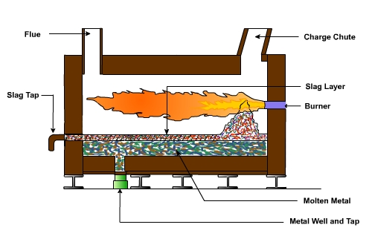
Schematic of a Reverberatory Furnace

Slide 14
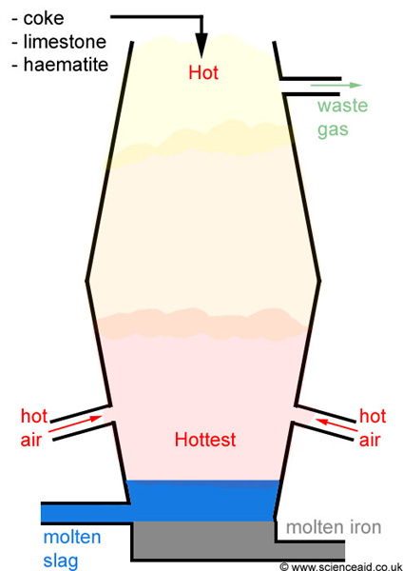
Blast Furnace

