Slide 1
Clinical Psychology

Slide 2
Diagnosis
DSM
ICD
Clinical Interview

Slide 3
Assessment
The Clinical Interview
MINI (Mini International Neuropsychiatric Interview 1990)
Behavioral Assessment
Rating Scale (MACC)Motility,Affect,Cooperation,Communication
Physiological Tests
Notes:
*

Slide 4
Psychological Testing
Projective Tests
Rorschach Inkblots
Thematic Apperception Tests
Self Reports
Personality Inventories
MMPI
Notes:
*

Slide 5
Neurological Functioning
The Halstead- Reitan Battery (1974)
perceptual, motor and cognitive tasks
EEG
MRI
PET
Notes:
*

Slide 6
Diagnostic and statistical manual of mental disorders
Developed in 1952 by APA
Revisions
DSM I- (emotional reactions)
DSM II -1968- based on ICD (international classification of diseases)
DSM III - 1980- to overcome low reliability
DSM III REVISED - refined /improved - 1987
DSM IV- revised/ simpler- 1994
DSM IV text revision (2000)
DSM V- May, 2013

Slide 7
Provides a common language for discussion, research
Describes disorders in terms of symptoms

Slide 8
The DSM is a categorical classification system.
Not assumed that each category of mental disorder is a completely discrete entity with absolute boundaries
Qualifiers are sometimes used, for example mild, moderate or severe forms of a disorder.
For nearly half the disorders, symptoms must be sufficient to cause significant distress or impairment in social, occupational, or other important areas of functioning.
Each category of disorder has a numeric code

Slide 9
DSM V
Neurodevelopmental disorders
Schizophrenia spectrum and other psychotic disorders
Bipolar and related disorders
Depressive disorders
Anxiety disorders
Obsessive‐compulsive and related disorders
Trauma‐ and stressor‐related disorders
Dissociative disorders
Somatic symptom and related disorders
Feeding and eating disorders
Elimination disorders
Sleep‐wake disorders
Sexual dysfunctions
Gender dysphoria

Slide 10
Disruptive, impulse‐control, and conduct disorders
Substance‐related and addictive disorders Neurocognitive disorders
Personality disorders
Paraphilic disorders
Other mental disorders

Slide 11
ICD 10 - WHO
F00-F09 Organic, including symptomatic, mental disorders
F10-F19 Mental and behavioural disorders due to psychoactive substance use
F20-F29 Schizophrenia, schizotypal and delusional disorders
F30-F39 Mood [affective] disorders
F40-F48 Neurotic, stress-related and somatoform disorders
F50-F59 Behavioural syndromes associated with physiological disturbances and physical factors
F60-F69 Disorders of adult personality and behaviour
F70-F79 Mental retardation
F80-F89 Disorders of psychological development
F90-F98 Behavioural and emotional disorders with onset usually occurring in childhood and adolescence
F99-F99 Unspecified mental disorder

Slide 12
Depression
Sad Face
Stooped Posture
Low Mood
Indecisiveness
Hopelessness
Feeling Inadequate
Conscious Guilt
Loss of interest
Loss of motivation
Fatigability
Sleep Disturbance
Loss of Appetite

Slide 13
“My life had come to a sudden stop. I was able to breathe, to eat, to drink, to sleep.
I could not, indeed help doing so; but there was no real life in me.”
Leo Tolstoy, My Confession, 1887

Slide 14
Major Depression – at least 5 symptoms
last two or more weeks.
Evolutionary Perspective

Slide 15
Incidence
Gender
Culture
Public Health Concern

Slide 16
Causes
Genetic
The Brain
Social-Cognitive Perspective

Slide 17
Treatment
Bio-Medical Perspective – anti depressants, ECT – severe depression
Psychological Approaches – Cognitive Behavior Therapy, Morita Therapy
Exercise

Slide 18
Schizophrenia
Lack of insight
Auditory hallucinations
Visual hallucinations
Suspiciousness
Flatness of Affect
Delusions of persecution
Delusions of control
Poor rapport
Hearing thoughts spoken out aloud

Slide 19
Catatonic
Bizarre, immobile, or relentless motor behaviors
Paranoid
Hallucinations (voices), delusions of persecution and/or grandeur, suspicion
Intellect and affect are usually normal
Disorganized
Personality deterioration, bizarre behavior (public urination), disorganized speech
Or flat, inappropriate affect (laughter)
Undifferentiated: no specific category is appropriate

Slide 20
Causes
Genetic
Brain Abnormalities
Maternal Virus in Midpregnancy

Slide 21
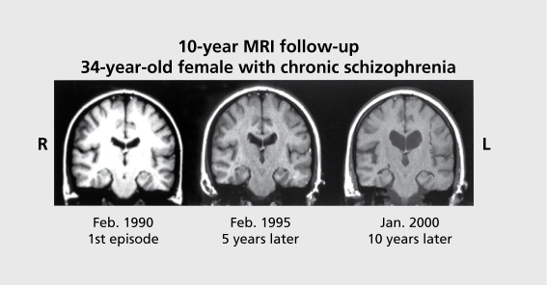
Notes:
Lynn E. DeLisi, et al ; Understanding structural brain changes in schizophrenia Dialogues Clin Neurosci. 2006 Mar; 8(1): 71–78.
*

Slide 22
Treatment
Bio-Medical Perspective
The Behavioral Perspective
The Psychoanalytic Perspective
The Humanistic Perspective
The Cognitive – Behavioral Perspective

Slide 23
Information sought through interviews:
Reasons for being in treatment
Symptoms
Health status
Family background
Life history

