Slide 1
Emotion

Slide 2
Emotions are psychological responses
that involve
- Conscious experience – cognitive appraisal
- Physiological arousal
- Expression (Behavior)

Slide 3
James-Lange Theory- people have a physiological response to environmental stimuli and that their interpretation of that physical response then results in an emotional experience. eg I am trembling therefore I must be scared
- Physiological arousal
- Interpreted as emotion
Cannon-Bard Theory: we feel emotions and experience physiological reactions such as sweating, trembling, and muscle tension simultaneously.
physiological arousal and emotional experience occur simultaneously

Slide 4
Two-factor Theory – Schachter & Singer
Physiology - Two factors 1) Stimulus followed by physical arousal and 2) How we label them congnitively (association with the physical response)
Cognition (perceptions, memories and interpretations)
experience of emotion grows from arousal
need to consciously interpret arousal
Notes:
Supproxin
*

Slide 5
Feeling with the body
Autonomic Nervous System – mobilizes the body for action and then calms it.
Sympathetic Parasympathetic
arousal calming
accelerated ht bt slows
inhibits digestion activates
perspiration dries

Slide 6
Many emotions have similar physiological responses
Subtle physiological distinctions between emotions
Some tendency for
neg emotions – right hemisphere
positive emotion – left hemisphere

Slide 7
25 soldiers severed spinal cords recall emotional experiences before and after surgery (Hohmann, 1966).
Lower spinal cord injuries – lost sensation in the legs
Upper spinal injuries – paralyzed neck below – change in emotion experienced

Slide 8
Cognition and Emotion
Spillover Effect – Schacter & Singer(1962)
epinephrine injection experiment – college students (male)
Informed, Ignorant, Misinformed, Placebo
euphoric and irritated condition
Maslach – repeated the experiment
did not find the arousal being interpreted as joy in the euphoric condition
Notes:
3 groups
1. Informed : Told the effect of ephinephrine
2. ignorant: Nothing told
3. Misinformed: Other effects are told
4. Placebo: Given under the name Supproxin, but not given anything
Euphoric: Very happy - 3>2>4>1
Irritated condition: level of anger- 3>4>1
Actors were behaving and introducing these conditions to them

Slide 9


Slide 10
When Emotion precedes Cognition
react automatically sometimes
some emotions take the low road bypass the cortex
pathway runs from eye/ear via thalamus to amygdala

Slide 11
Whalen et al (2004)
subliminally presented
happy eyes or fearful eyes
increased activity in the amygdala after frightened eyes

Slide 12
Emotion Expression
Do our facial expressions influence our feelings?
Pencil in the lips
Botox Injections

Slide 13
Detecting Emotion
Subtle Expressions
10 sec film clip teacher’s voice/face – teacher liked or admired the student
a tenth of a second glimpse of a face - to make judgments about trustworthiness
Rosenthal & Hall (1979)
2 second scene of a woman’s face
asked whether she was
- criticizing someone for being late or
- talking about her divorce
Notes:
*
trusworthniness

Slide 14
Gender
Hall - meta-analysis – women are better than men at decoding emotions
- gives them an edge in spotting lies (DePaulo, 1994)
Women more emotionally responsive in positive and negative situations (Grossman & Wood, 1993)
Women are more likely to describe themselves as being empathic
Kring & Gordon (1998) diff in watching a film
Notes:
*
Physiological measures of ht rt show no diff in empathy

Slide 15

Notes:
Izzard et al
*

Slide 16
Facial Expression, Emotion and Culture
Darwin believed that human emotional expressions are universal
Current research indicates that about 6 major emotional expressions that are universal
Happiness, surprise, anger, fear, sadness and disgust
Notes:
*
Survival value – sneer – bared teeth – snarl
Disgust –wrinkle nose – to block odours
Infants
Even in blind children from birth
Shame guilt contempt interest excitement

Slide 17
Ekman & Friesen’s (1971) study with New Guinnea tribes’ people
Slightly enhanced accuracy when judging emotions from their own culture (Elfenbein & Ambady, 2002, 2003) from 182 studies

Slide 18
Fear
Fear is adaptive – protects us from danger
Learning Fear
Little Albert
Monkeys reared in the wild vs lab reared monkeys – fear of snakes (Mineka, 1985)

Slide 19
Physiology of fear
Amygdala – key role in associating emotions with situations
Rabbits & Rats - unable to learn conditioning response if amygdala is damaged (tone with a small shock)
Schacter – blaring horn with a blue slide

Slide 20
Amygdala damage (Adolphs et al,1998)
participants with damaged amygdalas – choose between two faces
Based on approachability & trustworthiness
Compared with control SS – they tended to
choose the more negative faces
Serotonin Reuptake – gene that does not allow serotonin reuptake
serotonin activates the amygdala’s neurons

Slide 21
Anger
Reaction to being treated unjustly.
High temperature, foul odor, pain
Catharsis – emotional release - venting
Rumination – dwelling on the insult
Notes:
*

Slide 22
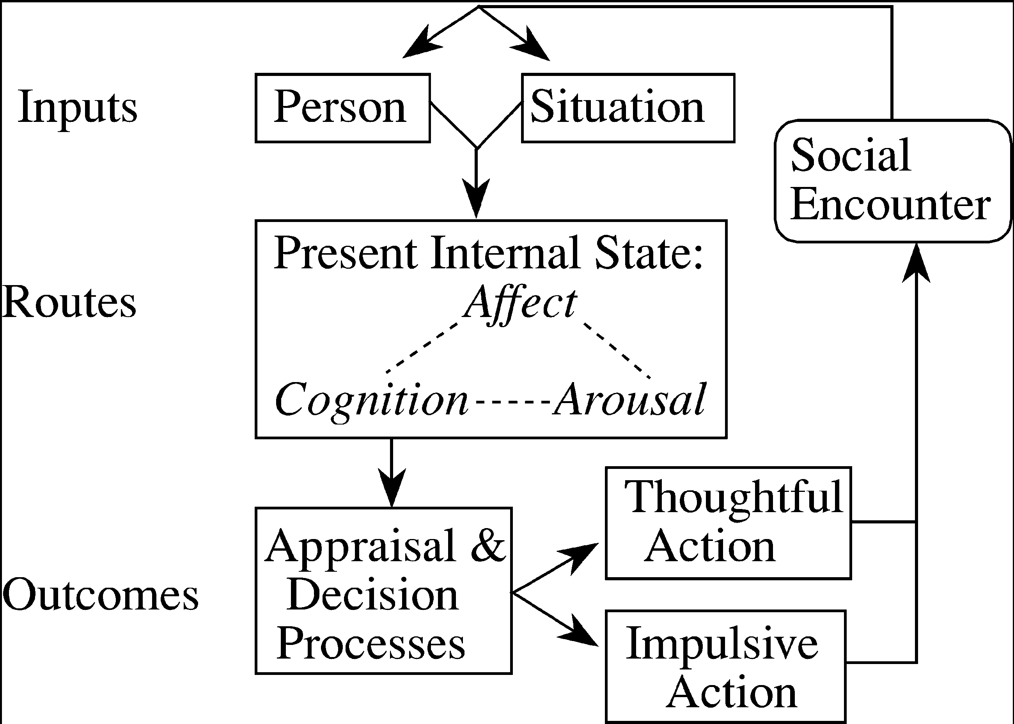
General Aggression Model (Anderson & Bushman)

Slide 23
“Anger will never disappear so long as thoughts of resentment are cherished in the mind” Buddha
Witvliet (2001) – When forgiveness was mentally rehearsed – perspiration, BP, ht rt, facial tension were all lower than when
- grudges were rehearsed.
Controlled expressions of anger are better than outbursts

Slide 24
Happiness
Happiness: Positive emotional state that is subjectively defined by each person
Subjective Well-Being – combination of positive affect and general life satisfaction
Social
Cognitive
Physiological

Slide 25
Fredrickson – Broaden & Build Model
Positive emotions
Broaden Thought –action repertoire
Behave positively towards others
Build resources
Create an upward spiral

Slide 26
The Trajectory of Ups and Downs
Positive emotions tend to rise over the early to middle part of most days and negative emotions towards the end of the day (based on 4500 mood reports)
Watson (2000) Kahneman (2004)
HIV patients
Kidney Dialysis

Slide 27
Positive emotions too are hard to sustain
Wealth
People in rich countries are somewhat happier than poor countries
People with more money are happier, especially in poor countries than those who struggle to manage basic needs (Diener & Biswas –Diener, 2009)
Curve of Diminishing returns

Slide 28
Prior Experience
Adaptation level phenomenon
Other’s Attainment
Upward Comparisons
Downward Comparisons
Twins – about 50% difference in happiness is attributed to heredity (Lykken & Tellegen, 1996, Lucas 2008)

Slide 29
Realize that enduring happiness may not come from financial success
Take control of your time
Act Happy
Seek work and leisure that engage your skills
Exercise
Sleep
Give priority to close relationships
Focus beyond the self
Count your blessings and record your gratitude
Nurture your spiritual self
From Myers The Pursuit of Happiness

