Slide 1
Motivation
!

Slide 2
Many human behaviors are complex and difficult to understand

Slide 3
Motivation
Theories
Instinct - A complex behaviour that is species specific(Hard Wired)
Drive Theory - Biological aspect to maintain homeostasis
Homeostasis - Biological eqm. - perturbation cause unrest- behaviour occurs to remove this. Also signifies mental homeostasis ( optimum or boredom).
Incentive
Maslow
Social Motives

Slide 4
Goal directed behavior - that the individual persists at until the goal is attained – motivated behavior
The process that initiates, guides and maintains goal oriented behavior – motivation
“The reason or reasons for acting or behaving in a particular way”

Slide 5
Shares the same root as ‘motion’ – something that moves an organism

Slide 6
Some views of Motivation
Instinct – a complex behaviour that is species specific and not learnt
infants – sucking
imprinting
mating
building nests

Slide 7
Drive Theory
Motivation as ‘energy’
A Drive is a state of unrest or disturbance that leads to one behavior after another until the disturbance is removed
Thirsty rat keeps looking for water until it’s thirst is quenched
Splinter in the paw
Drive Reduction – animal strives to reduce arousal

Slide 8
However once all needs have been met, the organism would become inactive
But Some people seek stimulation (thresholds could be different)
The presence of external stimulation – the availability of drinks in the environment

Slide 9
Homeostasis – maintenance of optimal physiological states – temperature, hydration, nutrition..
mental states – boredom
state of optimal arousal
expend energy to maintain optimal state

Slide 10
Incentive Theory
Incentive – external stimulus that elicits behavior or ‘pulls’ behavior (Carrot for Donkey)
The sight of chips
Most behaviors are a combination of drives (push) and incentives (pull)

Slide 11
Intrinsic Motivation – doing something because it is fun or interesting – because you want to do it.
Extrinsic Motivation – doing something because of the rewards and punishments involved
- attending class

Slide 12
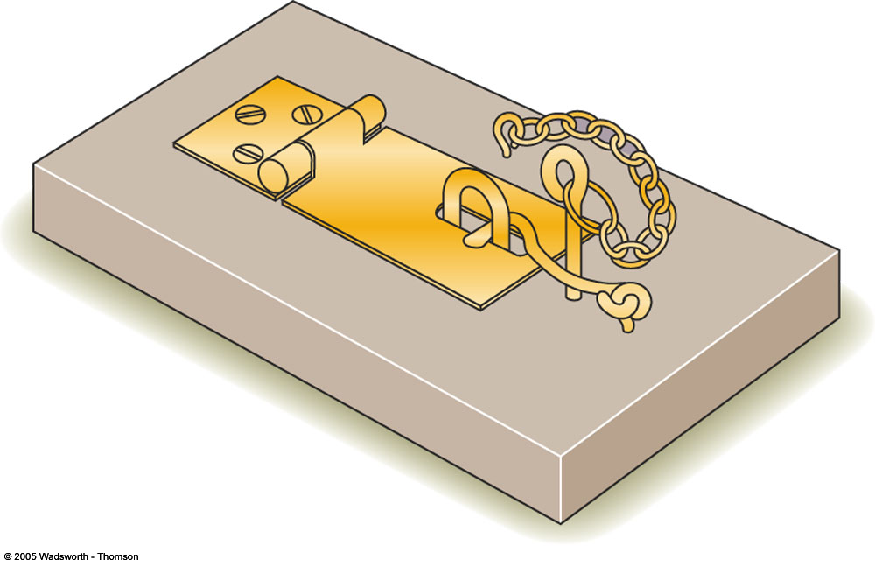
Figure 11.2 Monkeys learned to remove the pin, hook, and hasp in that order to open this device. When they started receiving a raisin instead of opening it just for fun, their performance deteriorated. Kalat 7th edition

Slide 13
Overjustification Effect – When expected extrinsic rewards are introduced for activities that have high intrinsic motivation, it leads to a drop in the level of intrinsic motivation.
Deci (1971) – college students working on puzzles
control group – no payment group
experimental group – paid
time 1 time 2(money) time 3
puzzle use in free time

Slide 14
Lepper, Greene & Nisbett (1973) – gold stars
- Expected award condition
- Unexpected award
- No award
Self perception Theory – In the absence of a clear attitude – people observe their behavior and then draw an inference about their attitude.
Notes:
Expected award condition - decrease in interest from baseline
Unexpected reward – no sig change from before
No Award – no sig change from before
group
Children were given markers among other toys: It provides baseline for the affinity towards the marker.
Divided in to 3 different groups and experimented then were left to again free play.
1st - Group told that they will get the reward - slightly less activity observed from baseline
2nd - Reward was given unexpectedly- No significant diff. from baseline
3rd- No rewards were told and given - No significant diff. from baseline
*

Slide 15
Deci et al (1999) – Meta-analysis (128 studies) showed a negative effect of extrinsic rewards on intrinsic motivation.
Cameron et al (2001) – Meta-analysis
verbal reward – positive effect (Expected tangible rewards have negative effects)
Surpassing others or exceeding a score – positive effect of reward

Slide 16
Goal Setting
Goal Setting Theory – conscious human behavior is purposeful (Locke & Latham, 1984)
- all living beings including plants show goal directedness
purely physiological
short term goals
long term goals

Slide 17
Why do some people with same knowledge perform differently
Goal specificity: Specific goals tend to have better results.
Goal difficulty: higher the goal higher the performance
Intensity: Clarity, mental effort, commitment (whether it is possible, whether it is worth)
Goal setting have tradeoffs with two people have very different perception on their ability.

Slide 18
Why do some people perform better than others?
Holding ability and knowledge constant – difference can be attributed to Performance Goals people set themselves
Goal Specificity -
Vague - I’ll work on this
Specific – I’ll try to finish this section in the next 30 minutes
I’ll try to get a score of 35 on the next exam

Slide 19
Goal Difficulty
The higher the goal the higher the performance - 400 studies
Those without specific goals evaluate their performance more positively than those with specific harder goals in response to negative feedback (Kernan & Lord, 1989).

Slide 20
“Maximum effort is not aroused under a do best - goal. ..ambiguity inherent in doing one’s best allows people to give themselves the benefit of doubt in evaluating their performance” Latham & Locke, 1991
Norms affect goals in influencing performance (Meyer & Gellatly, 1988)

Slide 21
Intensity
Scope, clarity and the mental effort
SS who thought most intensely and comprehensively about how to solve a problem were more committed to it (Gollwitzer et al 1990)
Commitment – action taken to attain it
2 aspects that influence it are
- whether it is possible
- whether it is important

Slide 22
Goal setting has trade offs with
- possible
- effort
- time
- other values
- ability
- self efficacy
- norms

Slide 23
Leadership
Effective leaders first develop a vision for the organization - make employees feel that what they are doing is worthwhile
- take concrete steps and provide indicators for what reflects the vision
- modeling behavior for others – problem solving and decision making to attain proximal goals towards the end for distal goals
Accessible to employees – listen to them
What gets measured gets done – reset goals

Slide 24
Upper management – teaches employees to be effective self regulators through mechanisms such as self set goals, self monitoring, self administering rewards and punishments.

Slide 25
A Hierarchy of Motives – Maslow (1970)
Self Transcendence
Self Actualization
Esteem Needs
Belongingness
Safety Needs
Physiological Needs

Slide 26
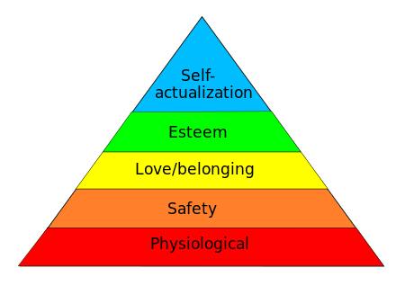

Slide 27
Keys (1950) - manipulated hunger
Oishi et al 1999 –
Poorer countries – financial satisfaction – stronger predictor of well being
than in wealthier countries
Individualistic countries (US) – esteem needs more important than in collectivist countries (India)

Slide 28


Slide 29
Social Motives
complex motive states or needs that trigger action
culture - normative
components of personality
Some social motives that have been researched are Need for Achievement, Need for Affiliation, Need for Power

Slide 30
Measurement of Social Motives
Projective Tests: TAT
Personality Questionnaires
Situational Tests

Slide 31
Need for Achievement
expresses itself
- Prefer to work on moderately challenging tasks
- like to compare performance with others
- persistent in tasks that maybe career related
- when successful they raise their aspirations in a realistic way
- like to work in situation where they have moderate control
(McClelland & Winter, 1969, Hoyenga & Hoyenga, 1984)

Slide 32
Motivated by a job well done – satisfaction
not financial gain
not recognition/ fame
not security
not status

Slide 33
Achievement Motivation and Society
- n ach has been suggested to be related to society’s economic and business growth
(McClelland, 1961, 1971).
- high n ach precedes spurts in economic growth

Slide 34
Entrepreneurship
McClelland - those with higher N ach – were more likely to become entrepreneurs – college graduates – followed 14 years later.
Collins, Hanges & Locke (2004) –Meta-analysis
N ach predicted entrepreneurial activity – both career choice as well as performance.
Other domains – skills, business strategies and environmental factors

Slide 35
Power Motivation
Social Power “the ability or capacity of a person to produce intended effects on the behavior or emotions of another person” (Winter, 1973 in Morgan & King, )
Expressed
- aggressive behavior, esp by men in the lower socioeconomic class

Slide 36
- participation in competitive sports
- joining organizations and holding office in these organizations
- drinking and dominating women
- collecting possessions
- building and disciplining their bodies
- selecting occupations that allow them to impact others
(Hoyenga & Hoyenga, 1984)

Slide 37
Machiavellianism
express their power motive by manipulating and exploiting others in a deceptive and unscrupulous fashion (Christie & Geis, 1970)

Slide 38
Effectance Motive
to act competently and effectively when interacting with the environment
Self Actualization Motive
develop potential to the fullest

Slide 39
Motivational Conflict
Approach – Approach Conflict
Approach –Avoidance
Avoidance – Avoidance

