Slide 1
Nature and Nurture

Slide 2
Genes
Parents
Culture

Slide 3
23 chromosomes from the mother
23 chromosomes from the father
Dominant
Recessive
X linked recessive conditions
X chromosome is larger and has more genetic material than the Y chromosome

Slide 4
Some X linked recessive conditions – hemophilia, diabetes, color blindness, some forms of night blindness, one form of muscular dystrophy, inability to produce antibodies for some bacterial infections

Slide 5
Environment Gene Interaction
Range of Reaction (Gottesman, 1963, Plomin, 1995) – heredity does not determine behavior but rather presents a range of possibilities that is influenced by the environment
Critical Periods – stage of the child’s development determines if it is susceptible to environmental influence
Fetus, infant, toddler, child

Slide 6
Rosenzweig, 1984 - rat pups were raised in either impoverished or enriched environments- those in the enriched environment had heavier and thicker cortexes by 7% and 20% more synapses (Kolb & Whishaw, 1998)

Slide 7
Gene- Environment Interaction
Niche picking – people look for, choose or create environments that are suited to their predispositions (Scarr, 1996)

Slide 8
Human Behavior Genetics - relative contribution that genes and environment make to individual differences in traits and abilities

Slide 9
Twin Studies
Fraternal Twins Dz - similar to siblings but sharing the same environment since conception
Identical Twins Mz – genetically identical
Research lit - studied identical twins reared apart to understand the role of heredity vs environment.

Slide 10
Bouchard et al, 1990 – more than 100 sets of reared apart twins or triplets – a week of psychological and physiological assessments – temperament, leisure time activities, attitudes were as similar as Mz twins reared together

Slide 11
Correlation bet IQ scores
Mz twins reared together .86
Mz reared apart .79
Fraternal twins reared together .60
Siblings reared together .47
Parent and child .40
Foster parent and child .31
Siblings reared apart .24
Cousins .15
Bouchard & McGue, 1981

Slide 12
Temperament and Personality
Mode of responding to the environment
Thomas & Chess, 1986 - proposed
- Difficult, easy and slow to warm up
Emotionality, activity and sociability (Plomin, 1995) most influenced by inheritance – the influence of which declines with age
Parental Differences
Birth order – first borns – new parents

Slide 13
Parenting
Imprinting
Harlow
Bowlby
Ainsworth

Slide 14
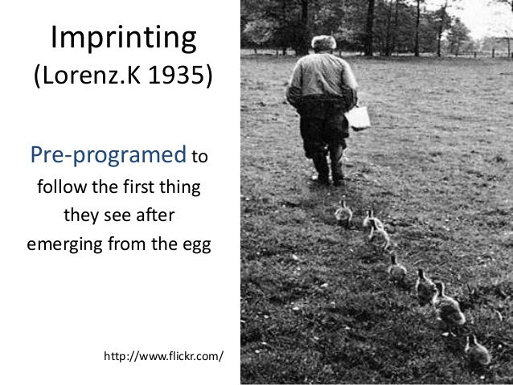
Imprinting

Slide 15
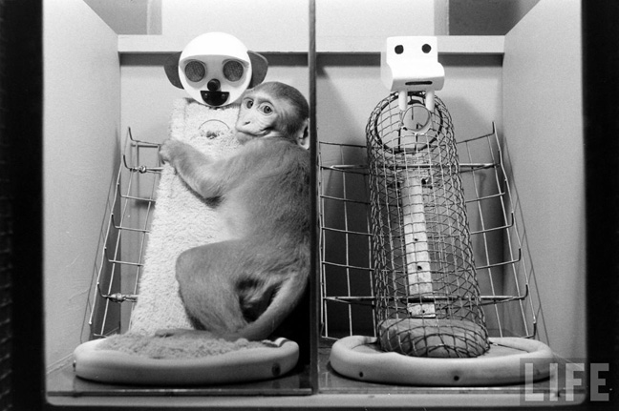
Harlow’s Monkeys https://sites.google.com/site/hookappsychology2a/key-experiments-by-maticyn-milia/harry-harlow-s-monkey-experiment

Slide 16
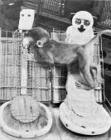
http://muskingum.edu/~psych/psycweb/history/harlow.htm

Slide 17
Bowlby
Instinctual infant responses – sucking, clinging, following and smiling
Elicits parental responses – leads to nurturance and bonding
Early signaling system that leads to mutual attachment - relationship

Slide 18
Ainsworth - Strange Situation
Secure Attachment – slightly disturbed by separation – easily soothed by mother on return
Insecure Avoidant – Avoid and ignore mother on reunion
Insecure-Disorganised – Crying at the door – then running away - freeze

Slide 19
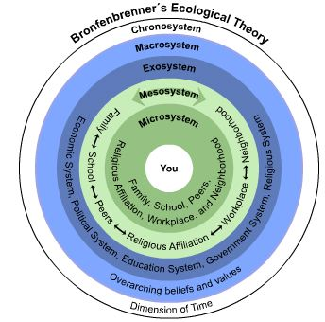
Bronfenbrenner’s Ecological Theory https://geopolicraticus.wordpress.com/tag/urie-bronfenbrenner/

Slide 20
Parenting Style
Baumrind (1967) – observation of nursery school children
Authoritative
Authoritarian
Permissive

Slide 21
Authoritative Parenting – Sets standards – communicate them clearly, enforce them firmly – does not yield to coercion from the child – Confronts disobedient behavior (firm but not overly emotional)
Expects mature behavior – age appropriate
Warm, responsive, supportive of constructive behavior, considers child’s opinion – offers alternatives, involved with the child’s life

Slide 22
Children – energetic - friendly
Cheerful, interested, purposive,
Friendly, cooperative
Reasonable
Self control

Slide 23
Authoritarian Parenting
Enforce rules rigidly – Confronts bad behavior – shows anger displeasure
harsh punitive discipline
very controlling
Not warm and involved

Slide 24
Children – conflicted – irritable
Moody, apprehensive, easily annoyed
Alternates between aggressive behavior and sulky withdrawal
Vulnerable to stress

Slide 25
Permissive
allows free expression of impulses and desires
Rules not communicated clearly
Ignore bad behavior
Inconsistent discipline – yields to coercion
Does not demand mature behavior
Warm

Slide 26
Children - Aggressive –Impulsive
Aggressive, domineering
Resistant
Lacks self control
Aimless

Slide 27
Uninvolved - Maccoby & Martin (1983)
Self centered, uninvolved with the child
does not monitor child’s activities
may have depression, other problems.

Slide 28
Children – Neglected
Moody, insecure attachment
aggressive
Low self esteem
Irresponsible
Truancy

Slide 29
Two Dimensions of Parenting
Control – High - low
Emotionality – warmth - lack of it

Slide 30
Child’s personality/temperament
Parent’s personality
Both parents style
Culture

Slide 31
Culture
Traditional vs Modern societies
Individualism vs Collectivism
Collectivists are closely linked individuals who view themselves primarily as parts of a whole, be it a family, a network of co-workers, a tribe, or a nation. Such people are mainly motivated by the norms and duties imposed by the collective entity.
Individualists are motivated by their own preferences, needs, and rights, giving priority to personal rather than to group goals.
Triandis

Slide 32
Collectivist Societies
Extended family, sub community - matter
norms
fit in

Slide 33
Individualist Societies
Independence
Personal Goals

Slide 34
Social Class
Working Class
Middle Class
Upper Class
Values, Time Spent with children, Involvement

Slide 35
Peers & Friends
School
Teachers
TV
Internet

