Slide 1
AI + Voice Powered Rural Business Platform
Hackathon Startup Idea

Slide 2
Problem Statement
Rural producers struggle to sell online. Lack of digital knowledge and tools.

Slide 3
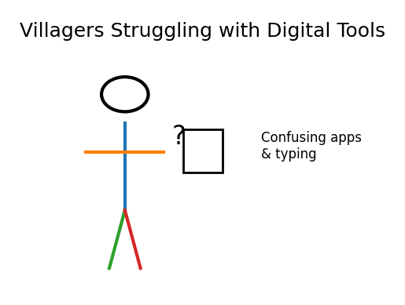
Villagers Struggling with Technology
Many farmers cannot use complex apps.

Slide 4
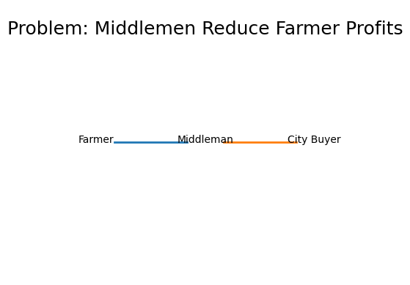
Middlemen Problem
Farmers earn less because of intermediaries.

Slide 5
Our Solution
AI + Voice platform that helps villagers run online businesses.

Slide 6
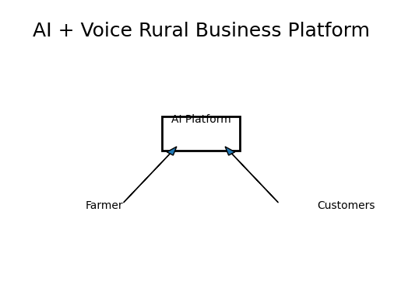
AI Village Brand Builder
Automatically create brand names, logos and packaging.

Slide 7
Voice Based Selling
Farmers speak and the app creates product listings.

Slide 8
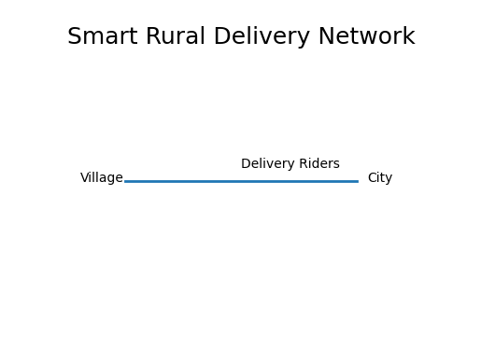
Smart Rural Delivery
Local youth deliver products to nearby buyers.

Slide 9
Live Village Marketplace
Farmers show products through live video selling.

Slide 10
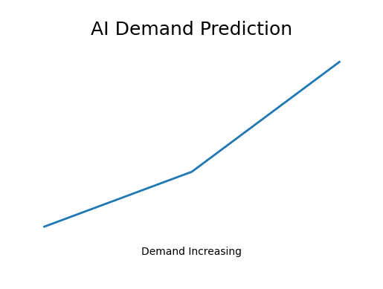
AI Demand Prediction
Predict market demand to increase profits.

Slide 11
Platform Architecture
Farmers → AI Platform → Customers

Slide 12
Impact
Increase farmer income and rural employment.

Slide 13
Market Opportunity
Millions of rural entrepreneurs in India.

Slide 14
Why This Wins Hackathons
AI innovation + social impact + scalability.

