Slide 1
Presentation on Online Hardware & Software Support System
Group Members:
Sameer Kumar(Leader)
Prabhat Kumar
Saurav Kumar
Sunny Saurav

Slide 2
Contents
TOPIC Page No.
Introduction 03
Project Overview 04
System Design 05
Use Case Diagram 06
Data Flow Diagram 07
Database Design-ERD 08
Expected Output Page 09
Home Page 10
Login Portal 11
Admin Functionalities 12
Customer Register 13
Customer Page 14
Engineer Page 15
Project Scope of Improvement 16
References 17
Any Queries 18

Slide 3


Slide 4
Project Overview
This project is aimed at developing an online help desk for the customers whoever wants assistance in any Hardware and Software related issues.
This is an internet base web application which can be assed through the internet.
This system can be used to automate the workflow of service requests for the customers to Engineers via admin.
Registered customers will be able to log in and request for services for any of suported facilities.
These requests will be assigned to the concerned Engineers by the admin.

Slide 5

SYSTEM DESIGN

Slide 6
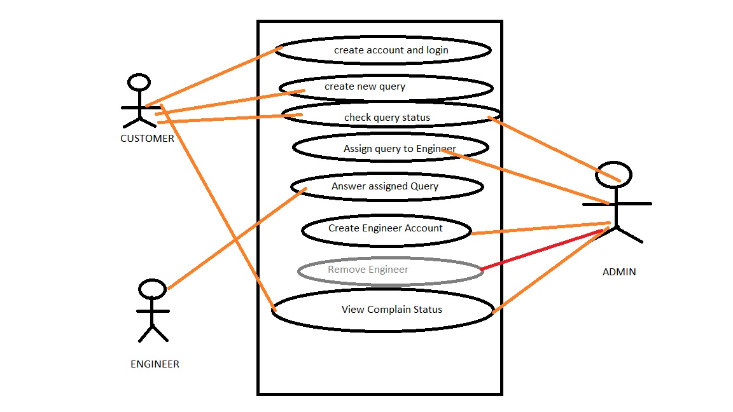
USE CASE DIAGRAM

Slide 7
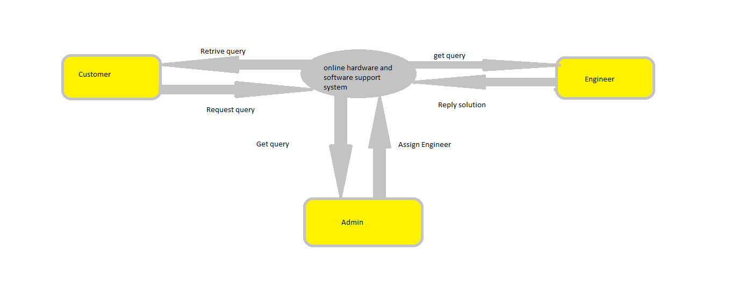
Data Flow Diagram

Slide 8
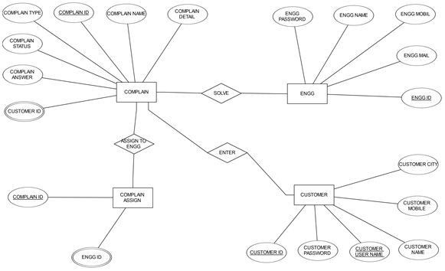
Database Design-ERD

Slide 9

EXPECTED OUTPUT PAGE

Slide 10
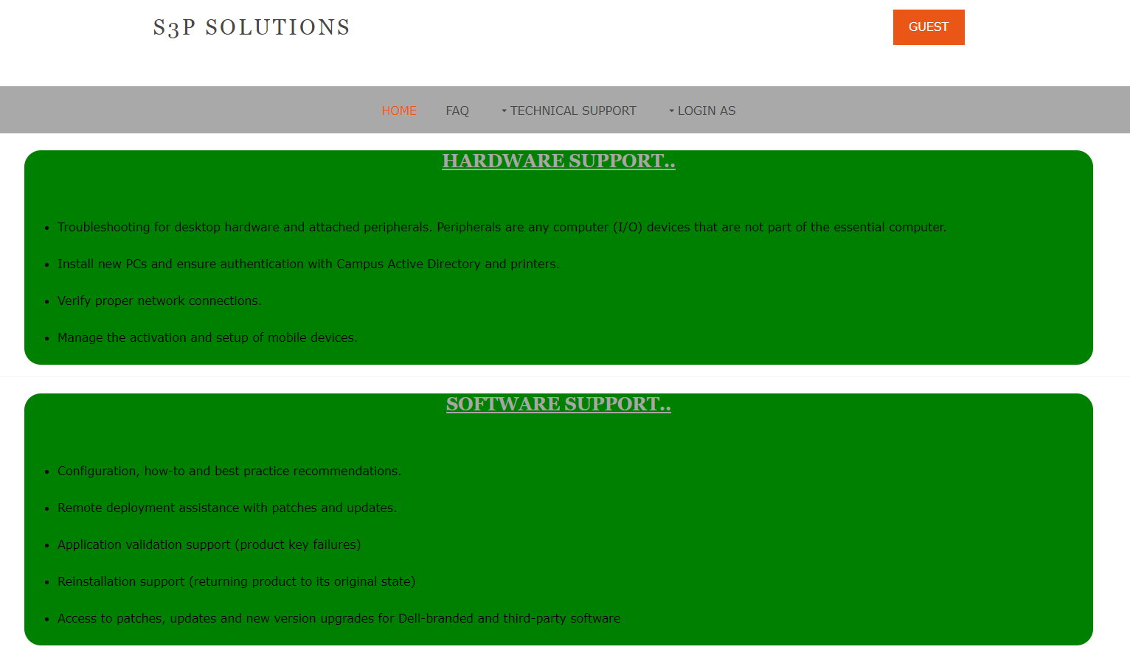
HOME PAGE

Slide 11
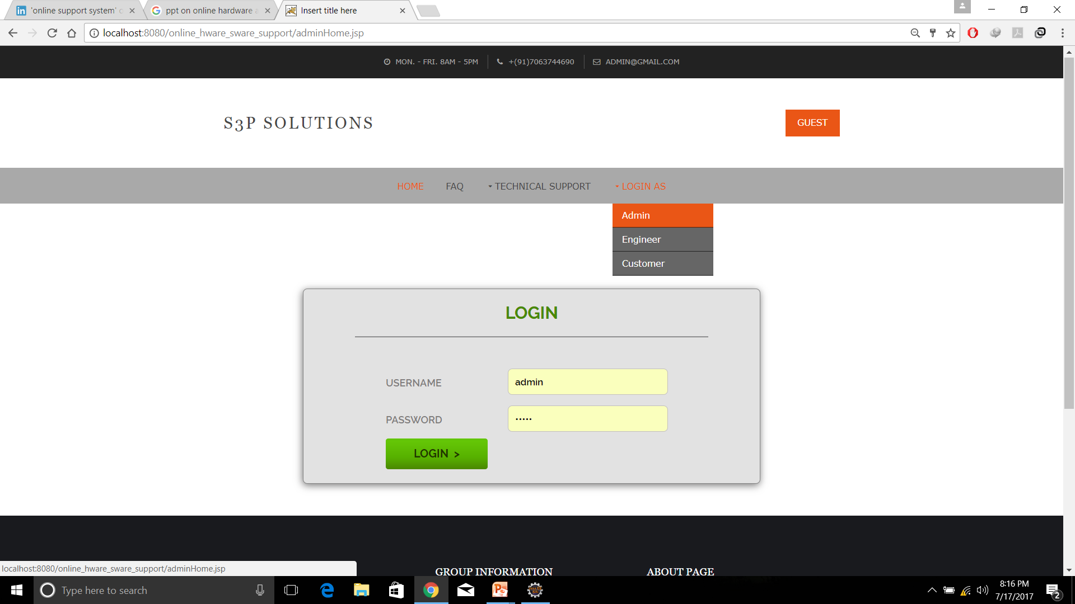
Login Portal

Slide 12
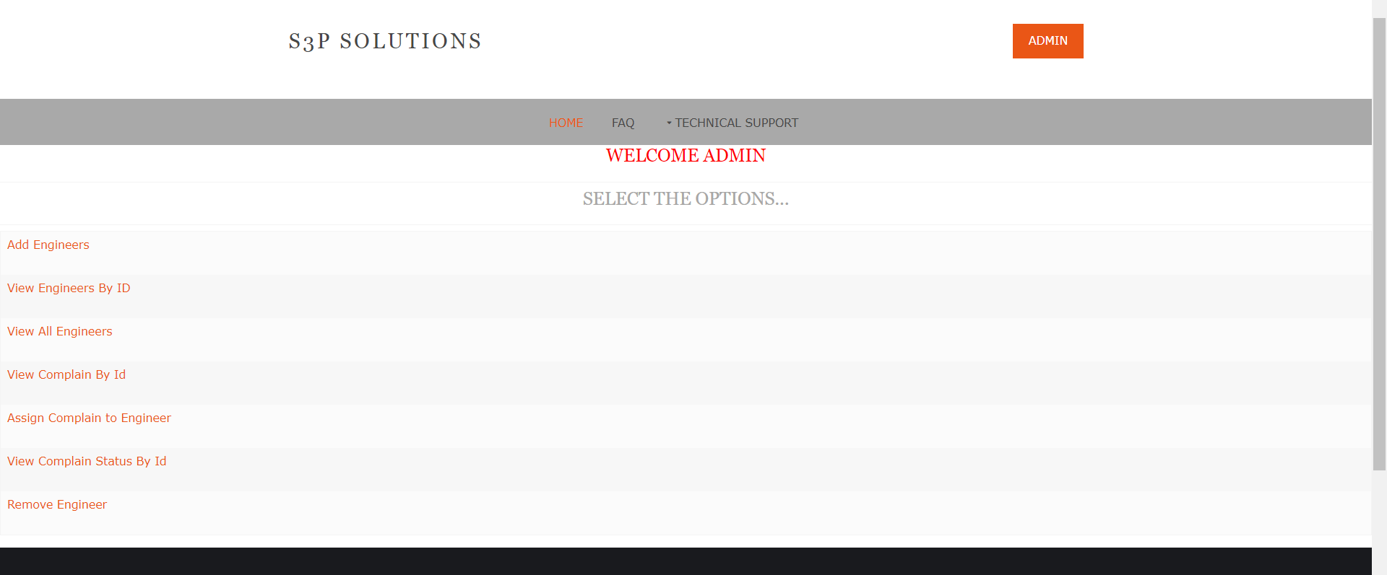
Admin Functionalities

Slide 13
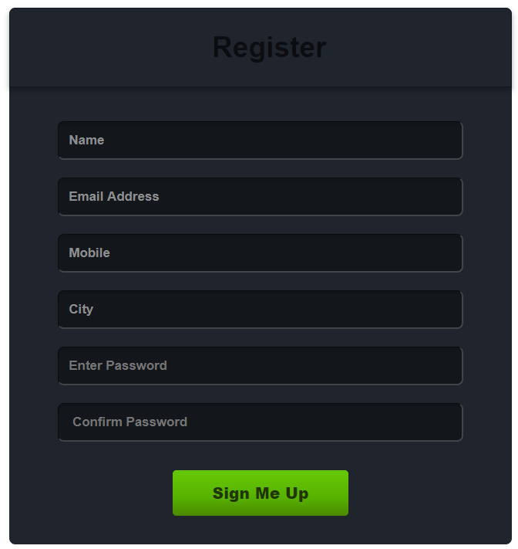
Customer Register

Slide 14
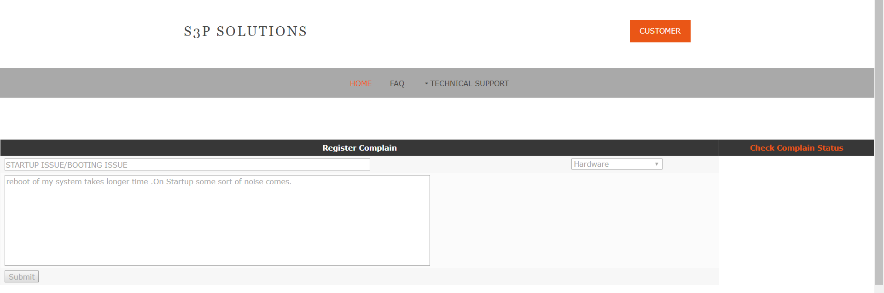
Customer Page

Slide 15
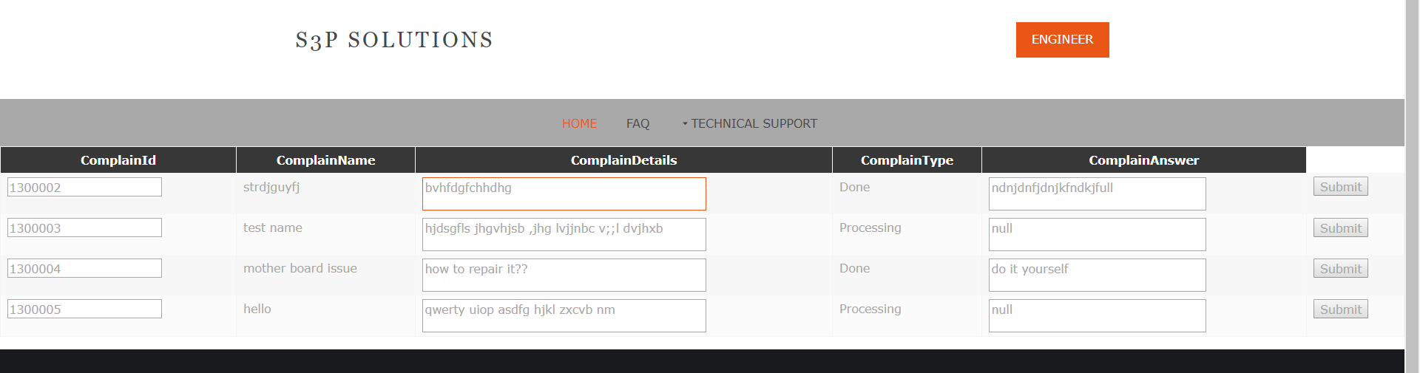
Engineer Page

Slide 16
Future Scope
In future this project can improved by providing assistance to customers live video chat and solve their problems then and there.
we will supply software links to customer so that they can download that software and their issue can be resolved.
This assistance project can be implmented at any service providing company to assist consumers.

Slide 17
References
https://www.google.co.in
www.wikipedia.org

Slide 18
Any Queries?

