Slide 1

IILM UNIVERSITY, GREATER NOIDA
School of Computer Science and Engineering
Internship Presentation
Junior Web Developer
Apparel & Textiles E-Commerce Platform
STUDENT
ENROLLMENT NO.
PROGRAM & SEMESTER
ORGANIZATION
Prabhat Nath Goswami
2410030811
B.Tech CSE — 5th Semester
YuvaIntern
10 August 2026 – 07 September 2026

Slide 2








Agenda
1
About YuvaIntern & the Internship
2
Objectives & Project Scope
3
Week 1 — Planning & Strategy
4
Week 2 — UX & Design System
5
Week 3 — Architecture & APIs
6
Week 4 — Testing & Results
7
Key Learnings
8
Conclusion & Certificate
YuvaIntern — Junior Web Developer, Apparel & Textiles
02

Slide 3


01
YuvaIntern is a skill-development and virtual internship platform, working in association with the National Skill Development Corporation (NSDC), that gives students structured, project-based internship experience across web development, design, marketing, and data.
Organization
Profile
Real-world, industry-styled tasks that simulate a professional team environment
Weekly milestones with mentor review and structured feedback
YuvaIntern
Certificate of Experience issued on successful completion
“Throughout the tenure of this internship, Prabhat demonstrated consistent dedication, professionalism, and a strong willingness to learn and grow.”
— Certificate of Experience, YuvaIntern
03

Slide 4
Internship at a Glance
ROLE
DOMAIN
DURATION
ORGANIZATION
Junior Web
Developer
Apparel &
Textiles
4 Weeks
YuvaIntern
10 August 2026 → 07 September 2026
The internship was structured as a four-week, project-based programme: planning an e-commerce concept for the apparel & textiles industry, designing its front-end UX, planning its back-end architecture, and validating it through structured testing.
YuvaIntern — Junior Web Developer, Apparel & Textiles
04

Slide 5





Project Objectives
Build a responsive, visually appealing apparel & textiles e-commerce site
Deliver an intuitive shopping experience — clear categorisation, search & filtering
Integrate secure cart, checkout, and payment-gateway functionality
Enable real-time inventory tracking to prevent overselling
Optimise the platform mobile-first, for the majority-mobile shopper base
Establish a scalable technical foundation for future growth
YuvaIntern — Junior Web Developer, Apparel & Textiles
05

Slide 6
Week 1
Project Planning & Strategy
Defined project goals, target audience, and website scope; produced a 4-week roadmap, resource plan, and risk-mitigation strategy grounded in competitor research.
Competitive Analysis
Myntra
Week 1
Requirement gathering & planning
Huge catalogue, fast checkout
→ Keep filters, simplify layout
Week 2
Wireframing & UI/UX design
Zara
Clean, minimal UI
Week 3
Front-end build & responsive coding
→ Adopt minimal aesthetic
Week 4
Testing, optimisation & final review
Fabindia
Strong fabric storytelling
→ Add product storytelling
YuvaIntern — Junior Web Developer, Apparel & Textiles
06

Slide 7
Week 2
UX Strategy & Visual Design System
A calm, image-led, mobile-first design: a shallow site architecture (≤ 3 clicks to any page), a persistent PDP template, and generous product information to reduce sizing anxiety.
Visual Design System
Colour Palette
Category / Search / Lookbook / Account
↓
Product Detail Page (PDP)
Ink
Sand
Oat
Rust Accent
↓
Shopping Bag
Typography
↓
A single grotesque sans-serif throughout, with weight and size — not extra typefaces — creating hierarchy. Body copy: 15–16px / 1.5 line-height.
Streamlined Checkout
Mobile-first responsive breakpoints: <600px · 600–1024px · >1024px
YuvaIntern — Junior Web Developer, Apparel & Textiles
07

Slide 8
Week 3
Back-End System Architecture
Client Layer
Web storefront & mobile app over a versioned REST/JSON API
API Gateway
Node.js (Express) — routing, auth, validation, rate limiting
Core Domain Modules
Catalog · Inventory · Cart & Checkout · Orders · Users · Payments
Integration Layer
Adapters for payment gateway, ERP/inventory, shipping carriers
Data & Async Layer
PostgreSQL · Redis · S3 storage · message queue for background work
YuvaIntern — Junior Web Developer, Apparel & Textiles
08

Slide 9



Week 3
Technology Stack & API Integration
Node.js + Express
PostgreSQL + Redis
Elasticsearch
API-heavy, high-concurrency runtime
ACID orders, sub-ms caching
Faceted search by size / colour / fabric
S3 + CDN
RabbitMQ
JWT + OAuth2
Product imagery at scale
Decouples ERP sync, email, webhooks
Stateless, horizontally-scalable auth
Checkout Flow:
Client → API Gateway → Inventory check → Payment intent → Gateway webhook → Async worker confirms order & releases inventory
YuvaIntern — Junior Web Developer, Apparel & Textiles
09

Slide 10
Week 4
Testing & Performance Framework
1
2
3
Unit Testing
Integration Testing
User Acceptance Testing
Jest / Mocha on core logic (pricing, stock rules) — ≥ 80% coverage
Supertest / Postman against staging, incl. sandboxed payment & ERP
Manual + exploratory, end-to-end browse → checkout → return journeys
Real-world test scenarios: mobile browsing under average network · saved-address checkout · last-unit concurrency · declined-payment retry · size-exchange returns · flash-sale load spikes (10x concurrency)
Targets: ≥ 95% usability task success · SUS score ≥ 75 · p95 API response ≤ 400ms · LCP ≤ 2.5s · checkout success ≥ 99%
YuvaIntern — Junior Web Developer, Apparel & Textiles
10

Slide 11
Week 4
Staging Results Against Benchmarks
Page Load Time (LCP, seconds)
Test Pass Rate by Category (%)
Finding: Core flows pass at 96%; usability (89%) and peak-load performance (90%) fall just short of the 95% release threshold — addressable via targeted, low-risk fixes (async checkout calls, inventory-check caching, clearer size-guide placement) rather than architectural rework.
YuvaIntern — Junior Web Developer, Apparel & Textiles
11

Slide 12

Key Learnings & Skills Gained
Product Planning
UX & Responsive Design
Back-End Architecture
Translating business goals into scoped, milestone-driven technical requirements
Mobile-first wireframing, visual systems, and iterative usability testing
Service-oriented design, database schema modelling, and API planning
Third-Party Integration
Structured Testing
Evidence-Based Iteration
Payment gateways, ERP/inventory sync, and asynchronous processing
Multi-level test planning and benchmarking against real performance metrics
Reading test results and translating findings into prioritised fixes
YuvaIntern — Junior Web Developer, Apparel & Textiles
12

Slide 13
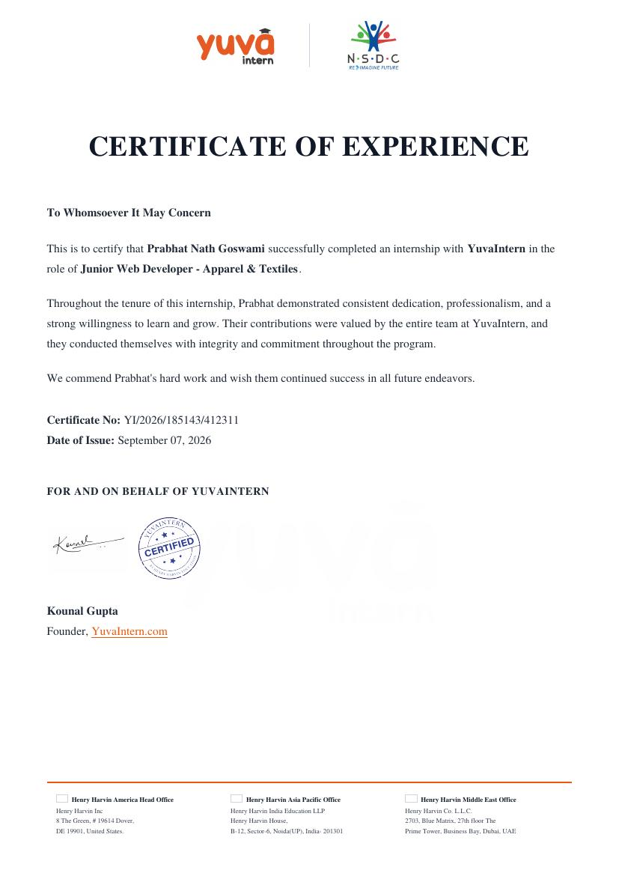
Conclusion
This internship translated a real apparel & textiles e-commerce brief into a validated, end-to-end technical plan — spanning strategy, UX, architecture, and structured testing.
A shallow, mobile-first site architecture backed by a restrained, textile-appropriate design system
A scalable, service-oriented back end with clear integration boundaries for payments, ERP, and shipping
A structured, benchmark-driven testing framework, with 96% functional pass rate at staging
A clear, evidence-based path to production release once the flagged usability & performance items are resolved
Certificate of Experience — YuvaIntern · Cert. No. YI/2026/185143/412311
13

Slide 14
Thank You
Prabhat Nath Goswami · 2410030811 · B.Tech CSE, 5th Semester
IILM University, Greater Noida — Internship at YuvaIntern

