Slide 1
Manual GUI Calculator & Indian National Flag
Name : Prabhat Kumar Gupta
Affiliations : Digicrome

Slide 2
Project overview/Problem Statement
To create a simple calculator using GUI Tkinter
To develop a simple calculator app with attractive presentation to ensure the Quality and effectiveness of the program.

Slide 3
Methodology/Software requirements
Creating a calculator app using Tkinter GUI
Using the tkinter library
It can perform basic mathematical operations such as addition, subtraction, multiplication and division.
Creating an Indian National flag using Canvas and tkinter library.
System requirements us as follow
Windows 10/11
Visual Studio code
Python 3.2 or the latest version

Slide 4
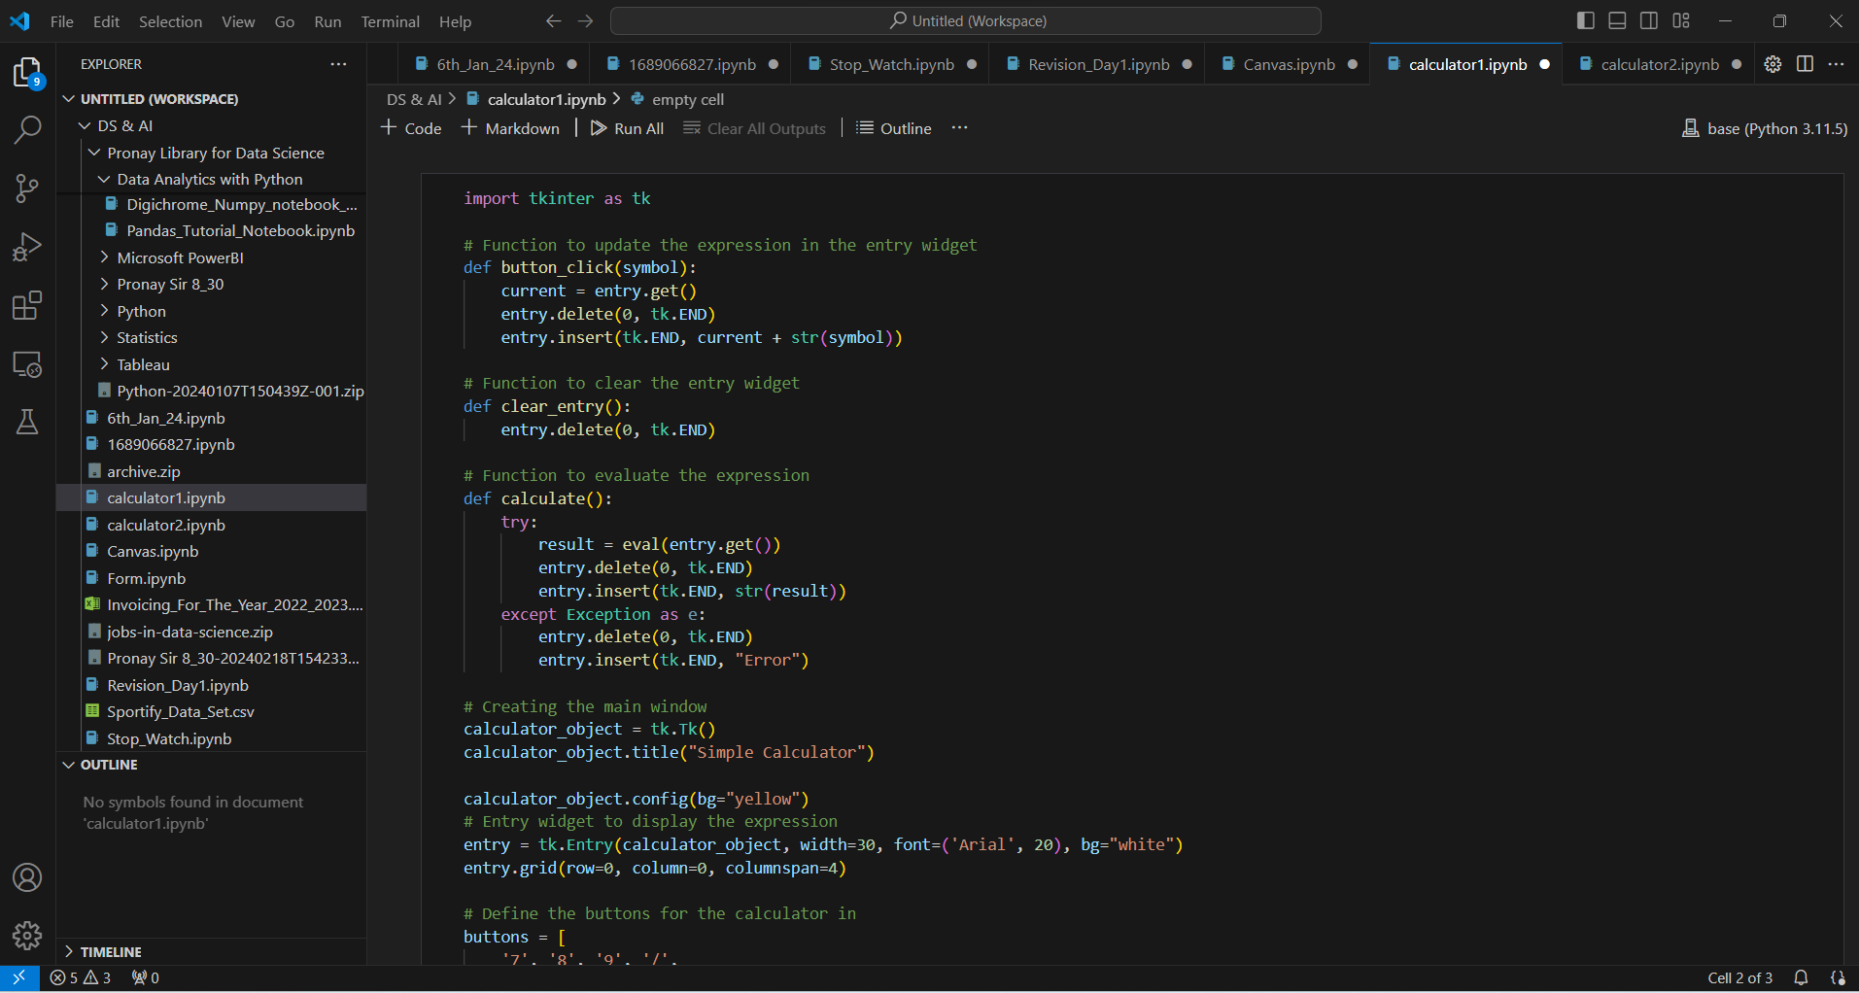
Following are the screen shots of calculator1.py, a python program used to create a GUI calculator

Slide 5
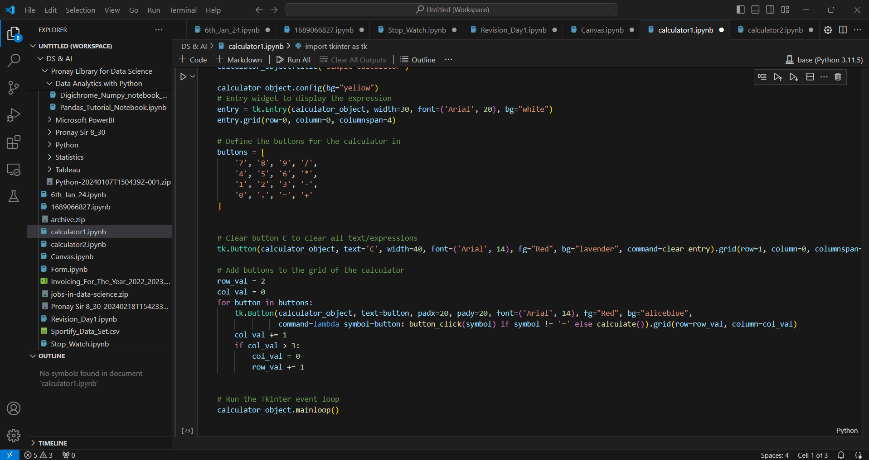

Slide 6
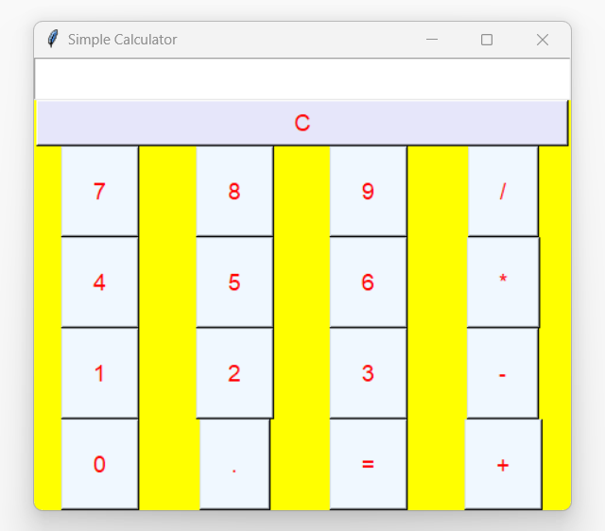
OUTPUT for the calculator1 program

Slide 7
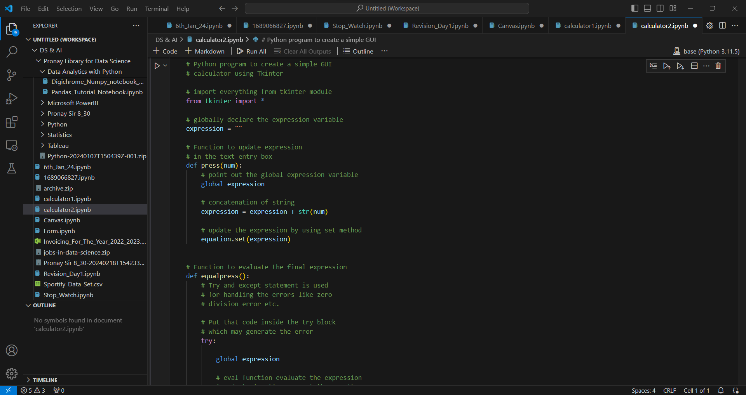
Following are the screen shots of calculator2.py, a python program used to create a GUI calculator

Slide 8
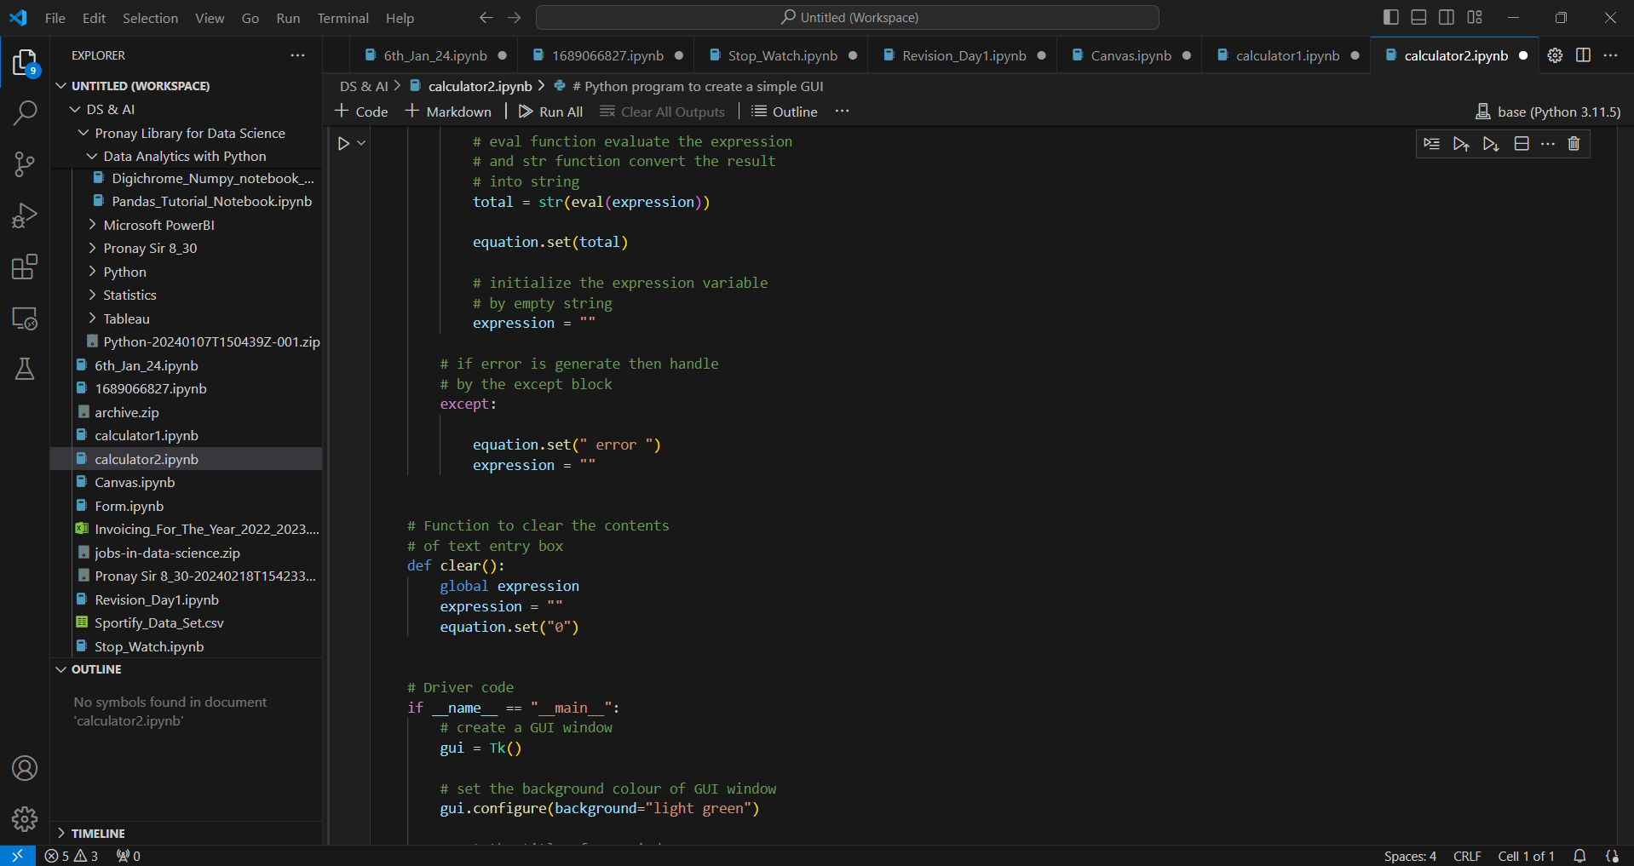

Slide 9
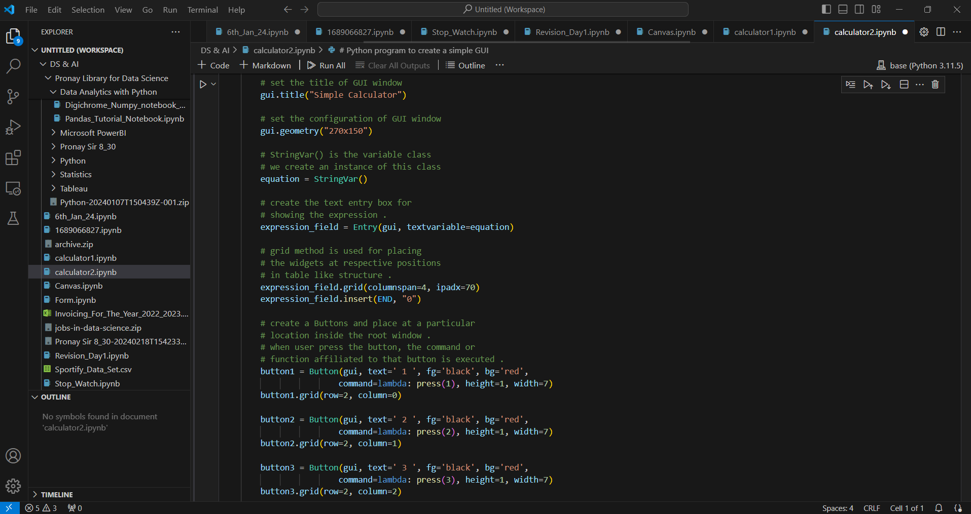

Slide 10
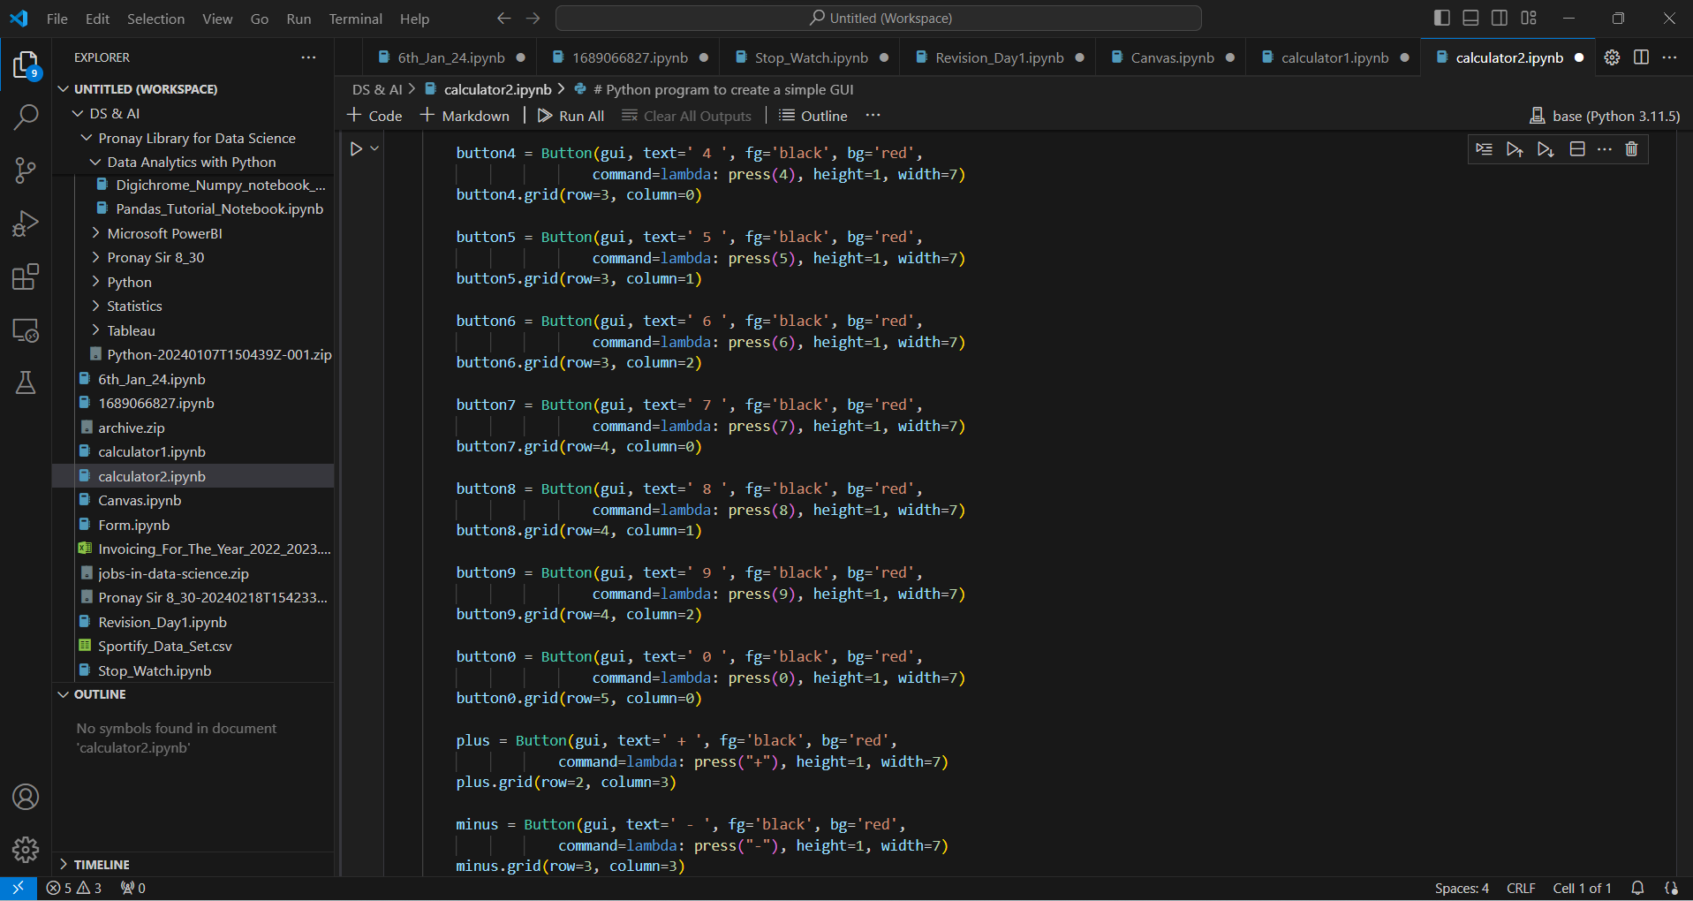

Slide 11
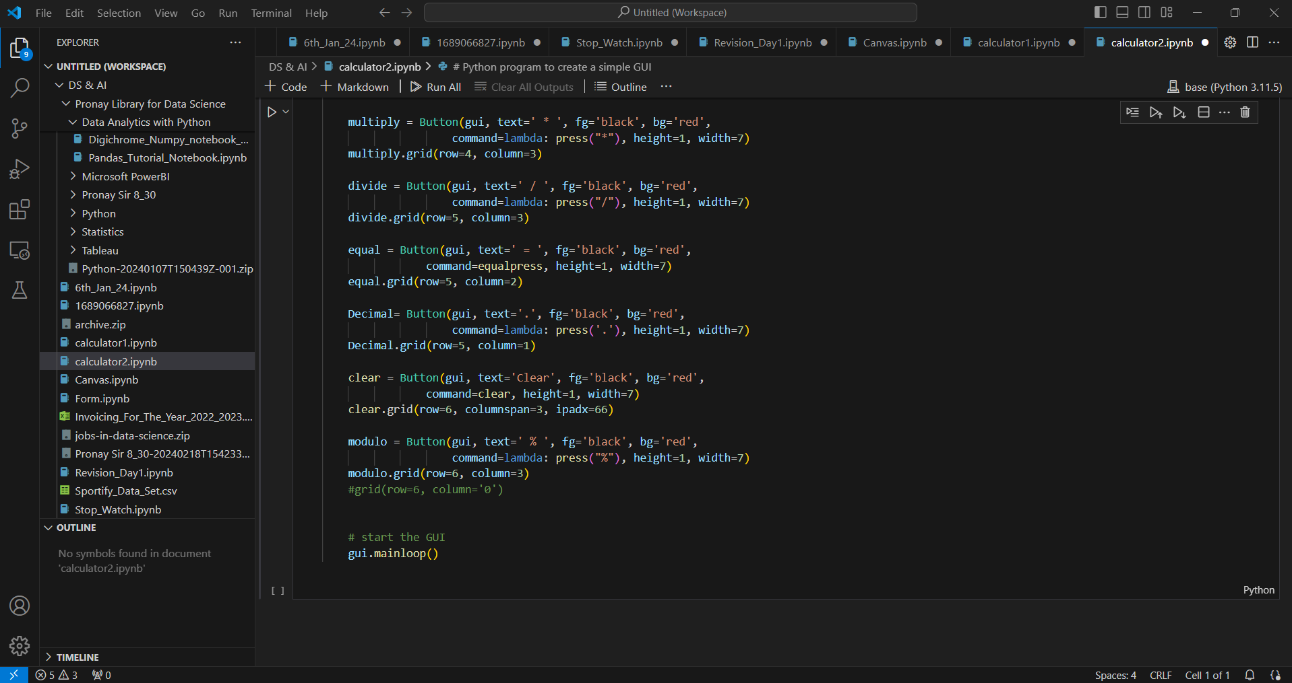

Slide 12
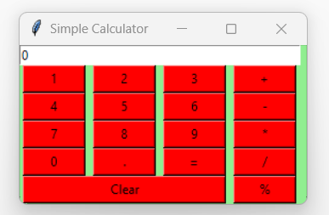
OUTPUT for the calculator1 program

Slide 13
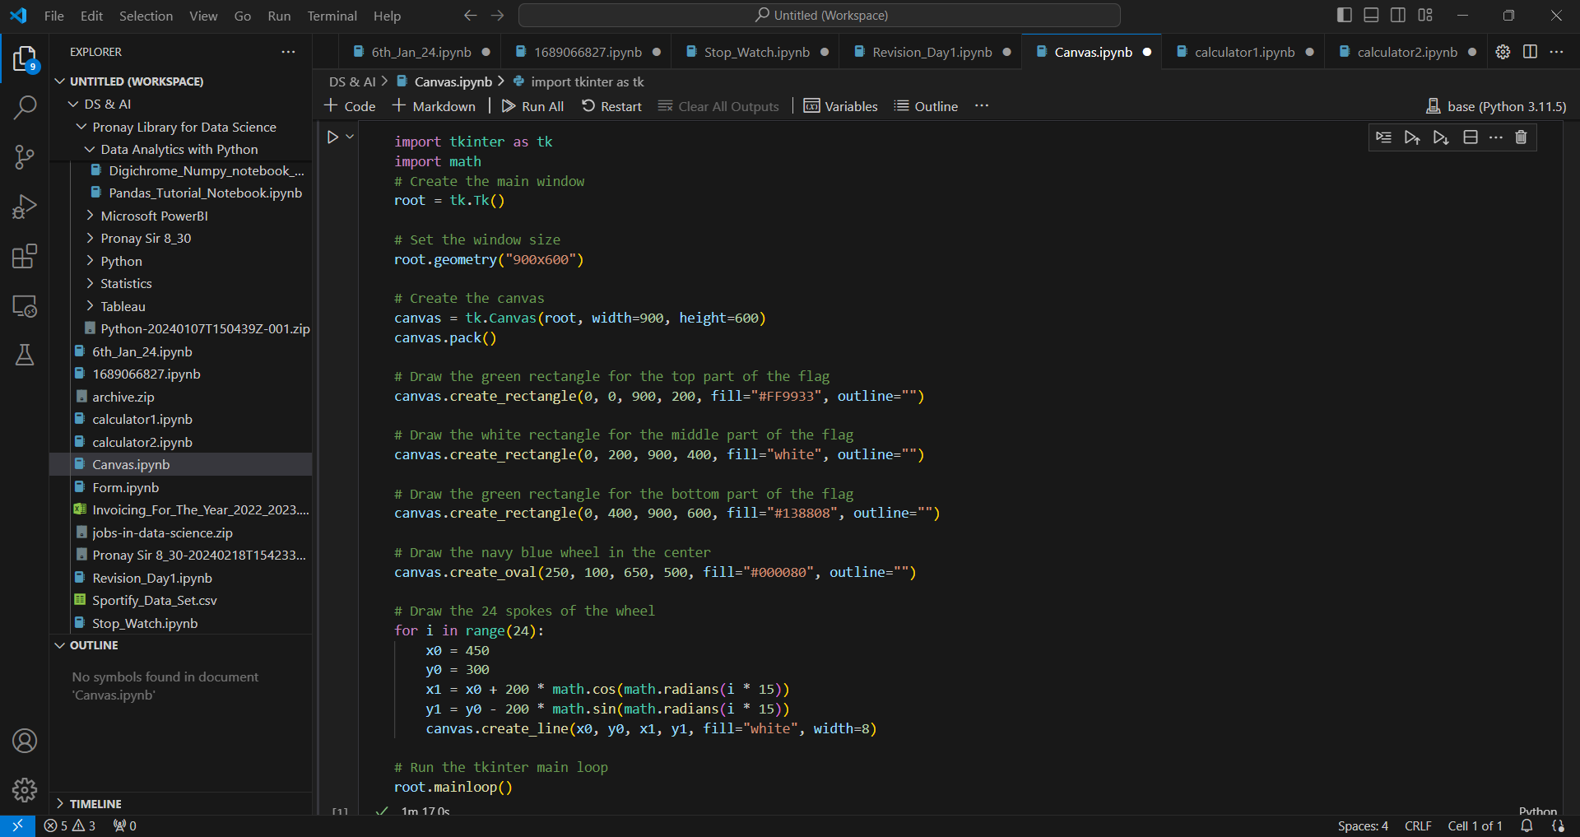
Following are the screen shots of Canvas.py, a python program used to create Indian Flag

Slide 14
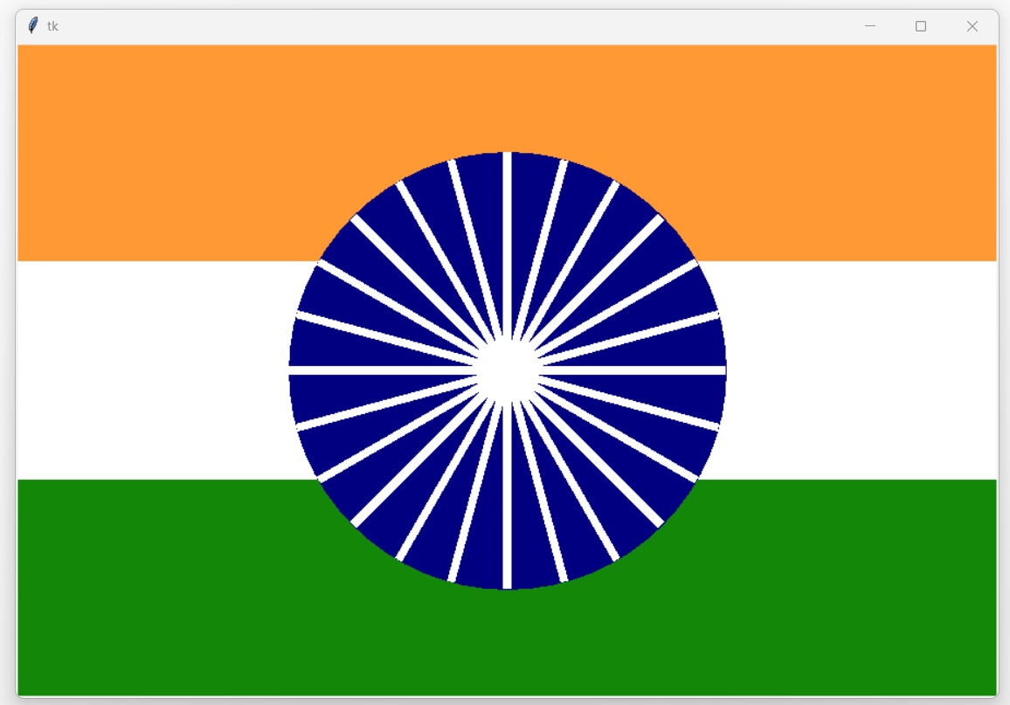
OUTPUT for the calculator1 program

Slide 15
THANK_YOU

