Slide 1
Abstract
Code-Mixed analysis has several applications in various fields ranging from customer experience management to social media campaigns. As the range of internet grows a lot of code-mixed data is generated from the users of the multilingual society. One of the common practice is using Hindi language words written with the help of the English alphabets. The project implements an LSTM model for the sentiment analysis of Hindi-English (Hi-En) code-mixed data and comparing it with the pre-existing character-level LSTM model.
The project focuses on learning the sentiments of individual words and combining them all together to determine the sentiment of the whole sentence. The learning model comprises of word-level LSTM architecture instead of character-level representations. This linguistics prior to the architecture enables us to learn the information about the sentiment value of important morphemes. Data translation and then pre-trained GloVe Embedding is used to preprocess the code-mixed dataset. The processed data is used to train a multilayer LSTM classifier to determine the sentiments of the text. The performance of the trained model is compared with that of character-level architecture. The system attains a performance comparable to that of the existing architecture and outperforms the available system in classifying some examples of the code-mixed dataset.

Slide 2
Acknowledgment
I would like to express my special thanks to all those who have provided me with guidance and assistance in doing this report. I pay my deep sense of gratitude to Dr. Annavarapu Chandra Sekhara Rao (Assistant professor), Department of Computer Science and Engineering, Indian Institute of Technology (ISM), Dhanbad, for encouraging and providing me all the elementary inputs needed to complete this report.
Furthermore I would also like to acknowledge with much appreciation the crucial role of Mr. Mayur Wankhade (Research scholar), who gave me the esteemed guidance and encouragement from beginning to the end of this project work and the necessary material to complete the report.
My special thanks and appreciations also go to my colleagues and people who have willingly helped me out with their abilities.
April, 2020
IIT(ISM), Dhanbad

Slide 3
CONTENTS:
1. Introduction
2. Dataset
3. Model Overview
4. Observation
5. Comparative Study
6. Conclusion
7. Reference

Slide 4
1. Introduction
1.1 What is Code Mixing?
Code Mixing is a natural phenomenon of embedding linguistic units such as phrases, words, or morphemes of one language into an utterance of another. For example (तुम कैसे हो? is usually written as “Tum Kaise ho?”). Code-mixing is widely observed in multilingual societies like India, which has 22 official languages most popular of which are Hindi and English. With over 400 million Indian population online, usage of Hindi has been steadily increasing on the Internet.
1.2 Sentiment Analysis
Sentiment Analysis is the Natural Language Processing (NLP) task dealing with the detection and classification of sentiments present in the texts. There are some tasks that deal with identifying the presence or absence of any sentiment in the text, while other task aims at determining the polarity of the text by categorizing them as positive, negative and neutral. The presence of sentiment in a text always has a source like people, groups of people, or entity, and the sentiment is directed towards some entity, person, object, or event.

Slide 5
There is a huge demand in the market related to sentiment analysis tasks as it allows businesses to identify customer sentiment towards products, brands, or services in online conversation and feedbacks. For example: “I really like the new design of your website!” → Positive, “I do not like this product…” → Negative, “I have my salon appointment today” → Neutral. The ability to extract insights from social data is a practice that is being widely adopted by organizations all across the world.
1.3 What I focused on
In this project I try to automatically extract sentiments (positive, negative or neutral) from given code-mixed social media data using the concepts of Recurrent neural networks (RNNs) and used a multi-layered word-level LSTM model for training and developing the classification model to determine the sentiment of the text. The model is developed in Keras framework using Tensorflow as a backend. The words are preprocessed by translation API and then converted into embedding vector with the help of pre-trained GloVe word embeddings. The sequence of embedding vectors is fed to a multi-layered LSTM model for training and finally classified with the help of a softmax classifier. Also, the performance of the model is compared with a pre-existing architecture that uses a character-level model and sub-word level model for Sentiment analysis.

Slide 6
2. Dataset
The Dataset is collected from the user comments from public Facebook pages popular in India. It includes the pages of Salman Khan, a popular Indian actor with a massive fan following, and Shri. Narendra Modi, the current Prime Minister of India. These pages have 35 million and 40 million Facebook user likes respectively. These pages attract a large variety of users from all across India and contain a lot of comments on the original posts in code-mixed representations in varied sentiment polarities. From the set of comments, those longer than 50 words or containing only English words were removed. The comments were annotated in a 3-level polarity scale – positive, negative, or neutral. The dataset contains 15% negative, 50% neutral and 35% positive comments owing to the nature of conversations in the selected pages.
Example | Meaning | Sentiment
Salman khan pagal hai | Salman Khan is Mad | Negative
Hello Bhai kaise ho? | How are you, Bhai? | Neutral
Mera PM Mahan. | My PM is great. | Positive
Table 2.1: Examples of Hi-En Code Mixed Comments from the dataset

Slide 7
2.1 Some Major Data Issues
The Dataset exhibits some of the major issues while dealing with the code-mixed data like:
Short sentences with unclear grammatical structure.
Number of variations of how words can be written.
Presence of multiple sentiments in a single comment.
Multiple variations of comments conveying the same sentiment.
Word | Meaning | Appearing Variations
बहुत (bahut) | Very | bahout bohut bhout bauhat bohot bahut bhaut bahot bhot
मुबारक (mubaarak) | Wishes | mobarak mubarak mubark
प्यार (pyaar) | Love | pyaar peyar pyara piyar pyr piyaar pyar
Table 2.3: Spelling variations of words in the Hi-En code-mix dataset.

Slide 8
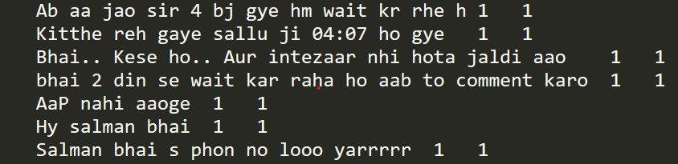
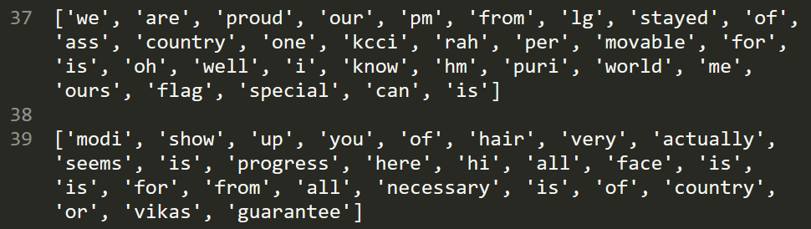
2.2 Data Preprocessing
The extracted data is in the text format. It is loaded into the python code and split into separate lines using python’s split() function. Each line of comment is used then parsed and its annotated sentiment value is collected. Also, each word in the comment is translated into a common language (English in this case) using Google Translation API (googletrans).
Cloud translation is a feature provided by Google that can dynamically translate text between thousands of language pairs. This translation enables websites and programmers to integrate with their customers or products.
Fig 2.1: Comments collected from the Facebook page (Before Translation).
Fig 2.3: Comments generated using Google Translation API (After Translation).

Slide 9
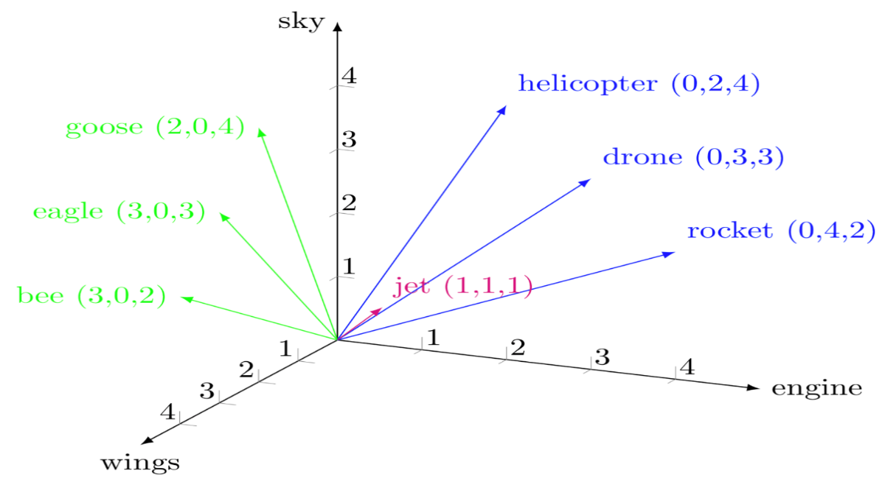
2.3 Words To Embeddings
Word level models are the most commonly used statistical approaches to learn word-level feature representations. Word2Vec (Mikolov et al. 2013) and Word-RNNs (thang Luong et al. 2013) have substantially contributed to the development of vector representations of English words and their applications in various NLP tasks such as Summarization, Machine Translation and Sentiment Analysis. They are theoretically sound since language consists of inherently arbitrary mappings between words of different languages. One of the most common approaches in using the Word2Vec model is to use a pre-trained Embedding that has already been trained on a very large corpus of data. One such Embedding is the GloVe embedding provided online by Stanford University.
Fig 2.4: Vector representation of a word using Word Embeddings.

Slide 10
2.3.1 GloVe Embeddings
GloVe: Global Vectors for Word Representation.
Introduction
Glove is an unsupervised learning algorithm for obtaining vector representations for words. Training is performed on aggregated word-to-word co-occurrence statistics from a corpus, and the resulting representations showcase interesting linear substructure on the word vector space.
Key Features
Nearest Neighbours: The cosine similarity between words pertaining to the similar meaning is very high and those words are in very close proximity to each other. According to metric the nearest neighbors are rare and such relevant words that are far beyond the normal human vocabulary. For example: Frog → Toad, leptodactylidae.
Linear Substructure: The similarity metric used for nearest neighbor evaluation produces a single scalar that quantifies the relatedness of words. Man can be kept similar to the woman on some axis, these words highlights a primary axis along which the human differs from each other. For example: Man:Woman::King:Queen.

Slide 11
Embeddings Overview
In this project, I have used glove.6B.100d.txt file that contains word embedding that is trained on a corpus of 6 Billion words where each embedding is a 100-Dimensional vector. The words and vectors are stored in the form of a dictionary mapping which can be easily loaded in a python file. These embeddings are trained by researchers at Stanford University NLP team and are provided online for use over any task related to Natural Language Processing.
Training of GloVe Vectors
The GloVe model is trained based on the non-zero entries of a global word-to-word co-occurrence matrix, which can tabulate how frequently words can co-occur with one another in the given corpus of text. To populate this matrix it requires a single pass through the entire corpus and collects the statistics. For large corpora, this type of pass can be very computationally expensive, but this cost is a one-time consumable cost, as once trained the embeddings can be used along with any problem related to the NLP domain. Further training iterations are much faster as the number of non-zero matrix entries is typically much smaller than the total number of words in the corpus.

Slide 12
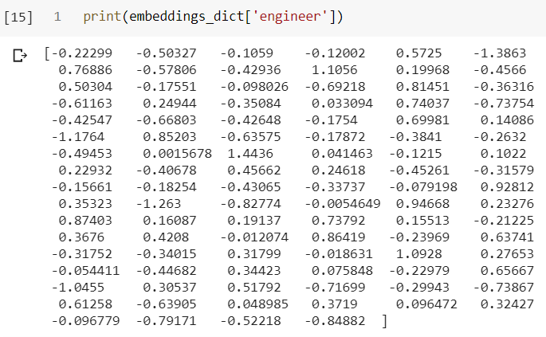
There are tools provided in this package that can automate the collection and preparation of co-occurrence statistics for input into the model. The core training code is a separate one from these preprocessing steps and can be executed independently whenever required.
Fig 2.5: An Example 100-Dimensional embedding vector of GloVe Word Embedding.

Slide 13
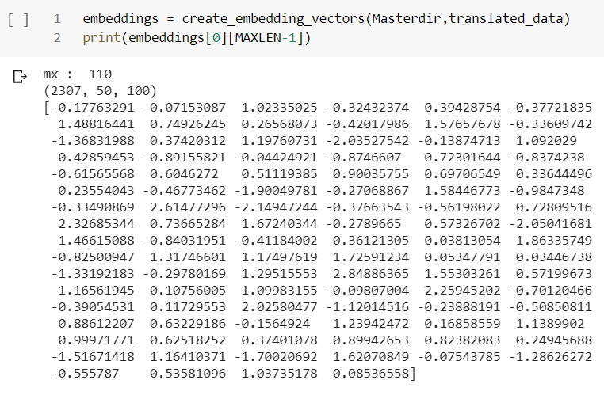
2.4 Using Glove Embeddings
After the translation of sentences to English, the translated data/comments are loaded along with the pre-trained GloVe embeddings. For each word present in the translated comment, it’s corresponding word embedding is checked. If it exists then the corresponding embedding is appended to the embeddings_vector, otherwise, a 100-Dimensional vector of all zeros is appended to signify the absence of the word in the GloVe embeddings. Each training example is padded up to 50 embeddings while each word embedding is a 100-Dimensional vector.
Fig 2.6: Creation of Embedding vector from translated words.

Slide 14
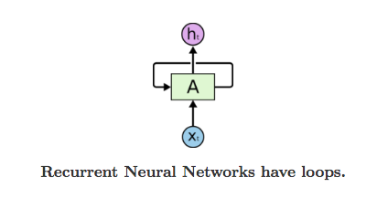
3. Model Overview
3.1 Introduction
Recurrent Neural Networks (RNNs) are one of the powerful tools to develop Deep learning models for analyzing time-series data. In RNNs the connection between nodes create a directed graph along the temporal sequence which allows it to exhibit temporal dynamic property. Each RNN cell has some internal memory to process variable-length inputs. The basic principle behind the working of RNNs is that the previously computed outputs/activations along with the input of the current time step is used to derive the current time step output/activation.
RNN finds application in various fields related to Natural Language Processing like Machine translation, Speech recognition, Sentiment Analysis, Language model etc.
Fig 3.1: Representation of a time sequence RNN model.

Slide 15
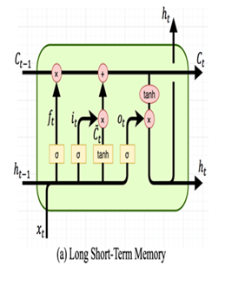
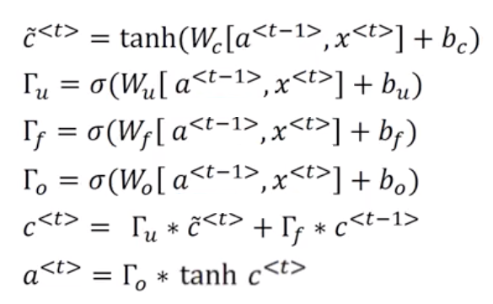
3.1.1 Basic RNN Learning Cell
Long-Short Term Memory (LSTM)
They were invented by Hochreiter and Schmidhuber in 1997 and set accuracy records across multiple application domains. Models trained on LSTM has outperformed their own benchmarks and brought a revolution to the language processing methods.
LSTM has broken the records for Language modeling, Machine translation, and Automated Image captioning.
Fig 3.3: Mathematical computation of a single time step in the LSTM cell.
Fig 3.2: General architecture of an LSTM cell.

Slide 16
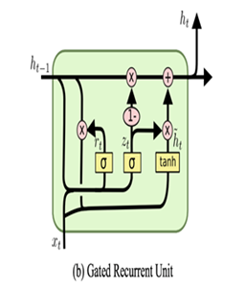
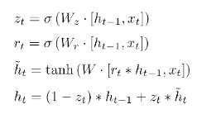
Gated Recurrent Units (GRU)
GRUs were introduced in 2014 by Kyunghyun Cho et al. It has a similar working principle to that of an LSTM cell but with fewer parameters. Due to its simplicity, it has become one of the favorable choice of building an RNN model. GRUs even tend to show better performance on certain smaller datasets.
Fig 3.5: Mathematical computation at a single time step in the GRU cell.
Fig 3.4: General architecture of a GRU cell.

Slide 17
3.2 Objective
To develop a multi-layer LSTM model that takes the embedding vectors as input at each time step (There are a total of 50 time steps). Perform linear combination and pass the result through some activation function and after doing all mathematical calculations predict the probability of sentence/comment belonging to different sentiment classes (0 → Negative, 1 → Neutral, 2 → Positive).
3.2.1 Methodology
The representation of one input training example is given by the matrix Q є R^{dxl} where ‘R’ is a set of Real numbers, ‘d’ is the dimension of one embedding vector and ‘l’ is the total time steps. In the project, I used d=100 and l=50. This data is used to map the relationship between features R^{dxl} and the sentiment output. The mapping is learnt using a multi-layer LSTM model which is best suited in learning to propagate and remember useful information even after longer time steps, and finally arriving at a sentiment value prediction.
I provided X_{t} input at ‘t’ time step and A_{t-1} is the activation of the previous time step. The values of forget gate, update gate, and output gates are calculated along with the activations C_{t} and Ḉ_{t}. The final output activation is calculated by element-wise multiplication of output gate and the linear combination of activations calculated above. The final step’s output is passed through a fully connected dense layer which calculates the sentiment polarity.

Slide 18
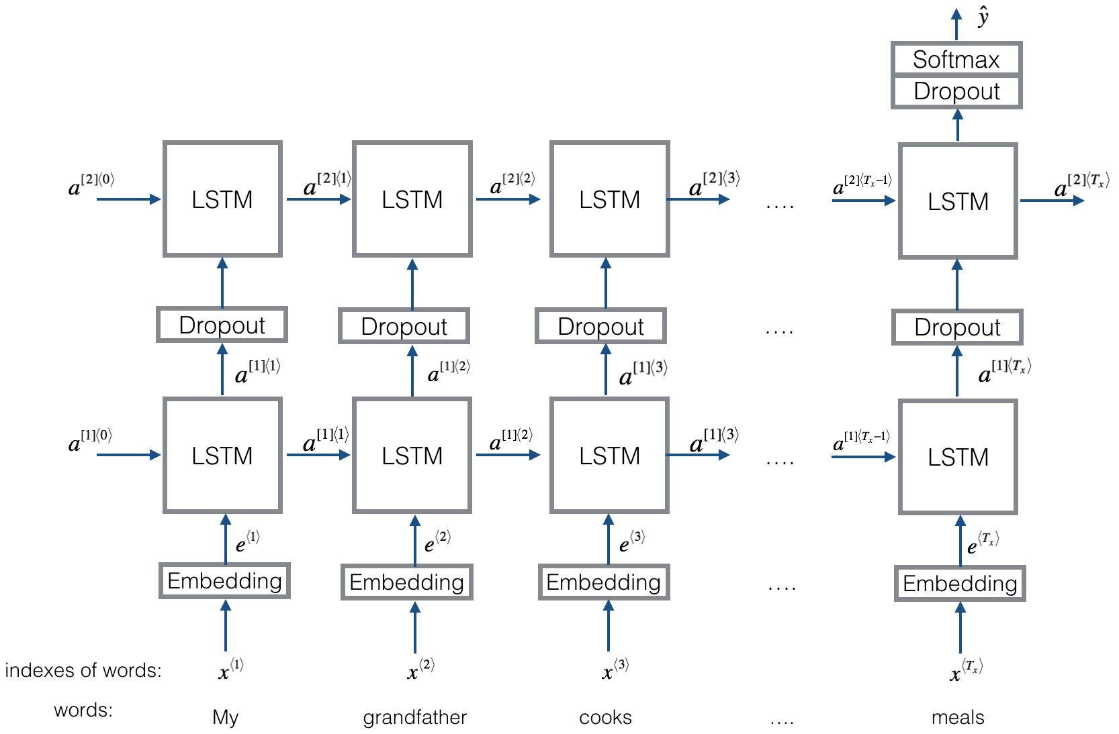
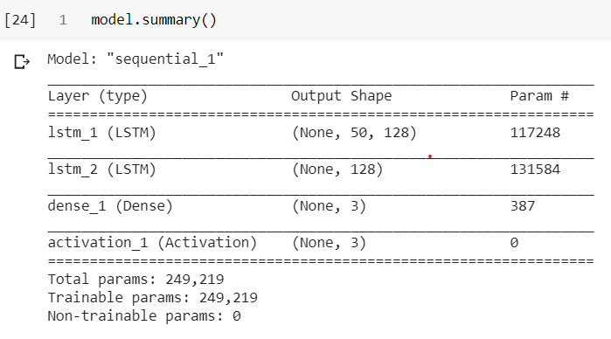
3.3 Architecture
Fig 3.8: Summary of the model developed in Keras.
Fig 3.7: Illustration of the proposed methodology.

Slide 19
3.4 Experimental Setup
The dataset is divided into 3 splits- Training, validation, and testing. I first divided the data randomly into 80-20% train-test split, then further randomly divided the training data into 80-20% train-validation split to obtain the appropriate training, validation, and testing examples.
The model is developed in Keras framework using Tensorflow in the backend. The model contains a multi-layered LSTM layer to better learn the mappings between embeddings and sentiment classes. The output produced by the LSTM layers is passed through a fully connected Dense layer and finally, a Softmax classifier is used to predict the probability of data example belonging to different sentiment classes. The class having the maximum probability is considered as the sentiment for the training example under consideration.
The model uses a Categorical cross-entropy loss model and Accuracy as the performance metric. In order to improve the performance of training, Adam optimizer is used for smooth gradient descent. During training, Dropout is also applied to remove any kind of overfitting occurring in the system and to improve the test set accuracy. The validation data is also supplied to the model so that it can generalize over newer test examples and thus improve its performance. Training is done in mini-batches to optimize the backpropagation step.

Slide 20
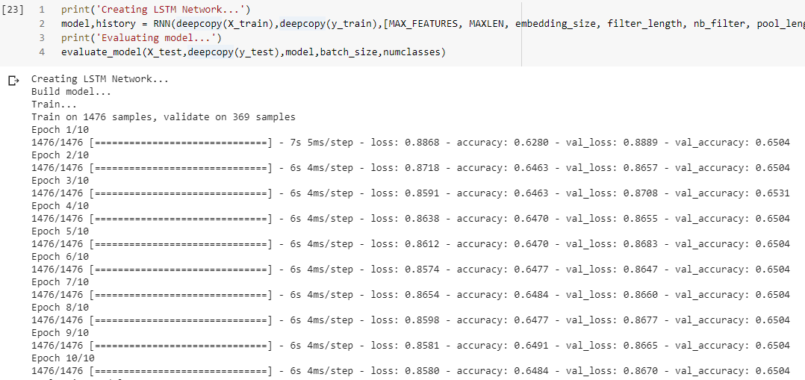

Fig 3.9: Snapshot of the model during the training stage.
Fig 3.10: Snapshot of the model during the testing.

Slide 21
3.5 Method Suitability
There are some techniques that are used to perform sentiment analysis in only English based text:
NLP Tool based approach: It involves the generation of parse trees which may not be available for the code-mixed dataset.
Approach based on Surface feature engineering: Hashtags, User mentions, Emoticons, etc. should not be present in the data, which is simply not the case of code-mixed data.

Slide 22
4. Observation
The model is developed in Keras framework was trained using more than 2000 training examples and tested on nearly 300 examples. There were certain important observations made during the training and testing phase of the model. These observations are listed below:
Due to the presence of a lot of misspelled words the model training accuracy is not surpassing a certain threshold.
The dataset includes multiple variations of same word, which makes their translation to English a tough task even for highly efficient and trained Google Translation API.
There are certain words that are improperly written and makes no sense even in their native language, this makes training very tough and fewer chances improve accuracy.
The model’s training accuracy can be improved by using more parameters for training or training the model for large a number of epochs.
On increasing the number of parameters of the model or number of epochs the model starts to overfit the training set data, due to which the testing accuracy decreases.

Slide 23
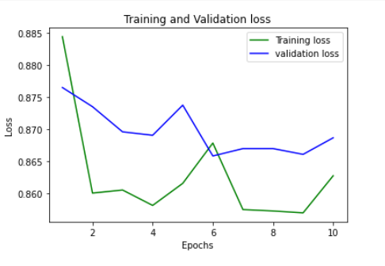
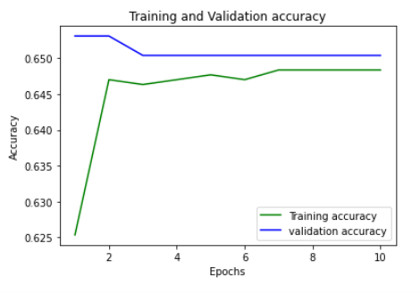
6. To reduce the overfitting of data, dropout and recurrent dropout are used on dense and recurrent layers respectively. Using dropout the Variance of the model is reduced and the model is able to generalize to new examples present in the test set.
Fig 4.1: Plot of Training and Validation Loss.
Fig 4.2: Plot of Training and Validation Accuracy.

Slide 24
3.5 Method Suitability
There are some techniques that are used to perform sentiment analysis in only English based text:
NLP Tool based approach: It involves the generation of parse trees which may not be available for the code-mixed dataset.
Approach based on Surface feature engineering: Hashtags, User mentions, Emoticons, etc. should not be present in the data, which is simply not the case of code-mixed data.

Slide 25
5. Comparative Study
5.1 Comparing Results
I have used exactly the same dataset for the comparative study between the sub-word level model and the model proposed by me. The pre-trained weights of the sub-word LSTM model are loaded from .h5 file. An evaluation function was defined to determine the performance of the model on the given test data based on the Accuracy as a metric. The results produced are as follows:
Model/Type | Train Set Performance |  | Test Set Performance
 | Accuracy | F1 Score | Accuracy | F1 Score
Char-LSTM | 59.8% | 0.511 | 46.6% | 0.332
Sub-Word LSTM | 69.7% | 0.658 | 67.3% | 0.637
Translation + LSTM | 67.3% | 0.642 | 66.2% | 0.652
Table 5.1: Classification results depicting the performance of proposed system over sub-word and character LSTM.

Slide 26
6. Conclusion
I have proposed a new architecture for the Sentiment Analysis of a noisy Code-Mixed (Hi-En) Dataset. I discussed some of the issues present in such a code-mixed dataset due to which there is an unavailability of NLP tools for Sentiment Analysis. The solution that I proposed involved translation of the given dataset in the English language with the help of a Translation API. After the translation, the words are converted into embedding vectors using the pre-trained GloVe embeddings provided by Stanford University. These embeddings comprise a feature matrix, that is used over a multi-layer LSTM model to learn the mapping from input sentences to output sentiments. Furthermore, the performance of the proposed model was compared with that of character-level and sub-word level models, and the results depicted that the performance of the proposed architecture is comparable and sometimes better in comparison to the later.
6.1 Future Work
Future work would be to explore ways to remove noise from the dataset to improve the test set performance, and also to observe the effects of scaling of the proposed model with a large dataset and deeper RNNs.

Slide 27
7. References
Basics of using pre-trained GloVe Embeddings in python. https://medium.com/analytics-vidhya/basics-of-using-pre-trained-glove-vectors-in-python-d38905f356db
Documentation for Google Cloud Translation API. https://cloud.google.com/translate/docs
Pre-trained GloVe Embeddings. https://nlp.stanford.edu/projects/glove/
Build a Machine Learning Model using Google Colaboratory. https://colab.research.google.com/
Keras Documentation. https://keras.io/
Preprocessing of Dataset using Kaggle GPU/TPU. https://www.kaggle.com/
Data Visualization in Deep Learning using Matplotlib. https://www.pluralsight.com/guides/data-visualization-deep-learning-model-using-matplotlib

Slide 28
Thank You

