Slide 1
CS 410 Project
Medicine Reminder Web App
PRESENTED BY – PRABHAT KUMAR RAJAK
ROLL NO. – 1901139
BTECH CSE 8th SEMESTER
Under the Supervision of
Dr. ANGSHUMAN JANA

Slide 2
Contents
01
02
03
04
05
06
Introduction
07
SetReminder Screen
Motivation
08
Technologies Used so far
Objective
09
Future Work
Work Done Till Now
Homepage Screen
Signin and Signup Screen

Slide 3
Inroduction
Purpose : The purpose of a medicine reminder system is to remind individuals to take their medication at the appropriate times, as prescribed by their healthcare provider.
Scope :
Individuals who are taking multiple medications with complex dosing schedules
Elderly individuals who may have difficulty remembering to take their medication
Individuals with chronic conditions who need to take medication on a regular basis

Slide 4
Motivation
Improved adherence to medication schedules: Many people struggle to take their medications consistently, whether due to forgetfulness or other reasons. A medicine reminder web app can help improve adherence by providing users with notifications and reminders to take their medications at the appropriate times.
Convenience: A medicine reminder web app can be accessed from any device with an internet connection, making it a convenient way for users to stay on top of their medication schedules.
Increased medication safety: Some medications can have serious side effects if not taken correctly or if taken in combination with other medications. A medicine reminder web app can help users avoid dangerous medication interactions and ensure they are taking the right dosage at the right time.

Slide 5
Objective
The Web app should allow users to set reminders for taking their medicine and receive notifications at the appropriate times.
The Web app should allow users to view and edit their reminders.
The Web app should allow users to schedule recurring reminders for taking their medicine.
The Web app should allows users to view and edit their medication history.
Users will be able to input and store information about their medications, including name, dosage, and frequency.

Slide 6
Work Done Till Now
I have almost completed the designing and the frontend part of the Medicine Reminder Web App.
I have completed some backend part like the authentication of the user.

Slide 7

Homepage Screen

Slide 8
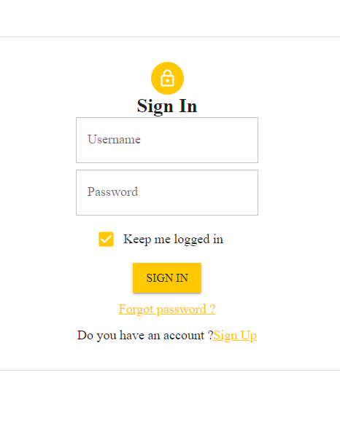
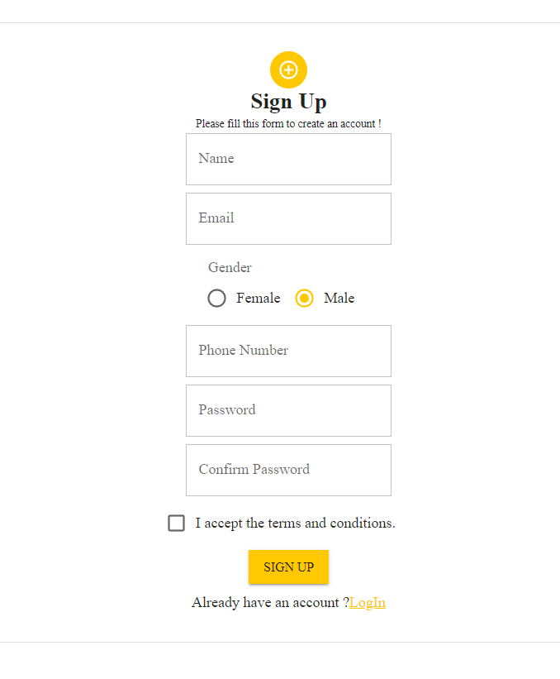
Signin and Signup Screen

Slide 9
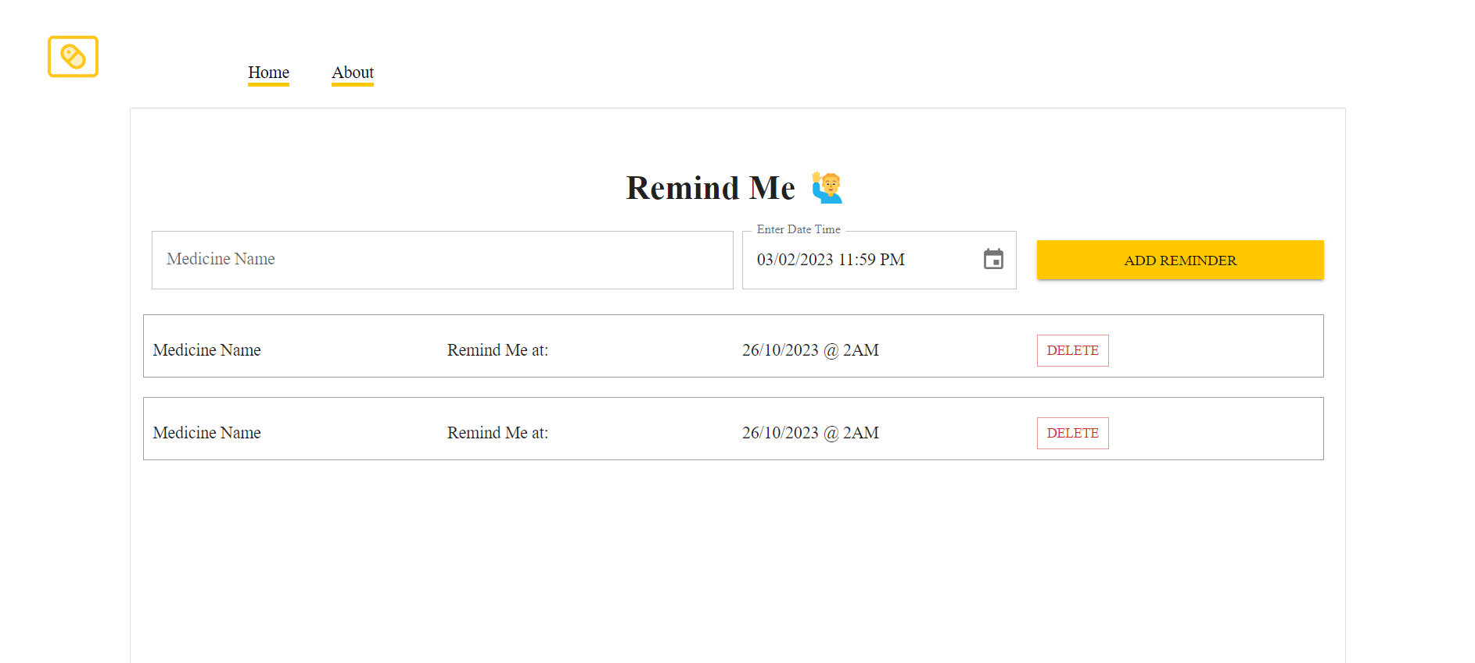
SetReminder Screen

Slide 10







Tecnologies Used so far

Slide 11
Future Work
Implementation of the backend part of the Medicine reminder Web App.
Integrate Automatic Addition of Medicine using Prescription.

Slide 12
Thank You

