Slide 1
CS 410 Project
Medicine Reminder Web App
PRESENTED BY – PRABHAT KUMAR RAJAK
ROLL NO. – 1901139
BTECH CSE 8th SEMESTER
Under the Supervision of
Dr. ANGSHUMAN JANA

Slide 2
Contents
01
02
03
04
05
06
Introduction
Motivation
Objective
Demonstration
Technologies Used
Conclusion

Slide 3
Inroduction
Purpose : The purpose of a medicine reminder system is to remind individuals to take their medication at the appropriate times, as prescribed by their healthcare provider.
Scope :
Individuals who are taking multiple medications with complex dosing schedules
Elderly individuals who may have difficulty remembering to take their medication
Individuals with chronic conditions who need to take medication on a regular basis

Slide 4
Motivation
Improved adherence to medication schedules: Many people struggle to take their medications consistently, whether due to forgetfulness or other reasons. A medicine reminder web app can help improve adherence by providing users with notifications and reminders to take their medications at the appropriate times.
Convenience: A medicine reminder web app can be accessed from any device with an internet connection, making it a convenient way for users to stay on top of their medication schedules.
Increased medication safety: Some medications can have serious side effects if not taken correctly or if taken in combination with other medications. A medicine reminder web app can help users avoid dangerous medication interactions and ensure they are taking the right dosage at the right time.

Slide 5
Objective
To improve medication adherence by providing customized reminders for users to take their medication on time.
To provide a convenient and user-friendly way for individuals to manage their medication schedules.
To reduce healthcare costs associated with medication nonadherence.
To empower individuals to take control of their health and medication management.

Slide 6
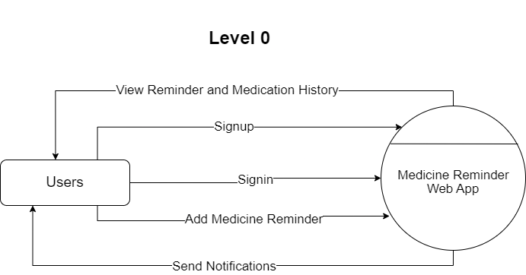
DFD

Slide 7
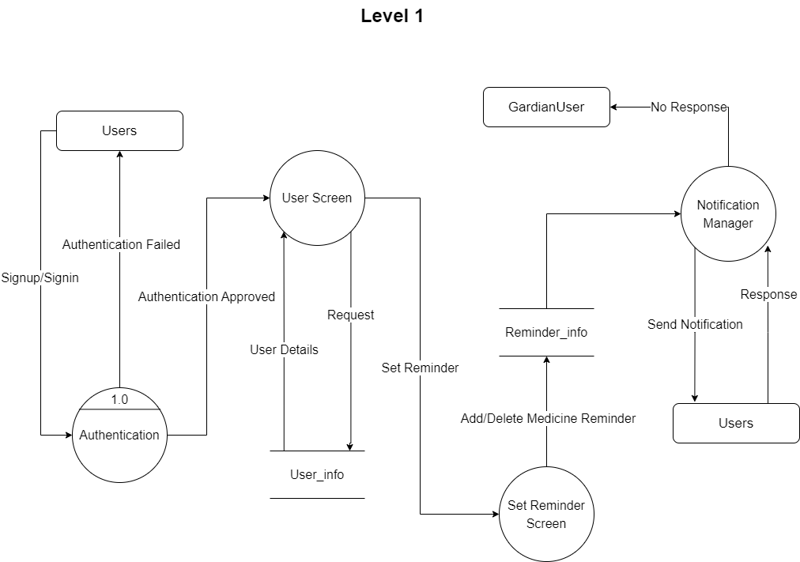

Slide 8
Demonstration

Slide 9
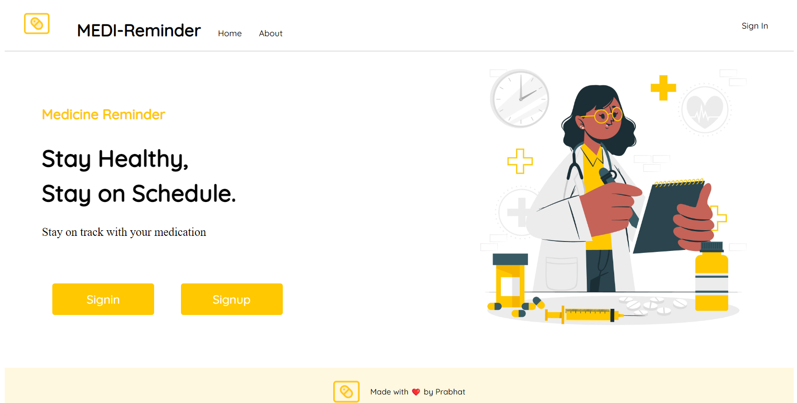
Landing Page

Slide 10
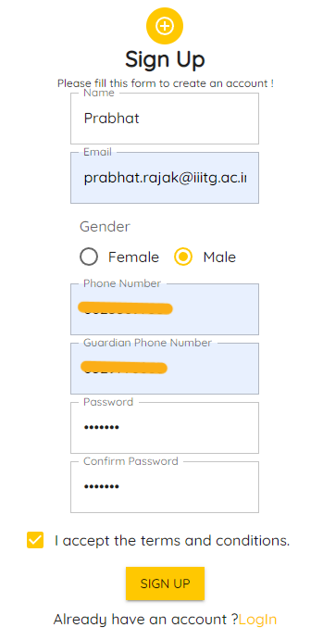
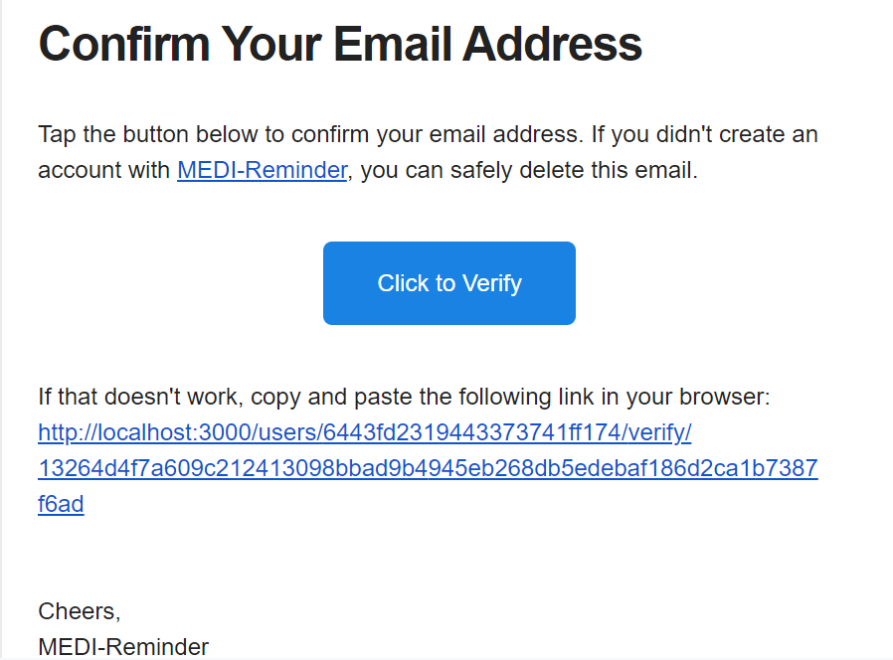
Sign Up Screen
After Clicking the Sign Up button an email is send for the verification

Slide 11
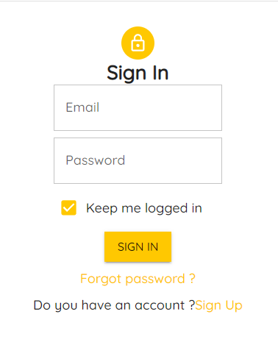
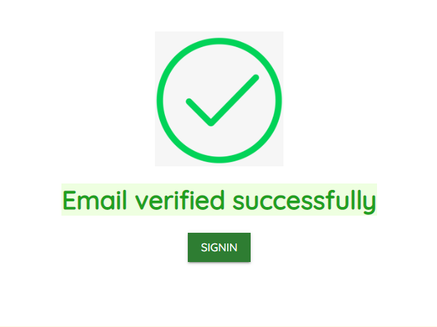
Sign In Screen
After Clicking on the link email is verified and
Now the user can login.

Slide 12
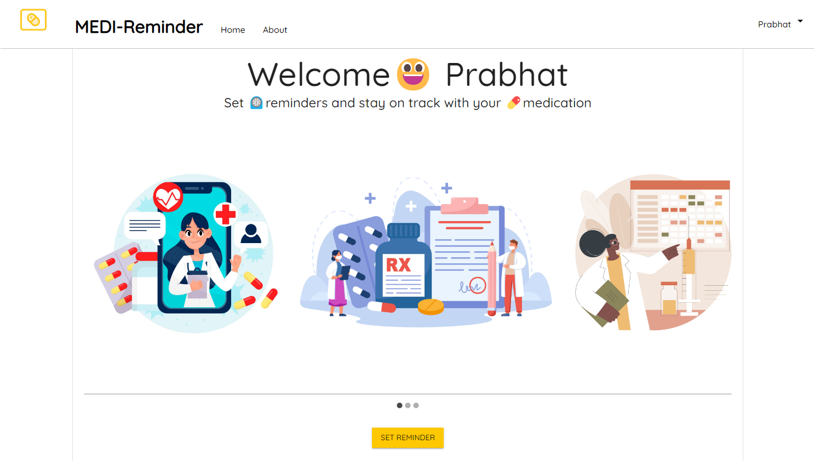
Home Screen

Slide 13
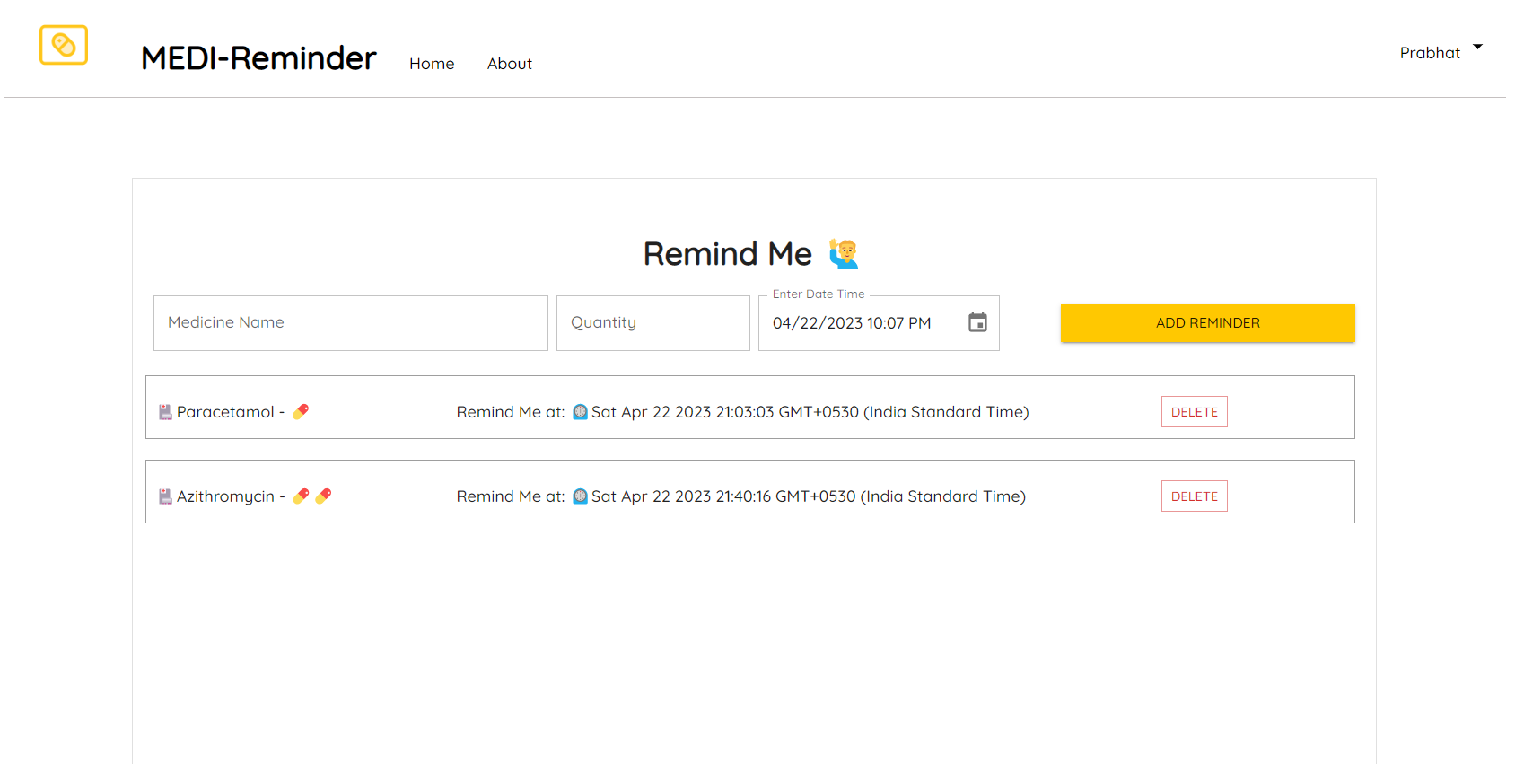
Set Reminder Screen

Slide 14
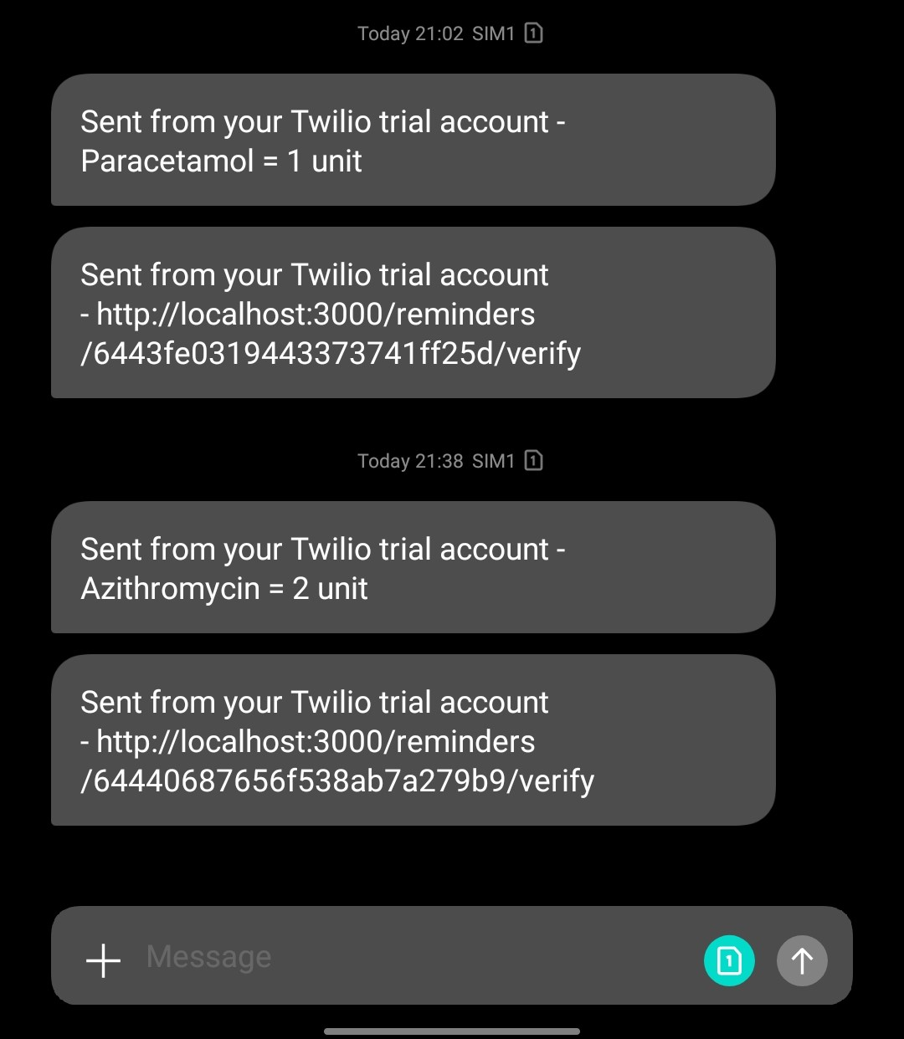
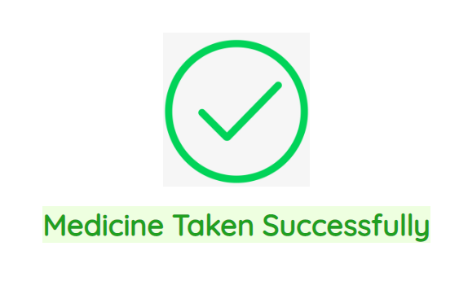
After Adding Reminder and Verification
Link is sent using SMS Notification
After Clicking on the link, it is verified that the user have
Have successfully taken the medicine.

Slide 15
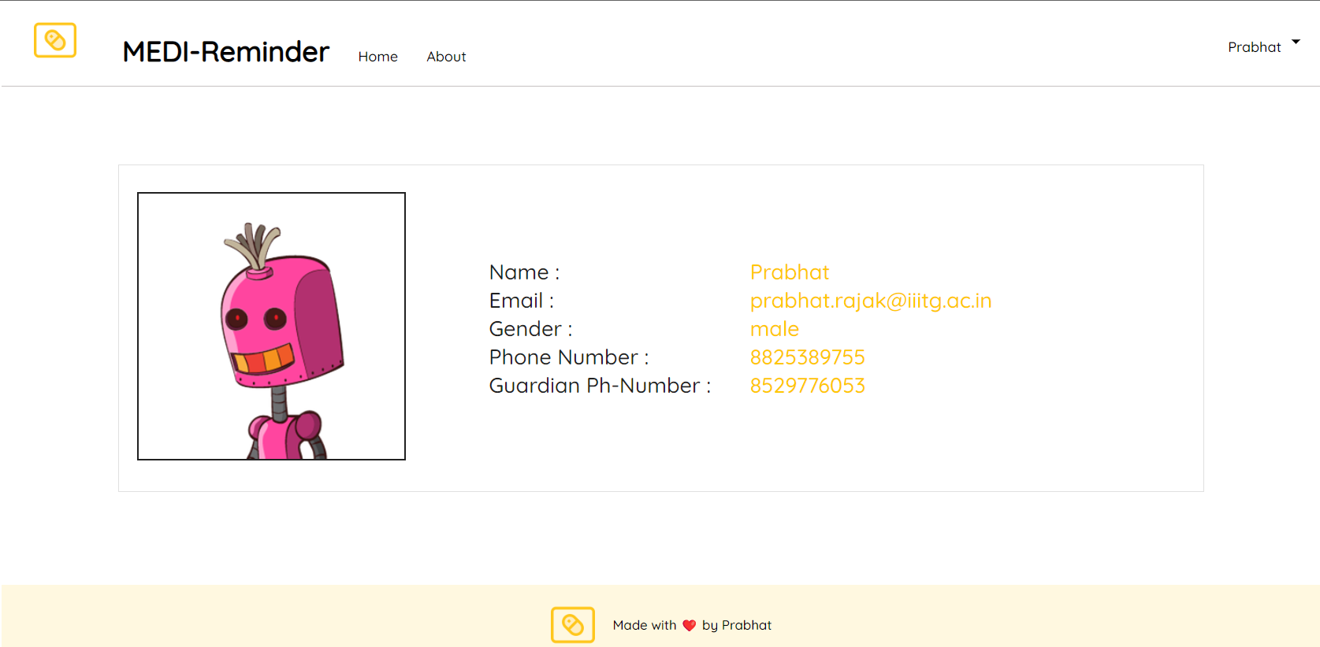
Profile Screen

Slide 16
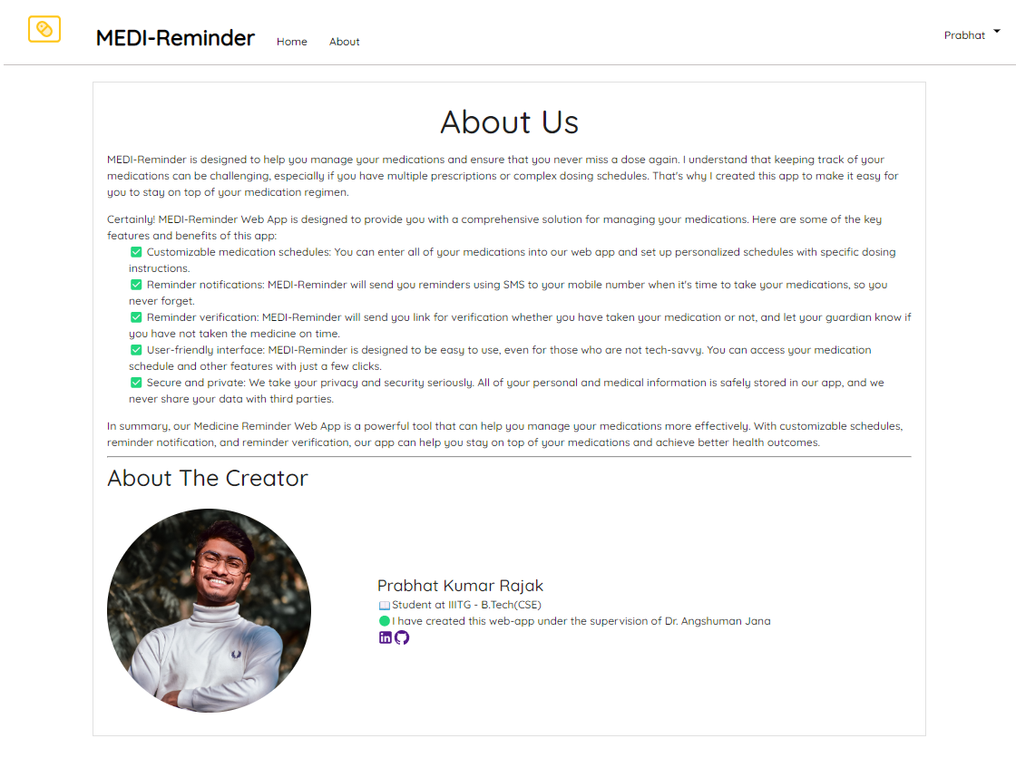
About Screen

Slide 17









Tecnologies Used

Slide 18
Conclusion
This web app is already been deployed in github and anyone can take benefits who wants to manage their medications more effectively and improve their medication adherence. With its userfriendly interface and comprehensive features, it can help individuals stay on top of their medication schedules and maintain their health and well-being.
https://github.com/prabhatkrrajak/Medi-Reminder

Slide 19
Thank You

