Slide 1
CAEZAR GAME
Team CCZZ
XINLU CHEN, CHENG LI, XUAN ZHANG, LIJIE ZHOU

Slide 2
OVERVIEW
Introduction
Project Overview
Database Diagram
Functionality and Main Challenge
Registration, Login/Logout (Xuan, Xinlu)
Lobby Page (Lijie)
Game Page (Cheng)
3. Conclusion and Future Works
4. DEMO

Slide 3
PROJECT OVERVIEW
•CaeZar is an online Texas Hold’em game.
•It supports multiple game rooms with up to 4 players in each game room.
•CaeZar allows chatting in the game lobby and in each game room.
•CaeZar provides game rules page for beginners as a reference.

Slide 4
PROJECT OVERVIEW
•Users need to register or log in to enter the game lobby.
•Users can create or join in a game room from the lobby to begin a game
with friends.
• Users can view their profile after log in.

Slide 5
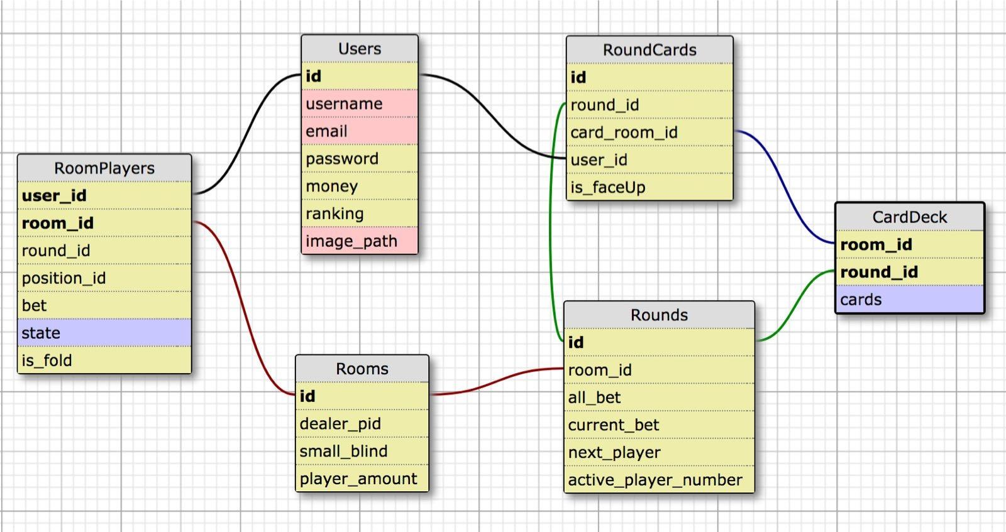
DATABASE DIAGRAM

Slide 6
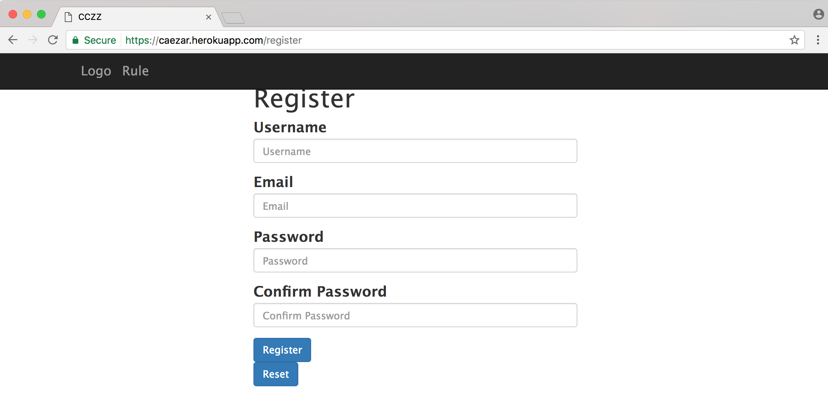
REGISTER

Slide 7
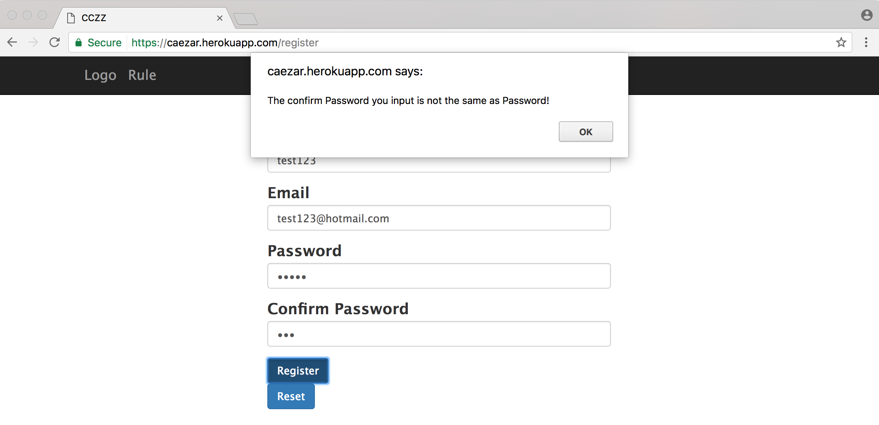
REGISTER

Slide 8

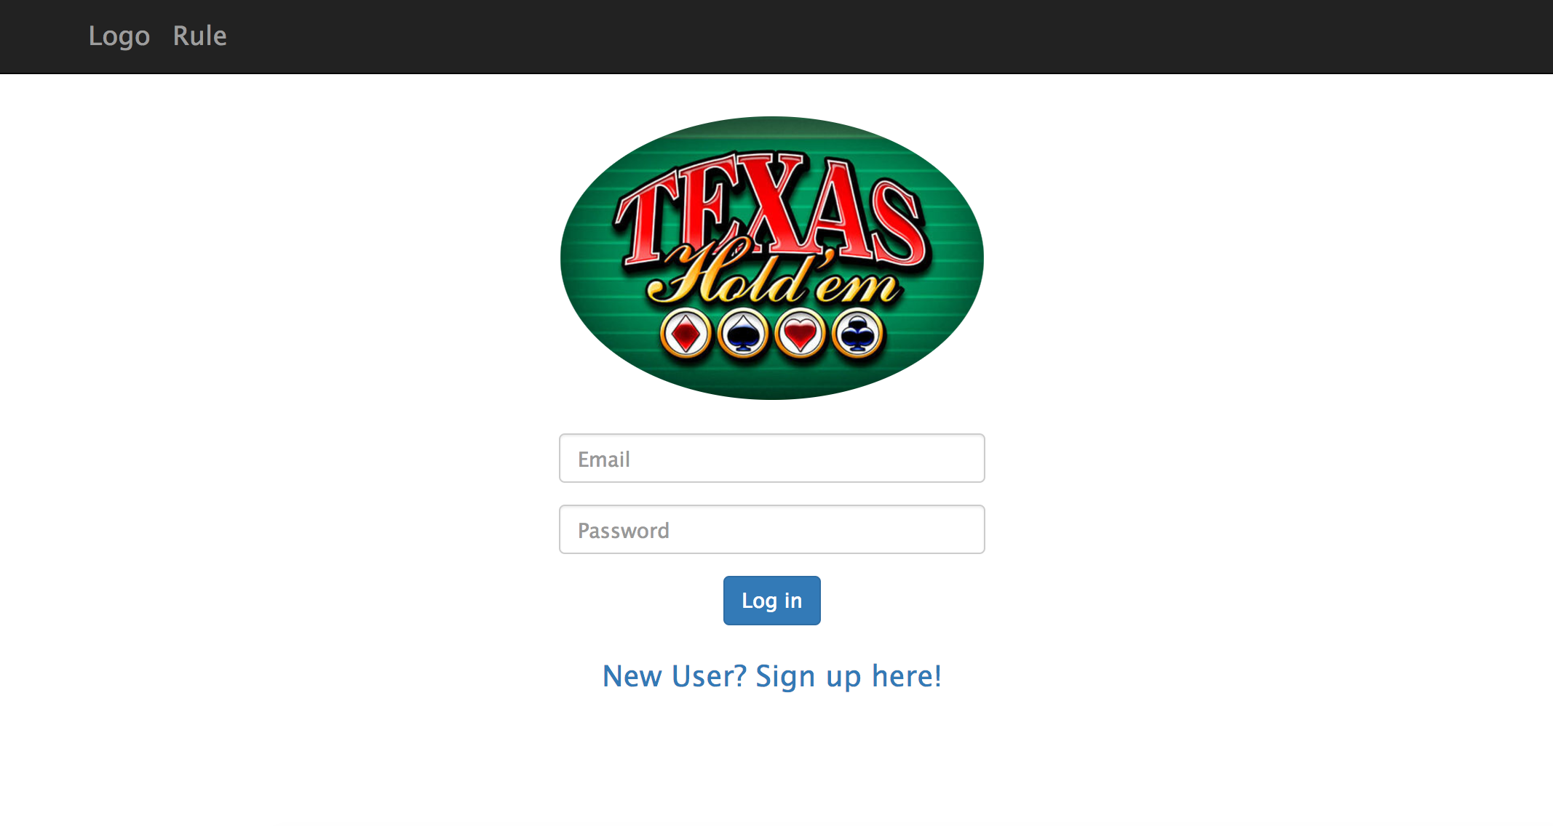
LOGIN/LOGOUT

Slide 9
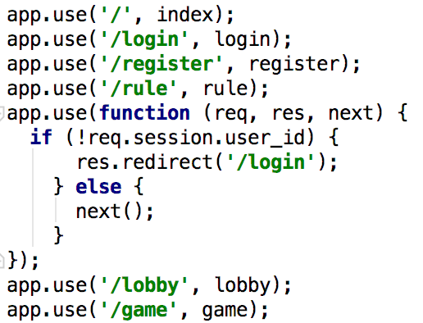
LOGIN/LOGOUT
Use session to check if a user logs in or not
If a user does not login, type https://caezar.herokuapp.com/game or https://caezar.herokuapp.com/lobby
will not lead to the corresponding pages.
will redirect to https://caezar.herokuapp.com/login

Slide 10
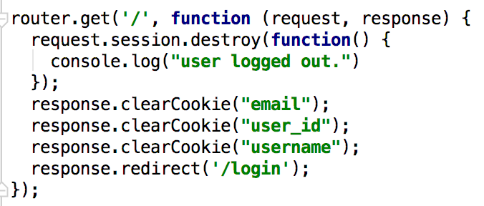
LOGIN/LOGOUT
Store user information in cookies when user login
so that we don’t have to send another request to server to get user information
Destroy session and clear cookies when a user clicks on Sign out button

Slide 11
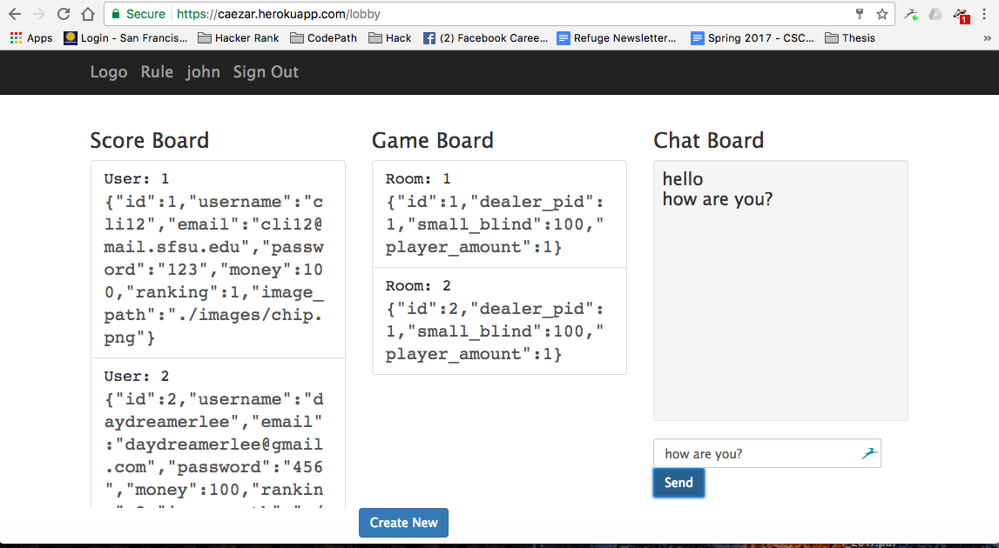
LOBBY
Join room and create new room
$ get
Chat board

Slide 12
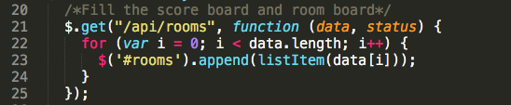
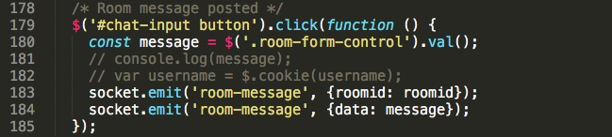
LOBBY
Join room and create new room: use cookie to get user_id and room_id
All the data populated on this page is by using JQuery’s $.get method.
Chat board: using socket to handle
Client-side:

Slide 13
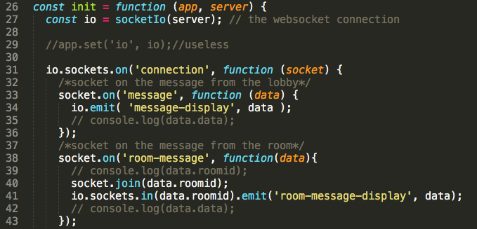
LOBBY
Server-side socket

Slide 14
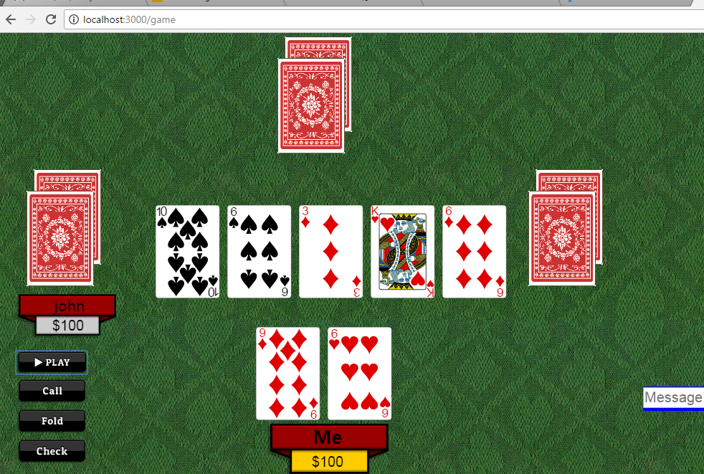
GAME
Canvas
Name plate
Cards
Bet amount
Form/submit
Action buttons

Slide 15
GAME
socket.io to handle the Client /Server communication (user-return, user-join, start-play, room-chat)
Use socket.io /room
Sokect.join
io.sockets.in(room).emit(... )

Slide 16
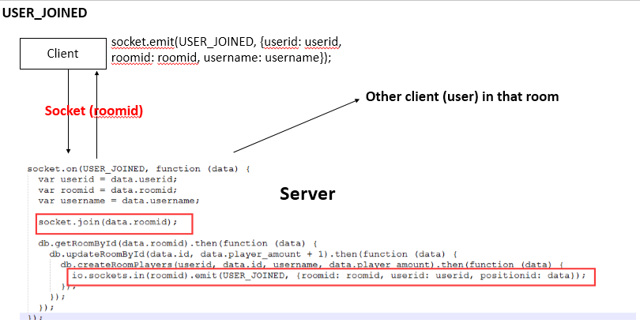
GAME

Slide 17
GAME
Canvas
Name plate (user_join/user return)
Cards (start_play)
Bet amount (update_game)
Form/submit
Action buttons (trigger start_game/
update_game)

Slide 18
CONCLUSION
Features Implemented
login/logout, register, user profile, chat, create/join a game, wait other players to begin the game, click play button to deal cards.
Although we don’t have time to finish all the other functions, we learnt a lot from building this project! That is the most invaluable experience to us.

Slide 19
FUTURE WORKS
We would like to finish other features and make this game work!

Slide 20
DEMO
Thanks for your time!

