Slide 1

Predicting Loan Defaults with HCDR Dataset
Group 8

Slide 2
Project Description
Home Credit is a non-bank money lending institution that serves to provide loans and other financial services to the unbanked population or those who do not have good credit scores. The goal of this project is to use alternative data of the customer such as transactional information to make sure that this section of the population gets their required financial assistance without any unfair rejection. This project is of great significance in the real world. The cost of misclassifying an applicant would be extremely high, for the applicant as well as the financial institution.

Slide 3
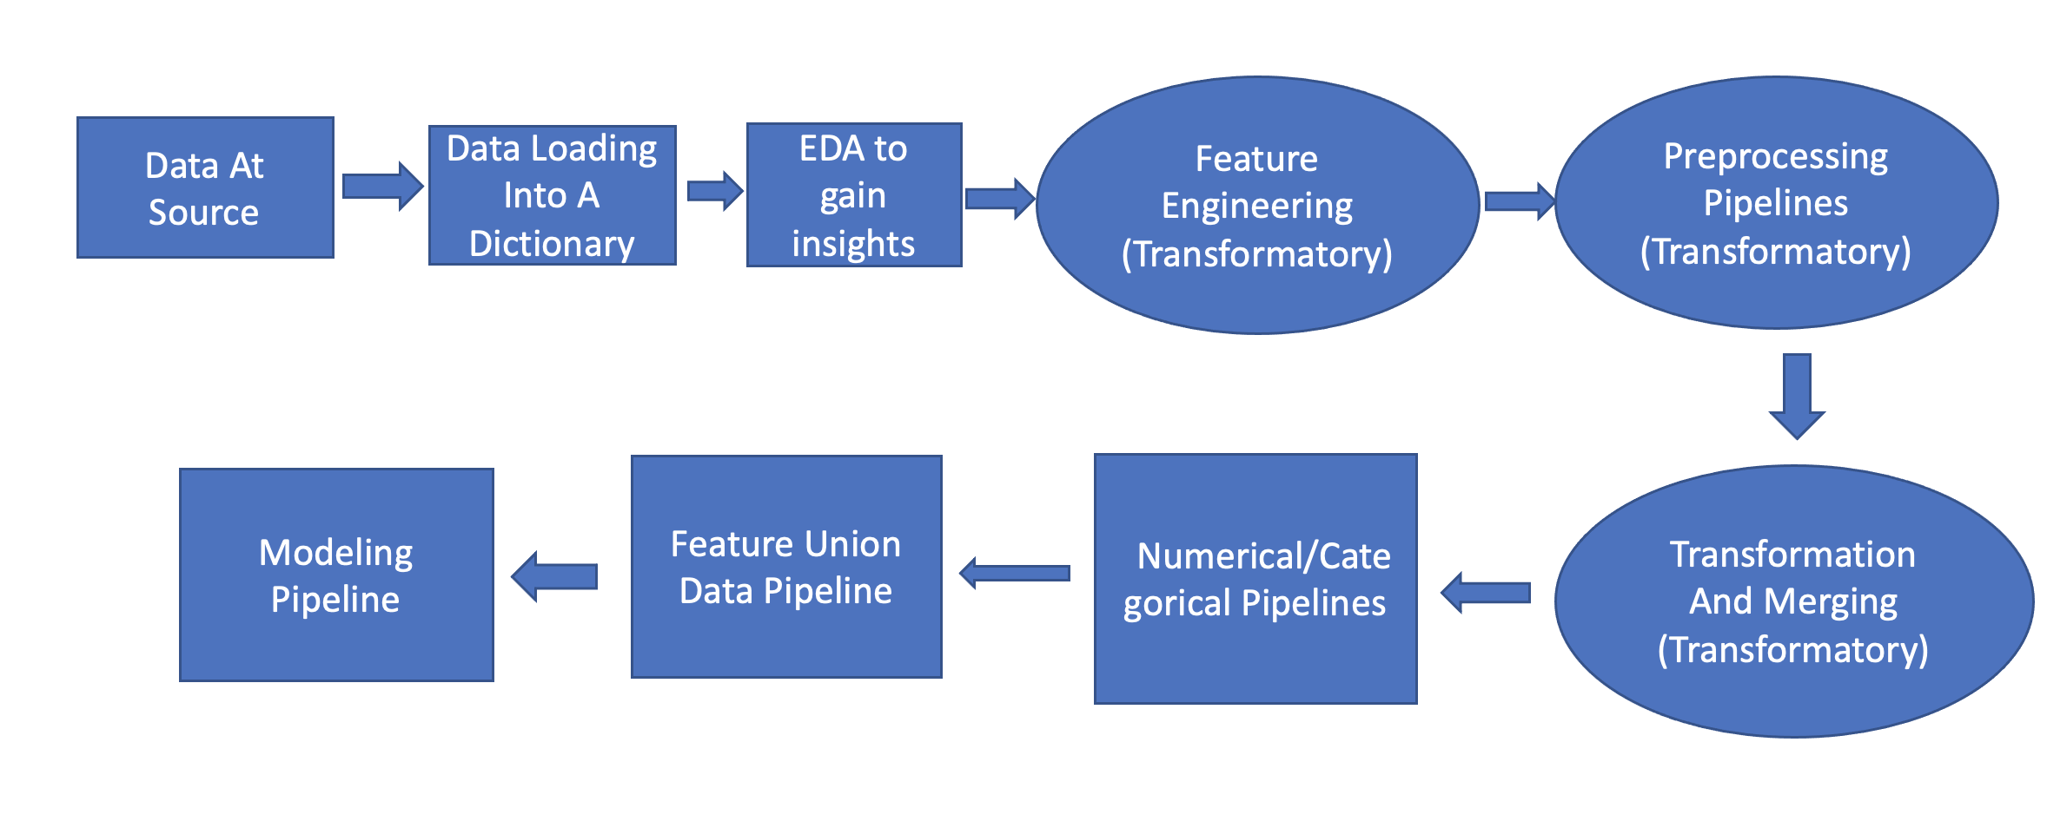
Data Lineage
Block Diagram

Slide 4
Data Lineage (Data flow in brief)
The data was initially downloaded from Kaggle website which was made open by the home credit group in an attempt to make better predictions while classifying a user as a potential defaulter/non-defaulter based on non-conventional user data.
The downloaded data was in .csv files that has train and test data separately, along with other secondary tables such as previous applications table, bureau balance table etc.
Loading of Data: The data was then loaded into a variable named datasets (a dictionary) that has the table names as it's keys and the table content as it's associated values.
Exploratory Data Analysis: A lot of EDA was done on the loaded dictionary 'datasets' to understand and analyze the source data and its numerous features. Most of the features has lot of missing values and some of the features are highly correlated with each other .
Feature Engineering: Two new features namely, 'Count' , that specifies the number of previous applications of a current applicant with a unique 'SK_ID_CURR' and 'AverageAppAmt' , that specifies the average amount of loan applied by an applicant in his/her previous applications are added to the prevappcounts data frame.

Slide 5
Data Lineage (Continued)
Pre-processing Pipelines: The data with new features is then passed through Feature aggregator pipelines that aggregate the features from secondary tables and also deals with features with missing values by dropping the features with missing values over a specified threshold and features with high collinearity by dropping one of the highly correlated features and retaining the other.
Transformation and merging : The pipelines are then used to transform the secondary table data frames using the .fit_transform method and then merged with the primary data by using .merge method along with relevant primary key .
Numerical and Categorical pipelines: The relevant numerical and categorical features are passed through their respective pipelines
Feature Union Data Pipeline: The relevant numerical and categorical features after being passed through their respective pipelines are then passed through a Feature union data pipeline which combines the two.
Modelling pipeline: The data pipeline so achieved above, is then passed as input to a model pipeline that uses selected model to train upon the preprocessed, feature engineered data and predicts output on the held-out test data and accuracy is measured on different models.

Slide 6
Data Leakage
Data leakage occurs when the training set contains information that we are going to predict.
Steps that we have taken to avoid data leakage:
1. Operations such as Standardization were done on the train and test set separately, to avoid knowing the distribution of the entire dataset.
2. We also split the data to create a Validation set and kept it held out before working on the model.

Slide 7
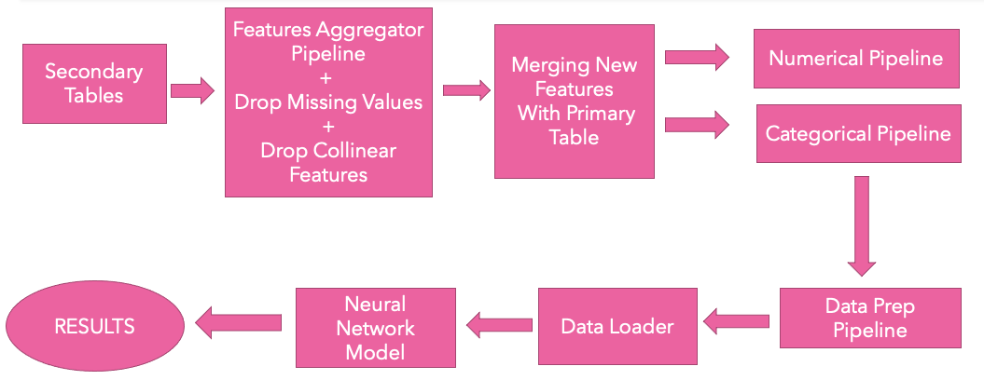
Modeling Pipelines

Slide 8
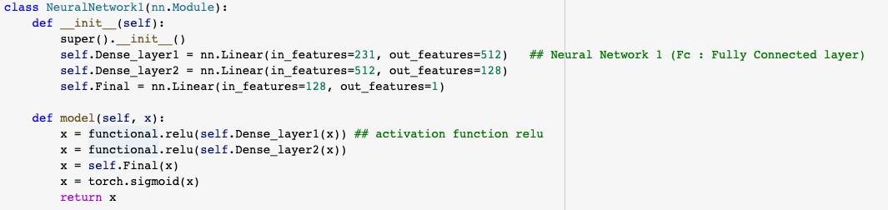
Neural Network 1 Architecture

Slide 9
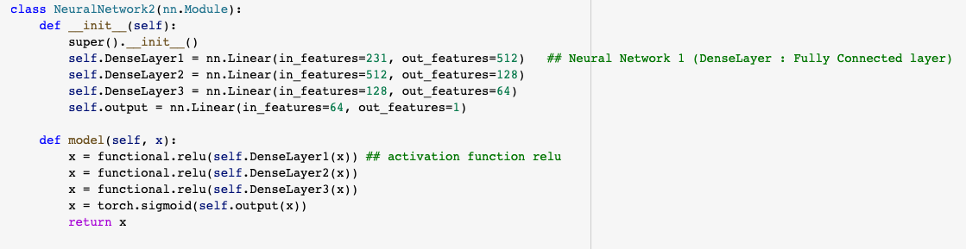
Neural Network 2 Architecture

Slide 10
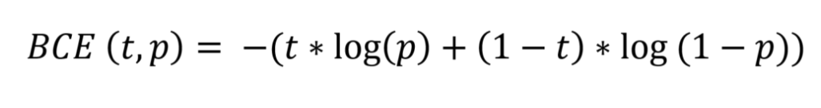
Loss function in PyTorch
Binary Cross Entropy –
We got a loss of 0.16 in neural network 1 and 0.11 in neural network 2. We ran for 20 epochs with a batch size of 256.

Slide 11
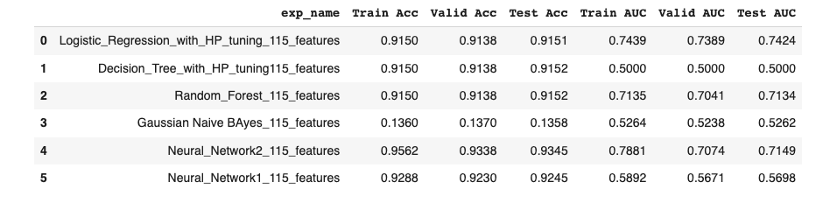
Accuracy

Slide 12
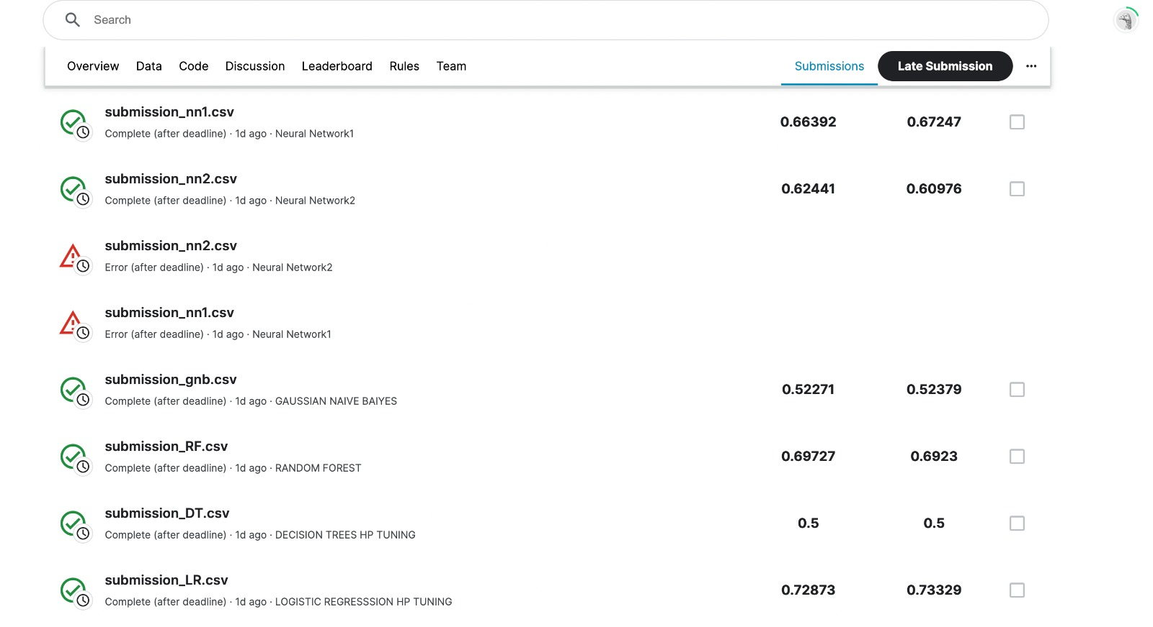
Kaggle Submission

Slide 13
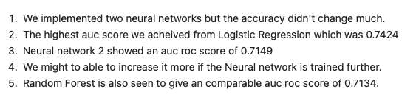
Discussion & Conclusion

Slide 14

Thanks

