Slide 1

Data Storage Models
Independent Seminar
Guide:
Dr. Shelly Sachdeva
Associate Professor
Presented By :
Prabhat Pushp
212211012
March 2023

Slide 2
Table of Contents
INTRODUCTION
FLAT FILE-BASED DATABASE
RELATIONAL BASED DATABASE
KEY-VALUE-BASED DATABASE
DOCUMENT-BASED DATABASE
GRAPH-BASED DATABASE
COLUMN-BASEDATABASE
NATIVE XML-BASED DATABASE
HIERARCHICAL DATABASES (4th sem)
NETWORK DATABASES (4th sem)
TIME SERIES DATABASES (4th sem)
NEWSQL DATABASES (4th sem)
MULTI-MODEL DATABASES (4th sem)
COMPARATIVE ANALYSIS
REFERENCES

Slide 3
Introduction
A data model is a representation that we use to perceive and manipulate our data.
It allows us to :
represent the data elements under analysis
how these are related to each others
The Various data storage models available are:
Flat File based database
Relational based database
Key-Value based database
Document based database
Graph based database
Column based database
Native XML based database
Hierarchical database
Network database
Time series database
NewSQL database
Multi-model database

Slide 4
Flat File Based Databases
In this type of database data stored in file. A flat file can be a plain text file or a binary file. The term has generally implied a small, simple database.
Advantage of Flat file database
Ideal for small amount of database
Stored many data in file
Less Software and Hardware Required
Less Skills are required to handle flat database systems.
Disadvantage of Flat file database
Files are not linked
Security
Not stored images
Slow for huge database

Slide 5
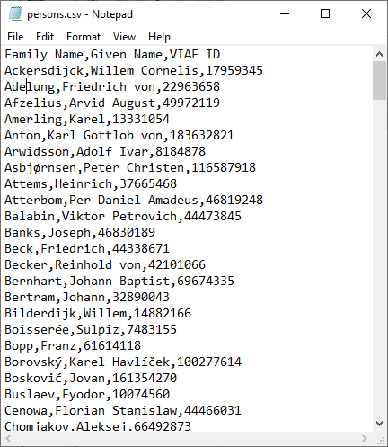
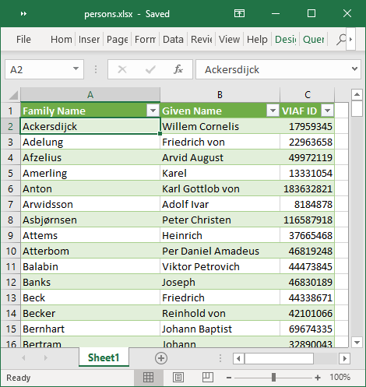
Flat File Based Databases
Fig 1 : Flat File based databases (CSV and XML file) [1]

Slide 6
Relational Based Databases
A relational database organizes data into tables which can be linked or related based on data common to each. Tables contains tuples(rows) and attributes(columns). You can communicate with relational databases using Structured Query Language (SQL)
Advantages of Relational based databases:
Strict ACID rules
Strict Schema
Disadvantages of Relational based databases:
Strict ACID rules
Strict Schema
Vertical Scalability

Slide 7
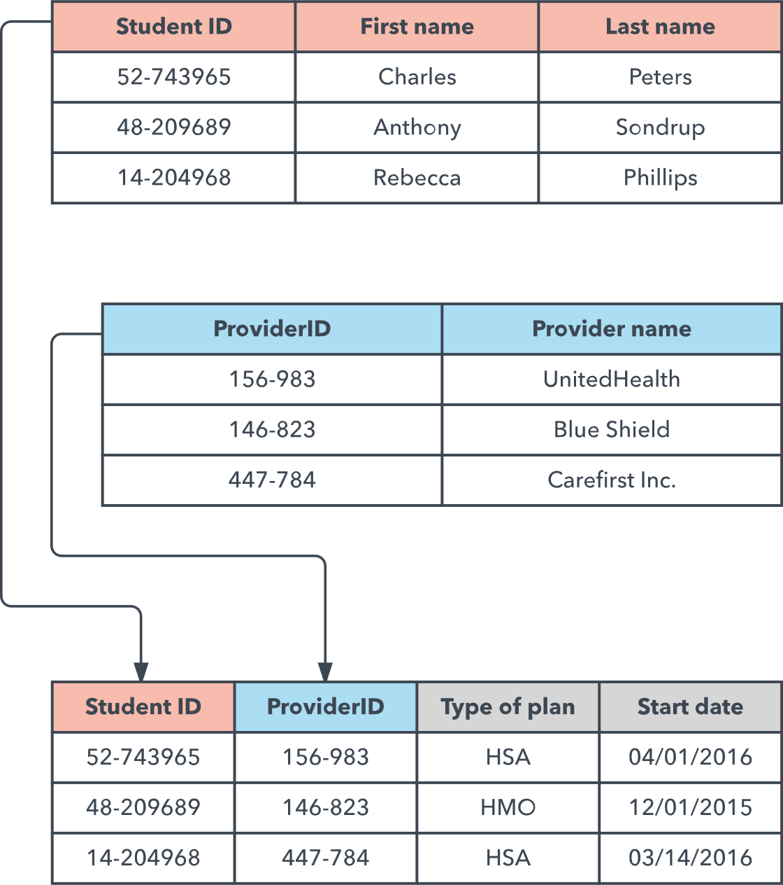
Relational Based Databases
Fig 2 : Relational Databases [2]

Slide 8
Key-Value Based Databases
Key-value databases are the simplest type of NoSQL database. It has simplicity, they are also the most scalable, allowing horizontal scaling of large amounts of data.
Advantages of Key-Value based databases:
Very Fast
Good for session stores and shopping carts
Disadvantages of Key-Value based databases:
Generally in-memory databases
Not suitable for storing complex data
Bad for large data

Slide 9
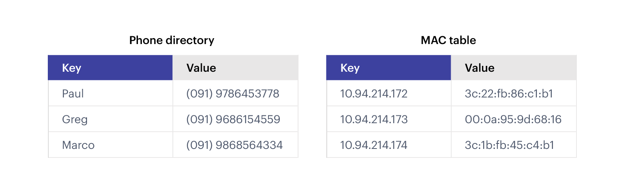
Key-Value Based Databases
Fig 3 : Key-Value based database (Redis) [3]

Slide 10
Document Based Databases
A document-oriented database is a computer program designed for storing, retrieving, and managing document oriented, or semi-structured data information.
Advantages of Document based databases:
Schema-less
Faster creation and care
No foreign keys
Open formats
Built-in versioning
Disadvantages of Document based databases:
Consistency-Check Limitations
Atomicity weaknesses
Security

Slide 11
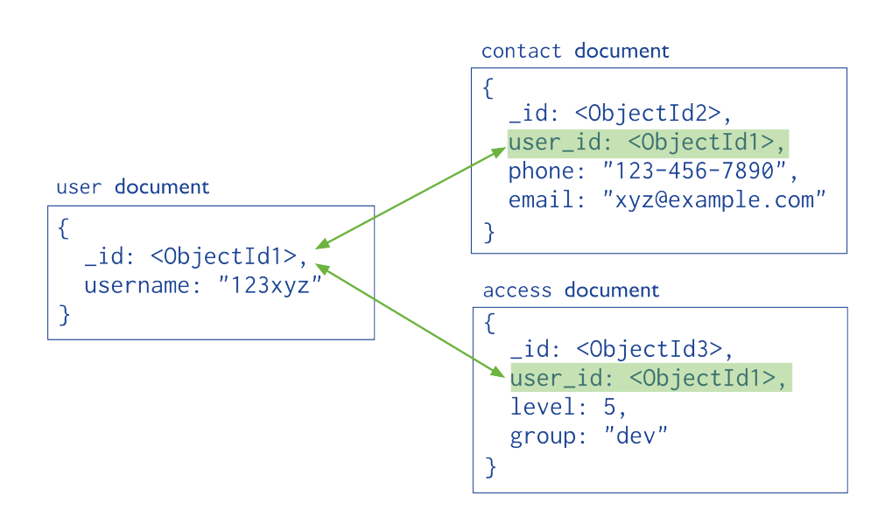
Document Based Databases
Fig 4 : Document based database (MongoDB) [4]

Slide 12
Graph Based Databases
Graph database is a kind of No SQL database that uses graph structures with nodes, edges, and properties to represent and store information.
Advantages of Document based databases:
Agile and Flexible Structure
Explicit Entity Relationship
Realtime results
Useful for systems with highly connected relationships
Disadvantages of Document based databases:
No Standard Query Language
Not for Transactional Based Systems
User base is small. Debugging and support is hard to find.

Slide 13
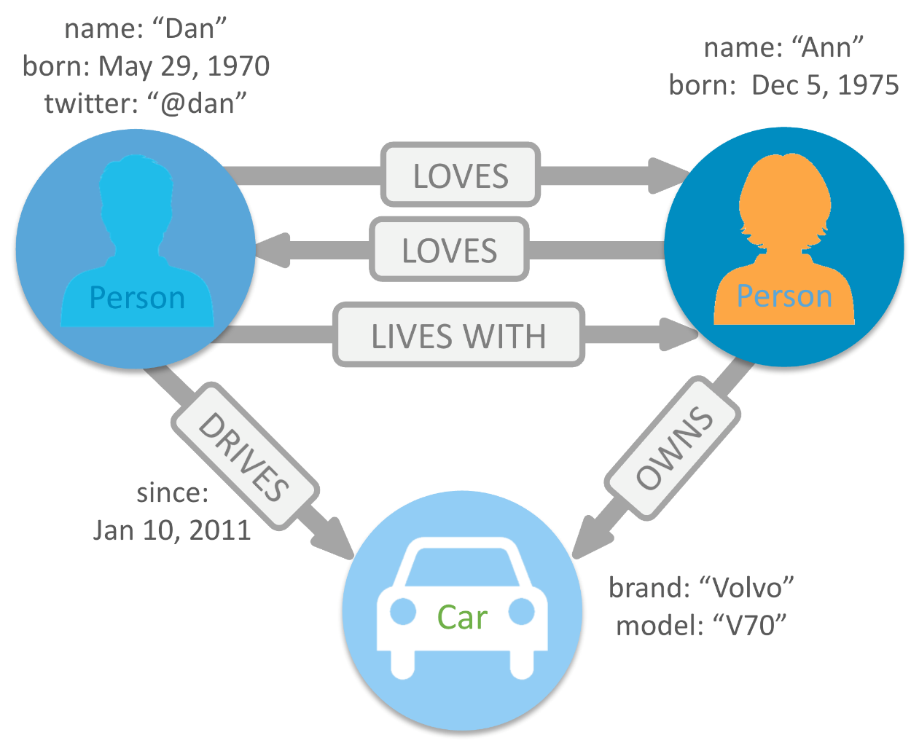
Graph Based Databases
Fig 5 : Graph based database (Neo4j) [5]

Slide 14
Column Based Databases
Column oriented databases are databases that organize data by field, keeping all of the data associated with a field next to each other in memory. Columnar databases are great for querying data.
Advantages of Column based databases:
Self-Indexing
Speed and efficiency
Compressible data
Bulk data
Disadvantages of Column based databases:
Bad for transactional data
Security

Slide 15
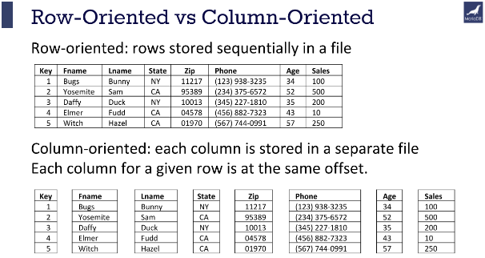
Column Based Databases
Fig 6 : Column based database (MariaDB) [6]

Slide 16
Native XML Based Databases
Native XML database is based on the container rather than table format. It can store large amount of XML document and data. Native XML database is queried by the XPath-expressions.
Advantages of Native XML based databases:
Efficient in storing and managing XML documents than XML-enabled databases
Can store more than 2 dimensional data
Disadvantages of Native XML based databases:
Relatively new
Not easy to learn
Small community so support is hard to find.

Slide 17
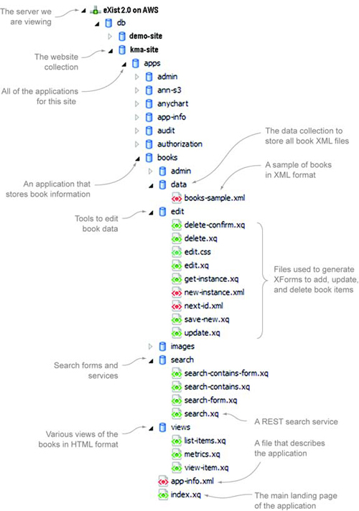
Native XML Based Databases
Fig 7 : Native XML based database [7]

Slide 18
Hierarchical Databases
Hierarchical databases revolutionized the field of database management by introducing a new way of organizing data. Hierarchical databases provide a hierarchy of records where each record has a single parent, resulting in a tree-like structure that may be used to classify entries based on their parent record.
Advantages of Hierarchical Databases:
Hierarchical structure, like a family tree
Simple and easy to use
Good for applications that require fast data access and retrieval
Efficient for batch processing
Disadvantages of Hierarchical Databases:
Limited flexibility
Difficult to handle complex relationships between data elements
Can lead to data redundancy and inconsistency
Not suitable for handling unstructured data
Examples:
Filesystems, DNS, LDAP directories

Slide 19
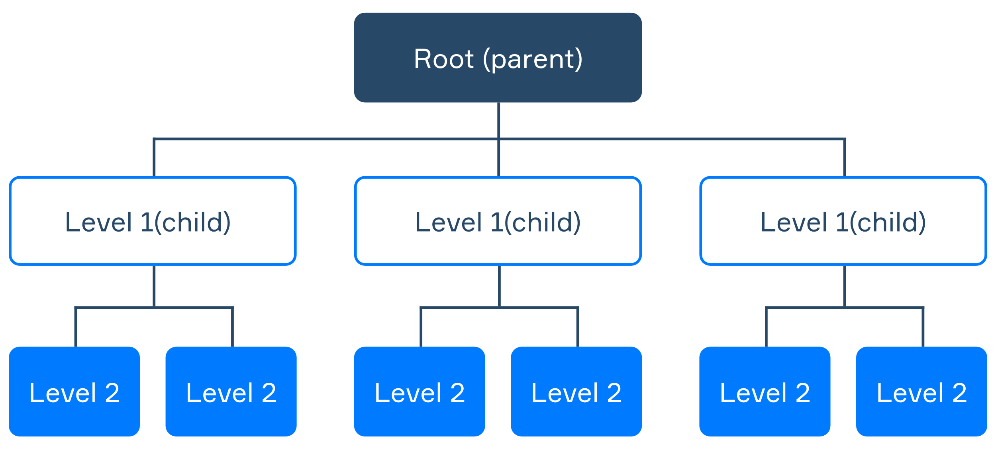
Hierarchical Databases
Fig 8 : Hierarchical Databases [8]

Slide 20
Network databases
Network databases are a type of database management system (DBMS) that allows data to be stored in a network-like structure. This structure allows for complex relationships between data elements, making it a popular choice in applications such as engineering, scientific research, and telecommunications.
Advantages of Network databases:
Offers greater flexibility than a hierarchical database
Allows for complex relationships between data elements
Useful for applications that require a high level of data integrity, such as banking, finance, and scientific research.
Disadvantages of Network databases:
Difficult to use for simple data structures
Requires extensive programming knowledge to manage
Can be slow to retrieve data due to complex relationships
Examples:
The Integrated Database Management System (IDMS)

Slide 21
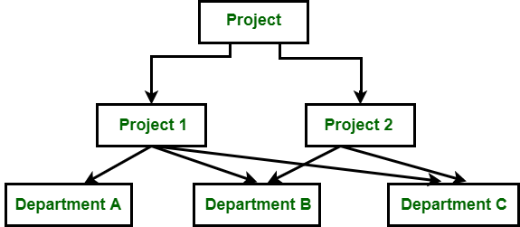
Network databases
Fig 9 : Network databases [9]

Slide 22
Time series databases
Time series databases are a type of database management system (DBMS) designed to handle time-stamped data. They are used in applications that require storing and analyzing large amounts of data over time, such as financial trading, IoT (Internet of Things), and scientific research.
Advantages of Time series databases:
Designed specifically for handling time-stamped data, making it efficient for time-based analysis.
High performance and scalability due to the ability to store and query large amounts of data quickly.
Provides real-time analytics capabilities, allowing for rapid decision-making.
Easy to integrate with other systems, making it an ideal solution for IoT and big data applications.
Disadvantages of Time series databases:
Limited flexibility for non-time-based data analysis.
Complex data models can be difficult to implement in a time series database.
Can be expensive to implement and maintain.
Examples:
OpenTSDB, Prometheus, InfluxDB, TimescaleDB, KairosDB

Slide 23
Time series databases
Fig 10 : Time series databases [10]

Slide 24
NewSQL databases
NewSQL databases are a type of database management system (DBMS) that combines the scalability of NoSQL databases with the traditional ACID (Atomicity, Consistency, Isolation, Durability) properties of relational databases. They are designed to handle large amounts of data in distributed environments and are popular in modern, high-performance applications.
Advantages of NewSQL databases:
High performance and scalability due to the distributed architecture.
ACID compliance, making them suitable for transactional applications.
Familiar SQL interface, making them easy to integrate with existing systems and applications.
In-memory processing and caching for faster data retrieval.
Ability to handle both structured and unstructured data.
Disadvantages of NewSQL databases:
Can be complex to set up and maintain.
Limited support for advanced analytics and reporting.
Examples:
MemSQL, VoltDB, Spanner, Calvin, CockroachDB, FaunaDB, yugabyteDB, PlanetScale

Slide 25
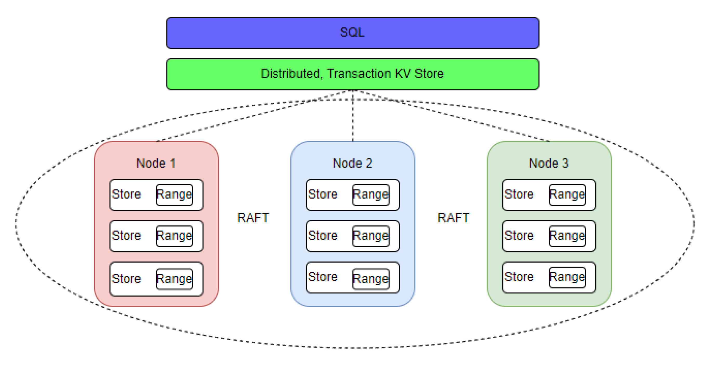
NewSQL databases
Fig 11 : NewSQL databases (CockroachDB) [11]

Slide 26
Multi-model databases
Multi-model databases are a type of database management system (DBMS) that can support multiple data models, such as relational, document, key-value, graph, and more. They are designed to provide flexibility and efficiency in handling different types of data, making them popular in modern, complex applications.
Advantages of Multi-model databases:
Flexibility in handling different types of data, reducing the need for multiple databases.
Improved efficiency and cost-effectiveness, as multiple data models can be managed within a single system.
Easy integration with existing applications and systems.
Scalability and availability through distributed architectures.
Better support for complex data relationships and analytics.
Disadvantages of Multi-model databases:
Increased complexity compared to single-model databases.
Higher learning curve for developers and administrators.
Limited support for some data models or query languages.
Performance may be affected when using multiple data models in the same database.
Examples:
ArangoDB, OrientDB, Couchbase

Slide 27
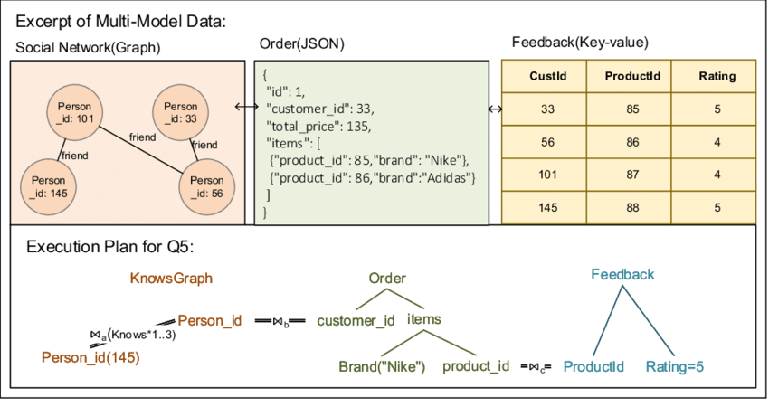
Multi-model databases
Fig 12 : Multi-model databases [12]

Slide 28
Uses of Databases in Electronic Health Records
Use Cases of Flat File-Based Databases in Electronic Health Records:
Patient Demographics (excel sheets, csv)
Medical History (excel sheets, csv, pdf, images)
Lab Results (images, videos, pdfs)
Research and Analysis (csv)
Pros:
Simplicity (no processing required and easy to maintain)
Portability (easily sharable)
Speed (easy access as retrieval of data does not require complex querying)
Cons:
Limited scalability (cannot handle large amount of data or relationships)
Data redundancy (data duplication problem, inconsistency problem)
Lack of data integrity (no constraints leads to data corruption and inconsistency)
Limited querying capabilities (make searching and retrieval slow as no query compatibility)
Limited security features (more vulnerable to unauthorized access)

Slide 29
Uses of Databases in Electronic Health Records
Use Cases of Relational Databases in Electronic Health Records:
Patient Demographics (excel sheets, csv)
Medical History (excel sheets, csv, pdf, images)
Lab Results (images, videos, pdfs)
Research and Analysis (csv)
Pros:
Simplicity (no processing required and easy to maintain)
Portability (easily sharable)
Speed (easy access as retrieval of data does not require complex querying)
Cons:
Limited scalability (cannot handle large amount of data or relationships)
Data redundancy (data duplication problem, inconsistency problem)
Lack of data integrity (no constraints leads to data corruption and inconsistency)
Limited querying capabilities (make searching and retrieval slow as no query compatibility)
Limited security features (more vulnerable to unauthorized access)

Slide 30
Comparative Analysis
Database | Speed | Use Case | Support | Examples
Flat File | Slowest (Read) | File Systems | High | CSV, XML
Relational | Slow (Write) | Transactional Databases | High | MySQL
Key-Value | Fastest (Read) | Authentication | Medium | JSON, Redis
Document | Fast (Read) | Single Entity queries | High | MongoDB
Graph | Fastest (relationship) | Social Network | Low | Neo4j, OrientDB
Column | Fast (Write) | Real-time analytics | Medium | Cassandra, HBase
Native XML | Fast (XML) | Hierarchical data, websites | Low | eXist, BaseX

Slide 31
Comparative Analysis
Database | Speed | Use Case | Support | Examples
Hierarchical | Fast (Tree) | File Systems, DNS | Low | DNS, LDAP, IMS
Network | Fast (Tree + networks) | Complex Relationships, Graphs, and Trees | Low | IDMS
Time Series | Fast (storage) | Time-Stamped Data, Sensor data | Medium | OpenTSDB, Prometheus, InfluxDB, TimescaleDB
NewSQL | Fast (Distributed) | High-Volume, High-Velocity Transactions | Medium | MemSQL, VoltDB, Spanner, Calvin, CockroachDB
Multi-Model | Fast (Different Databases) | Multiple Data Models, Complex Data | Medium | ArangoDB, OrientDB, Couchbase

Slide 32
References
“Nodegoat” CSV and XML Figures, accessed 02/10/2022 [https://nodegoat.net/guide.s/22/upload-a-csv-file]
“LucidCharts” Relational database Figure, accessed 02/10/2022 [https://www.lucidchart.com/pages/database-diagram/database-models]
“Redis” Key-value database Figure, accessed 02/10/2022 [https://redis.com/nosql/key-value-databases/]
“Future-Processing” Document database Figure, accessed 02/10/2022 [https://kariera.future-processing.pl/blog/rules-of-data-conversion-from-document-to-relational-databases/]
“Neo4j” Graph Based Databases figure, accessed 02/10/2022, [https://neo4j.com/developer/graph-database/]
“MariaDB” Column Based Databases figure, accessed 02/10/2022, [https://mariadb.com/resources/blog/why-is-columnstore-important/]
“Manning” Native XML Databases, accessed 06/10/2022, [https://livebook.manning.com/book/making-sense-of-nosql/chapter-5/]

Slide 33
References
“Hyperskill” Hierarchical database model, accessed 05/03/2023, [https://hyperskill.org/learn/step/17042]
“GeeksForFeeks” Difference between Network and Relational data model, accessed 05/03/2023, [https://www.geeksforgeeks.org/difference-between-network-and-relational-data-model/]
“Dongyueweb” Introduction to Time Series Database, accessed 06/03/2023, [https://blog.dongyueweb.com/introduction_to_time_series_database.html]
Pina, E.; Sá, F.; Bernardino, J. NewSQL Databases Assessment: CockroachDB, MariaDB Xpand, and VoltDB. Future Internet 2023, 15, 10. https://doi.org/10.3390/fi15010010
Zhang, Chao & Lu, Jiaheng. (2021). Holistic evaluation in multi-model databases benchmarking. Distributed and Parallel Databases. 39. 10.1007/s10619-019-07279-6.
“GeeksForGeeks” SQL vs NoSQL, accessed 02/10/2022, [https://www.geeksforgeeks.org/difference-between-sql-and-nosql/]

Slide 34
References
“GeeksForGeeks” Intro to NoSQL, accessed 02/10/2022, [https://www.geeksforgeeks.org/introduction-to-nosql/]
“MongoDB” Types of NoSQL Databases, accessed 03/10/2022, [https://www.mongodb.com/scale/types-of-nosql-databases]

Slide 35
Thank You

