Slide 1


Project ID: 2022-24MCAPID007
Development of E-Bharat :
Essential Voting System
By
Sanjay Saini(2202900140037)
Prabhat Singh Chauhan(2202900140027)
Pranjul Awasthi(2202900140028)
Prashant Kumar(2202900140030)
Prateek Yadav(2202900140031)
Under the Supervision
of
Mrs. Deepshikha Rai
(Assistant Professor)
Department of Master Of Computer Application
ABES INSTITUTE OF TECHNOLOGY,GHAZIABAD
Affiliated to
DR. A.P.J. ABDUL KALAM TECHNICAL UNIVERSITY
LUCKNOW,UTTAR PRADESH
(ODD SEM, 2023-24)

Slide 2
ABSTRACT
The Online Voting System is a web based application. The system has a centralized database to keep records of all the Voters and Candidates and Final Results. This web based system is time saving, work load reduced information available at time and it provide security for the data. During the election, the election commission of India has introduced a new method of polling by online voting system (OVS). The election commission will maintain this website. This is a simple, safe and secure method that takes minimum of time.
The word VOTE means to choose from a list, to elect or to determine. The main goal of voting (in a scenario involving the citizens of a given country) is to come up with leaders of the people’s choice. Most countries, India not an exception have problems when it comes to voting. Some of the problems involved include ridging votes during election, insecure or inaccessible polling stations, inadequate polling materials and also inexperienced personnel.
Notes:
Insert a map of your country.

Slide 3
introduction
The existing manual Voting system consumes more time for Vote Casting. Voter has to wait for vote polling station to vote for a right candidate. The election officers has to be check the voter , this voter can vote in this booth then check voter ID present in voters list of booth those are information will be present then the voter can vote in that booth. The voter had to stand in the queue to cast his vote. All the work is done in paper ballot so it is very hard to locate a particular candidates, some voters cast their votes for all candidates. To overcome of all these problems we have to implement a web application, which is helpful for Voting from any where.
Notes:
Insert a picture of one of the geographic features of your country.

Slide 4
About project
An electronic voting system which is used nowadays provide some characteristic different from the traditional voting technique, and also it provides improved features of voting system over traditional voting system such as accuracy, convenience, flexibility, privacy, verifiability and mobility.
But Electronic voting systems suffers from various drawbacks such as time consuming, consumes large volume of paper work, no direct role for the higher officials, damage of machines due to lack of attention, mass update doesn’t allows users to update and edit many item simultaneously etc.
These drawbacks can overcome by Online Voting System. This is a voting system by which any voter can use his/her voting rights from anywhere in the country. Voter can cast their votes from anywhere in the country without visiting to voting booths, in highly secured way. That makes voting a fearless of violence and that increases the percentage of voting.
Notes:
Insert a picture illustrating a season in your country.

Slide 5
Literature Review
This is a system that can be used by user to cast vote in an election. All the voters have to login and click on cast vote to his/her chosen candidates to submit his/her vote. The research development and testing are done on LAN. On other hand online voting software is been in research for many years, researched cases of wrong implementations reported in recent years. These factors are need to be resolved so public can cast their vote in a secured and fitting environment. online voting is a voting software in which any user can use his/her voting rights from anywhere.
To make the voting process very easy and efficient wireless and web technologies are used. The online- voting system has the possibility of secure, easy and safe way to capture and count the votes in the election.
The author in [3] in 2017 ” online voting system based on adhaar id” uses adhaar id as key of authentication, system is efficient in terms of time and provides security the system is great improvement over traditional system but the main problem resides in this system is that of authentication, the authentication technique used is not that efficient as biometric is not used.
The paper [4] in 2019” Secure Authentication for Online Voting System” presents non traceability and integrity of the votes, smart card has been used to avoid multiple votes casted by users, biometric is being used for authenticating voters. The author has introduced smart card for biometric identification and voter id card to be used at the time of casting vote. They are using smart card and voter id card at the time of election which is not feasible as anything can happen to those cards thus relying completely upon cards in not a good idea. And the use of various cards makes the system costly now each and every voter need to have these additional cards. Also it may take reasonable amount of time to generate so many cards. All voting system generated priory though have met various features, which a voting system may consists but the main problem one could find in these system is that little “online” word, despite all techniques they have used to make system robust there is always a chance of malpractice when your system is online.
Notes:
Insert a picture of an animal and or plant found in your country.

Slide 6
Problem with the existing system
The problems of the existing manual system of voting include among others the following:
1. Expensive and Time Consuming:
The process of collecting data and entering this data into the database takes too much time and is expensive to conduct, for example, time and money is spent in printing data capture forms, in preparing registration stations together with human resources, and there after advertising the days set for registration process including sensitizing voters on the need for registration, as well as time spent on entering this data to the database.
2. Too much paper work:
The process involves too much paper work and paper storage which is difficult as papers become bulky with the population size.
3. Error during data entry:
Errors are part of all human beings; it is very unlikely for humans to be 100 percent efficiency in data entry.
4. Loss of Registration Forms:
Some times, registration forms get lost after being filled in with voter’s details, in most cases these are difficult to follow-up and therefore many remain unregistered even though they are voting age nationals and interested in exercising their right to vote.
5. Short time provided to view the voter register:
This is very big problem since not all people have free time during the given short period of time to check and update the voter register
Notes:
Add key points in the history of your country to the timeline.

Slide 7
E-Bharat : AN essential voting System
As we are looking at the existing system, they are just providing online voting. As we knew that Government of India conduct multiple elections. So we are implementing our system such that voter can select election and submit their vote region/ward wise. After studying existing system we observed that they are not providing state wise, region wise voting facility. So its difficult to vote because there is no restriction, so voter can also cast his/her vote to those candidate who is not belonging from his/her area.
In proposed system we are implementing that voter can cast his/her vote only those candidate who’s belonging from his/her region/ward. We will display only those candidate who are belonging from that particular voters ward. So it will also help to conduct small election such as Gram Panchayat Election or Nagar Sevak Election. We are making our voting system user friendly.
Notes:
Insert a picture illustrating a custom or tradition here.

Slide 8
System requirement
MINIMUM HARDWARE REQUIREMENT:
• Processor – Intel Pentium G6405 2.2GHz or Above/AMD
• RAM- 512MB or Above
• Hard Disk – 10GB Or Above
SOFTWARE REQUIREMENT:
• Front-End- HTML, CSS, Bootstrap, JavaScript
• Back-End – MYSQL, PHP
• Operating System- WINDOWS XP or Above
• Browser- Any latest Browser
Notes:
Insert a picture of the head leader of your country.

Slide 9
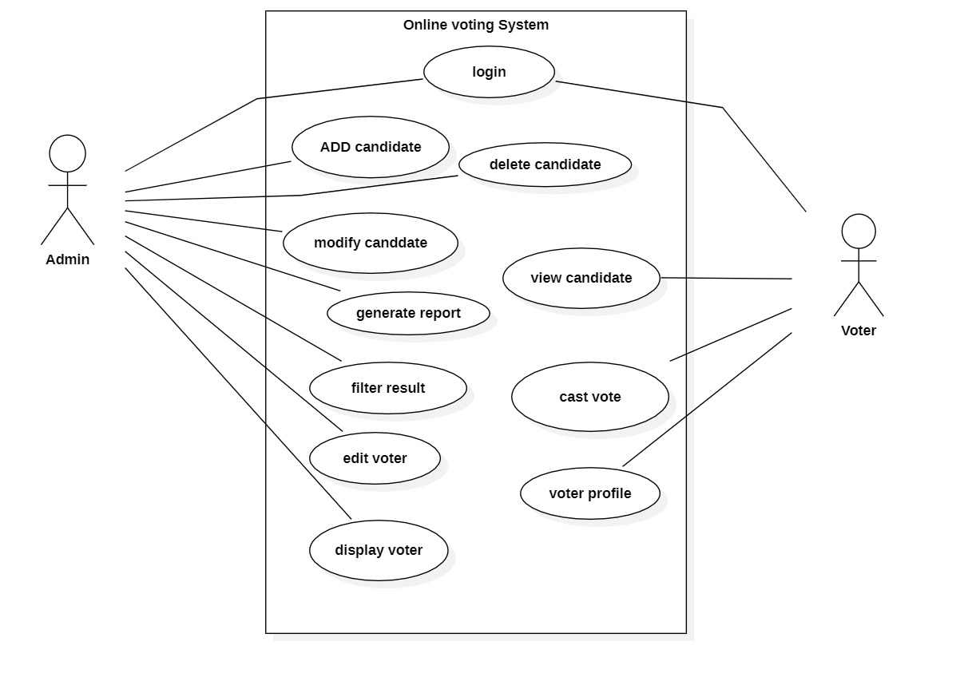
Use Case Diagram

Slide 10
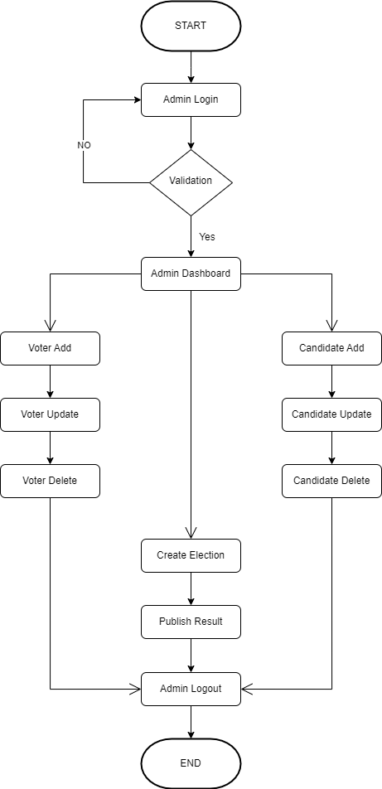
Flowchart of Admin

Slide 11
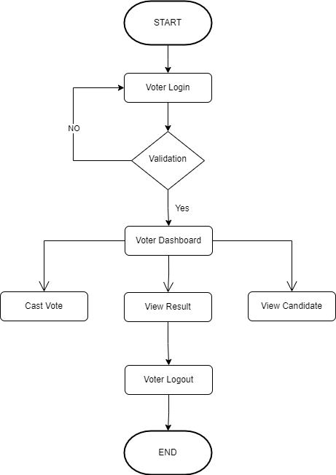
Flowchart of Voter

Slide 12
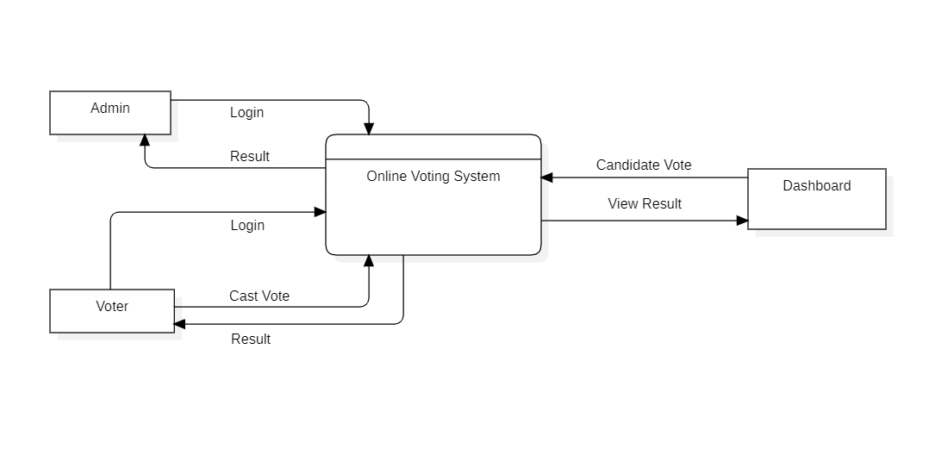
DFD LEVEL-0

Slide 13
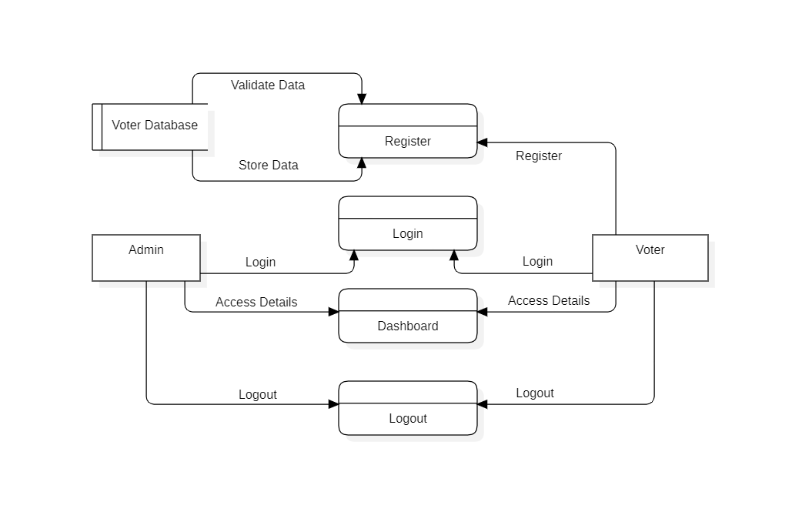
DFD LEVEL-1

Slide 14
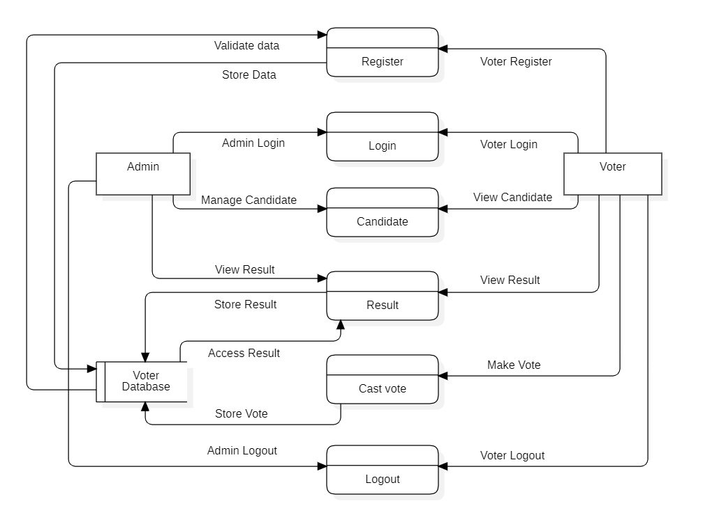
DFD LEVEL-2

Slide 15

COnclusion
This online Voting system will manage the Voter’s information by which voter can login and use his voting rights. The system will incorporate all features of voting system. It provides the tools for maintaining voter’s vote to every party and it count total no. of every party. There is a DATABASE which is maintained by the ELECTION COMMISION OF INDIA in which all the names of voter with complete information is stored.
The traditional method of manual voting system has few drawbacks. This method is obviously not efficient as it wastes the voter’s energy and quite slow in term of completion. This smart system involves the voter’s can cast their vote easily, and can be implemented to the entire India.
Data can be managed on cloud so that it will be secured and managed efficiently. We have developed the online system for only one particular booth , this should be extended to all the polling booths in India .
Notes:
Insert a picture that illustrates some part of your country’s economy.

Slide 16
Future scope
In the current scenario, most of the countries of the world hold their elections using Electronic Voting Machines, where your vote gets registered electronically with the help of an Electronic Machine without using and wasting ballot paper to vote for elections.
As security is a major concern nowadays, ensuring that no person exercises the right to vote twice is the main aspect. We can resolve this issue by introducing Finger Print Based Voting, where a person can be authorized based on his Finger Print. This will put an end to fake voting. The domain of the project is the Internet of Things where we are building Fingerprint Based Biometric Voting Machine.
We know that IoT is the system of interrelated computing devices, mechanical and digital machines, objects, and the ability to transfer data over a network without requiring human-to-human or human-to-computer interaction. Thus our Fingerprint online module is an application where the user is recognized by his finger pattern. As we know that the minutiae features on a finger of each human being are different, the voter can be easily authenticated. The online system allows the voter to vote through his fingerprint.
The fingerprint of the voter is used to uniquely and distinctively identify him/her using the fingerprint module. Also, the system promises the right to vote a candidate only once, thus not allowing the voter to vote for the second time. An admin is assigned to add all the candidates standing for the election. Only the admin has the right to add a candidate name and photo who are nominated. The Admin will also register the voter's name by verifying voter's details. Admin will authenticate the voter by verifying the voter's identity and then admin will register the voter. Once the user has got the voters id and password from the admin the user can log in and vote for the candidates who were nominated. The system will allow the user to vote for only one candidate. In the end, the election result is published by using the election id. Even users can view the election result.

Slide 17
REferences
[1] https://www.electionsonline.com/online-votingsystem/
[2] https://en.wikipedia.org/wiki/Electronic_voting
[3]. K. P. Kaliyamurthie, R. Udayakumar, D. Parameswari and S. N. Mugunthan, “Highly Secured Online Voting System over Network,” in Indian Journal of Science and Technology | Print ISSN: 0974-6846 | Online ISSN: 0974-5645
[4]. Ankit Anand, Pallavi Divya, An Efficient Online Voting System, Vol.2, Issue.4, July-Aug. 2019, pp2631-2634.
[5]. Drew Springall, Travis Finkenauer, Zakir Durumeric, Jason Kitcat, Harri Hursti Margaret MacAlpine J. Alex Halderman, November 3–7, 2021, “Security Analysis of the Estonian Internet Voting System,” in CCS‟14, Scottsdale, Arizona, USA. ACM 978-1-4503-2957-6/14/11.
Notes:
Insert a picture of one of the points of interest for your country.

Slide 18


