Slide 1

Basic Details of the Team and Problem Statement
Ministry/Organization Name/Student Innovation:
Ministry of Education
PS Code: SIH1433
Problem Statement Title: Mental health and well-being surveillance, assessment and tracking solution among children.
Team Name: CodeCrafters
Team Leader Name: Rajat Singh
Institute Code (AISHE): C-46247
Institute Name: ITS Engineering College
Theme name: Smart Education

Slide 2
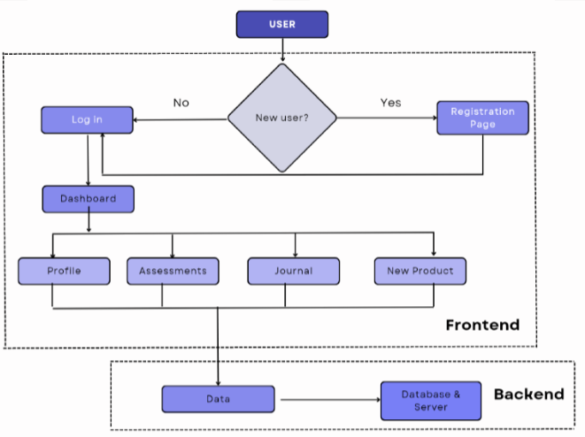

Idea/Approach Details
Describe your idea/Solution/Prototype here:
Making a Web Application to evaluate Mental Health and provide solution:
User Authentication and Profiles.
Assessment to evaluate User’s Mental Health Status and Developing algorithms to calculate score.
Secured personal Journal for self assessment and generating a personalised Feedback.
Creating a community space for student to interact and share experiences.
Providing Educational Content on topics related to Mental Health.
Offering immediate access to crisis helplines for user in urgent needs and offering counsellors for support.
Creating a user Dashboard to track your progress with a notification for daily reminder
Add process flow chart or simulated image of prototype or any relevant image related to your idea
Technology stack

Slide 3
Idea/Approach Details
Exam Stress: The software offers specialized assessments and techniques to cope with exam-related stress
Handling Personal Challenges: The software offers assessments tailored to address personal challenges.
Improving Sleep Quality: The software includes assessments related to sleep hygiene and quality.
Addressing Anxiety and Depression: The software includes assessments designed to identify symptoms of anxiety and depression.
Coping with Social Pressures: It provides guidance on building healthy relationships, assertiveness, and effective communication.
Mental Health Professionals recommendation: offer specialized expertise to help individuals understand and manage their mental health challenges effectively.
Describe your Use Cases here
Describe your Dependencies / Show stopper here
Dependencies:-
Collaboration with mental health professionals.
Compliance with data protection regulations (e.g., GDPR, HIPAA).
Gathering user feedback for continuous improvement.
Stopper:-
Insufficient input from mental health professionals.
Inadequate or unreliable content could hinder the effectiveness of the recommendation engine.

Slide 4
Team Member Details
Team Leader Name: Rajat Singh
Branch (B.Tech): Stream (CSE): Year (II):
Team Member 1 Name: Mo. Kaif Siddiqui
Branch (B.Tech): Stream (CSE): Year (II):
Team Member 2 Name: Nirbhika Khajuria
Branch (B.Tech): Stream (CSE): Year (II):
Team Member 3 Name: Mukul Yadav
Branch (B.Tech): Stream (CSE): Year (II):
Team Member 4 Name: Mohammed Abbas Kazim
Branch (B.Tech): Stream (CSE): Year (II):
Team Member 5 Name: Vatsal Mishra
Branch (B.Tech): Stream (CSE): Year (II):
Team Mentor 1 Name: Mr. Ghanshyam Yadav
Category (Academic/Industry): Expertise (AI/ML/Blockchain etc): Domain Experience (in years):
Team Mentor 2 Name: Dr. Ashish Kumar
Category (Academic/Industry): Expertise (AI/ML/Blockchain etc): Domain Experience (in years):

