Slide 1
JAVA
By Narayan Subedi

Slide 2
Local and Remote Applets

Slide 3
Local Applets
A local applet is one that is stored on your own computer system.
When your Web page must find a local applet, it doesn't need to retrieve information from the Internet-in fact, your browser doesn't even need to be connected to the Internet at that time

Slide 4
Local Applets
<applet
codebase="tictactoe"
code="TicTacToe.class"
width=120
height=120>
</applet>

Slide 5
Remote Applets
A remote applet is one that is located on another computer system.
This computer system may be located in the building next door or it may be on the other side of the world-it makes no difference to your Java-compatible browser.
No matter where the remote applet is located, it's downloaded onto your computer via the Internet. Your browser must, of course, be connected to the Internet at the time it needs to display the remote applet.

Slide 6
Remote Applets
<applet codebase="http://www.myconnect.com/applets/"
code="TicTacToe.class"
width=120
height=120>
</applet>
In the first case, codebase specifies a local folder, and in the second case, it specifies the URL at which the applet is located.

Slide 7
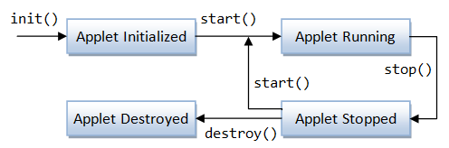
Life Cycle of an Applet

Slide 8
Life Cycle of an Applet
init: This method is intended for whatever initialization is needed for your applet. It is called after the param tags inside the applet tag have been processed.
start: This method is automatically called after the browser calls the init method. It is also called whenever the user returns to the page containing the applet after having gone off to other pages.

Slide 9
Life Cycle of an Applet
stop: This method is automatically called when the user moves off the page on which the applet sits. It can, therefore, be called repeatedly in the same applet.
destroy: This method is only called when the browser shuts down normally. Because applets are meant to live on an HTML page, you should not normally leave resources behind after a user leaves the page that contains the applet.

Slide 10
Life Cycle of an Applet
paint: Invoked immediately after the start() method, and also any time the applet needs to repaint itself in the browser. The paint() method is actually inherited from the java.awt.

Slide 11
Java I/O
File:
java.io.File
An abstract representation of file and directory pathnames.

Slide 12
Java I/O
Directories:
java.io.File
A directory is a File which can contains a list of other files and directories. You use File object to create directories, to list down files available in a directory.
String dirname = "/tmp/user/java/bin";
File d = new File(dirname);
// Create directory now.
d.mkdirs();

Slide 13
I/O Stream Classes
FileInputStream A FileInputStream obtains input bytes from a file in a file system.
FileOutputStream A file output stream is an output stream for writing data to a File or to a FileDescriptor.
FileReader Convenience class for reading character files.
FileWriter Convenience class for writing character files.
InputStreamReader …

Slide 14
Byte Streams
Java byte streams are used to perform input and output of 8-bit bytes.
Though there are many classes related to byte streams but the most frequently used classes are , FileInputStream and FileOutputStream.
Following is an example which makes use of these two classes to copy an input file into an output file:

Slide 15
Byte Streams
import java.io.*;
public class CopyFile {
public static void main(String args[]) throws IOException
{
FileInputStream in = null;
FileOutputStream out = null;
try {
in = new FileInputStream("input.txt");
out = new FileOutputStream("output.txt");
int c;
while ((c = in.read()) != -1) {
out.write(c);
}
}finally {
if (in != null) {
in.close();
}
if (out != null) {
out.close();
}
}
}
}

Slide 16
Character Streams
Java Character streams are used to perform input and output for 16-bit unicode.
FileReader and FileWriter.
Reads / Writes two bytes at a time.
Input and output done with stream classes automatically translates to and from the local character set (internationalization ). So, more convenient than Byte Streams.

Slide 17
Character Streams
import java.io.*;
public class CopyFile {
public static void main(String args[]) throws IOException {
FileReader in = null;
FileWriter out = null;
try {
in = new FileReader("input.txt");
out = new FileWriter("output.txt");
int c;
while ((c = in.read()) != -1) {
out.write(c);
}
}finally {
if (in != null) {
in.close();
}
if (out != null) {
out.close();
}
}
}
}

Slide 18
Reading File
import java.io.*;
public class ReadFileExample {
public static void main(String[] args) {
File file = new File("D:/robots.txt");
FileInputStream fis = null;
try {
fis = new FileInputStream(file);
System.out.println("Total file size to read (in bytes) : "
+ fis.available());
int content;
while ((content = fis.read()) != -1) {
// convert to char and display it
System.out.print((char) content);
}
} catch (IOException e) {
e.printStackTrace();
} finally {
try {
if (fis != null)
fis.close();
} catch (IOException ex) {
ex.printStackTrace();
}
}
}
}

Slide 19
Writing to File
import java.io..*;
public class WriteFileExample {
public static void main(String[] args) {
FileOutputStream fop = null;
File file;
String content = "This is the text content";
try {
file = new File("d:/newfile.txt");
fop = new FileOutputStream(file);
// if file doesnt exists, then create it
if (!file.exists()) {
file.createNewFile();
}
// get the content in bytes
byte[] contentInBytes = content.getBytes();
fop.write(contentInBytes);
fop.flush();
fop.close();
System.out.println("Done");
} catch (IOException e) {
e.printStackTrace();
} finally {
try {
if (fop != null) {
fop.close();
}
} catch (IOException e) {
e.printStackTrace();
}
}
}
}

Slide 20
File Input Stream
read() method
Reads a byte of data from this input stream (InputStream class). This method blocks if no input is yet available.
The methods returns the next byte of data, or -1 if the end of the file is reached.

Slide 21
RandomAccessFile
The Java.io.RandomAccessFile class file behaves like a large array of bytes stored in the file system. Instances of this class support both reading and writing to a random access file.
RandomAccessFile(File file, String mode)

Slide 22
RandomAccessFile

Slide 23
Introduction to Java NIO
Non-blocking I/O (usually called NIO, and sometimes called "New I/O") is a collection of Java programming language APIs that offer features for intensive I/O operations. Beginning with version 1.4
It supports a buffer-oriented, channel-based approach to I/O operations.
Package java.nio
NIO subsystem does not replace the stream-based I/O classes found in java.io.
NIO buffers
NIO data transfer is based on buffers (java.nio.Buffer and related classes). These classes represent a contiguous extent of memory, together with a small number of data transfer operations.
Notes:
Buffer is a region of a physical memory storage used to temporarily store data while it is being moved from one place to another.

Slide 24
Distributed Application using RMI

Slide 25
Distributed Application
A distributed application is software that is executed or run on multiple computers within a network.
These applications interact in order to achieve a specific goal or task.
Traditional applications relied on a single system to run them. Even in the client-server model, the application software had to run on either the client, or the server that the client was accessing. However, distributed applications run on both simultaneously.
The very nature of an application may require the use of a communication network that connects several computers: for example, data produced in one physical location and required in another location.

Slide 26
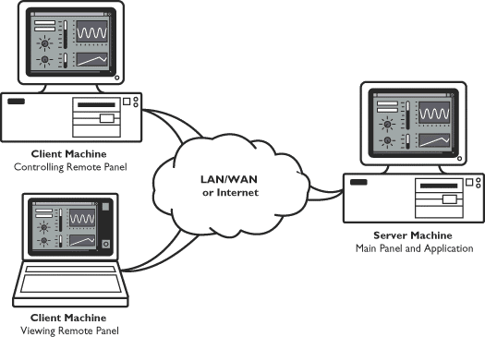
Distributed Application
There are many cases in which the use of a single computer would be possible in principle, but the use of a distributed system is beneficial for practical reasons. For example, it may be more cost-efficient to obtain the desired level of performance by using a cluster of several low-end computers, in comparison with a single high-end computer.

Slide 27
Remote Method Invocation (RMI)
Remote Method Invocation (RMI) allows a Java object that executes on one machine to invoke a method of a Java object that executes on another machine.
This is an important feature, because it allows you to build distributed applications.

Slide 28
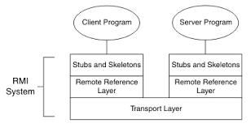
RMI Layers
Stub and Skeleton Layer
The stub and skeleton layer is responsible for marshaling and unmarshaling the data and transmitting and receiving them to/from the Remote Reference Layer
Remote Reference Layer
The Remote reference layer is responsible for carrying out the invocation.
Transport Layer
The Transport layer is responsible for setting up connections, managing requests, monitoring them and listening for incoming calls

Slide 29
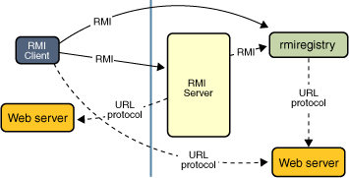
RMI Mechanism
Locate remote objects. Applications can use various mechanisms to obtain references to remote objects. For example, an application can register its remote objects with RMI's simple naming facility, the RMI registry.
Communicate with remote objects. Details of communication between remote objects are handled by RMI.
Load class definitions for objects that are passed around. Because RMI enables objects to be passed back and forth, it provides mechanisms for loading an object's class definitions as well as for transmitting an object's data.

Slide 30
RMI Registry
Essentially the RMI registry is a place for the server to register services it offers and a place for clients to query for those services.
RMI Registry acts a broker between RMI servers and the clients.
A Simple Client/Server Application Using RMI
This section provides step-by-step directions for building a simple client/server application by using RMI. The server receives a request from a client, processes it, and returns a result.

Slide 31
Java Network Programming

Slide 32
Java Network Programming
Introduction to Network Programming
The term network programming refers to writing programs that execute across multiple devices (computers), in which the devices are all connected to each other using a network.
The java.net package of the J2SE APIs contains a collection of classes and interfaces that provide the low-level communication details, allowing you to write programs that focus on solving the problem at hand.

Slide 33
Java Network Programming
TCP:
TCP stands for Transmission Control Protocol, which allows for reliable communication between two applications. TCP is typically used over the Internet Protocol, which is referred to as TCP/IP.
UDP:
UDP stands for User Datagram Protocol, a connection-less protocol that allows for packets of data to be transmitted between applications.
The speed for TCP is slower than UDP. UDP is faster because there is no error-checking for packets.
In TCP, there is absolute guarantee that the data transferred remains intact and arrives in the same order in which it was sent. In UDP, there is no guarantee that the messages or packets sent would reach at all.

Slide 34
Java Network Programming
IP Address : (Ex: 192.168.1.1)
An Internet Protocol address (IP address) is a numerical label assigned to each device (e.g., computer, printer) participating in a computer network that uses the Internet Protocol for communication.
Port Number:
In TCP/IP and UDP networks, an endpoint to a logical connection. The port number identifies what type of port it is. For example, port 80 is used for HTTP traffic.

Slide 35
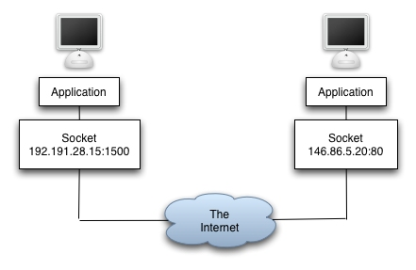
Java Network Programming
Socket:
A socket is one endpoint of a two-way communication link between two programs running on the network. A socket is bound to a port number so that the TCP layer can identify the application that data is destined to be sent to.
An endpoint is a combination of an IP address and a port number. Every TCP connection can be uniquely identified by its two endpoints. That way you can have multiple connections between your host and the serve

Slide 36
Java Network Programming
URL
It is an acronym for Uniform Resource Locator and is a reference (an address) to a resource on the Internet. A URL has two main components: Protocol identifier: For the URL http://example.com , the protocol identifier is http . Resource name: For the URL http://example.com , the resource name is example.com .
java.net.URL
Class URL represents a Uniform Resource Locator, a pointer to a "resource" on the World Wide Web. A resource can be something as simple as a file or a directory, or it can be a reference to a more complicated object, such as a query to a database or to a search engine.

Slide 37
Java Network Programming
java.net.URLConnection
The abstract class URLConnection is the superclass of all classes (HttpURLConncetion…) that represent a communications link between the application and a URL. Instances of this class can be used both to read from and to write to the resource referenced by the URL. In general, creating a connection to a URL is a multistep process using openConnection() and connect()
The connection object is created by invoking the openConnection method on a URL.
The setup parameters and general request properties are manipulated.
The actual connection to the remote object is made, using the connect method.
The remote object becomes available. The header fields and the contents of the remote object can be accessed.

Slide 38
Java Network Programming
URL & URLConnection Example

Slide 39
Java Network Programming
Creating a client/server application using TCP Sockets
Creating a client/server application using UDP Datagram

Slide 40
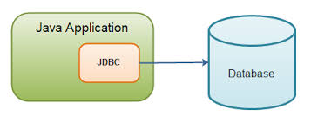
Java Database Programming

Slide 41
Java Database Programming
Relational Database Overview
A database is a means of storing information in such a way that information can be retrieved from it.
In simplest terms, a relational database is one that presents information in tables with rows and columns.
A table is referred to as a relation in the sense that it is a collection of objects of the same type (rows).
Data in a table can be related according to common keys or concepts, and the ability to retrieve related data from a table is the basis for the term relational database. A Database Management System (DBMS) handles the way data is stored, maintained, and retrieved.
In the case of a relational database, a Relational Database Management System (RDBMS) performs these tasks.

Slide 42
Java Database Programming
JDBC API
JDBC API is a Java API that can access any kind of tabular data, especially data stored in a Relational Database. JDBC works with Java on a variety of platforms, such as Windows, Mac OS, and the various versions of UNIX.
java.sql package

Slide 43
Java Database Programming
Driver Manager and JDBC Drivers
JDBC drivers implement the defined interfaces in the JDBC API for interacting with your database server.
An individual database system is accessed via a specific JDBC driver that implements the java.sql.Driver interface.
Drivers exist for nearly all popular RDBMS systems, though few are available for free.
Sun bundles a free JDBC-ODBC bridge driver with the JDK to allow access to standard ODBC data sources, such as a Microsoft Access database.
An easy way to load the driver class is to use the Class.forName() method:
Class.forName("sun.jdbc.odbc.JdbcOdbcDriver");

Slide 44
Java Database Programming
Driver Manager and JDBC Drivers
When the driver is loaded into memory, it registers itself with the java.sql.DriverManager class as an available database driver.
The next step is to ask the DriverManager class to open a connection to a given database, where the database is specified by a specially formatted URL. The method used to open the connection is DriverManager.getConnection() . It returns a class that implements the java.sql.Connection interface:
Connection con = DriverManager.getConnection("jdbc:odbc:somedb", "user", "passwd");

Slide 45
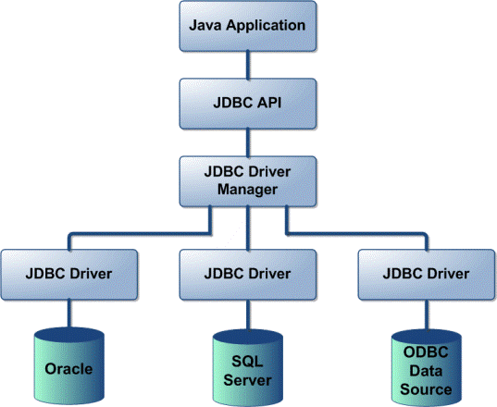
Java Database Programming
JDBC Driver Types
JDBC driver implementations vary because of the wide variety of operating systems and hardware platforms in which Java operates.
Sun has divided the implementation types into four categories, Types 1, 2, 3, and 4, which is explained below:
Type 1: JDBC-ODBC Bridge Driver:
Type 2: JDBC-Native API:
Type 3: JDBC-Net pure Java:
Type 4: 100% pure Java:
Reference
http://www.tutorialspoint.com/jdbc/jdbc-driver-types.htm

Slide 46
Java Database Programming
Introduction to ODBC
ODBC (Open Database Connectivity) is a standard programming language middleware API for accessing database management systems (DBMS).
The designers of ODBC aimed to make it independent of database systems and operating systems. An application written using ODBC can be ported to other platforms, both on the client and server side, with few changes to the data access code.
ODBC was originally developed by Microsoft during the early 1990s.

Slide 47
Java Database Programming
Connecting Database using JDBC ODBC Driver

Slide 48
Web Programming Using Java Servlet APIs

Slide 49
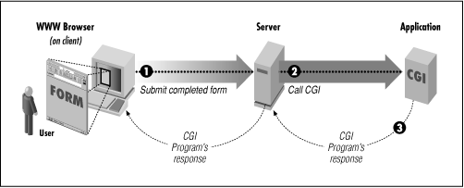
Web Programming Using Java Servlet APIs
Introduction to CGI
Common Gateway Interface (CGI) are programs run by the web server (at "server side").
CGI is a standard method used to generate dynamic content on Web pages and Web applications. CGI, when implemented on a Web server, provides an interface between the Web server and programs that generate the Web content.

Slide 50
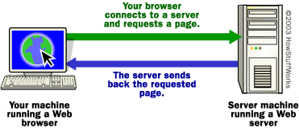
Web Programming Using Java Servlet APIs
Introduction to Web Server
A Web Server is a computer system that processes requests via HTTP.
The term can refer either to the entire system, or specifically to the software that accepts and supervises the HTTP requests.
The most common use of web servers is to host websites, but there are other uses such as gaming, data storage, running enterprise applications, handling email, FTP, or other web uses.

Slide 51
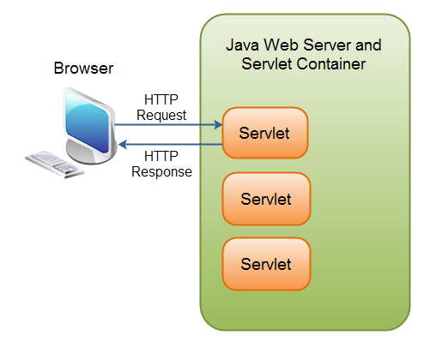
Web Programming Using Java Servlet APIs
Servlet Defination
A Servlet is a small Java program that runs within a Web server.
Servlets receive and respond to requests from Web clients, usually across HTTP, the HyperText Transfer Protocol.
To implement this interface, you can write a generic servlet that extends javax.servlet.GenericServlet or an HTTP servlet that extends javax.servlet.http.HttpServlet.

Slide 52
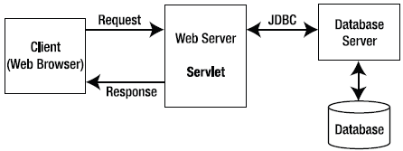
Web Programming Using Java Servlet APIs
HTTP request response model of Servlet

Slide 53
Web Programming Using Java Servlet APIs
Advantages of Servlet over CGI
Better performance: because it creates a thread for each request not process.
Portability: because it uses java language.
Robust: Servlets are managed by JVM so no need to worry about momory leak, garbage collection etc.
Secure: because it uses java language.
Reference
http://www.dineshonjava.com/2013/12/advantages-of-servlets-over-cgi.html#.VMTkxixsvm4
Notes:
A process is an executing instance of an application.

Slide 54
Web Programming Using Java Servlet APIs
Servlet Life Cycle Methods
The init() method :
The init method is designed to be called only once. It is called when the servlet is first created, and not called again for each user request.
public void init() throws ServletException { // Initialization code... }
The service() method :
The servlet container (i.e. web server) calls the service() method to handle requests coming from the client( browsers) and to write the formatted response back to the client.
The service () method is called by the container and service method invokes doGet, doPost, doPut, doDelete, etc. methods as appropriate.
public void service(ServletRequest request, ServletResponse response) throws ServletException, IOException{ }
Notes:
A process is an executing instance of an application.

Slide 55
Web Programming Using Java Servlet APIs
Servlet Life Cycle Methods
The doGet() Method
A GET request results from a normal request for a URL or from an HTML form that has no METHOD specified and it should be handled by doGet() method.
public void doGet(HttpServletRequest request, HttpServletResponse response) throws ServletException, IOException { // Servlet code }
The doPost() Method
A POST request results from an HTML form that specifically lists POST as the METHOD and it should be handled by doPost() method.
public void doPost(HttpServletRequest request, HttpServletResponse response) throws ServletException, IOException { // Servlet code }
Notes:
A process is an executing instance of an application.

Slide 56
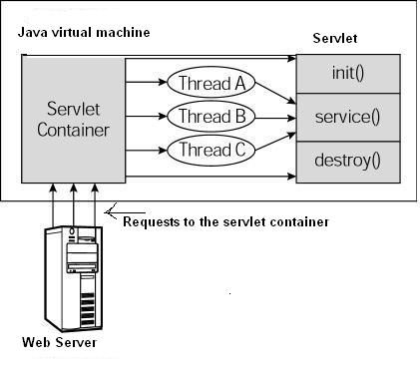
Web Programming Using Java Servlet APIs
Servlet Life Cycle Methods
The destroy() method :
The destroy() method is called only once at the end of the life cycle of a servlet.
public void destroy() { // Finalization code... }
Notes:
A process is an executing instance of an application.

Slide 57
Web Programming Using Java Servlet APIs
Servlet API
javax.servlet
The javax.servlet package contains a number of classes and interfaces that describe and define the contracts between a servlet class and the runtime environment provided for an instance of such a class by a conforming servlet container.
RequestDispatcher : Defines an object that receives requests from the client and sends them to any resource (such as a servlet, HTML file, or JSP file) on the server.
Servlet: Defines methods that all servlets must implement.
ServletConfig : A servlet configuration object used by a servlet container to pass information to a servlet during initialization. ServletContext : Defines a set of methods that a servlet uses to communicate with its servlet container, for example, to get the MIME type of a file, dispatch requests, or write to a log file. …
Notes:
A process is an executing instance of an application.

Slide 58
Web Programming Using Java Servlet APIs
Creating Java Servlet
Compile
servlet-api.jar should be included while doing compile
javac -cp .;F:\apache-tomcat-7.0.23\lib\servlet-api.jar HelloWorld.java
A HelloWolrld.class will be created if compile is success.
Deploy
Copy HelloWorld.class into <Tomcat-installation-directory>/webapps/ROOT/WEB-INF/classes
Notes:
A process is an executing instance of an application.

Slide 59
Web Programming Using Java Servlet APIs
Create following entries in web.xml file located in <Tomcat-installation-directory>/webapps/ROOT/WEB-INF/
<servlet>
<servlet-name>HelloWorld</servlet-name>
<servlet-class>HelloWorld</servlet-class>
</servlet>
<servlet-mapping>
<servlet-name>HelloWorld</servlet-name>
<url-pattern>/HelloWorld</url-pattern>
</servlet-mapping>
Above entries to be created inside <web-app>...</web-app> of web.xml
Now start Tomcat (startup.bat in bin folder of Tomcat installation) and hit http://localhost:8080/HelloWorld in browser.
Notes:
A process is an executing instance of an application.

Slide 60
Web Programming Using Java Servlet APIs
Session
A period devoted to a particular activity.
A session is a way to store information (in variables) to be used across multiple pages.
Saving in Session
String username=request.getParameter("txtusername");
HttpSession session = request.getSession(true);
session.setAttribute("username", username);
Getting from Session
String username=(String) session.getAttribute("username");
//session.invalidate()

Slide 61
Web Programming Using Java Servlet APIs
Cookie
A cookie, also known as an HTTP cookie, web cookie, Internet cookie, or browser cookie, is a small piece of data sent from a website (web application) and stored in a user's web browser while the user is browsing that website (web app).
A cookie, the information is stored on the user’s computer.
Creating Cookie
String username=request.getParameter("txtUsername");
Cookie cookie=new Cookie("username", username); cookie.setMaxAge(60*60*24*30); response.addCookie(cookie);

Slide 62
Web Programming Using Java Servlet APIs
Getting Cookie
Cookie cookies[] = request.getCookies();
Cookie mycookie = null;
if (cookies != null) {
for (int i = 0; i < cookies.length; i++) {
if (cookies[i].getName().equals("username")) {
mycookie = cookies[i];
break;
}
}
}
String userName = mycookie.getValue();

Slide 63
Introductory Concept of Java Beans

Slide 64
Introductory Concept of Java Beans
Java Beans
JavaBeans are classes that encapsulate many objects into a single object (the bean).
They are serializable, have a 0-argument constructor, and allow access to properties using getter and setter methods.
The name "Bean" was to encompass this standard, which aims to create reusable software components for Java.
There is no restriction on the capability of a Bean.
It may perform a simple function, such as obtaining an inventory value, or a complex function, such as forecasting the performance of a stock portfolio.

Slide 65
Introductory Concept of Java Beans
Bean Development Kit (BDK)
BDK is (according to allinterview.com):
Bean Development Kit is a tool that enables to create,configure and connect a set of Beans and it can be used to test Beans without writing a code.
and according to mindprods glossary:
Bean Development Kit. It is now obsolete. Code-building features of modern IDEs take over much of the function of the BDK.
Bean Builder
Bean Builder is a pure Java application, built over market proven and open standards such as XML, Java Beans, and JFC/Swing.
http://www.cs.wustl.edu/~kjg/cs102/Notes/JavaBeans/
http://www.javaworld.com/article/2077005/client-side-java/the-beanbox--sun-s-javabeans-test-container.html

Slide 66
Introductory Concept of Java Beans
Persistance
Persistence is the ability to save the current state of a Bean, including the values of a Bean’s properties and instance variables, to nonvolatile storage and to retrieve them at a later time.
Take Reference from below provided ebook
CHAPTER 29 Java Beans
Java: The Complete Reference™ - Herbert Schildt

Slide 67
Introductory Concept of Java Beans
Creating a New Bean

Slide 68
Questions ???

