Slide 1
Advanced Java Programming B.Sc.CSIT Seventh Semester
By Narayan Subedi

Slide 2
Unit 4: Database Connectivity

Slide 3
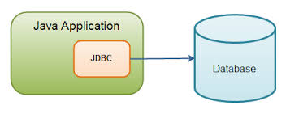
Database Connectivity
What is JDBC?
JDBC is a standard Java API for database-independent connectivity between the Java programming language and a wide range of databases.
Making a connection to a database
Creating SQL or MySQL statements
Executing that SQL or MySQL queries in the database
Viewing & Modifying the resulting records

Slide 4
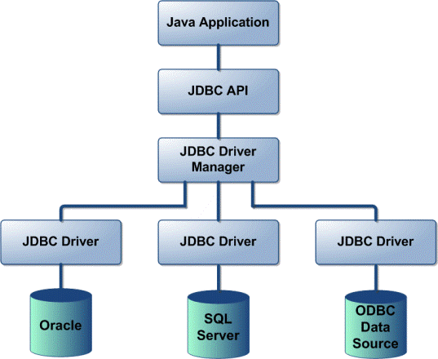
4.1 Design of JDBC
JDBC Driver Types
JDBC driver implementations vary because of the wide variety of operating systems and hardware platforms in which Java operates.
Sun has divided the implementation types into four categories, Types 1, 2, 3, and 4, which is explained below:
Type 1: JDBC-ODBC Bridge Driver:
Type 2: JDBC-Native API:
Type 3: JDBC-Net pure Java:
Type 4: 100% pure Java:
Reference
http://www.tutorialspoint.com/jdbc/jdbc-driver-types.htm

Slide 5
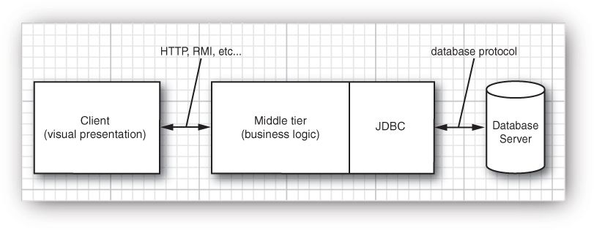
4.1 Design of JDBC
Typical Uses of JDBC

Slide 6
Database Connectivity
JDBC API
JDBC API is a Java API that can access any kind of tabular data, especially data stored in a Relational Database. JDBC works with Java on a variety of platforms, such as Windows, Mac OS, and the various versions of UNIX.
java.sql package

Slide 7
Database Connectivity
Driver Manager and JDBC Drivers
JDBC drivers implement the defined interfaces in the JDBC API for interacting with your database server.
An individual database system is accessed via a specific JDBC driver that implements the java.sql.Driver interface.
Drivers exist for nearly all popular RDBMS systems, though few are available for free.
Sun bundles a free JDBC-ODBC bridge driver with the JDK to allow access to standard ODBC data sources, such as a Microsoft Access database.
An easy way to load the driver class is to use the Class.forName() method:
Class.forName("sun.jdbc.odbc.JdbcOdbcDriver");

Slide 8
Database Connectivity
Driver Manager and JDBC Drivers
When the driver is loaded into memory, it registers itself with the java.sql.DriverManager class as an available database driver.
The next step is to ask the DriverManager class to open a connection to a given database, where the database is specified by a specially formatted URL. The method used to open the connection is DriverManager.getConnection() . It returns a class that implements the java.sql.Connection interface:
Connection con = DriverManager.getConnection("jdbc:mysql://localhost/limen", "user", "passwd");

Slide 9
4.2 JDBC Configuration 4.3 Executing SQL Statements 4.4 Query Execution

Slide 10
4.4 Query Execution
Scrollable Result Sets
Statement stat = conn.createStatement(type, concurrency);
PreparedStatement stat = conn.prepareStatement(command, type, concurrency);
Statement stat = conn.createStatement( ResultSet.TYPE_SCROLL_INSENSITIVE, ResultSet.CONCUR_READ_ONLY);
ResultSet rs = stat.executeQuery(query)
if (rs.previous()) … // to go previous
rs.relative(n); // cursor backward or forward by a number of rows with the call

Slide 11
4.4 Query Execution
Updatable Result Sets
Statement stat = conn.createStatement( ResultSet.TYPE_SCROLL_INSENSITIVE, ResultSet.CONCUR_UPDATABLE);
String query = "SELECT * FROM Books"; ResultSet rs = stat.executeQuery(query); while (rs.next()) { if (. . .) { double increase = . . . double price = rs.getDouble("Price"); rs.updateDouble("Price", price + increase); rs.updateRow(); // make sure to call updateRow after updating fields } }

Slide 12
4.4 Query Execution
Row Sets
RowSets don’t have to be tied to a database connection.
RowSetFactory factory = RowSetProvider.newFactory(); CachedRowSet crs = factory.createCachedRowSet();
Cached Row Sets
A cached row set contains all data from a result set.
ResultSet result = . . .; CachedRowSet crs = new com.sun.rowset.CachedRowSetImpl(); // or use an implementation from your database vendor crs.populate(result); conn.close(); // now OK to close the database connection

Slide 13
4.4 Query Execution
Transactions
You can group a set of statements to form a transaction. The transaction can be committed when all has gone well. Or, if an error has occurred in one of them, it can be rolled back as if none of the statements had been issued.
The major reason for grouping statements into transactions is database integrity.
For example, suppose we want to transfer money from one bank account to another. Then, it is important that we simultaneously debit one account and credit another. If the system fails after debiting the first account but before crediting the other account, the debit needs to be undone.

Slide 14
4.4 Query Execution
Transactions
Turn off this default so you can use transactions:
conn.setAutoCommit(false);
Create a statement object in the normal way:
Statement stat = conn.createStatement();
Call executeUpdate any number of times:
stat.executeUpdate(command1); stat.executeUpdate(command2); stat.executeUpdate(command3); . . .
If all statements have been executed without error, call the commit method:
conn.commit();
However, if an error occurred, call
conn.rollback();

Slide 15
Questions ???

