Slide 1
Advanced Java Programming B.Sc.CSIT Seventh Semester
By Narayan Subedi

Slide 2
Unit 7:
Servlets and Java Server pages

Slide 3
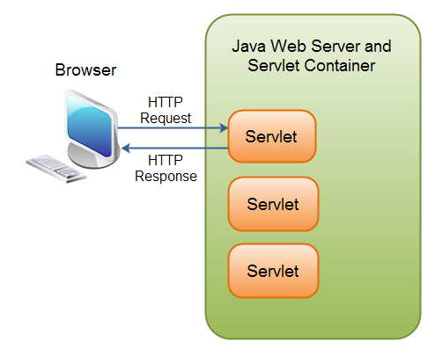
Servlets and Java Server pages
Servlet Defination
A Servlet is a small Java program that runs within a Web server.
Servlets receive and respond to requests from Web clients, usually across HTTP, the HyperText Transfer Protocol.
To implement this interface, you can write a generic servlet that extends javax.servlet.GenericServlet or an HTTP servlet that extends javax.servlet.http.HttpServlet.

Slide 4
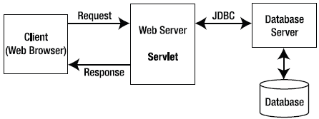
Servlets and Java Server pages
HTTP request response model of Servlet

Slide 5
Servlets and Java Server pages
Servlet Life Cycle Methods
The init() method :
The init method is designed to be called only once. It is called when the servlet is first created, and not called again for each user request.
public void init() throws ServletException { // Initialization code... }
The service() method :
The servlet container (i.e. web server) calls the service() method to handle requests coming from the client( browsers) and to write the formatted response back to the client.
The service () method is called by the container and service method invokes doGet, doPost, doPut, doDelete, etc. methods as appropriate.
public void service(ServletRequest request, ServletResponse response) throws ServletException, IOException{ }
Notes:
A process is an executing instance of an application.

Slide 6
Servlets and Java Server pages
Servlet Life Cycle Methods
The doGet() Method
A GET request results from a normal request for a URL or from an HTML form that has no METHOD specified and it should be handled by doGet() method.
public void doGet(HttpServletRequest request, HttpServletResponse response) throws ServletException, IOException { // Servlet code }
The doPost() Method
A POST request results from an HTML form that specifically lists POST as the METHOD and it should be handled by doPost() method.
public void doPost(HttpServletRequest request, HttpServletResponse response) throws ServletException, IOException { // Servlet code }
Notes:
A process is an executing instance of an application.

Slide 7
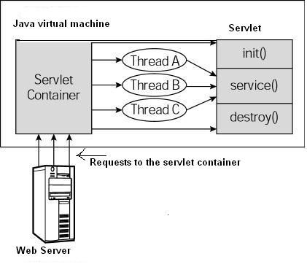
Servlets and Java Server pages
Servlet Life Cycle Methods
The destroy() method :
The destroy() method is called only once at the end of the life cycle of a servlet.
public void destroy() { // Finalization code... }
Notes:
A process is an executing instance of an application.

Slide 8
Servlets and Java Server pages
Servlet API
javax.servlet
The javax.servlet package contains a number of classes and interfaces that describe and define the contracts between a servlet class and the runtime environment provided for an instance of such a class by a conforming servlet container.
RequestDispatcher : Defines an object that receives requests from the client and sends them to any resource (such as a servlet, HTML file, or JSP file) on the server.
Servlet: Defines methods that all servlets must implement.
ServletConfig : A servlet configuration object used by a servlet container to pass information to a servlet during initialization. ServletContext : Defines a set of methods that a servlet uses to communicate with its servlet container, for example, to get the MIME type of a file, dispatch requests, or write to a log file. …
Notes:
A process is an executing instance of an application.

Slide 9
Servlets and Java Server pages
Creating Java Servlet
Compile
servlet-api.jar should be included while doing compile
javac -cp .;F:\apache-tomcat-7.0.23\lib\servlet-api.jar HelloWorld.java
A HelloWolrld.class will be created if compile is success.
Deploy
Copy HelloWorld.class into <Tomcat-installation-directory>/webapps/ROOT/WEB-INF/classes
Notes:
A process is an executing instance of an application.

Slide 10
Servlets and Java Server pages
Create following entries in web.xml file located in <Tomcat-installation-directory>/webapps/ROOT/WEB-INF/
<servlet>
<servlet-name>HelloWorld</servlet-name>
<servlet-class>HelloWorld</servlet-class>
</servlet>
<servlet-mapping>
<servlet-name>HelloWorld</servlet-name>
<url-pattern>/HelloWorld</url-pattern>
</servlet-mapping>
Above entries to be created inside <web-app>...</web-app> of web.xml
Now start Tomcat (startup.bat in bin folder of Tomcat installation) and hit http://localhost:8080/HelloWorld in browser.
Notes:
A process is an executing instance of an application.

Slide 11
Web Programming Using Java Servlet APIs
Session
A period devoted to a particular activity.
A session is a way to store information (in variables) to be used across multiple pages.
Saving in Session
String username=request.getParameter("txtusername");
HttpSession session = request.getSession(true);
session.setAttribute("username", username);
Getting from Session
String username=(String) session.getAttribute("username");
//session.invalidate()

Slide 12
Web Programming Using Java Servlet APIs
Cookie
A cookie, also known as an HTTP cookie, web cookie, Internet cookie, or browser cookie, is a small piece of data sent from a website (web application) and stored in a user's web browser while the user is browsing that website (web app).
A cookie, the information is stored on the user’s computer.
Creating Cookie
String username=request.getParameter("txtUsername");
Cookie cookie=new Cookie("username", username); cookie.setMaxAge(60*60*24*30); response.addCookie(cookie);

Slide 13
Servlets and Java Server pages
Getting Cookie
Cookie cookies[] = request.getCookies();
Cookie mycookie = null;
if (cookies != null) {
for (int i = 0; i < cookies.length; i++) {
if (cookies[i].getName().equals("username")) {
mycookie = cookies[i];
break;
}
}
}
String userName = mycookie.getValue();

Slide 14
Servlets and Java Server pages
Java Server pages
JavaServer Pages (JSP) is a server-side programming technology that enables the creation of dynamic, platform-independent method for building Web-based applications.
JSP have access to the entire family of Java APIs, including the JDBC API to access enterprise databases

Slide 15
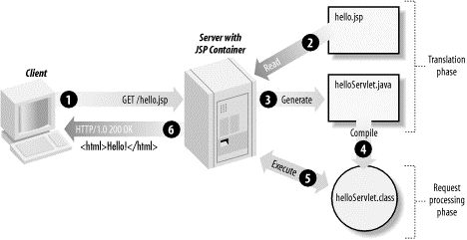
Servlets and Java Server pages
JSP Architecture
Typically, the JSP engine checks to see whether a servlet for a JSP file already exists and whether the modification date on the JSP is older than the servlet. If the JSP is older than its generated servlet, the JSP container assumes that the JSP hasn't changed and that the generated servlet still matches the JSP's contents. This makes the process more efficient than with other scripting languages (such as PHP) and therefore faster.

Slide 16
Servlets and Java Server pages
JSP Implicit Object
JSP Implicit Objects are the Java objects that the JSP Container makes available to developers in each page and developer can call them directly without being explicitly declared.
JSP Implicit Objects are also called pre-defined variables.

Slide 17
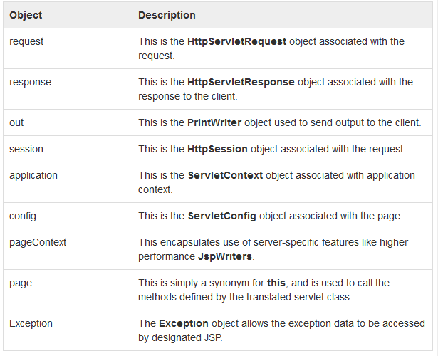
Java Server pages - JSP Implicit Object

Slide 18
JSP Implicit Object : Example

Slide 19
Questions ???

