Slide 1

Legal AI must prove what it says
HNX Legal Intelligence
EVIDENCE-GROUNDED CONTRACT ANALYSIS
HACKNEX 2026 · HNX26EPS01 — AGENTIC LEGAL ASSISTANT
UNSEEN-LOGISTICS-001
§ 2.3 Temperature Guarantee
“…shall remain strictly liable for consignment spoilage exceeding four (4) hours… regardless of customs detention.”
HNX Legal Intelligence — evidence-grounded analysis for complex commercial contracts
A fluent answer is not the same as a reliable legal answer.
VERBATIM QUOTE · CHECKED
UNSEEN-LOGISTICS-001#c004
SUPPORTED
Team No Sleep Till Deploy · Karunya Institute of Technology and Sciences, Coimbatore · Theme: AI & Emerging Technologies
Notes:
[~20 s]
SAY: We're No Sleep Till Deploy, and this is HNX Legal Intelligence for HNX26EPS01, the Agentic Legal Assistant. Our premise is simple: in legal work, a fluent answer isn't a reliable one. If an AI says who carries liability, it has to show the exact clause — or admit that it doesn't know.
TAKEAWAY: Legal AI must prove what it says.
NEXT: Here's why that matters on a real clause.

Slide 2
A fluent answer is not a verifiable answer
THE PROBLEM
01
Obligations are scattered
FLUENT ANSWER · ILLUSTRATIVE
Duties, carve-outs and schedules sit in different sections.
“The provider is not liable for delays caused by customs.”
02
Exceptions change the answer
NO SOURCE
EXCEPTION MISSED
“Subject to” and “notwithstanding” can reverse a general rule.
VERIFIABLE ANSWER
03
Fluency hides missing support
Not liable for customs-clearance delays (§2.2) — except for Temperature Sensitive Goods: strictly liable for spoilage beyond four hours of the delivery window, regardless of customs detention (§2.3 overrides §2.2).
A generic model can answer confidently with no source behind it.
04
Silence matters
§2.2 QUOTED
§2.3 QUOTED
SUPPORTED
What the contract does not say is often the key finding.
Clauses from UNSEEN-LOGISTICS-001; retrieval and the override link verified live (slide 5).
Notes:
[~30 s]
SAY: Contracts are hard because the answer is rarely in one place. Obligations are scattered, and words like 'subject to' or 'notwithstanding' can reverse a rule. Take one question from our test contract. The fluent answer says the provider isn't liable for customs delays — that's half true. Section 2.3 overrides 2.2 for temperature-sensitive goods. The verifiable answer quotes both clauses and shows the override.
TAKEAWAY: The missing exception is the dangerous part — and the user must be able to check it.
NOTE: no market statistics are claimed on this slide; none are sourced.
NEXT: So why don't today's approaches solve this?

Slide 3
Three ways to read a contract
WHY EXISTING APPROACHES FALL SHORT
 | Manual review | Generic LLM document chat | HNX Legal Intelligence
Evidence trail | Strong, but slow to assemble | Sources often missing or hard to check | Every cited quote is checked against the source text
Cross-clause links | Depends on reviewer attention | Left to the model; not inspectable | Follows “subject to”, “notwithstanding”, “defined in”
Missing evidence | Reviewer notes the gap | May fill the gap with plausible text | Abstains — no answer, no citations
Drafting | Written from scratch | Facts and allegations can blur | Clauses quoted, allegations labelled, gaps left as placeholders
Lawyer review | Is the review | Still required | Still required — drafts are labelled for review
An answer without supporting evidence is not enough for legal work.
Notes:
[~25 s]
SAY: Manual review is trustworthy, but slow to evidence. Generic document chat is fast, but sources are often missing and gaps get filled with plausible text. HNX keeps the speed and adds the evidence: checked quotes, followed cross-references, and an explicit 'not in this contract'. And look at the last row — a lawyer still reviews. We help them verify faster.
TAKEAWAY: An answer without evidence isn't enough for legal work.
NEXT: Here's the workflow.

Slide 4
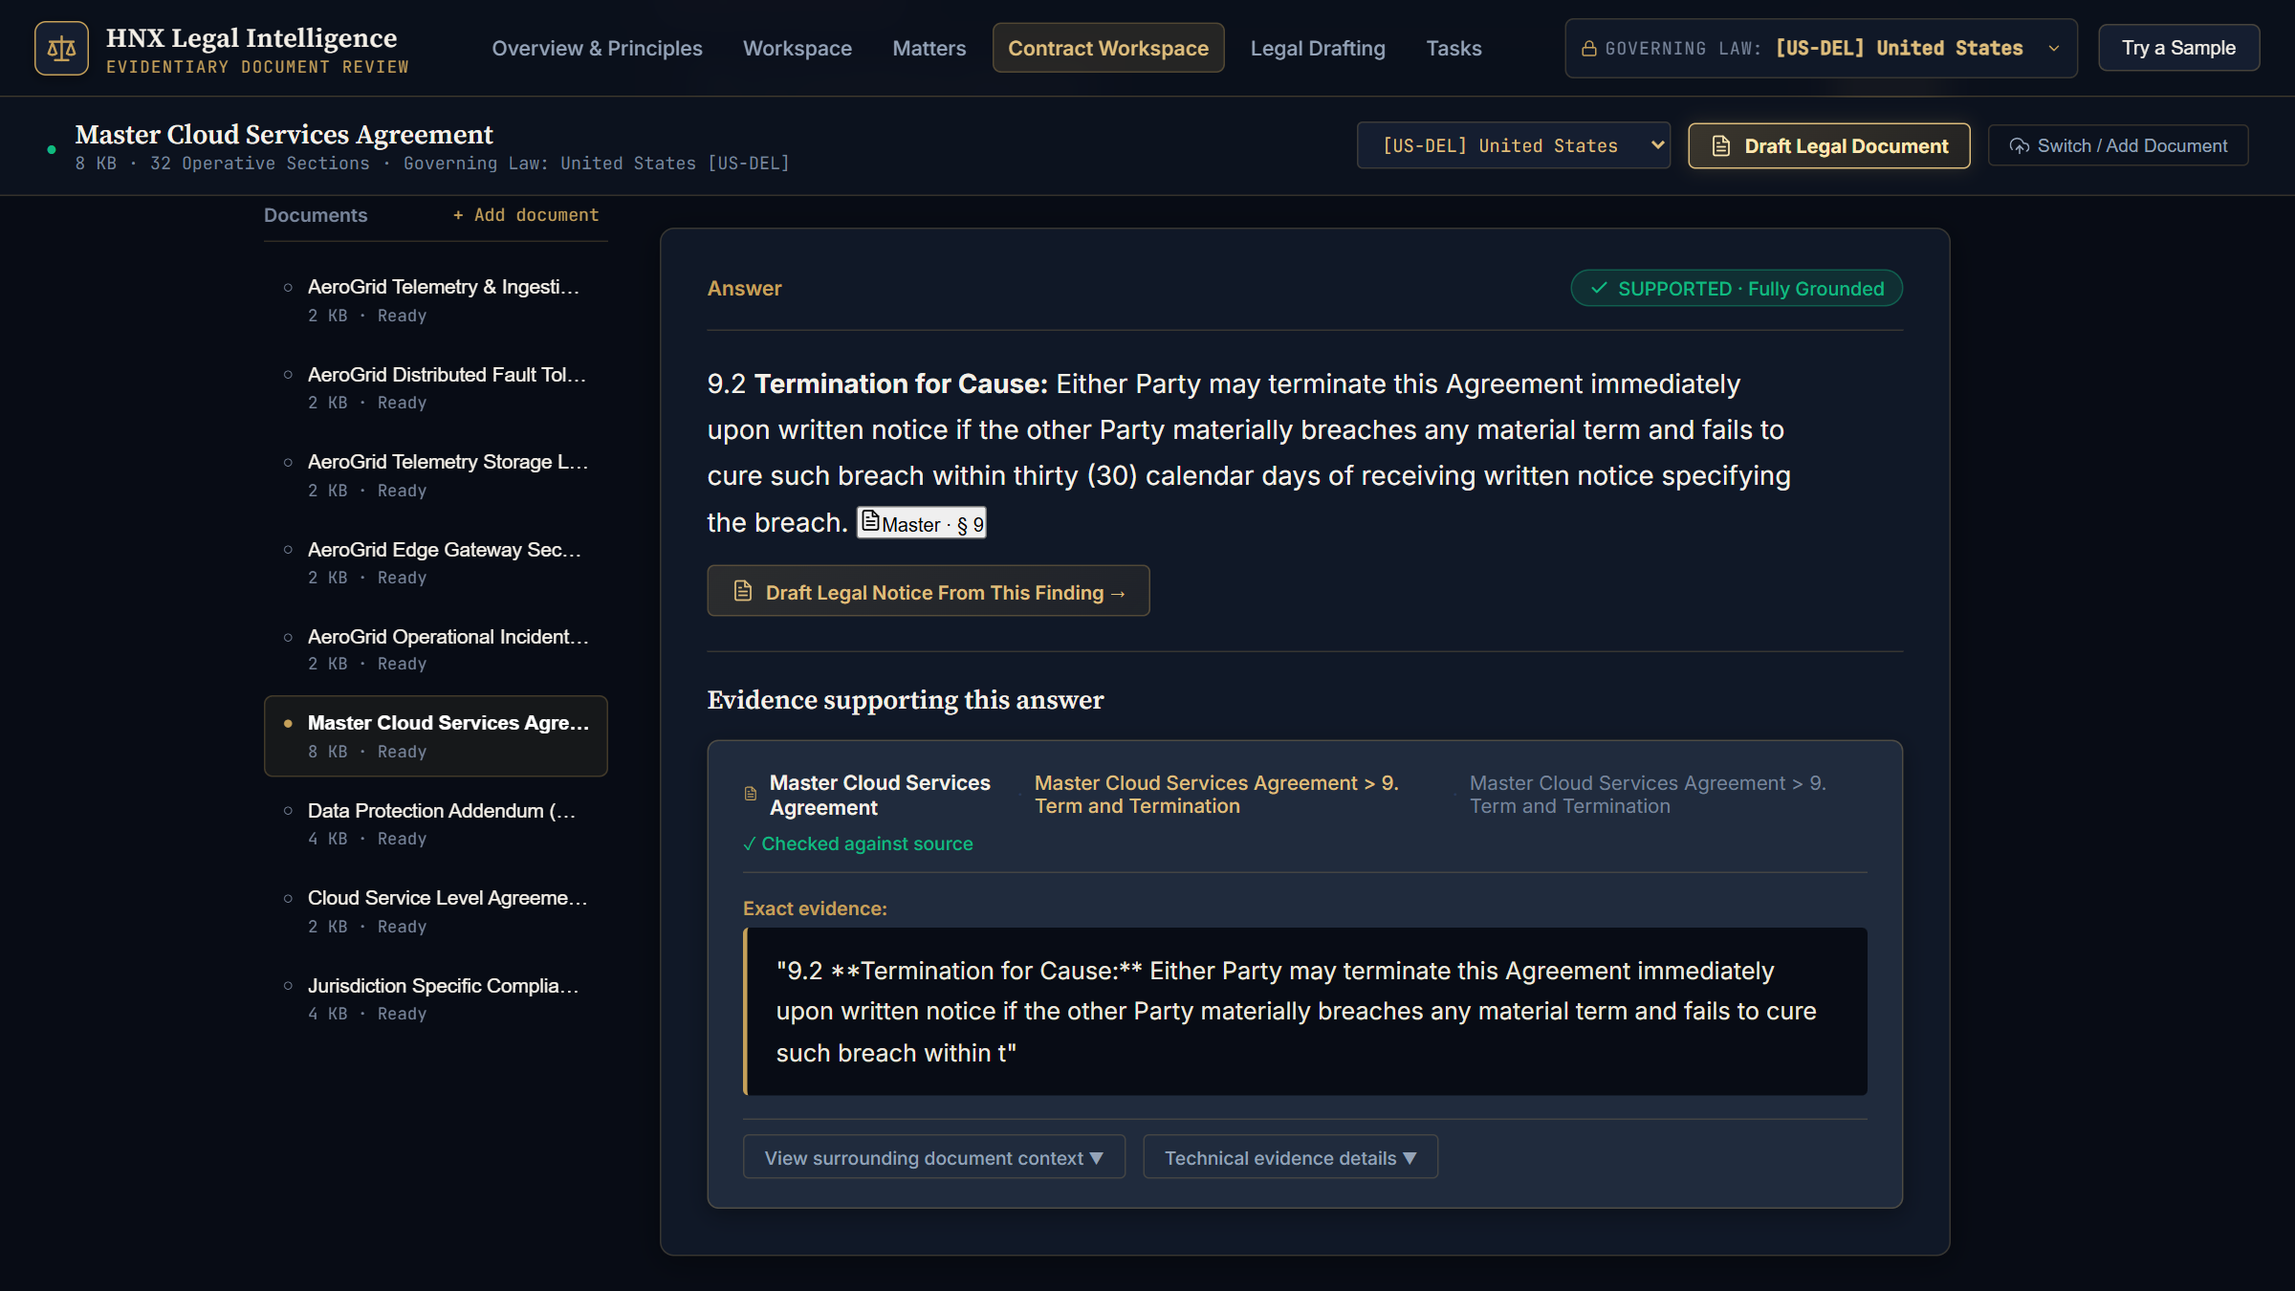
One workflow, from upload to evidence
OUR SOLUTION
01
02
03
04
05
06
Upload
›
Extract & index
›
Retrieve
›
Link clauses
›
Validate
›
Respond
PDF, TXT or Markdown
Section-aware chunks with page and path
Keyword + semantic search, fused
Follow cross-references
Sufficiency gate + quote check
Cited answer — or abstain
1
Status in words, not just colour
“SUPPORTED · Fully Grounded” or “INSUFFICIENT · Evidence Not Established”.
2
Exact evidence, with its location
The quoted span, the document and the section path.
3
From finding to draft
One click opens a notice draft labelled for lawyer review.
Live product — Contract Workspace, captured 9 Oct 2026
Notes:
[~30 s]
SAY: You upload a PDF, text or Markdown contract. We chunk it by section and keep the section path and page. Each question runs keyword and semantic search, fuses the two, follows cross-references, and then checks two things: is there enough evidence at all, and do the quotes really exist in the source? The output is a cited answer or an explicit abstention. This screenshot is the real product.
TAKEAWAY: Every answer is a claim plus its evidence.
NEXT: Let's prove it on a contract it has never seen.

Slide 5
A contract it has never seen
LIVE DEMO
UNSEEN-LOGISTICS-001 · synthetic cold-chain pharmaceutical logistics agreement · uploaded during the demo, questions scoped to this document
1 · CROSS-CLAUSE QUESTION
SUPPORTED
2 · OUT-OF-SCOPE QUESTION
“Is the service provider liable for spoilage of temperature sensitive goods when customs detention delays delivery?”
“What are the aircraft hangar maintenance guidelines and hazardous chemical disposal protocols?”
§2.2
“Subject to Section 2.3, Service Provider shall not be liable for delivery delays attributable to port customs clearance operations.”
INSUFFICIENT
0 citations. The system names the missing subject matter instead of guessing.
§2.3
“Notwithstanding Section 2.2, … shall remain strictly liable for consignment spoilage exceeding four (4) hours beyond the scheduled delivery window regardless of customs detention.”
DETECTED: §2.3 OVERRIDES §2.2
ALSO VERIFIED
Standard delivery window → “forty-eight (48) hours” §2.1, quoted verbatim
Customs delays are excused in general — but not spoilage of temperature-sensitive goods beyond four hours.
Checked against the running system on 9 Oct 2026 (/api/ask, scoped by doc_id). Gemini was unavailable at capture time, so answers came from the extractive path: verbatim source sentences.
Notes:
[~60 s — live demo]
DO (before the pitch): in Contract Workspace click '+ Add document', upload data/demo/demo_contract.md, then select 'Commercial Logistics and Cold-Chain Master Agreement' in the document list.
DO — question 1, type exactly: Is the service provider liable for spoilage of temperature sensitive goods when customs detention delays delivery?
EXPECT (verified 9 Oct): SUPPORTED; evidence sources §2.3, §2 and §5; the quoted §2.3 text 'Notwithstanding Section 2.2 … strictly liable for consignment spoilage exceeding four (4) hours … regardless of customs detention'; the Related provision box linking §2.3 and §2.2.
SAY: Customs delays are excused in general — but not spoilage of temperature-sensitive goods beyond four hours. And you can see exactly which clauses say so.
DO — question 2, type exactly: What are the aircraft hangar maintenance guidelines and hazardous chemical disposal protocols?
EXPECT: INSUFFICIENT, zero citations, and the 'Evidence Not Found — Refusal to Speculate' box naming the missing subject matter.
SAY: Nothing in this contract covers that, so it refuses instead of inventing an answer.
BACKUP: 'What is the standard delivery window for freight consignments?' returns §2.1 'forty-eight (48) hours' verbatim (the extractive path may append neighbouring clauses). Avoid the invoice payment-terms question: on 9 Oct it returned the overdue-interest sentence but missed the 30-day term. If the system is unreachable, use appendix slide A2.
NEXT: Here's what's underneath.

Slide 6
Evidence integrity, layer by layer
WHAT MAKES IT DIFFERENT
LAYER
WHAT IT DOES
WHY IT MATTERS
Document-scoped retrieval
Searches only the selected contract
Answers aren't borrowed from other files
1
Keyword search (BM25)
Matches exact terms and section numbers
Legal wording is precise
2
Semantic search
Gemini embeddings find passages by meaning
Catches paraphrased obligations
3
Reciprocal Rank Fusion
Merges both rankings by rank (k = 60)
No fragile score calibration
4
Clause-dependency expansion
Adds up to 2 clauses named by “subject to”, “notwithstanding”, “defined in”
Exceptions travel with the rule
5
Sufficiency gate + quote check
Abstains when core terms are absent; cited quotes must match the source exactly
No evidence → no answer, no citation
6
Notes:
[~35 s]
SAY: Six layers, all in the code. Retrieval is scoped to the contract you picked. BM25 — which we wrote ourselves — catches exact legal terms and section numbers; Gemini embeddings catch paraphrases. Reciprocal Rank Fusion merges the two lists by rank. When a clause says 'subject to' or 'notwithstanding', we pull in the clause it points to. Finally, if the question's core terms aren't in the evidence, we abstain before calling the model — and every cited quote must exist verbatim in the source.
IF ASKED: an exact quote proves the text exists, not that the claim built on it is correct. Claim-level entailment is on the roadmap.
NEXT: Here's the stack.

Slide 7
How a question becomes a cited answer
TECHNICAL ARCHITECTURE
Frontend
FastAPI
DATA BOUNDARIES
React 19 · TypeScript · Vite
Contract Workspace, Legal Drafting, Matters & Tasks
HTTP · JSON
/api/upload /api/ask
/api/draft/notice /api/draft/clauses
/api/documents
Index held in server memory; uploads are not written to disk
Contract text is sent to Google's Gemini API when enabled
Matters & tasks: browser-only metadata
QUESTION PIPELINE (/api/ask)
Parse
Chunk
Index
Retrieve
Expand
Gate
Generate
Validate
pypdf · text
Section-aware, 900 chars
BM25 + Gemini embedding-001
Doc-scoped hybrid, RRF
Cross-references
Evidence sufficiency
Gemini 3.5 Flash JSON
Exact-quote match
Fallbacks keep it running: LSA embeddings if the embedding API fails; a verbatim-sentence extractive generator if the LLM fails.
Answer response
Drafting path (/api/draft/notice)
Answer · evidence state · citations (chunk ID, quote, verified flag) · source passages · clause relationships
Retrieve clauses → template notice (no LLM) → contract quotes, labelled allegations, placeholders, “DRAFT — REQUIRES LAWYER REVIEW”
Notes:
[~25 s]
SAY: React and TypeScript on the front, FastAPI behind it. A question flows left to right: parse, chunk, index, retrieve, expand, gate, generate with Gemini 3.5 Flash in a strict JSON schema, then validate. If an API fails, we degrade instead of breaking. Drafting is template-based on purpose — no LLM writes the notice. And to be clear: contract text goes to Google's Gemini API when it's enabled; we claim no compliance certifications.
NEXT: So how do we know it works?

Slide 8
Evaluated, not asserted
EVALUATION & TRUST · GROUNDEDNESS · RETRIEVAL QUALITY
Real-LLM baseline · plain hybrid RAG
Adversarial legal stress test · 25 cases
Gemini 3.5 Flash + gemini-embedding-001 · 16 questions (8 answerable, 4 unanswerable, 4 adversarial) · internal technical corpus
Baseline RAG vs JC-PAR (jurisdiction routing + clause expansion + sufficiency gate)
100%
15/16
Recall@4
right document retrieved
Abstention decisions
correct
0
25/28
Citations to chunks
outside the retrieved set
Cited quotes
exact match to source
↓ lower is better · ↑ higher is better. Supported = strictly supported answers; abstention = correct on 3 unanswerable cases (0/3 → 3/3). Extractive generator, 8 Oct code snapshot. Recall@5 fell — an open problem we report, not hide.
34 / 34 automated tests pass (9 Oct) — including 10 unseen-contract scenarios: verbatim spans, §2.3↔§2.2 links, abstention, document isolation, injected-instruction text.
Not yet measured: claim-level entailment · lawyer-rated usefulness · real-LLM run on the legal stress set
Notes:
[~40 s]
SAY: We measured. On the left, plain hybrid RAG with real Gemini on 16 questions: the right document every time, 15 of 16 abstention calls correct, no citation outside the evidence, and 25 of 28 quotes exact. It's a small, technical set, and recall is document-level. On the right is our research: 25 adversarial legal cases broke the baseline 80% of the time. JC-PAR took correct abstention from zero of three to three of three and cut contradictions from 12 to 4 percent — but Recall@5 fell from 68 to 55. We show that rather than hide it. All 34 automated tests pass.
IF ASKED: the stress-test runs used the extractive generator on the 8 Oct code; details are in appendix A1.
TAKEAWAY: Every number comes with its caveat.
NEXT: So what is it good for today?

Slide 9
Useful today, honest about its limits
USEFULNESS, LIMITATIONS & NEXT STEPS
INTENDED VALUE
LIMITATIONS
ROADMAP
Design goals — not yet measured with lawyers
What we tell users up front
BUILT
Jump to the clause that answers the question
Trace each statement to a quoted source
See exceptions next to the rule they modify
Know when the contract is silent
Start notices from a lawyer-review draft
A lawyer must still review every output
An exact quote isn't proof the claim is right
Conflict flags rely on the model's classification
Clause expansion lowered Recall@5 (68% → 55%)
PDF, TXT and Markdown only — no DOCX or OCR yet
Hybrid RRF retrieval · clause expansion · sufficiency gate · quote validation · template drafting · matters & tasks prototype
NEXT
Claim-level entailment checks
Rule-based conflict flag in every answer
Fix the expansion recall penalty
DOCX and OCR ingestion
Evaluation with practising lawyers
Built to help lawyers verify faster — not to replace their judgment.
Notes:
[~25 s]
SAY: It's built to get lawyers to the right clause, with its evidence and its exceptions, and to say when the contract is silent. Those are design goals — we haven't measured them with lawyers yet. Limits we state up front: review is still required, a quote isn't proof, conflict flags rely on the model, and we don't read Word files or scans yet. Next: claim-level entailment, rule-based conflict flags, fixing the recall penalty, and evaluation with practising lawyers.
NEXT: To close —

Slide 10
Don't just generate an answer. Show why it deserves to be trusted.
CLOSING
HNX treats every legal answer as a claim that must carry its evidence — or say plainly that the evidence isn't there.
HNX Legal Intelligence
Team No Sleep Till Deploy
HACKNEX 2026 · HNX26EPS01
Ask us anything about the unseen contract — then inspect the evidence trail.
Notes:
[~15 s]
SAY: HNX treats every legal answer as a claim that must carry its evidence — or say plainly that the evidence isn't there. Don't just generate an answer. Show why it deserves to be trusted. Ask us anything about the unseen contract, and inspect the evidence trail yourself. Thank you.

Slide 11
Evaluation runs and their caveats
APPENDIX A1 · FOR QUESTIONS
Run | What ran | Data | Headline results | Caveats
Real-LLM baseline · 8 Oct | Plain hybrid RAG, top-4; Gemini 3.5 Flash; gemini-embedding-001 (3072-d) | 16 questions; 9 internal technical documents, 52 chunks | Recall@4 100% · groundedness 100%* · usefulness 85%* · abstention 15/16 · out-of-set citations 0 | *lexical heuristics, not entailment; document-level recall; 3/28 quotes not exact; false-premise QA-015 wrongly abstained
Adversarial stress test · 8 Oct | Baseline vs JC-PAR (JARF + CPDE + ESV); extractive generator | 25 legal cases (3 unanswerable, 5 jurisdiction) | Failure 80% → 72% · abstention 0/3 → 3/3 · contradictions 3 → 1 · Recall@5 68.2% → 54.5% | No LLM; earlier code snapshot; jurisdiction accuracy 2/5 for every variant
Automated tests · 9 Oct | pytest, 9 test files | 34 tests incl. 10 unseen-contract scenarios | 34 passed in 13.8 s | Most unseen-contract tests use the extractive path; the conflict test accepts several states
Live demo check · 9 Oct | /api/ask on UNSEEN-LOGISTICS-001, scoped by doc_id | 4 questions | 3 answered with verbatim quotes (status SUPPORTED) · 1 correct abstention, 0 citations | Gemini unavailable → extractive path; payment-terms answer missed the 30-day term
Sources: data/results/baseline_gemini_hybrid_rrf.json · data/results/ablation/*.json · pytest run of 9 Oct 2026 · presentation/assets/demo_verification.json
Notes:
Appendix — use only if judges ask about methodology. Every number here comes from a file in the repository; see presentation/README.md for the full verification notes.

Slide 12
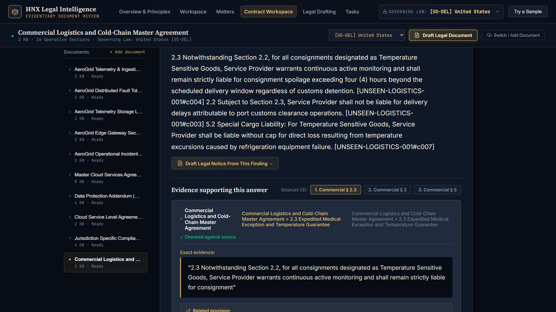
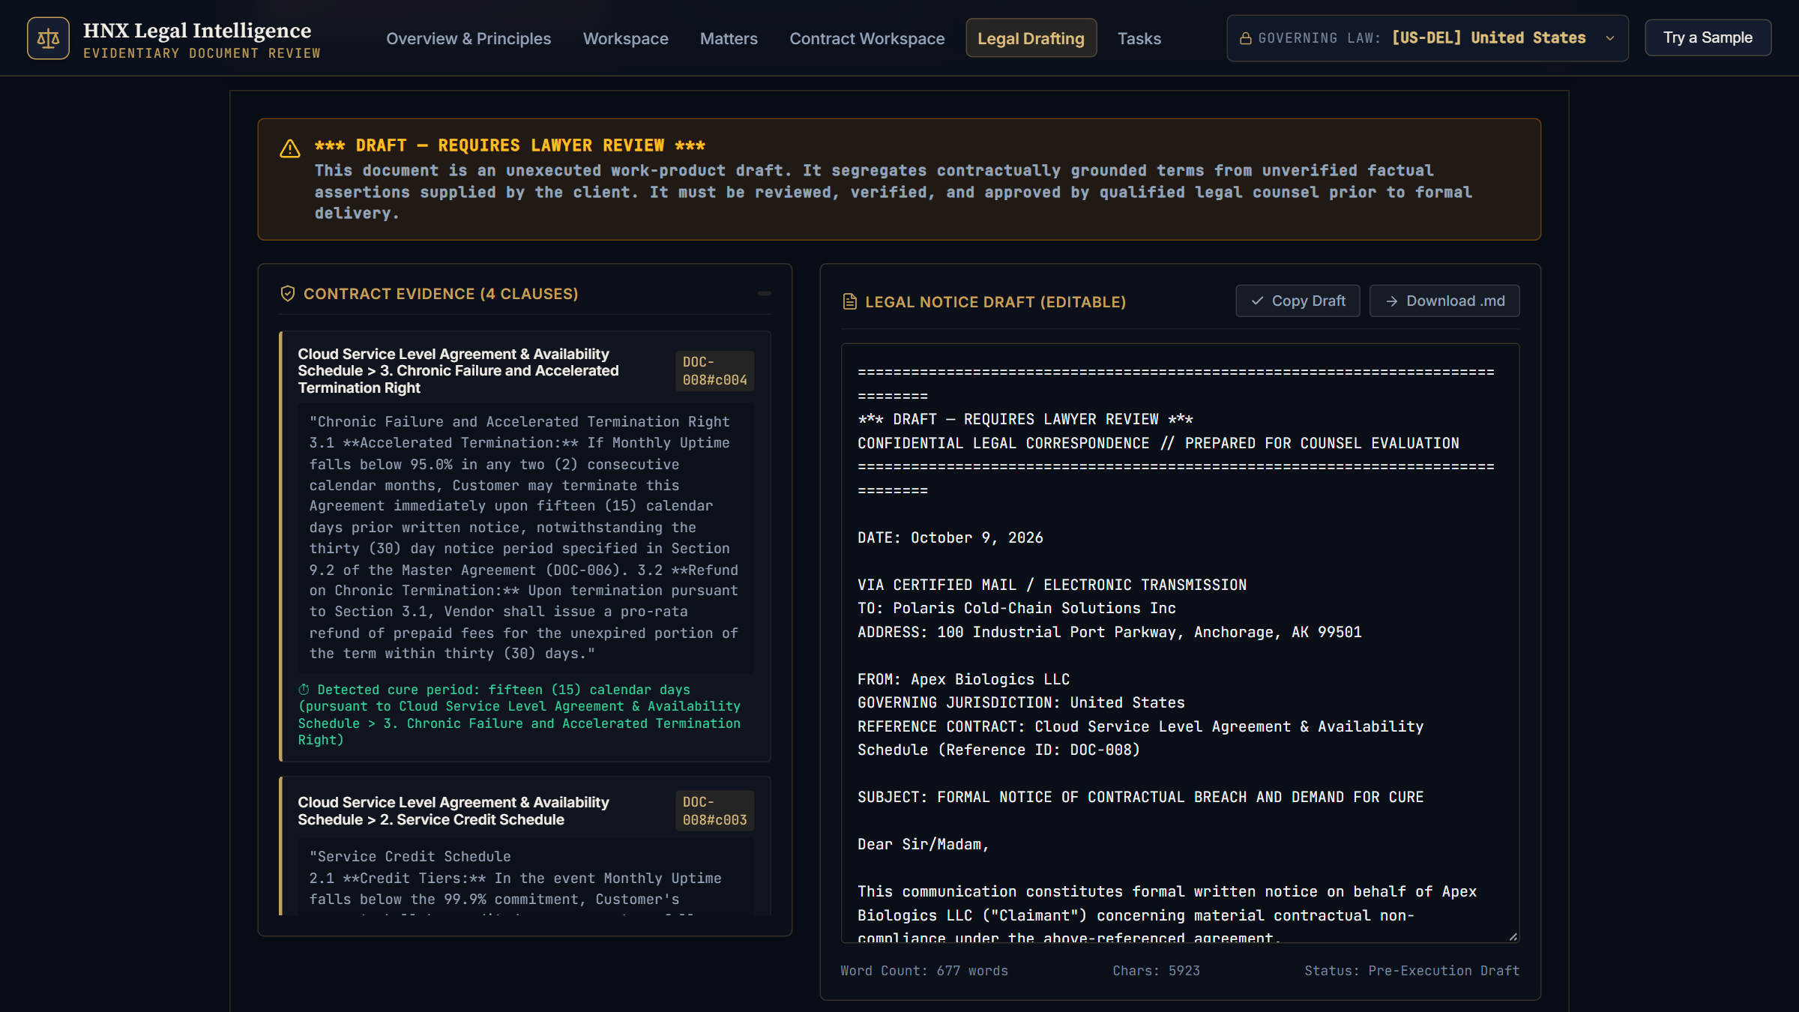
If the live demo is unavailable
APPENDIX A2 · DEMO BACKUP
Contract Workspace on UNSEEN-LOGISTICS-001: the cross-clause question returns SUPPORTED with §2.3, §2 and §5 as evidence sources.
Legal Drafting: notice generated from retrieved clauses, with the DRAFT — REQUIRES LAWYER REVIEW banner and a separate contract-evidence panel.
Captured from the running product on 9 Oct 2026 (headless Edge, 1600 × 900).
Notes:
Backup only. If the live system is unreachable, walk through these two real captures instead: the cross-clause answer with its evidence sources, and the drafting desk with the lawyer-review banner and separate evidence panel. Say clearly that these are screenshots, not a live run.

