Slide 1

PROJECT ON PHISHING DETECTION USING ARTIFICIAL INTELLIGENCE
NAME- Prabhneet Singh
(B.Tech CSE from GTBIT)

Slide 2
INTRODUCTION
Phishing is a cybercrime in which a target or targets are contacted by email, telephone or text message by someone posing as a legitimate institution to lure individuals into providing sensitive data such as personally identifiable information, banking and credit card details, and passwords.
The information is then used to access important accounts and can result in identity theft and financial loss.

Slide 3
TYPES OF PHISHING ATTACKS
LINK MANIPULATION
SOCIAL ENGINEERING
FILTER EVASION
COVERT REDRIECT
WEBSITE FORGERY

Slide 4
PHISHING DETECTION APPROACHES
PHISHING DETECTION:
SOFTWARE DETECTION
LIST BASE
VISUAL SIMILARITY
HEURISTICS AND MACHINE LEARNING BASED
USER TRAINING

Slide 5
SOME CONCEPTS WHICH WILL BE USED IN OUR PROJECTS:
ENSEMBLE LEARNING
Ensemble learning is a general meta approach to machine learning that seeks better predictive performance by combining the predictions from multiple models.
Although there are a seemingly unlimited number of ensembles that you can develop for your predictive modeling problem, there are three methods that dominate the field of ensemble learning. So much so, that rather than algorithms per se, each is a field of study that has spawned many more specialized methods.
The three main classes of ensemble learning methods are bagging, stacking, and boosting, and it is important to both have a detailed understanding of each method and to consider them on your predictive modeling project.
But, before that, you need a gentle introduction to these approaches and the key ideas behind each method prior to layering on math and code.
In this tutorial, you will discover the three standard ensemble learning techniques for machine learning.

Slide 6
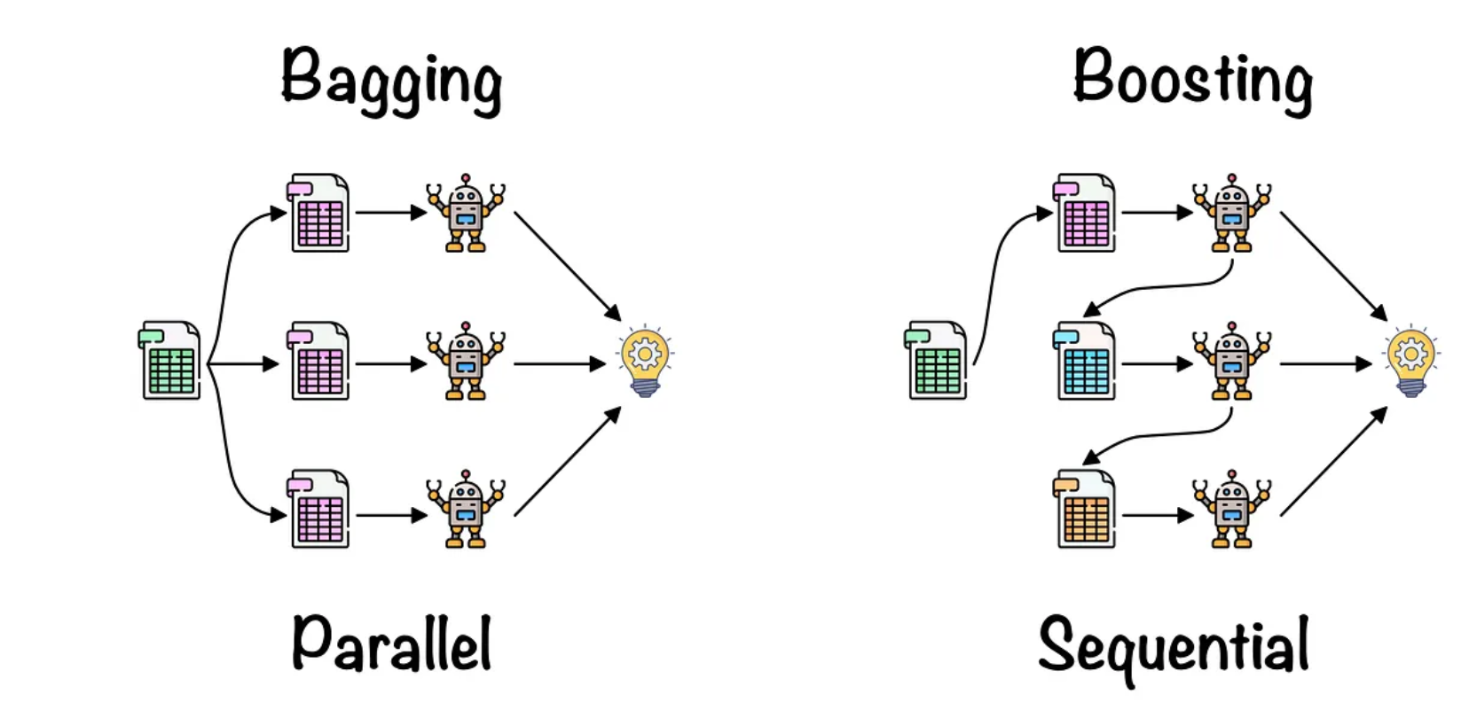
TYPES OF ENSEMBLE METHODS (WIDELY USED):- BAGGING AND BOOSTING

Slide 7
BAGGING
Bootstrap Aggregating, also known as bagging, is a machine learning ensemble meta-algorithm designed to improve the stability and accuracy of machine learning algorithms used in statistical classification and regression. It decreases the variance and helps to avoid overfitting. It is usually applied to decision tree methods. Bagging is a special case of the model averaging approach.

Slide 8
BOOSTING
Boosting is an ensemble modeling technique that attempts to build a strong classifier from the number of weak classifiers. It is done by building a model by using weak models in series. Firstly, a model is built from the training data. Then the second model is built which tries to correct the errors present in the first model. This procedure is continued and models are added until either the complete training data set is predicted correctly or the maximum number of models is added.

Slide 9
THANK YOU

