Slide 1
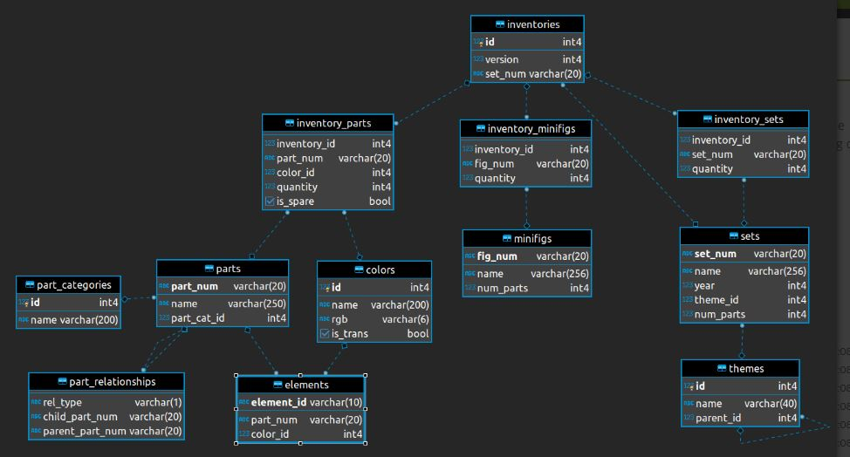
LEGO Catalog Dataset- Data Analysis Using SQL (MSSQL) Source-https://rebrickable.com/downloads/

Slide 2
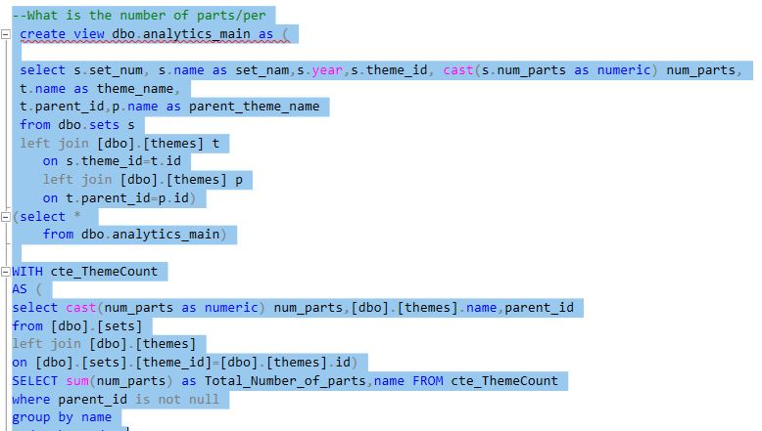
What is the number of parts per theme

Slide 3
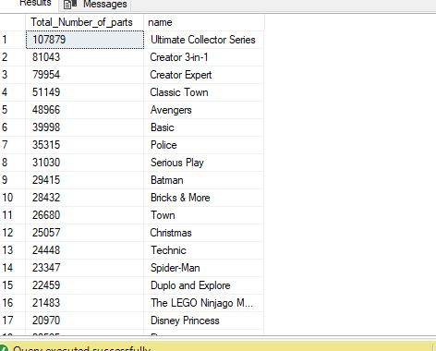
Query showed total number of parts/theme. “Ultimate Collector Series Theme adds up to maximum”

Slide 4
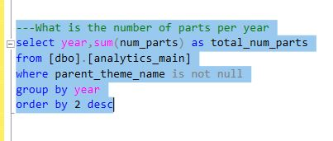
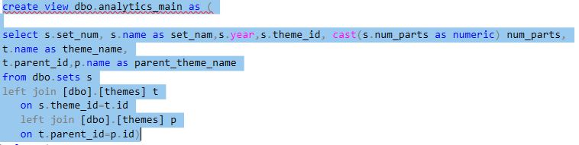
What is the number of parts per year

Slide 5
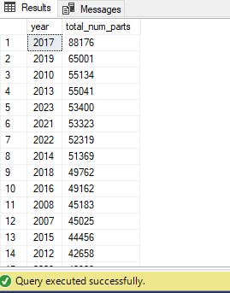
Query resulted total number of parts grouped by each Year.

Slide 6
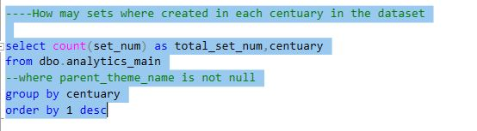
Query to find how many sets where created in each century in given dataset

Slide 7
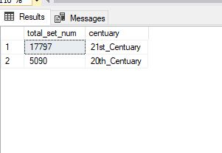
Query resulted total number of theme’ sets by century.

Slide 8
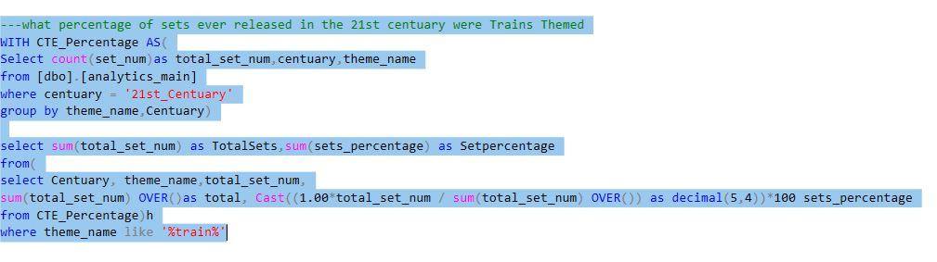
Query to find percentage of sets ever released in 21st century and have theme named “Train”

Slide 9
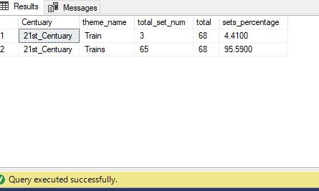
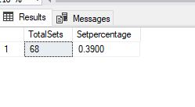
Out of total released themes, only 0.39%(<1%) of were named Train

Slide 10
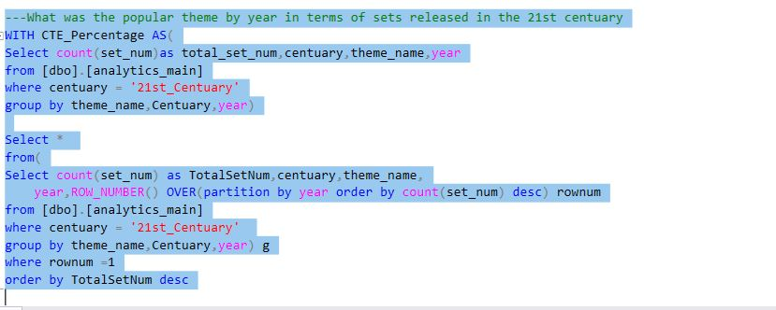
What was the popular theme by year in terms of sets released in 21st Century

Slide 11
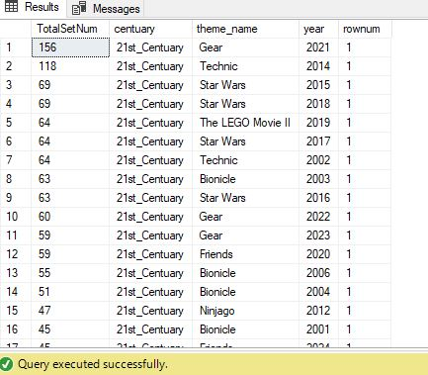
Out of total released themes, “Gear” Theme is the most popular in 21st century

Slide 12
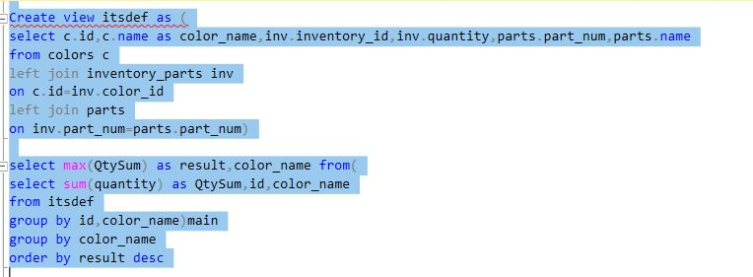
what is the most produced colour of LEGO ever in terms of quantity of parts?

Slide 13
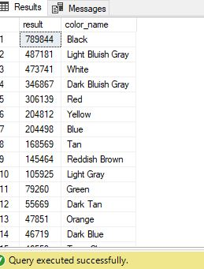
It is clear the Black colour has highest quantity per parts

