Slide 1
Intro
Problem
Game solving
Minimax
Choice for comparison
Optimized variations of minimax
Alpha beta pruning
Randomized alpha beta
NegaScout

Slide 2
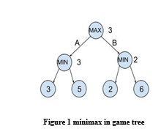
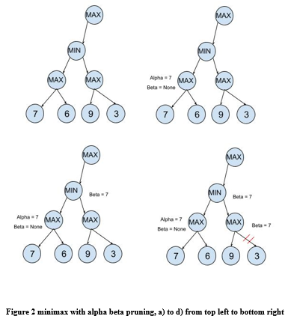
Algorithms of choice
Baseline – Minimax
Based on DFS on game tree
Maximize and minimize stages
Assumes optimal play by opposite player
Alpha beta pruning
Optimizing Minimax
Alpha -> best possible value at a max node
Beta -> best possible value at a min node
Beta is upper bound at max stage
Alpha is lower bound at min stage

Slide 3
Algorithms of choice
Randomized Alpha beta
Randomizing the moves to avoid repetitions
Good enough moves rather than best moves
NegaScout
Beta set to alpha + 1
Search only for the best values
If unsuccessful, employ regular alpha beta

Slide 4
Comparison & Conclusion

