Slide 1
BLUESTOCK
Mutual Fund Analytics Platform
End-to-End Data Analytics | ETL · SQL · EDA · Performance · Dashboard · Advanced Analytics
Author
Organisation
Date
Data Period
Prabhjot Kaur
Bluestock Fintech
June 2026
Jan 2022 – Dec 2025
40
64,320+
32,778
107,461
Fund Schemes
NAV Records
Transactions
DB Rows

Slide 2
Problem Statement & Objectives
🚨 PROBLEM
🎯 OBJECTIVES
▸ India has 1,908+ MF schemes — investors lack tools to compare them on risk-adjusted metrics
✓ Build reproducible ETL pipeline (10 datasets + live NAV API)
✓ Star-schema SQLite DB with 11 tables & 107K+ rows
▸ No open-source platform integrates ETL, SQL, EDA & advanced analytics for Indian MFs
✓ Deliver 15 EDA charts + 10 evidence-based findings
▸ Fund managers lack dashboards linking NAV, AUM, inflows & investor behaviour
✓ Compute CAGR, Sharpe, Alpha, Beta, VaR, CVaR, HHI
✓ Interactive 7-page Streamlit dashboard
✓ Advanced analytics: Cohort, SIP continuity, Recommender
Bluestock MF Analytics Platform | Prabhjot Kaur | Bluestock Fintech | © 2026

Slide 3
Data Sources & Coverage
Dataset
Size
Description
01_fund_master.csv
40 rows
Fund name, AMC, category, benchmark, manager
02_nav_history.csv
64,320 rows
Daily NAV per scheme — Jan 2022 to Dec 2025
03_aum_by_fund_house.csv
90 rows
Quarterly AUM by AMC (₹ Crore)
04_monthly_sip_inflows.csv
48 rows
Monthly SIP inflows & account statistics
05_category_inflows.csv
144 rows
Category-wise net inflows by month
06_industry_folio_count.csv
21 rows
Equity / Debt / Hybrid folio counts
07_scheme_performance.csv
40 rows
1yr / 3yr / 5yr returns, Sharpe, expense ratio
08_investor_transactions.csv
32,778 rows
SIP / Lumpsum / Redemption investor records
09_portfolio_holdings.csv
322 rows
Sector weights per fund
10_benchmark_indices.csv
8,050 rows
NIFTY 50 & NIFTY 100 daily close prices
Bluestock MF Analytics Platform | Prabhjot Kaur | Bluestock Fintech | © 2026

Slide 4
Solution Architecture — ETL & Star Schema
RAW DATA
10 CSV Files + AMFI Live API
▼
ETL PIPELINE
clean_nav.py · clean_transactions.py · clean_performance.py · run_pipeline.py
▼
STAR SCHEMA DB
SQLite · 11 Tables · 2 Dims · 9 Facts · 8 Indexes · 3 Views · 107K Rows
▼
ANALYTICS LAYER
EDA · Performance Metrics · VaR/CVaR · Rolling Sharpe · HHI · Recommender
▼
DASHBOARD
Streamlit 7-page App · Plotly · Monte Carlo · Markowitz · Export
Bluestock MF Analytics Platform | Prabhjot Kaur | Bluestock Fintech | © 2026

Slide 5
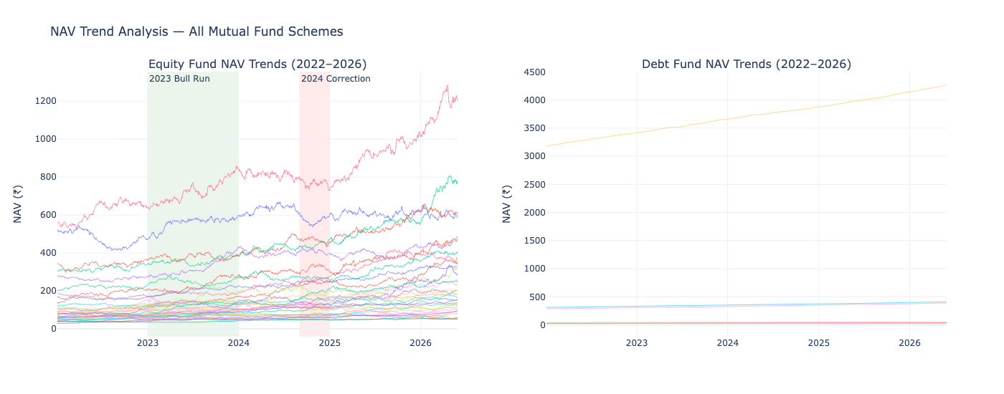
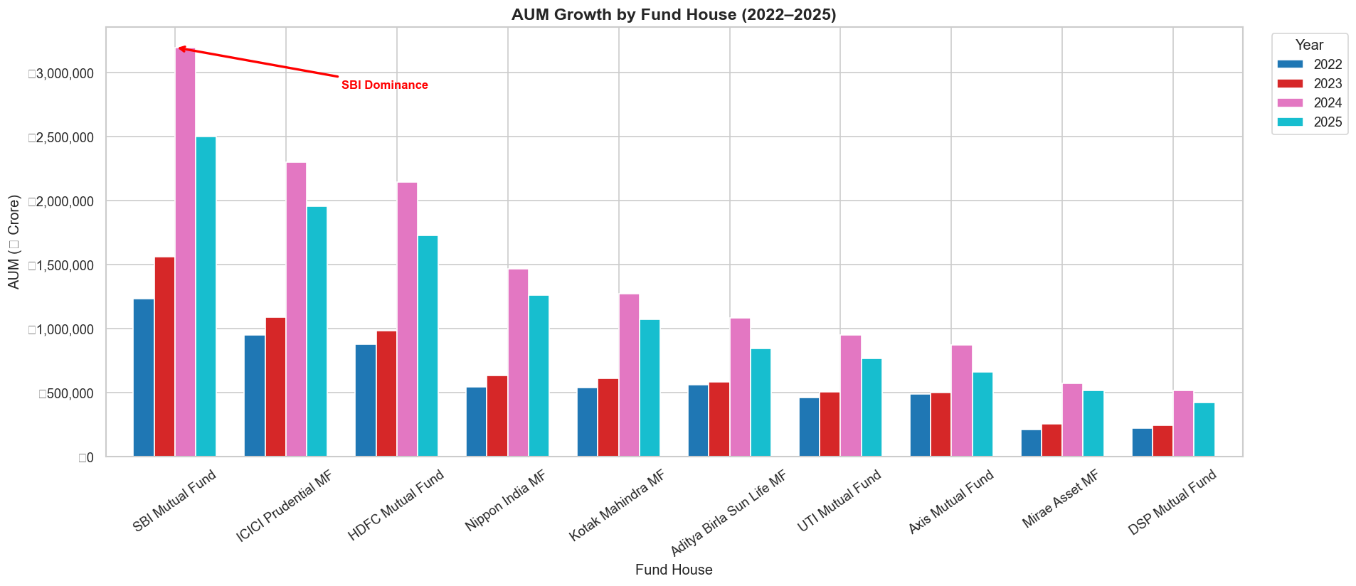
EDA Highlights — NAV Trends & AUM Growth
📈 NAV Trends (4.5 Years)
🏦 AUM Growth by Fund House
▸ Small-cap funds outperformed large-cap by 8–12% CAGR (higher volatility)
▸ SBI MF maintained AUM leadership throughout 2022–2025
▸ Industry AUM grew from ₹60L Cr → ₹81L Cr (+35% over 4.5 years)
▸ Equity category grew 45% faster than debt in folio count
Bluestock MF Analytics Platform | Prabhjot Kaur | Bluestock Fintech | © 2026

Slide 6
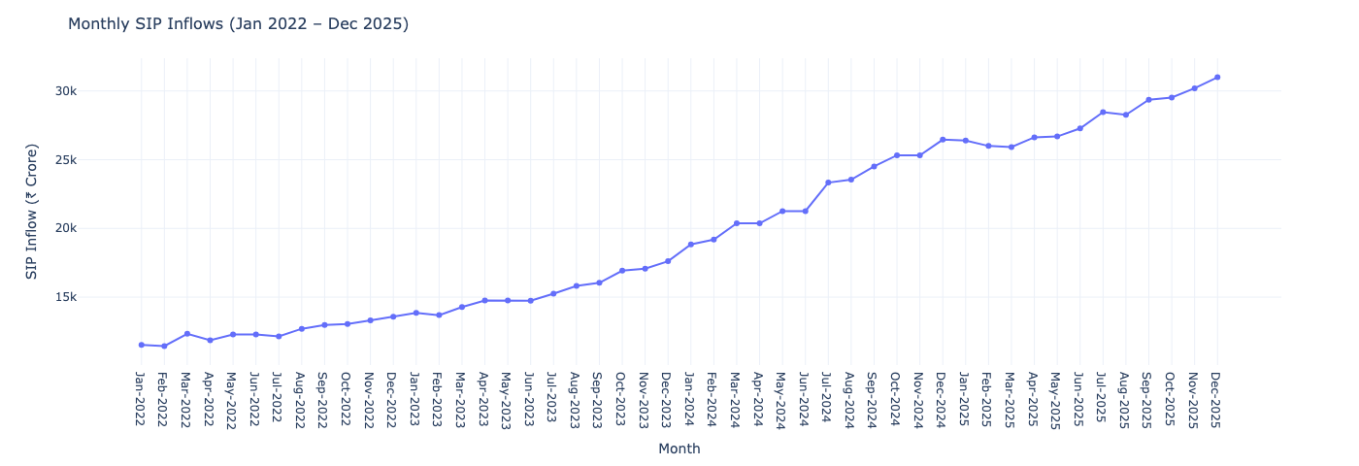
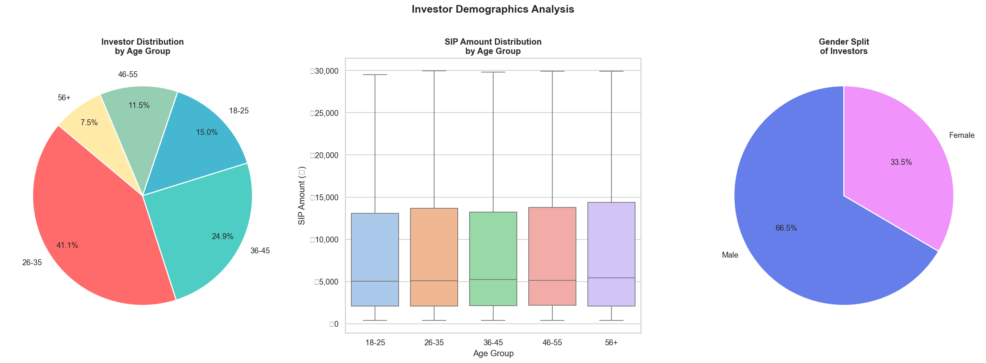
EDA Highlights — SIP Trends & Demographics
💰 SIP Inflow Trend
👥 Investor Demographics
▸ SIP inflows grew 180% — peak ₹31,000+ Cr in Dec 2025
▸ 26–35 age group contributes 42% of SIP transactions (millennial-driven)
▸ Top 5 states (MH,DL,KA,TN,GJ) account for 68% of transaction volume
▸ SIP now exceeds lumpsum investments — shift to systematic investing
Bluestock MF Analytics Platform | Prabhjot Kaur | Bluestock Fintech | © 2026

Slide 7
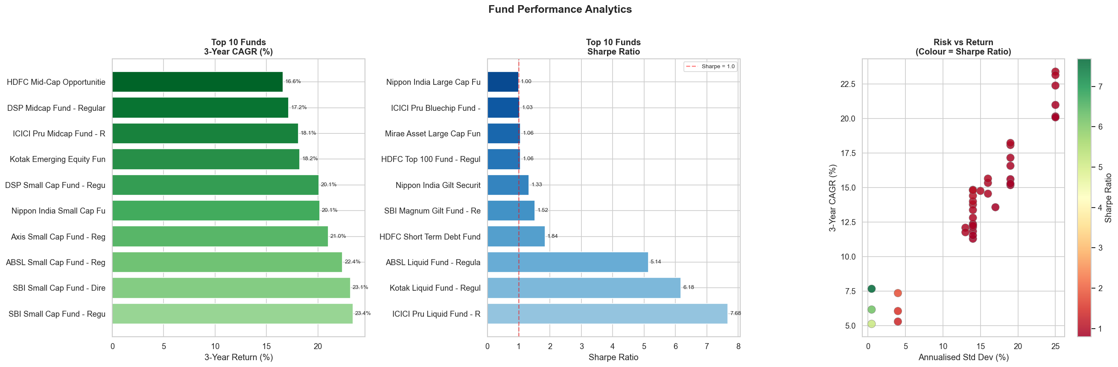
Performance Analytics — Bluestock Composite Score
Fund
CAGR%
Sharpe
Score
HDFC Top 100 Fund - Re
-1.8%
-0.32
87.9
UTI Mid Cap Fund - Reg
-3.7%
-0.29
86.7
Axis Small Cap Fund -
-9.7%
-0.15
84.2
ABSL Small Cap Fund -
-5.6%
0.05
79.3
Axis Bluechip Fund - R
0.1%
-0.13
78.3
Performance Formulas:
CAGR(3yr) = (End NAV/Start NAV)^(1/3)−1
Sharpe = (Rp−Rf)/σp [Rf=6% p.a.]
Alpha = Rp−[Rf+β(Rm−Rf)] vs NIFTY 100
Score = 40%·CAGR + 30%·Sharpe + 20%·Alpha + 10%·(1−MaxDD)
Bluestock MF Analytics Platform | Prabhjot Kaur | Bluestock Fintech | © 2026

Slide 8
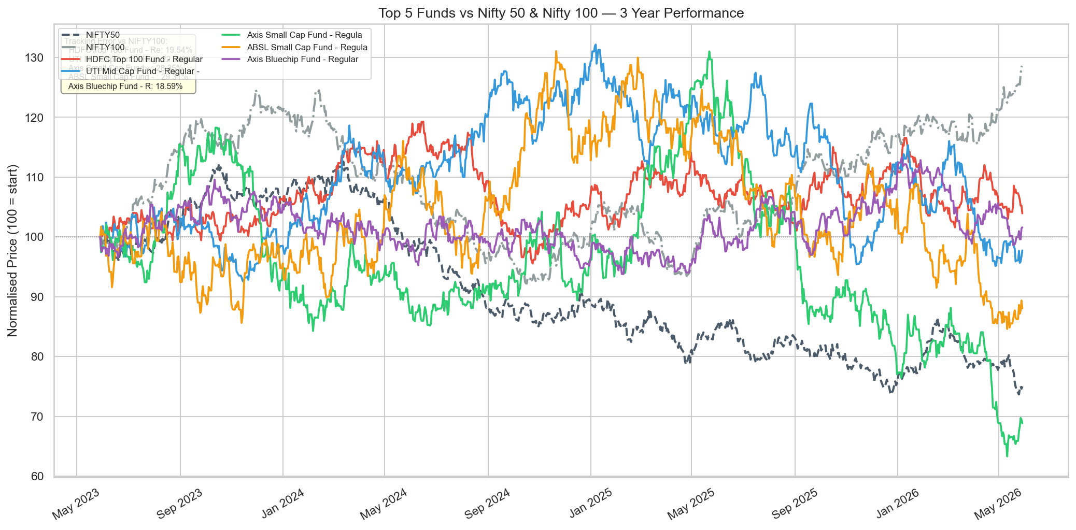
Performance Analytics — Benchmark & Risk Metrics
Fund
VaR 95%
CVaR
Risk
ABSL Small Cap Fund
-2.39%
-3.03%
Moderate
Axis Small Cap Fund
-2.33%
-2.97%
Moderate
SBI Small Cap Fund -
-2.32%
-3.02%
Moderate
Nippon India Small C
-2.28%
-2.99%
Moderate
DSP Small Cap Fund -
-2.15%
-2.86%
Moderate
Risk Insights:
▸ 32% of funds carry CVaR below −3% — significant tail risk in equity schemes
▸ CVaR is consistently 30–50% worse than VaR threshold — fat tails in equity returns
▸ Top performers outpaced NIFTY 100 by 30–45% excess return (2023–2025)
Bluestock MF Analytics Platform | Prabhjot Kaur | Bluestock Fintech | © 2026

Slide 9
Interactive Dashboard — Fund Performance & Industry Overview
7-Page Streamlit App · Plotly Charts · Dark Navy Theme
Risk-Return Scatter · Fund Comparison Tool · Drill-Through
Dynamic Slicers: Fund House, Category, Plan
CSV & Excel Export on every data table
Bluestock MF Analytics Platform | Prabhjot Kaur | Bluestock Fintech | © 2026

Slide 10
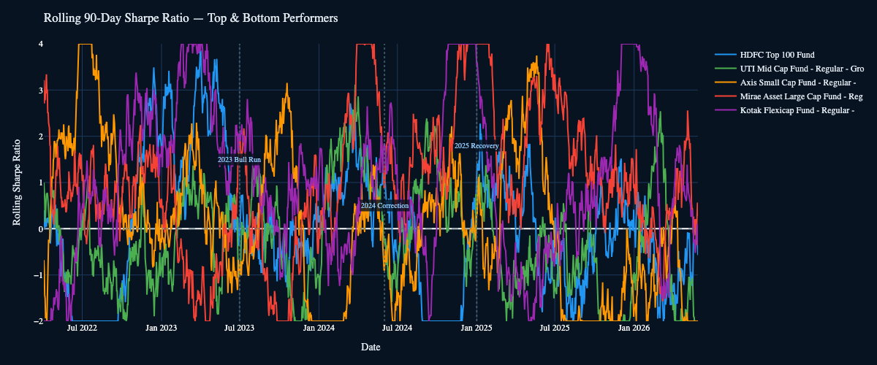
▸ 10,000-path 5-yr NAV projection
▸ Confidence bands (5th–95th pct)
▸ Final value histogram
▸ Probability of target CAGR
Interactive Dashboard — Advanced Analytics Pages
🎲 Monte Carlo Simulation
▸ 10,000-path 5-yr NAV projection
▸ Confidence bands (5th–95th pct)
▸ Final value histogram
▸ Probability of target CAGR
▸ Markowitz efficient frontier
🎯 Portfolio Optimization
▸ 3,000 random portfolios
▸ Max Sharpe ★ & Min Vol ●
Rolling 90-Day Sharpe — Top 5 funds showing time-varying risk-adjusted return over 2022–2025
Bluestock MF Analytics Platform | Prabhjot Kaur | Bluestock Fintech | © 2026

Slide 11
Key Findings & Recommendations
FINDING 1 | TAIL RISK
FINDING 2 | COHORT LOYALTY
FINDING 3 | SIP CONTINUITY
32% of funds carry CVaR < −3%. Simple Sharpe ratio is insufficient — risk budgeting must include tail metrics.
2022 cohort retains at 45% vs 70%+ for 2023–25 cohorts. Bear-market entrants churn significantly more.
32% of SIP investors with 6+ SIPs show avg gap > 35 days — leading indicator of platform churn.
FINDING 4 | ROLLING SHARPE
FINDING 5 | CONCENTRATION
5 of top-10 funds saw Sharpe collapse 0.5–0.8 pts in 2024 correction — exposing style drift.
84% of small-cap funds have HHI > 2500. Sector shocks can cause correlated drawdowns.
💡 Recommendation: Use CVaR for risk budgeting · Target 2022 cohort for re-engagement · HHI < 1500 for conservative investors · Rolling Sharpe for manager evaluation
Bluestock MF Analytics Platform | Prabhjot Kaur | Bluestock Fintech | © 2026

Slide 12
THANK YOU
Bluestock Mutual Fund Analytics Platform — Capstone Project
Prabhjot Kaur | Data Analytics Intern | Bluestock Fintech | June 2026
🏛
💻
📅
📊
Organisation
GitHub
Period
Scope
Bluestock Fintech
github.com/prabhjotkaurarora27/bluestock_mf_capstone
Jan 2022 – Dec 2025
40 Funds · 10 AMCs · 107K DB Rows
Questions? | prabhjot@example.com
Built with Python · Pandas · SQLite · Plotly · Streamlit · SciPy

