Slide 1
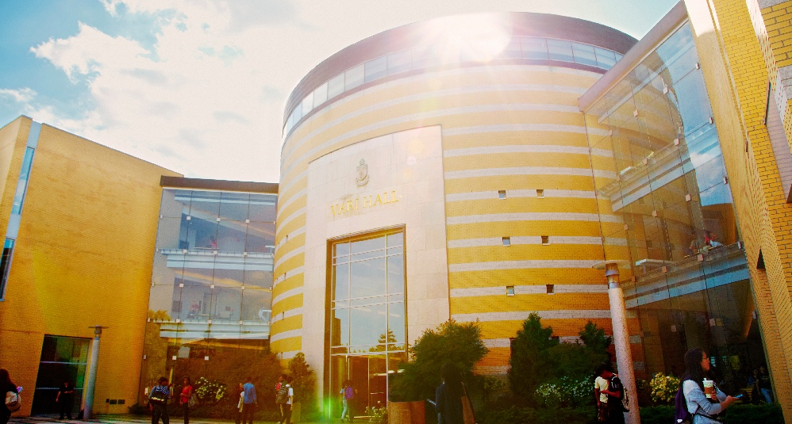
A Computational Approach to Understanding Empathy Expressed in Text-Based Mental Health Support
Prabhnoor Singh
Project Presentation - EECS 6322 | W21 Term

Slide 2

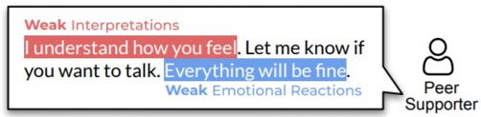
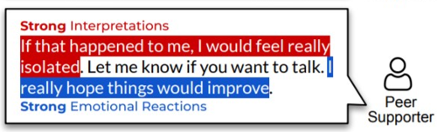
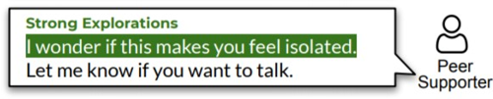
Paper Summary
a computational approach: EPITOME (EmPathy In Text-based, asynchronous MEntal health conversations.
Empathy
Emotional Reactions
Explorations
Interpretations
CONTRIBUTIONS
Annotated Dataset: <seeker_post, response_post, Identifiaction_label, rationale_extractions_sub_seq>
A multi-task bi-encoder model.
Model-based insights.

Slide 3
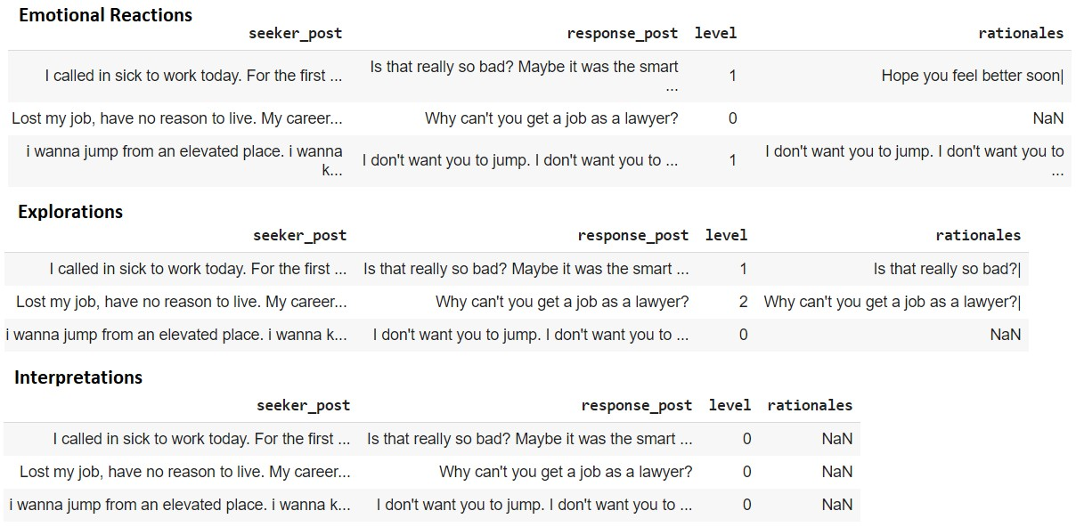
Data

Slide 4
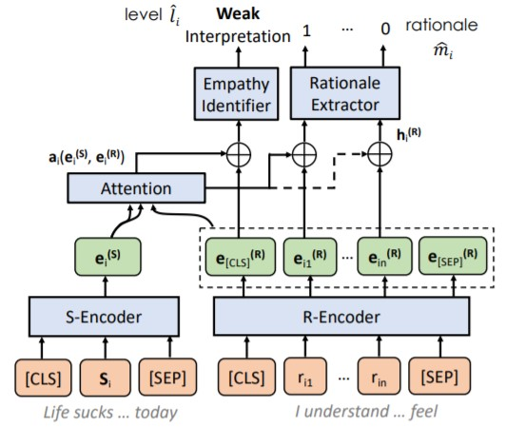

Architecture
Multi-Task Loss

Slide 5

Scope of Reproducibility
Metrics
Goals
The comparison of the metric scores obtained from my implementation with:
scores reported in the paper.
scores obtained by re-running the authors’ implementation on the public dataset (a subset of the original dataset used in the paper).

Slide 6
Methodology
The bi-encoder model, data loaders and pre-processors, evaluation metrics, training and evaluation utilities, testing module, everything was implemented from scratch.
Majorly relied on numpy and PyTorch.
Only, the code for pre-train ROBERTA model was re-used from the "transformers" library which was necessary for weight initialization.
The integration of this pre-trained model into the multi-task model architecture was implemented by myself.
GIT BRANCHING:
main
feature/data_loder_preprocessor
feature/training_utility
feature/stretch_goal

Slide 7
Stretch Goal Objectives
Multi-Head Attention
Dense Synthesizer
Talking-Heads Attention
ALL

Slide 8
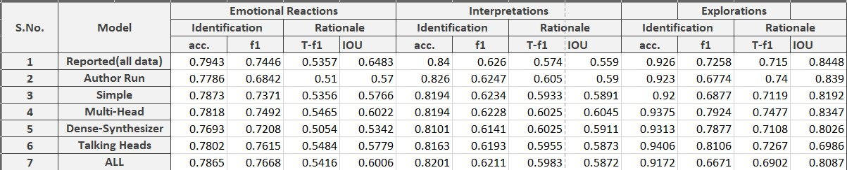
Results & Discussion
My results vs Reported : 1.37% relative difference.
My results vs Re-run : 0.58% relative difference.
Multi-Head vs Re-run: 3.5% relative difference.
Dense-Synthesizer vs Re-run: 0.6% relative difference.
Talking-Heads vs Re-run: 0.9% relative difference.
ALL vs Re-run: 0.77% relative difference.

Slide 9
Results & Discussion
Overall, the paper was easy to follow.
Implementation details were well covered in the paper.
Code was made public.
Minor hiccups with the token-level F1 metric.

Slide 10
References
Reproducibility Challenge Paper: https://arxiv.org/pdf/2009.08441v1.pdf (A Computational Approach to Understanding Empathy Expressed in Text-Based Mental Health Support )
Multi-Head Attention Paper: https://arxiv.org/pdf/1706.03762.pdf (Attention Is All You Need )
Dense Synthesizer Paper: https://arxiv.org/abs/2005.00743 (Synthesizer: Rethinking Self-Attention in Transformer Models)
Talking Head Attention Paper: https://arxiv.org/pdf/2003.02436.pdf (Talking-Heads Attention)

Slide 11
THANK YOU

