Slide 1
Backend Engineering Project
Campus Care
Kavya Aggarwal , 2310991952
Keshav Kinger, 2310991953
Himank Goel, 2310992580
Naman Singh, 2310991994
Prabhnoor Singh, 2310992493
Class Group: G-22
Submitted To : Mr. Gauri Nandan Faculty: Ms. Ankita
Department of Computer Science Engineering

Slide 2
Introduction
Campus Care – School Management System
The report “Campus Care – School Management System” presents a scalable and efficient platform designed to streamline school operations. It supports features such as student information management, attendance tracking, timetable scheduling, fee management, and communication between staff, students, and parents. Built with a modular and performance-focused architecture, the system is ready for seamless frontend integration. Future enhancements like analytics, role-based access, and smart notifications further strengthen its potential, making Campus Care a reliable foundation for modern educational institutions.

Slide 3
Features
🔑Key Features
User Authentication & Authorization – Secure login and registration system to manage user access.
Users Upload & Management – Allows admin to upload, store, and organize users.
Student Record Management – Enables efficient creation, updating, and maintenance of student profiles and academic data.
Search Functionality – Provides quick access to student, staff, and academic records through an optimized search system.
Real-Time Data Access – Ensures smooth and efficient retrieval of information such as attendance, schedules, and results with optimized performance..

Slide 4
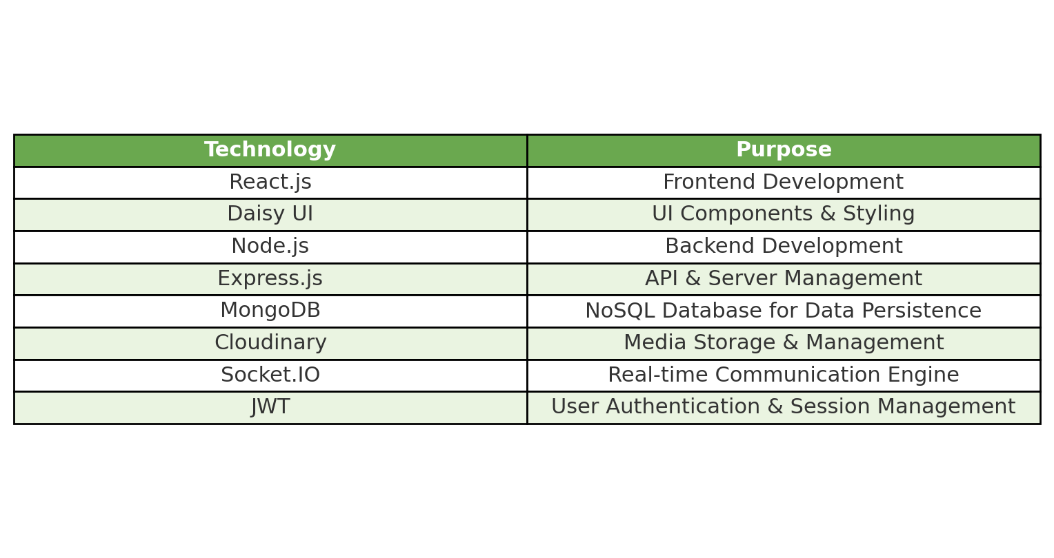
Tech Stack
Material UI

Slide 5
Problem Statements
With the increasing need for efficient digital management in educational institutions, schools require seamless access to student data, communication tools, and administrative workflows. Many existing systems are proprietary and lack flexibility for customization, experimentation, or academic use. There is a need for a scalable and adaptable school management system that covers core functionalities such as student records, attendance, scheduling, and communication, while allowing developers and institutions to extend features and build a comprehensive, full-stack solution for modern campus management.

Slide 6
Future Enhancements
Notification Integration – Send real-time alerts for announcements, attendance updates, and important notices using integrated services.
Role-Based Access Control – Define different permissions for administrators, teachers, students, and parents.
Communication Features – Enable interaction through messaging, announcements, and parent-teacher collaboration tools.
Offline Access Support – Allow users to view essential information like schedules and notices even without an active internet connection.

Slide 7
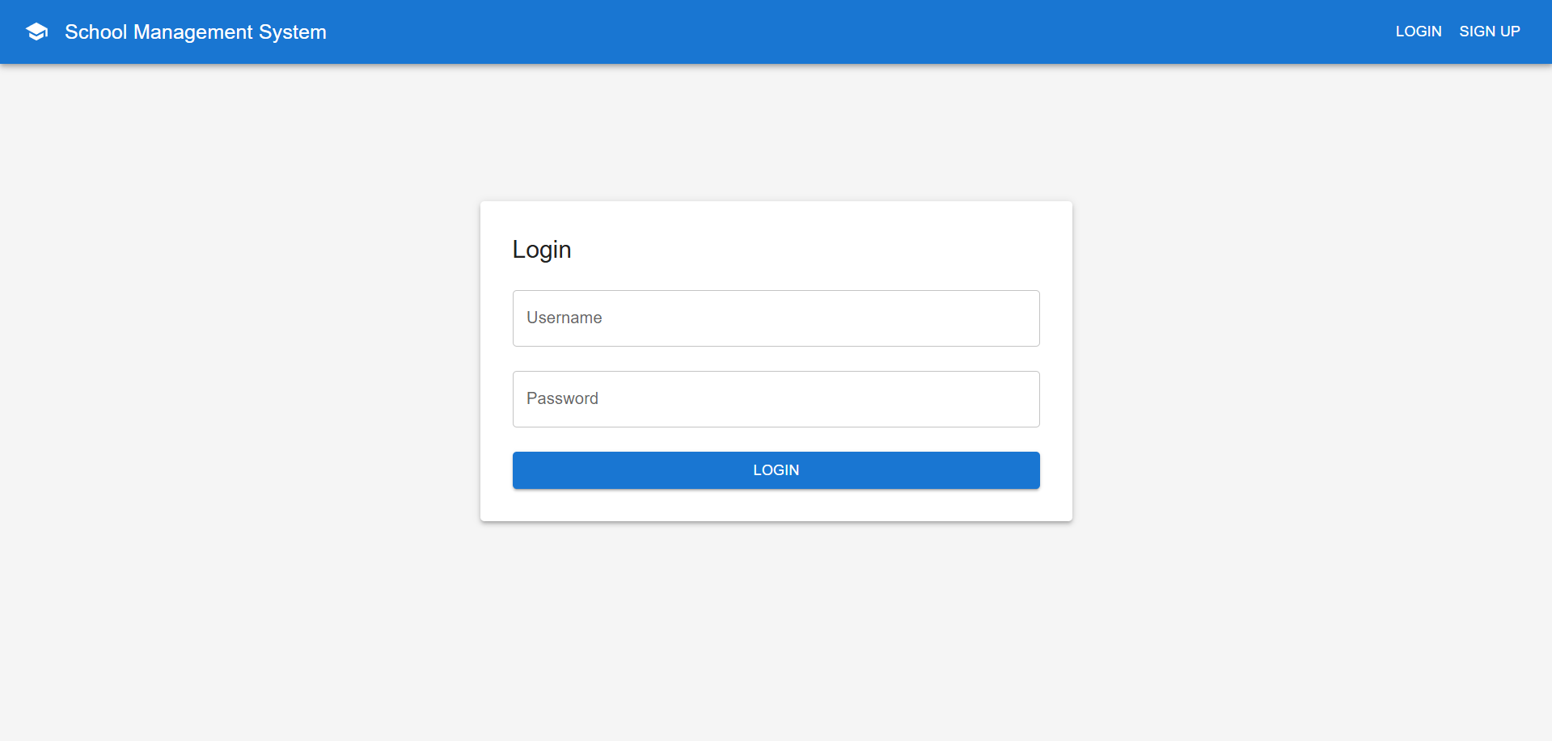
Project and Code Snippets

Slide 8
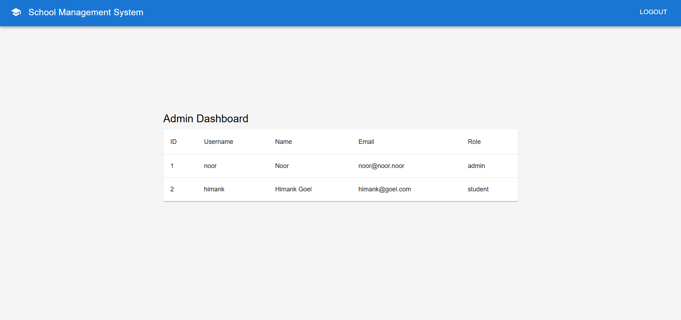
Project and Code Snippets

Slide 9
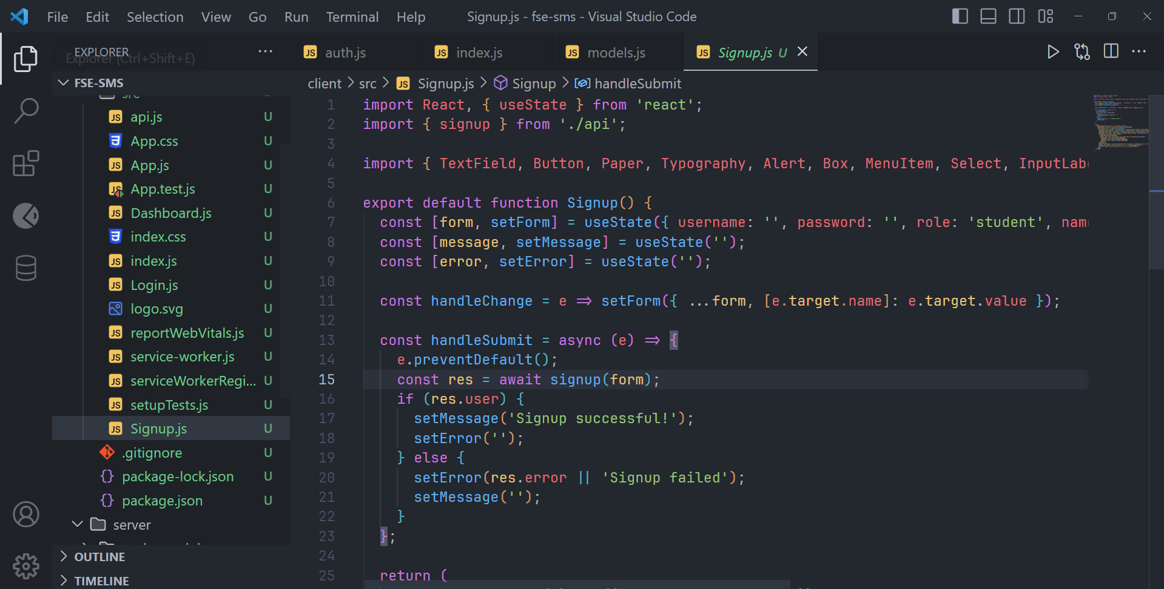
Project and Code Snippets

Slide 10
Thank You

