Slide 1
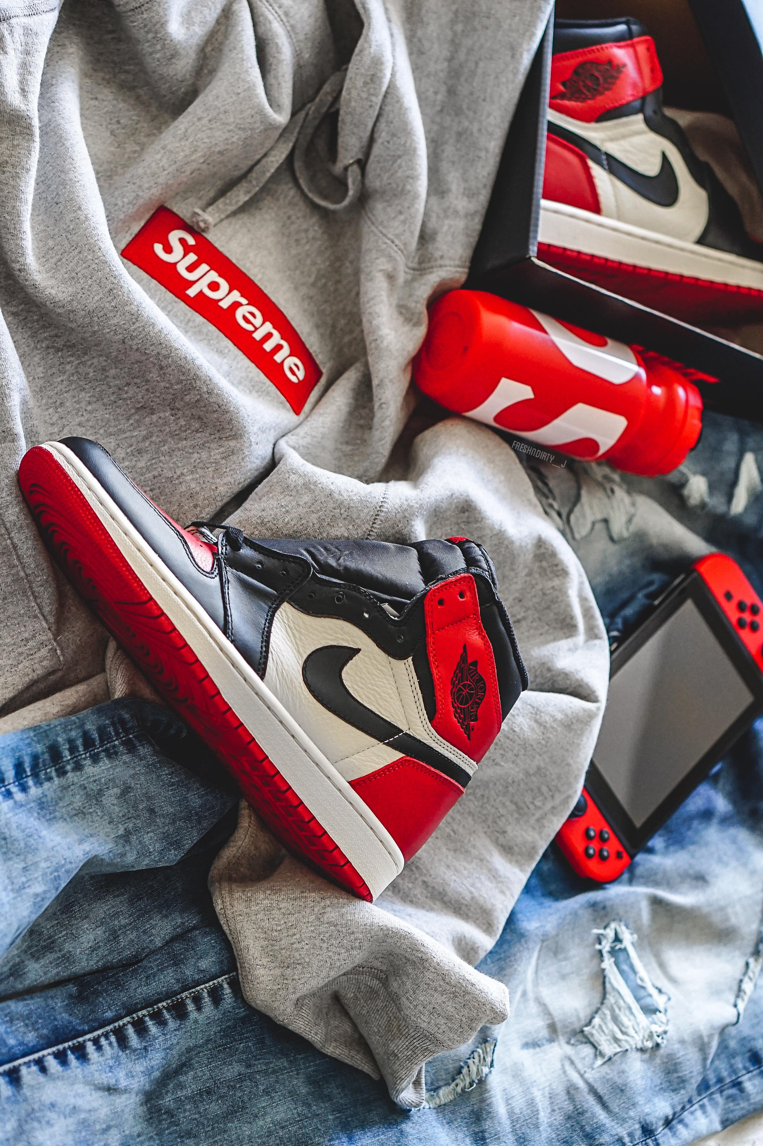



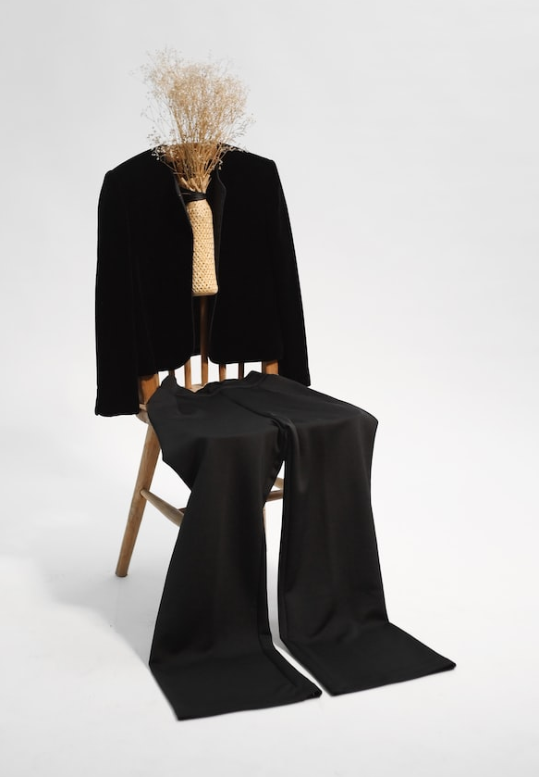
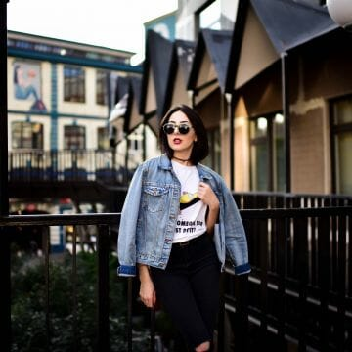
FASHION OUTFIT
RECOMMENDATION SYSTEM

Slide 2

LATEST TRENDS
UPLOAD
WARDROBE
PROFILE
SETTINGS
#Twitter
#Instagram
#Snapchat
#mail-ID

