Slide 1
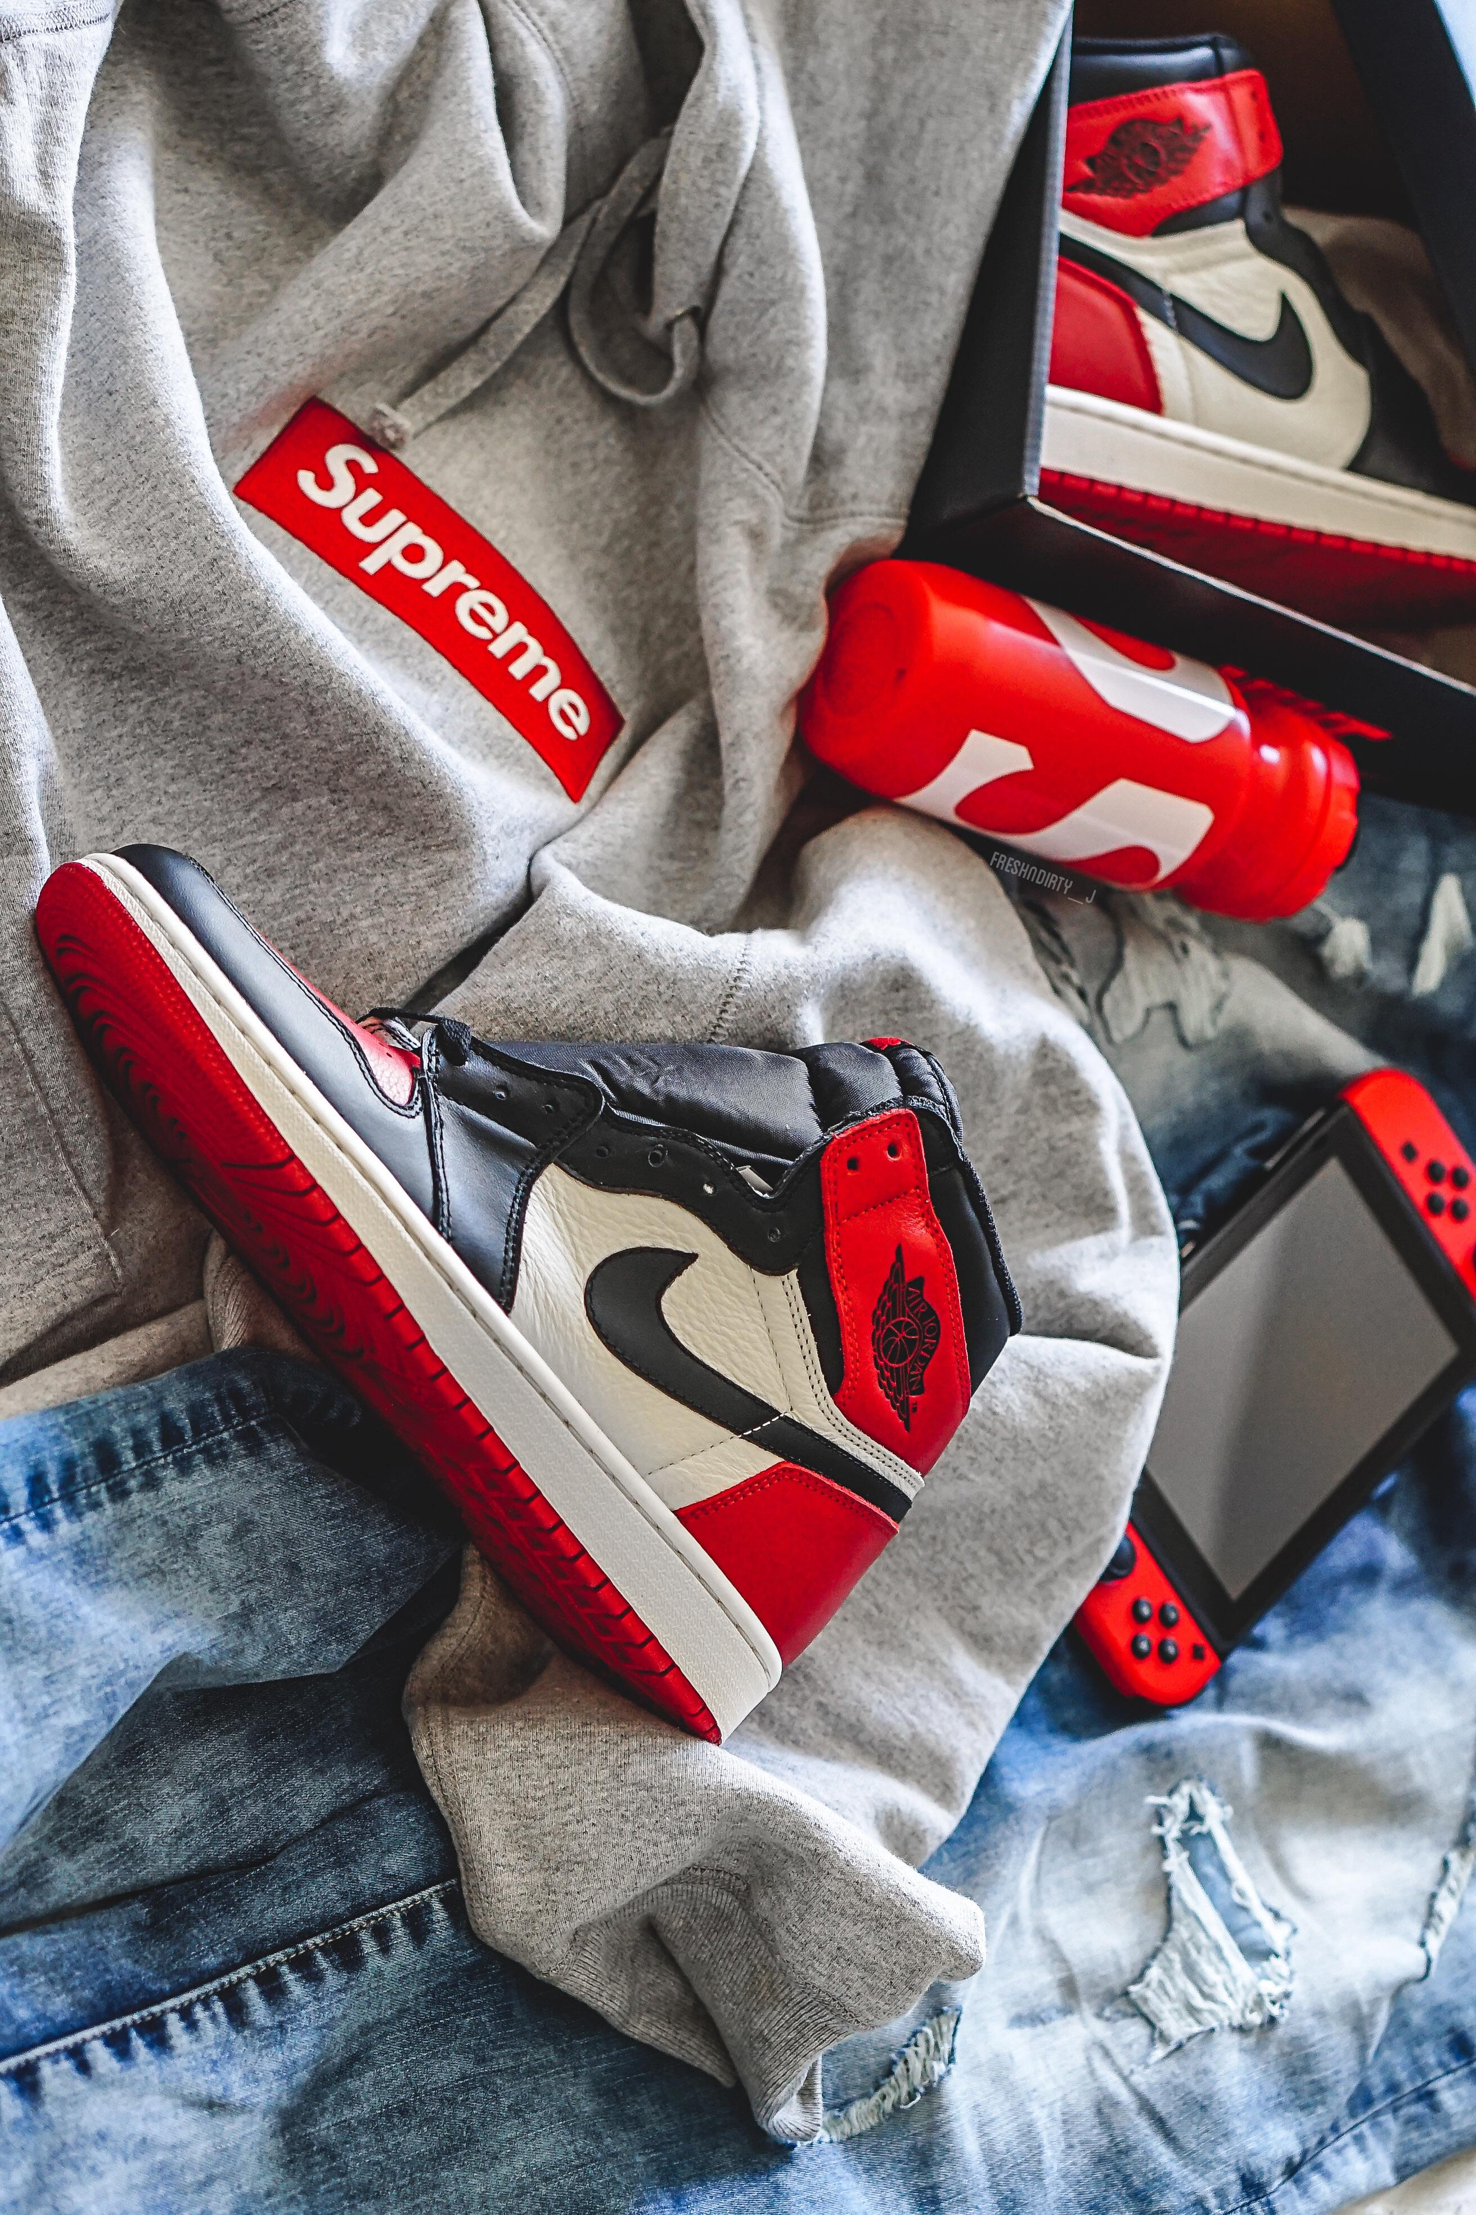



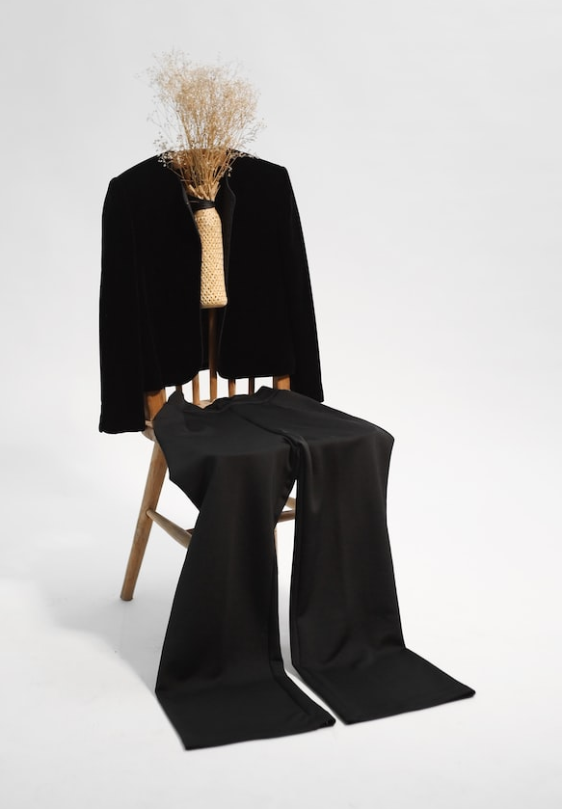

FASHION OUTFIT
RECOMMENDATION SYSTEM

Slide 2

LOGIN
username
password
Login
Need an account? Register

Slide 3
Register
username
password
Your password can’t be too similar to your other personal information.
Your password must contain at least 8 characters.
Your password can’t be a commonly used password.
Your password can’t be entirely numeric.
Enter the same password as before, for verification.
Password Confirmation
Register

Slide 4
LATEST TRENDS
UPLOAD
WARDROBE
PROFILE
SETTINGS
#Twitter
#Instagram
#Snapchat
#mail-ID

Slide 5
LOGOUT
Are you sure you want to log out?
Yes, Logout

