Slide 1
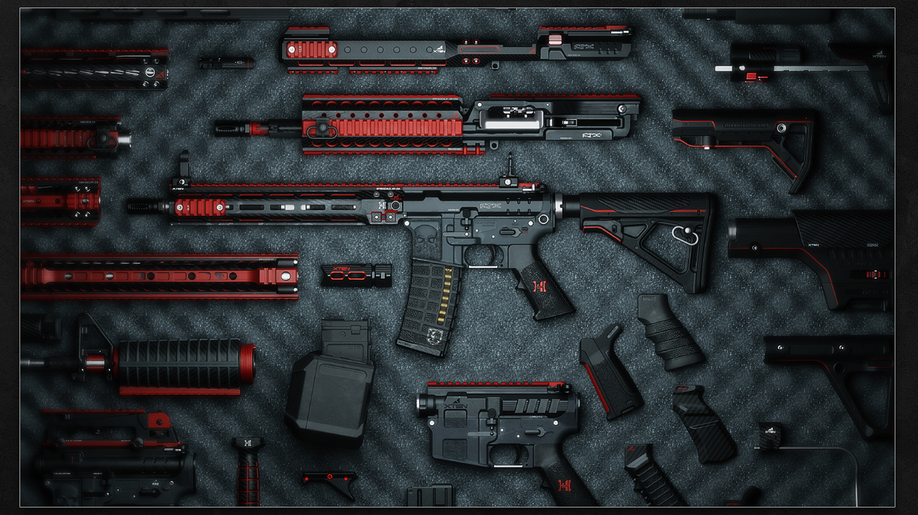



Weapon Management System
Presented by:
Manav
Hirey
Manav
Malavia
Kshitij
prabhu

Slide 2
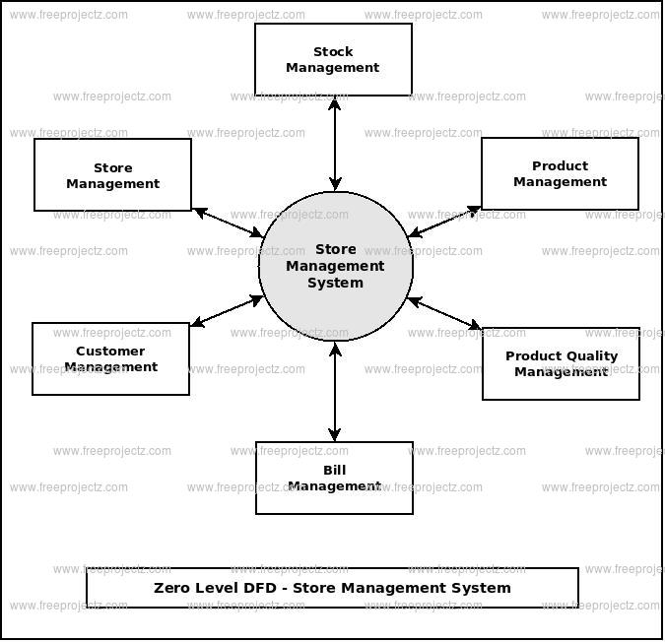
Summary
With several regulatory measures taken during manufacturing and proper e-kyc authentication of the customer who is buying, our Weapon Management System can assist in maintaining detailed records of who and when weapons are being handled as well as how the system as a whole manages the purchasing of weapons.
In this Project, there are : -
4 enterprises
8 organizations
11 Roles

Slide 3
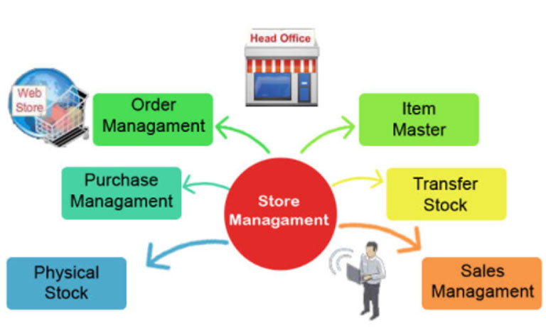
Enterprises
Manufacturer- Part oft the system in charge of Manufacturing weapons.
Regulator- Performs tests to regulate the weapons in accordance with safety standards.
Supplier- mediates the process between the manufacturer of the weapon and the dealer who sells it.
Dealer- accountable for authenticating (e-kyc) the customer and delivering them the weapons.

Slide 4
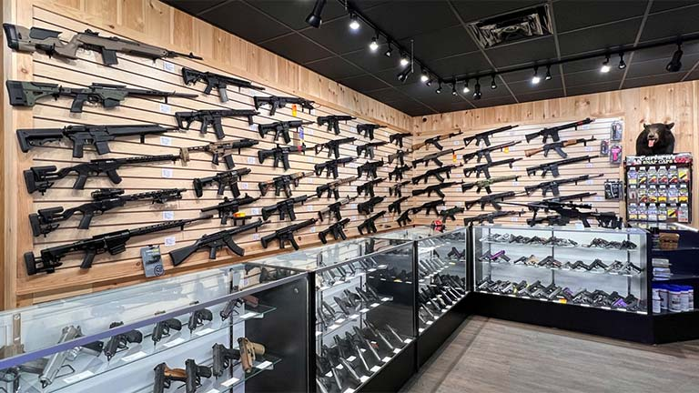
Organizations : -
Tester Department
Approval Department
Fulfillment Department
Approval Affairs Department
Development Department
Order Department
Shipping Department
Employee Department

Slide 5
Roles
Tester Regional Manager
Regulator System Admin Account Verifier
Supplier System Admin Store Manager
Manufacture System Admin. Customer
Approval Officer
Approval Employee
Fulfilment Officer
Assembler
Order Manager
Shipment Manager
Inventory Manager

