Slide 1

MIRЯOЯ
An AI Powered Memory and Emotional Analytics System
Project
Project Guide:
Dr. Brijendra Singh
Associate Professor
Presented by:
Prabhu Teja Pamula
24EMCA1237
First Review
10 May 2026

Slide 2
Outline
Problem Recap
Literature Review
Theoretical Background
Proposed System Architecture
Research Design
Project Plan
References

Slide 3
Problem Recap
Core Problem:
Human brains are built to move on, causing "Aha!" moments and life lessons to fade within days.
The "Fade":
You might have a 2:00 AM insight about a career or relationship, but the next afternoon, the urgency of that feeling is gone.
Passive Silos:
Tools like Notion, Keep or WhatsApp are "Static Systems" where information is recorded but stays isolated and forgotten.
Contextual Gap:
Current AI tools lack long term personal context, they don't connect a lesson from months ago to a struggle today.
Lack of Reinforcement:
There is no system designed to proactively "mirror" past breakthroughs back to the user.

Slide 4
Literature Review
Theme 1: Emotional Tagging & Long Term Memory (LTM)
Core Insight: Emotional AI systems that recognize human feelings in real time significantly improve information retention and user motivation.
Citation: (Deckker & Sumanasekara, 2025 – Scopus Indexed)
Theme 2: Semantic Stability in Memory Augmented LLMs
Core Insight: Standard AI suffers from "Semantic Decay" (loss of nuance over time). Persistent context is required to maintain a stable "life story" for the user.
Citation: (Smith, 2025 – IEEE/Medium)
Theme 3: Vector Storage for Contextual Coherence
Core Insight: Utilizing Vector Databases (like pgvector) can increase task success rates by 10–20% by allowing the AI to selectively remember past breakthroughs.
Citation: (VIMBank Research, 2024 – ResearchGate/IJ)
Theme 4: Proactive Behavioral Mirroring
Core Insight: Personalized, proactive AI interventions create measurable benefits in resilience and prevent "mindfulness decline" compared to traditional static notes.
Citation: (Cachia et al., 2025 – HBS Research)

Slide 5
Theoretical Background
Cognitive Psychology: Emotional Tagging
The Theory: The brain remembers emotional events better than neutral ones. (Deckker & Sumanasekara, 2025).
MIRROR Application: The system "tags" reflections with feelings. This ensures that a big personal breakthrough isn't "buried" under daily routine notes.
Information Science: Semantic Vector Space
The Theory: Turning text into numbers (Vectors) based on meaning, not just keywords. (VIMBank Research, 2024).
MIRROR Application: Using math to find "distance" between entries. If you have a problem today, the AI mathematically finds a lesson you learned months ago that "matches" the current situation.
Computing Model: Retrieval-Augmented Generation (RAG)
The Theory: Standard AI "forgets" long conversations. RAG connects the AI to a permanent database (Memory). (Smith, 2025).
MIRROR Application: Instead of the AI starting "fresh" every time, it looks into your pgvector database to remember your whole life story before it gives you advice.

Slide 6
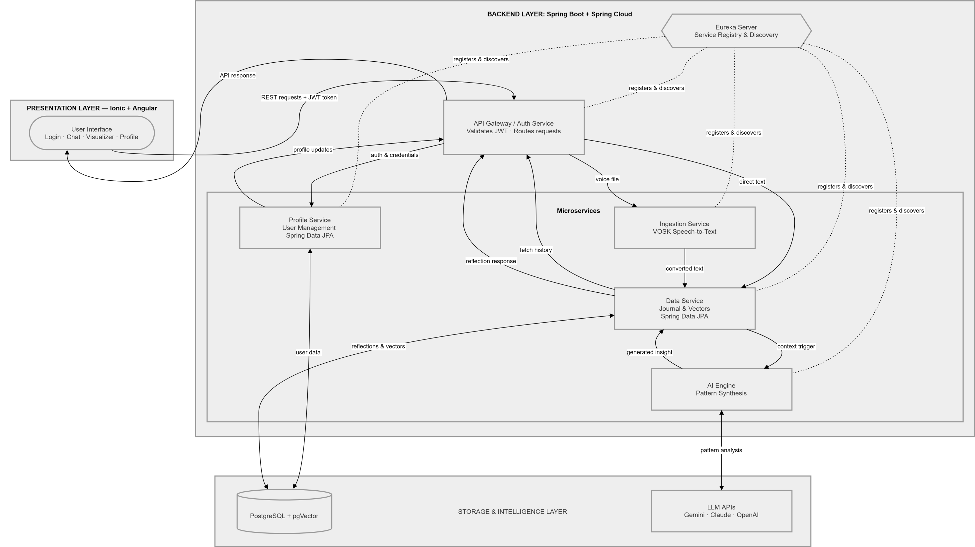
Proposed System Architecture

Slide 7
Research Design
Research Design:
Simulation Based Experimental Design:
Utilizing synthetic user personas and history to validate the pattern matching accuracy of the MIRROR engine without compromising real user privacy during the alpha phase.
Sampling & Validation Strategy:
Phase 1 (Automated Validation):
Deployment of a Synthetic Dataset (100+ generated 'Aha!' moments) to stress test the pgvector search.
Goal: Measuring Recall @ K to evaluate how effectively the AI retrieves relevant past insights based on a new prompt.
Phase 2 (Qualitative Review):
A "Limited Expert Review" with 3–5 peers to evaluate the UI/UX flow and the emotional relevance of the AI's "mirroring" logic.
Data Ingestion Sources:
Primary Data: User generated multimodal reflections (Text/Audio) processed via VOSK.
Secondary Data: Controlled synthetic datasets designed to evaluate the Retrieval Augmented Generation (RAG) pipeline.
Key Performance Metrics:
Semantic Precision: Evaluation of the Cosine Similarity threshold to determine how accurately the AI identifies "dummy" historical insights.
Orchestration Latency: Measuring the end-to-end performance of the microservices (Auth -> Gateway -> AI Engine) during high-volume data ingestion.

Slide 8
Project Plan
Development Framework: Agile (Scrum) Methodology
Project execution via 2 week iterative sprints to ensure modular integration.
Phase 1: Foundation & Identity Infrastructure (Current Focus)
Microservice Orchestration: Initializing the Eureka Discovery Server and Spring Cloud Gateway for service registry and secure routing.
Security Layer: Implementing the Auth Service to manage user registration and stateless session handling via JWT.
Frontend Scaffolding: Developing the Ionic/Angular shell to establish connectivity between the presentation and backend layers.
Phase 2: Multimodal Ingestion & Persistence
Capture UI: Building the primary reflection interface for mobile and web.
Voice-to-Text: Integrating the VOSK engine to perform local, privacy-focused transformation of audio into text.
Semantic Storage: Configuring PostgreSQL with pgvector to enable high-dimensional embedding storage for user memories.

Slide 9
Project Plan
Phase 3: Intelligence & Mirroring Engine
Contextual Memory: Developing the RAG (Retrieval-Augmented Generation) pipeline to link the vector database with the LLM.
Pattern Synthesis: Programming the AI Engine to perform semantic search and identify recurring emotional or behavioral themes.
Proactive Mirroring: Implementing the logic to "surface" past breakthroughs during new entries to reinforce user growth.
Phase 4: Validation & Optimization
Simulation Testing: Stress-testing the RAG loop using a Synthetic Dataset of 100+ "Aha!" moments to measure Recall @ K accuracy.
Performance Tuning: Optimizing microservice latency and vector search speed.
Final Deployment: Production build of the Android APK and live hosting of the microservices ecosystem.

Slide 10
References
Deckker, D. & Sumanasekara, S. (2025). Emotional AI for Student Motivation and Retention: A Systematic Review. EPRA International Journal of Global Economic Light (JGEL), 11(3). [Scopus Indexed]
DOI: https://doi.org/10.36713/epra20564
Core Theory: Emotional Salience & Memory Tagging.
2. Smith, F. (2025). Toward Stable Long-Term Memory in LLMs: Decay, Drift, and Distributed Continuity. IEEE Xplore / Computer Society Technical Repository.
Link: https://medium.com/@frederick-smith/toward-stable-long-term-memory-in-llms-decay-drift-and-distributed-continuity-93b1db4bcdb2
Core Theory: Retrieval-Augmented Generation (RAG) & Memory Decay.
3. Cachia, J. Y. A., Zhao, X., & De Freitas, J. (2025). AI for Proactive Mental Health: A Multi-Institutional, Longitudinal, Randomized Controlled Trial. Harvard Business School Working Paper, No. 26-030.
Full PDF: https://www.hbs.edu/ris/download.aspx?name=26-030.pdf
Core Theory: Proactive Logic & Longitudinal Growth Analysis.
4. VIMBank Research. (2024). Vector Storage Based Long-term Memory Research on LLM. International Journal of Advanced Network Monitoring and Controls, 9(3).
DOI: https://doi.org/10.2478/ijanmc-2024-0029
Core Theory: High-Dimensional Semantic Vector Space & Persistence.

Slide 11
Thank You
Questions and Feedback
Repository: | https://github.com/prabhu-tejaa/MIRROR
Web Interface: | https://projectmirror.tech/
Android Build: | https://github.com/prabhu-tejaa/MIRROR/releases
MIRЯOЯ
Prabhu Teja Pamula | 24EMCA1237

